Slide 1
Causation and Discovery: Concepts, Methods, & Applications
David Danks
Halicioǧlu Data Science Institute & Department of Philosophy
University of California, San Diego

Slide 2
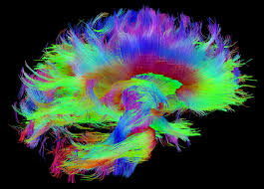
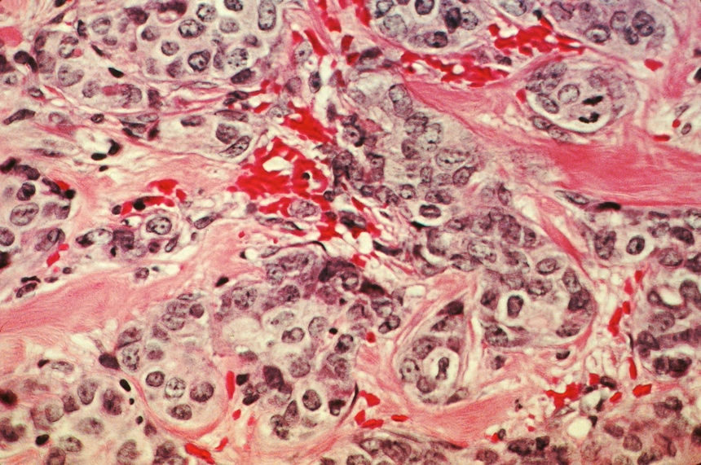
Correlation vs. Causation
Correlation = Using an observation about one factor to predict another Causation = Using an intervention on one factor to influence another
Diagnose whether someone suffers from schizophrenia?
or
Develop novel therapies to treat schizophrenia?
Predict development of cancer cells?
or
Give treatment to slow growth of cancer?

Slide 3
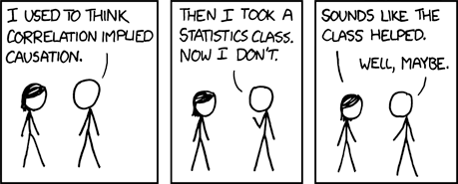
Correlation vs. Causation
Basic problem: Correlation ≠ Causation…

Slide 4
Correlation vs. Causation
They often go together…
Switch & lights ▪︎ Alcohol & cognitive ability
…but they are not the same…
Barometer & rainfall ▪︎ Hair color & job title
Sweater wearing & icy roads
…and it matters which we have
Heart strength & size ▪︎ Superstitions
Hormone replacement therapy & heart disease

Slide 5

Correlation vs. Causation
They often go together…
Switch & lights ▪︎ Alcohol & cognitive ability
…but they are not the same…
Barometer & rainfall ▪︎ Hair color & job title
Sweater wearing & icy roads
…and it matters which we have
Heart strength & size ▪︎ Superstitions
Hormone replacement therapy & heart disease
Caution:
Psychologically, it is very easy to confuse correlation for causation!

Slide 6
Correlation vs. Causation
What could explain correlation between X & Y?
X causes Y
Y causes X
Third factor causes both X & Y
Some combination of the above
Random chance (sampling variation)
Incorrectly applied statistical tests
…
“No causal connection” is not on list by itself!

Slide 7
Correlation vs. Causation
Suppose independence between X & Y:
No causal connection (of any type) between X & Y
Random chance (sampling variation)
Incorrectly applied statistical tests
(and not much else…)
Moral: Correlation is a noisy guide to causation

Slide 8
Correlation vs. Causation
Basic problem: Correlation ≠ Causation… …but Correlation is correlated with Causation!
Basic strategy:
Causal Structure
Reasoning & inference
Empirical Data
Learning & discovery

Slide 9
Correlation vs. Causation
Correlation | Causation

Slide 10
Correlation vs. Causation
Correlation | Causation
Classifying & identifying
Informational value of different evidence
Prediction & reasoning given observations
Probable explanations for some event or issue

Slide 11
Correlation vs. Causation
Correlation | Causation
Classifying & identifying | Influencing & acting
Informational value of different evidence | Using evidence to guide policy or actions
Prediction & reasoning given observations | Prediction & reasoning given interventions
Probable explanations for some event or issue | Ways to produce or prevent an event or problem

Slide 12
What is causation?
Only need some key features, not a full theory
“X causes Y” provides or supports:
Prediction given intervention or action
Inference about likely reasons for some event
Constructing effective manipulations or policies
Learning from results of my own or others’ actions
…

Slide 13
What is causation?
Only need some key features, not a full theory
“X causes Y” provides or supports:
Prediction given intervention or action
Inference about likely reasons for some event
Constructing effective manipulations or policies
Learning from results of my own or others’ actions
…
Theme: What happens given a change from outside of the “regular” system

Slide 14
What is causation?
Adopt a pragmatic interpretation of causal claims:
“X causes Y” implies:
If X’s value is changed by outside intervention, then Y’s value (probabilistically) changes
If Y’s value is changed by outside intervention, then X’s value does not change (due to Y)
Basically all theories of “what causation is” have these features ⇒ Pick the right one for your domain

Slide 15
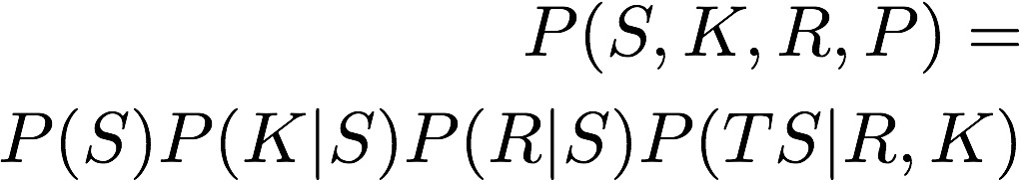
Causal representation
Knowledge
Directed Acyclic Graphs:
Graph ⇒ Qualitative causation
Probabilities ⇒ Quantitative causation
Mutually constrain via assumptions
Intuitive, compact “language”
Superior SME elicitation
Psychologically natural
Many natural variants
Studying
Test Score
Rest

Slide 16
Causal reasoning & inference
Given a causal model, computationally efficient methods to:
Predict given evidence or information
“The brain network has gotten denser; how likely is a schizophrenic episode?”
Construct explanations & troubleshoot
“The participant behaved poorly on this trial; what went wrong?”
Design actions/policies & predict outcomes
“How can we alter the visual input to improve participant performance?”
Many variations and uses of these methods

Slide 17
Causal discovery
Idea: Given data (observational or interventional), find causal structures that could plausibly have produced those data

Slide 18
Causal representation
Graph ➛ qualitative (direct) causation
Probabilities ➛ quantitative (direct) causation
Core assumptions:
Causal Markov: X is independent of non-effects given its direct causes
Causal Faithfulness (or Simplicity): Only independences are implied by Causal Markov
Knowledge
Studying
Test Score
Rest

Slide 19
Information representation
Graph ➛ qualitative (direct) informational relations
Probabilities ➛ quantitative (direct) informational relations
Core assumptions:
Causal Markov: X is independent of non-descendants given its direct parents
Causal Faithfulness (or Simplicity): Only independences are implied by Causal Markov
Knowledge
Studying
Test Score
Rest

Slide 20
Causal discovery
Idea: Given data (observational or interventional), find causal structures that could plausibly have produced those data
Success of this idea depends critically on the assumptions that we can make
Multiple algorithms implementing this idea
Almost all with long-run guarantees, but variable short-run performance
Standard data analysis methods are often special cases of these algorithms

Slide 21
Causal discovery: Algorithms
Idea #1: Markov + Faithfulness ⇒ Determinate pattern of independence & association for graph G
Given dataset D, find all G that predict the pattern in D
Challenge: DAG ↔ Independence map is many ↔ one
⇒ Can only learn the Markov Equivalence Class
MEC is sometimes a singleton, but often not
Explanation of “Correlation ≠ Causation”

Slide 22
Causal discovery: Algorithms
Multiple types of methods for this idea:
Constraint-based: Calculate independences in data and do “backwards inference”
Bayesian: Calculate P(MEC | D) for each MEC
Hybrid: Use constraint-based to get “close,” then Bayesian search around neighborhood

Slide 23
Causal discovery: Algorithms
Idea #2: P(Effect | Cause) should not depend on the value of Cause
Value of Effect should change because value of Cause changes, not because their relationship changes
For linear Gaussian systems, additional assumption provides no additional power
For non-Gaussian or non-linear, can often learn more than just MEC

Slide 24
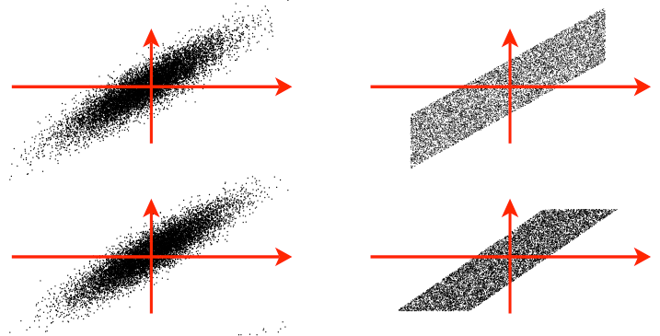
Causal discovery: Algorithms
Linear Gaussian
Linear non-Gaussian
X
Y
X
Y

Slide 25
Causal discovery
Challenges with known solutions:
Observation of all relevant factors
Linear systems with known noise
Unobserved common causes
Selection bias in the data
Measurements only of proxies
Time series causal structures
Equilibrated systems with feedback
Unobserved mechanisms
Multiple (overlapping) variables
Mixed variable-types
Non-stationary causal structure
Similar-but-varying causal structures across individuals
Undersampled time series with missing, causally relevant variables
Massive (> 1M) number of variables
…

Slide 26
Causal discovery
Many standard statistical methods are (mathematically) “special case” versions of causal discovery algorithms
Regression
Mediation analysis
ICA
…
Must ask “What do we know?” and “What do we need/want?”

Slide 27
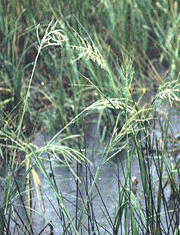
Causal discovery in action
Which factors influence growth of Spartina grass (in Cape Fear)?
Causal discovery on purely observational data: only pH
Other factors matter, but always mediated by pH
Greenhouse study that randomized key factors: Confirmation!

Slide 28
Thanks!
www.daviddanks.org
ddanks@ucsd.edu // david@danks.org

