Slide 1

Presented by Ashkan Faghiri
Fall 2021

Slide 2
Introduction
Graphs have been used to model many things like social networks, ecosystems and the human brain
Graphs have two parts:
Nodes: units of the system
Edges: pairwise interaction

Slide 3
Introduction
Graphs have been used to model many things like social netwokrs, ecosystems and the human brain
Graphs have two parts:
Nodes: units of the system (gICA components)
Edges: pairwise interaction (connectivity estimated by something like Pearson correlation)

Slide 4
Introduction
Graphs have been used to model many things like social netwokrs, ecosystems and the human brain
Graphs have two parts:
Nodes: units of the system (gICA components)
Edges: pairwise interaction (connectivity estimated by something like Pearson correlation)
Many discoveries have been found:
Small-world networks and clustering promote synchronization
Efficient communication structures tend to reach rapid and diffused consensus, but are also prone to the spreading of misinformation

Slide 5
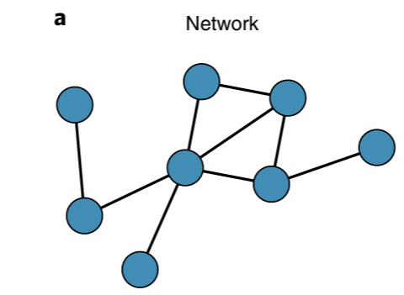
Introduction
Using graphs to represent systems can be limiting (only pairwise interaction)

Slide 6
Introduction
Using graphs to represent systems can be limiting (only pairwise interaction).
Evidence of higher order interaction (HOI) existence and importance
Yu, S. et al. Higher-order interactions characterized in cortical activity. J. Neurosci. 31, 17514–17526 (2011): they show that HOI are important if we want to explain neuronal avalanches
Santos GS, Gireesh ED, Plenz D, Nakahara H (2010) Hierarchical interaction structure of neural activities in cortical slice cultures. J Neurosci 30:8720 –8733.: higher-order interactions approximate LFP patterns better
But evidence of HOI being redundant also exist :D

Slide 7
Introduction
The mathematical framework for HOI is also important

Slide 8
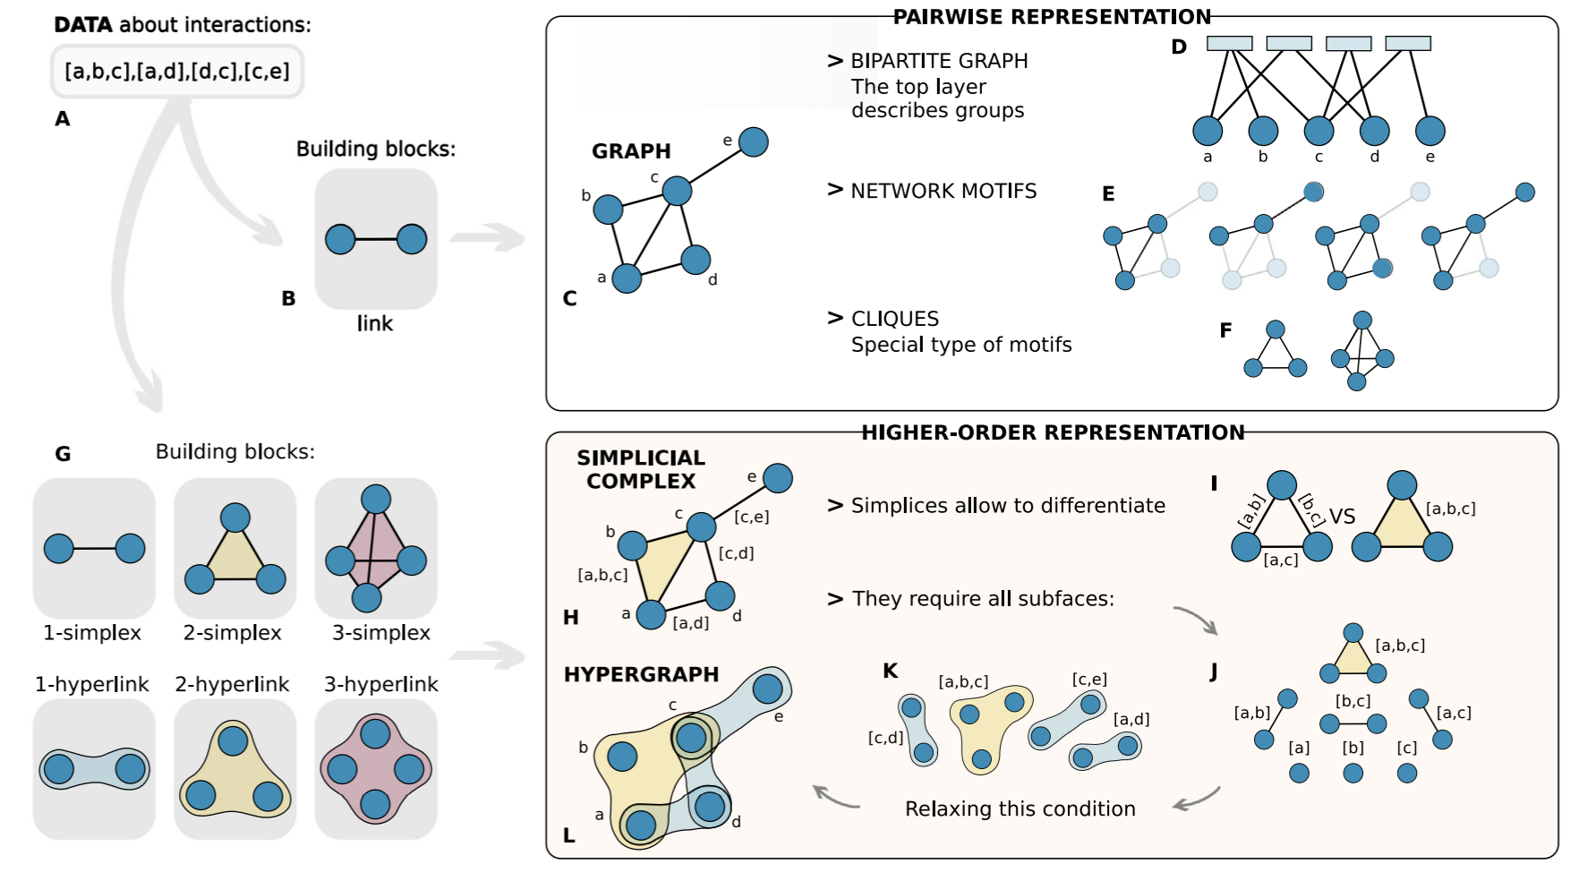
Introduction
The mathematical framework for HOI is also important
Networks beyond pairwise interactions: Structure and dynamics

Slide 9
Introduction
The mathematical framework for HOI is also important
Networks beyond pairwise interactions: Structure and dynamics

Slide 10
Introduction
In this Perspective, we outline the main signatures of new physics (have no idea what they mean by this but whatever) arising in higher-order systems:
A general pathway to explosive transitions
Topological dynamical processes
Inferring higher-order interactions from data

Slide 11
A general pathway to explosive transitions
This is of quite importance for us actually
continuous phase/state transitions vs. exploitive transition
neuronal avalanches for example
Notes:
a mathematical space in which each possible state of a physical system is represented by a point — this equilibrium point is also referred to as a "microscopic state"

Slide 12
A general pathway to explosive transitions
This is of quite importance for us actually
continuous phase/state transitions vs. exploitive transition
neuronal avalanches for example
It is hard to obtain explosive transition using networks (with pairwise interaction)
We need to engineer artificial rules or elements that stops transition (they mean continuous transition here). After a while, these rules can't stop transition and we will have explosive transitions

Slide 13
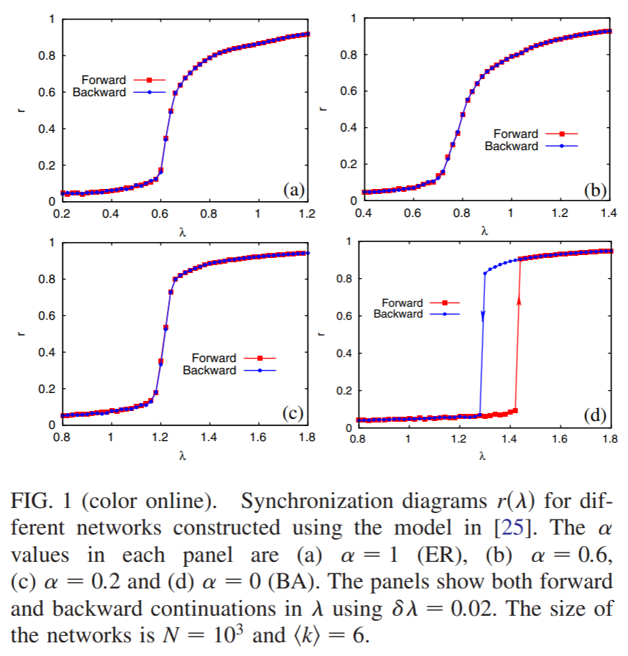
A general pathway to explosive transitions
synchronization can become explosive in heterogeneous networks by correlating the natural frequency of oscillators to their degree
r: (synchronization) order parameter
λ: strength of the coupling
Gómez-Gardenes, J., Gómez, S., Arenas, A. & Moreno, Y. Explosive synchronization transitions in scale-free networks. Phys. Rev. Lett. 106, 128701 (2011).

Slide 14
A general pathway to explosive transitions
This is of quite importance for us actually
continuous phase/state transitions vs. exploitive transition
neuronal avalanches for example
It is hard to obtain explosive transition using networks (with pairwise interaction)
We need to engineer artificial rules or elements that stops transition (they mean continuous transition here). After a while, these rules can't stop transition and we will have explosive transitions
Explosive phenomena exist in nature

Slide 15
A general pathway to explosive transitions
In models that go beyond pairwise interactions explosive transition happens “naturally”
E.g. An abrupt transition was recently observed in a model of social contagion evolving on simplicial complexes
Iacopini, I., Petri, G., Barrat, A. & Latora, V. Simplicial models of social contagion. Nat. Commun. 10, 2485 (2019)

Slide 16
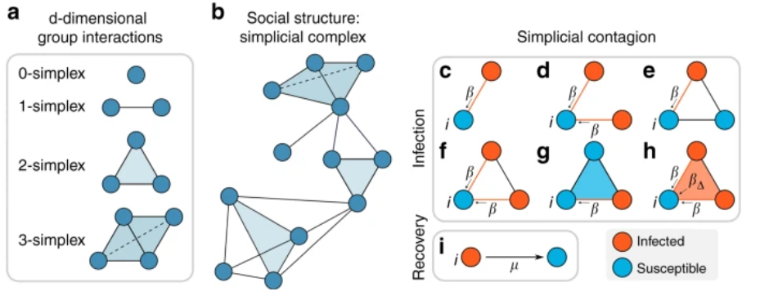
A general pathway to explosive transitions
In models that go beyond pairwise interactions explosive transition happens “naturally”
E.g. An abrupt transition was recently observed in a model of social contagion evolving on simplicial complexes
Iacopini, I., Petri, G., Barrat, A. & Latora, V. Simplicial models of social contagion. Nat. Commun. 10, 2485 (2019)
Notes:
Simplicial contagion model (SCM). The underlying structure of a social system is made of simplices, representing d-dimensional group interactions (a), organized in a simplicial complex (b). c–h Different channels of infection for a susceptible node i in the simplicial contagion model (SCM) of order D = 2. Susceptible and infected nodes are colored in blue and red, respectively. Node i is in contact with one (c, e) or more (d, f) infected nodes through links (1-simplices), and it becomes infected with probability β at each timestep through each of these links. g, h Node i belongs to a 2-simplex (triangle). In g one of the nodes of the 2-simplex is not infected, so i can only receive the infection from the (red) link, with probability β. In h the two other nodes of the 2-simplex are infected, so i can get the infection from each of the two 1-faces (links) of the simplex with probability β, and also from the 2-face with probability β₂ = β_{Δ}. i Infected nodes recover with probability μ at each timestep, as in the standard SIS model

Slide 17
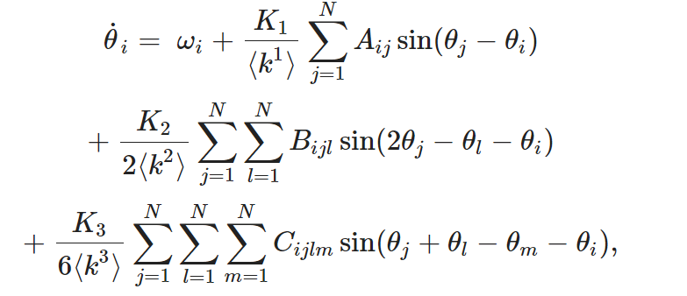
A general pathway to explosive transitions
Another example generalized Kuramoto–Sakaguchi phase rotator model for HOI
Skardal, P. S. & Arenas, A. Higher order interactions in complex networks of phase oscillators promote abrupt synchronization switching. Commun. Phys. 3, 218 (2020).
Notes:
Explosiveness is not limited to spreading processes. Of paramount importance for biology and neuroscience are systems of coupled oscillators, where the states of the nodes are d-dimensional continuous variables that evolve over time under mutual influence (Fig. 2b). The most well-known set-up is probably the one introduced by Yoshiki Kuramoto47, in which unidimensional phase oscillators are endowed with natural frequencies, and interactions occur through sinusoidal couplings. When generalized to account for structured higher-order interactions among oscillators, the additional nonlinearity generates abrupt switches between synchronized and incoherent states. The emergence of bistability and the appearance of hysteresis cycles are driven by the presence of higher-order interactions alone, without the need for ad hoc coupling mechanisms between the dynamical evolution and the local connectivity of the nodes
where θ_{i} is the phase of oscillator i, ω_{i} is its natural frequency (typically assumed to be drawn from a distribution g(ω)), and K₁, K₂, and K₃ are the coupling strengths of 1-, 2-, and 3-simplex interactions, respectively. Importantly, these addition forms of coupling (i.e., those with K₂ and K₃ coefficients) come directly from higher order terms that emerge from phase-reductions of limit-cycle oscillators
he 1-simplex adjacency matrix A, 2-simplex adjacency tensor B, and 3-simplex adjacency tensor C

Slide 18
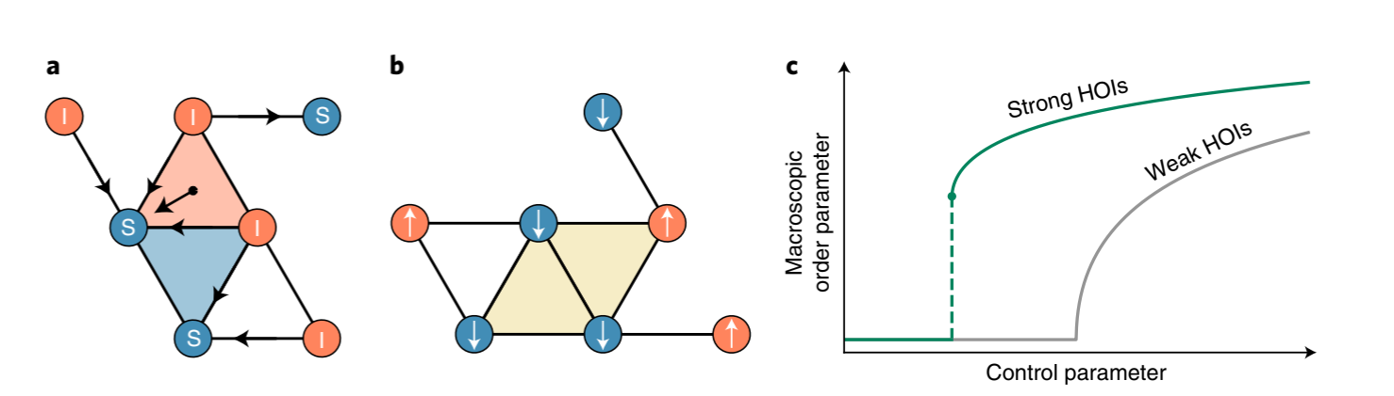
A general pathway to explosive transitions

Slide 19
A general pathway to explosive transitions
The similarity of the mechanisms yielding a first-order transition in these two very different dynamical processes leads to conjecture that the introduction of nonlinear higher-order interactions and the tuning of their intensity form a general ingredient sufficient to provide abrupt transitions in a dynamical process.
Notes:
K₂ = 1.6 and K₃ = 1.1

Slide 20
Topological dynamical processes
Typically we focus on dynamics of nodes
by encoding higher-order interactions, it becomes possible to define couplings between interactions of different orders (nodes, and hyperedges or simplices). More importantly, we can associate state variables, not only to nodes, but also to hyperedges and simplices.
For example, the state of an edge can influence the states of its two associated nodes, while contributing to and being influenced by the states of the higher-order interactions (for example, a 3-hyperedge) to which it belongs. In this way, higher-order dynamical systems transform static interactions into active agents that are coupled to the rest of the system and evolving in time.
What does this even mean?
Where did time come from?

Slide 21
Inferring higher-order interactions from data
This is very challenging
Usually, we do not have explicit knowledge of how to construct the network
In direct (pairwise) data (data that we have the pairwise interaction):
Just building HOI using pairwise interaction conflate the actual existence of HOI
A recent work aimed to distinguish between hyperedges and combinations of lower-order edges by casting the problem as a Bayesian inference task
Young, J.-G., Petri, G. & Peixoto, T. P. Hypergraph reconstruction from network data. Commun. Phys. 4, 135 (2021).

Slide 22
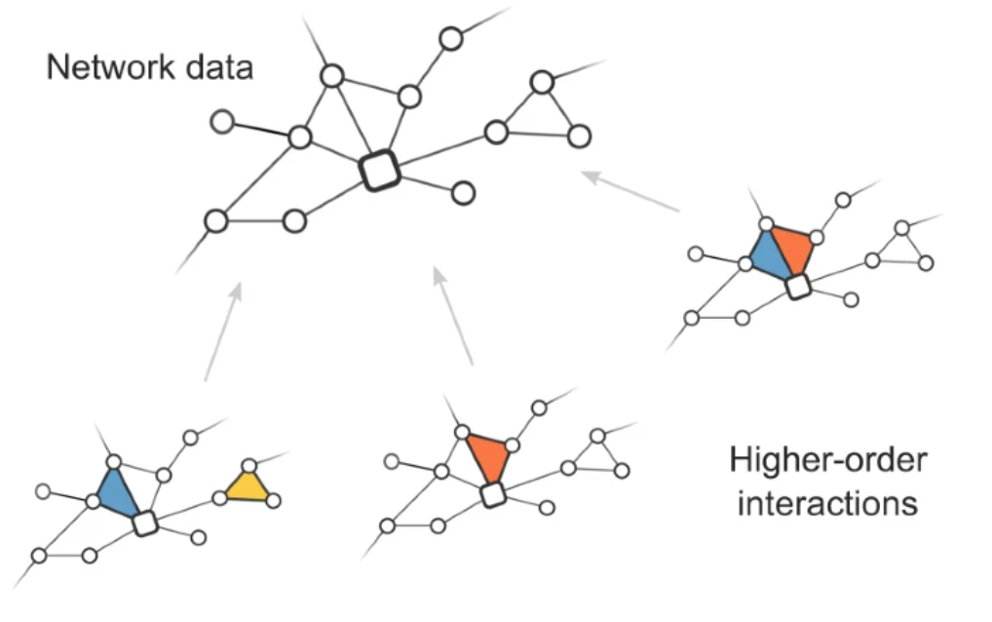
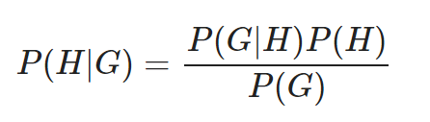
Inferring higher-order interactions from data
posterior probability that the latent hypergraph is H, given the observed network G.
Young, J.-G., Petri, G. & Peixoto, T. P. Hypergraph reconstruction from network data. Commun. Phys. 4, 135 (2021).

Slide 23
Inferring higher-order interactions from data
This is very challenging
Usually, we do not have explicit knowledge of how to construct the network
In direct (pairwise) data (data that we have the pairwise interaction):
Even if direct (HOI) data is available we need ways to account for errors and uncertainty
A recent work proposed a null model
Musciotto, F., Battiston, F. & Mantegna, R. N. Detecting informative higher-order interactions in statistically validated hypergraphs. Commun. Phys. https://doi.org/10.1038/s42005-021-00710-4 (2021)

Slide 24
Inferring higher-order interactions from data
This is very challenging
Usually, we do not have explicit knowledge of how to construct the network
In direct (pairwise) data (data that we have the pairwise interaction):
Even if direct (HOI) data is available we need ways to account for errors and uncertainty
Even more challenging is to infer HOI from indirect data (time series)
The authors here go on a tangent about causation that I did not understand at all the point in relation to the question at hand

Slide 25

Inferring higher-order interactions from data
A recent work proposed a formulation for triplet synchronization
This approach can better differentiate between the physical connections and the effective ones, which are associated with the temporal influence of one node on another, leading to more reliable network reconstruction methods
Kralemann, B., Pikovsky, A. & Rosenblum, M. Detecting triplet locking by triplet synchronization indices. Phys. Rev. E 87, 052904 (2013).
Notes:
this is strange statement, the authors implies here that this estimator can be used to infer causation. And is more reliable what?

Slide 26
Inferring higher-order interactions from data
We can also use information thoric methods
Check this paper “Quantifying high-order interdependencies via multivariate extensions of the mutual information “
Another point that the authors didn’t make here: sometimes we need to estimate nodes too which adds an additional complexity especially with the more recent evidence that nodes themselves might change.

Slide 27
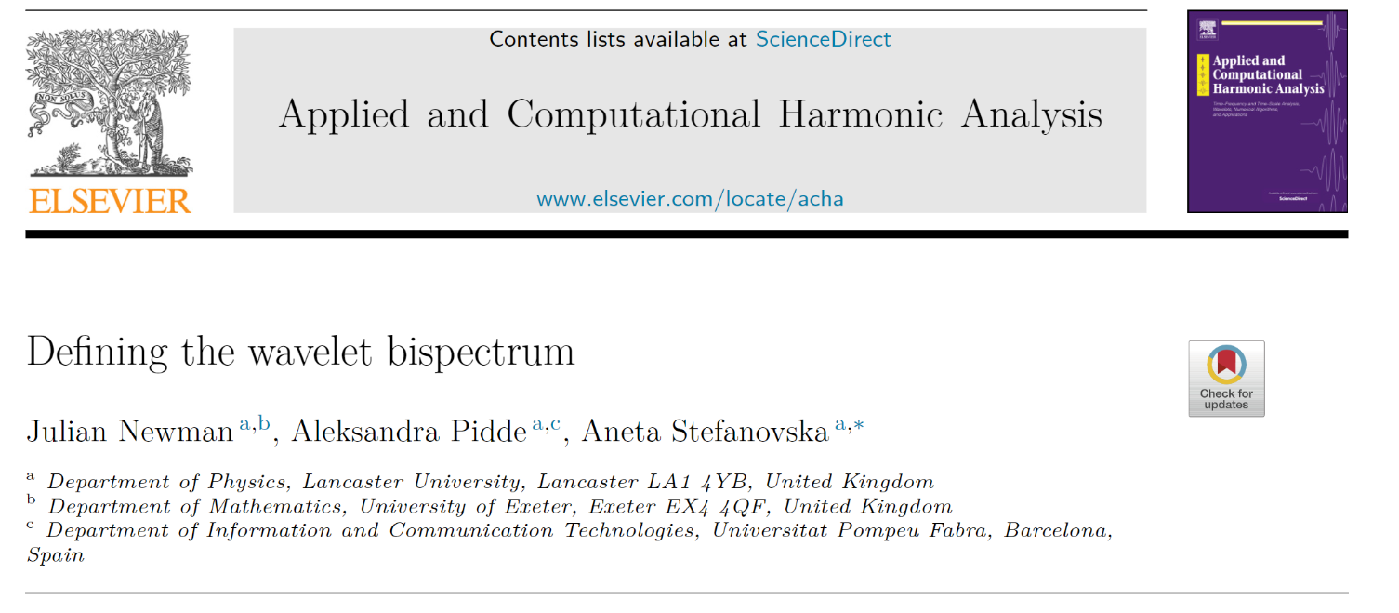
Future direction
Add hype keyword here
Causality
Time-frequency representation

