Slide 1
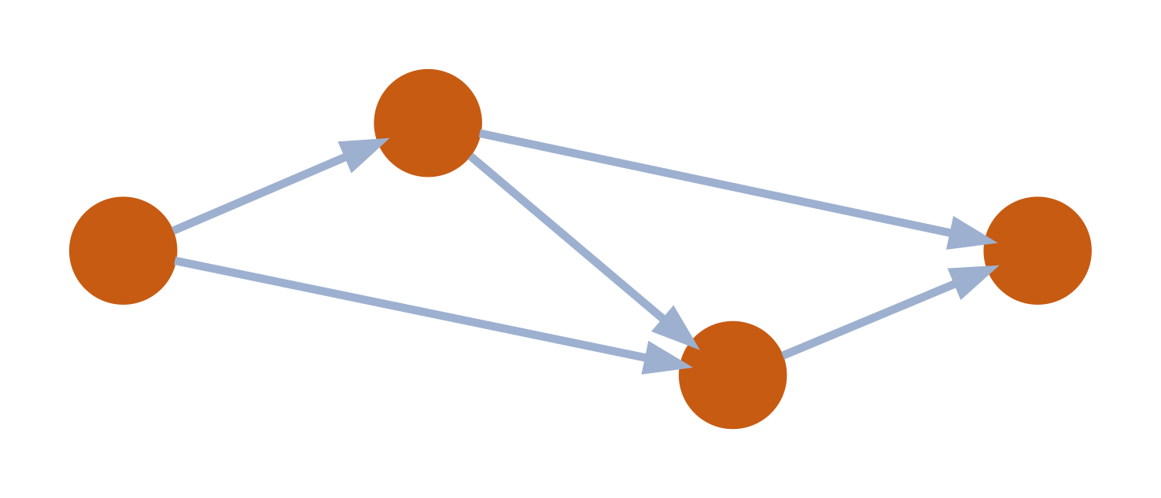
Causal Discovery
Lecture 1 - Learning the structure of cause and effect from data
Presenter: Selim Süleymanoğlu
Consultant: Joanne Wardell

Slide 2
Causal Discovery: Identify causal structures from data
Causal Inference: Given the causal structure, estimate causal effects.
2 / 19

Slide 3
Our data:
Person
Age
Cig/day
Tar
Lung cap.
Cancer
Cross-sectional snapshot. No timestamps
1
62
20
high
low
yes
2
55
0
low
normal
no
3
70
30
high
low
yes
4
45
10
med
normal
no
5
60
0
low
high
no
6
68
25
high
low
yes
How can we use this table to find what causes what without running an experiment?
3 / 19

Slide 4
Expert-established causal structure
● arrow = direct cause
● missing arrow = no direct effect
● node = random variable
S
T
L
A
C
4 / 19

Slide 5
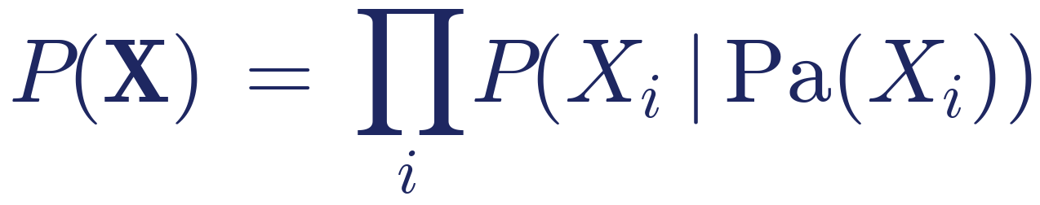
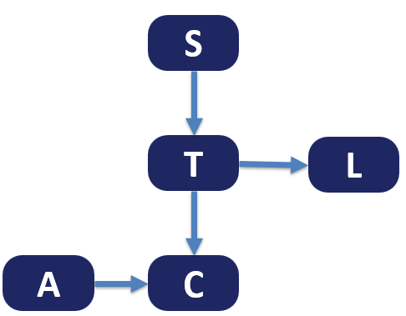
The joint distribution
General form:
5 / 19
Notes:
Each variable depends only on its parents.

Slide 6
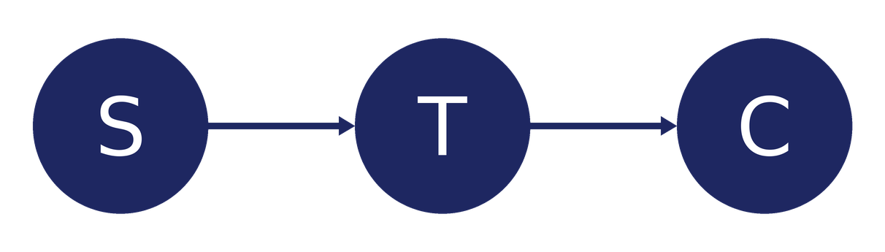
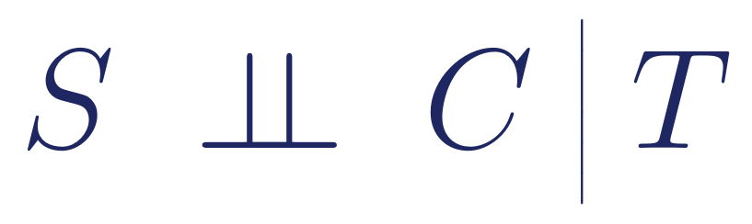
Missing edges → conditional independencies
In our DAG, there is no edge from Smoking to Cancer. Smoking only affects cancer via Tar.
What this implies in the data
Smoking is independent of cancer once we condition on tar exposure.
S, C independent given T: conditioning on T blocks the path
6 / 19

Slide 7
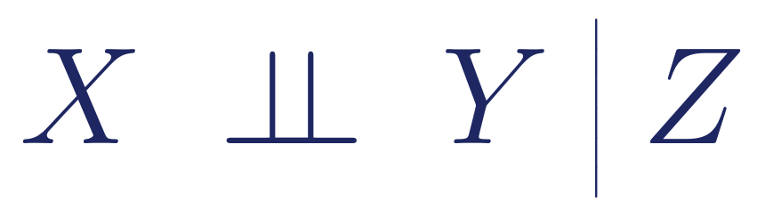
DEFINITION
Conditional Independence
X is conditionally independent of Y given Z if, for every combination of values:
In plain English
Knowing the value of Y doesn't change our belief about X if we already know Z.
7 / 19

Slide 8
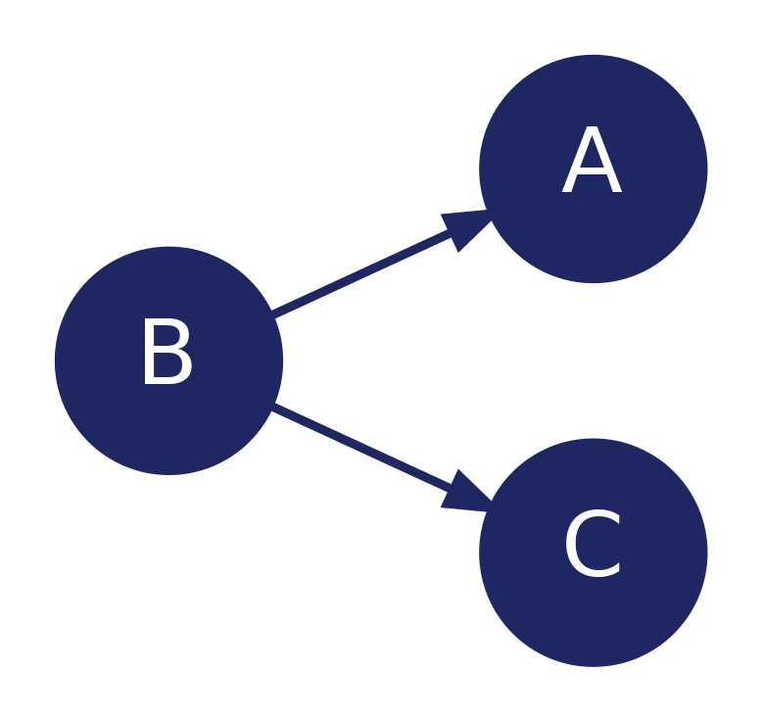
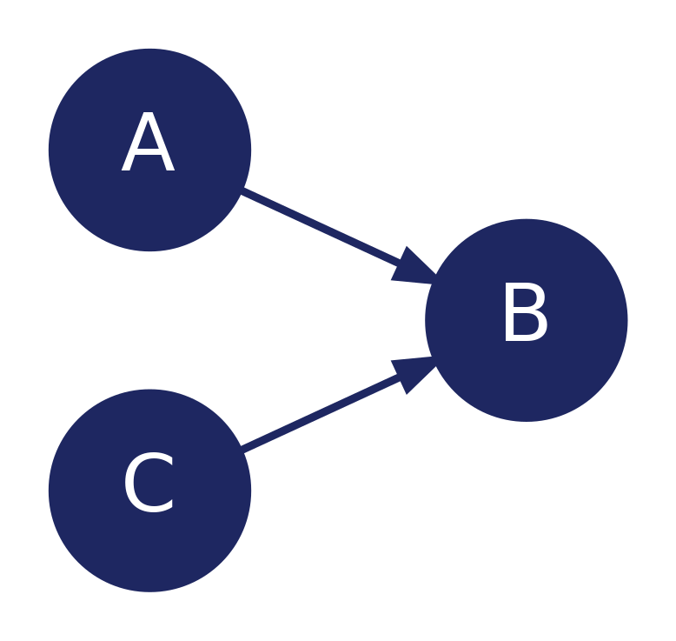
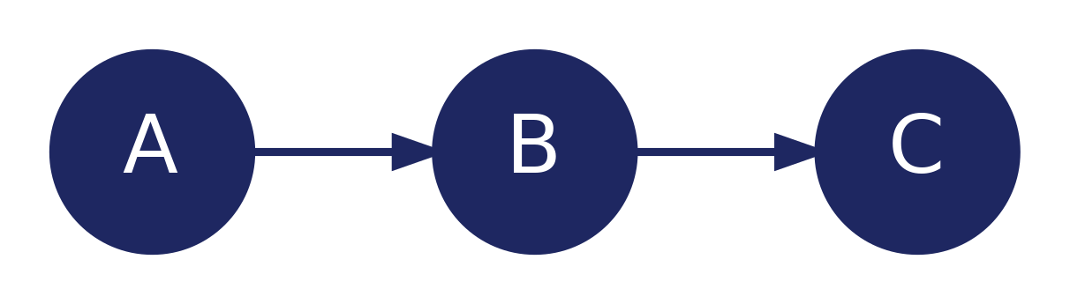



Triples
Every path in a graph is made of triples: three consecutive nodes A — B — C. Only the middle node matters for whether information flows through.
Chain
Fork
Unshielded Collider
B is on the way between A and C.
B is a common cause of A and C.
B is a common effect of A and C.
8 / 19

Slide 9
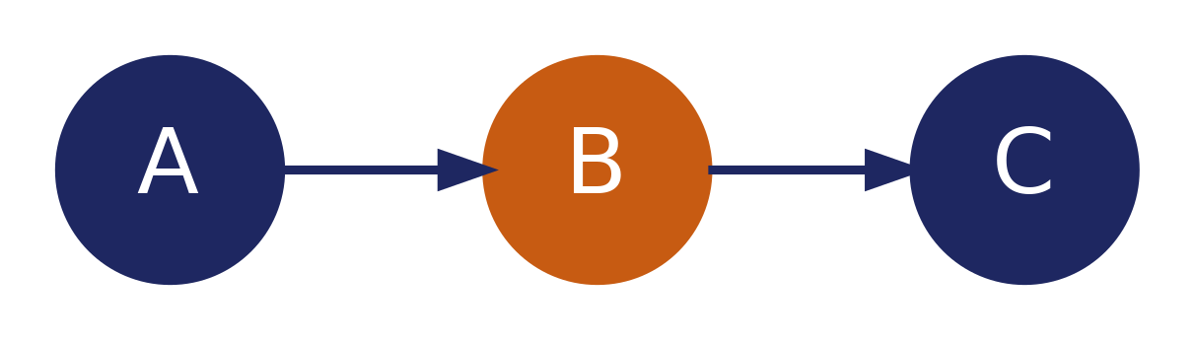
Chain, fork: middle node controls flow
ACTIVE
BLOCKED
B ∉ Z → info flows A — C
B ∈ Z → knowing B screens off A from C
Orange = node in Z
Z = the set of variables we observe (condition on)
Same rule for forks: if B sits on the path of causal flow, observing B catches the information.
9 / 19

Slide 10
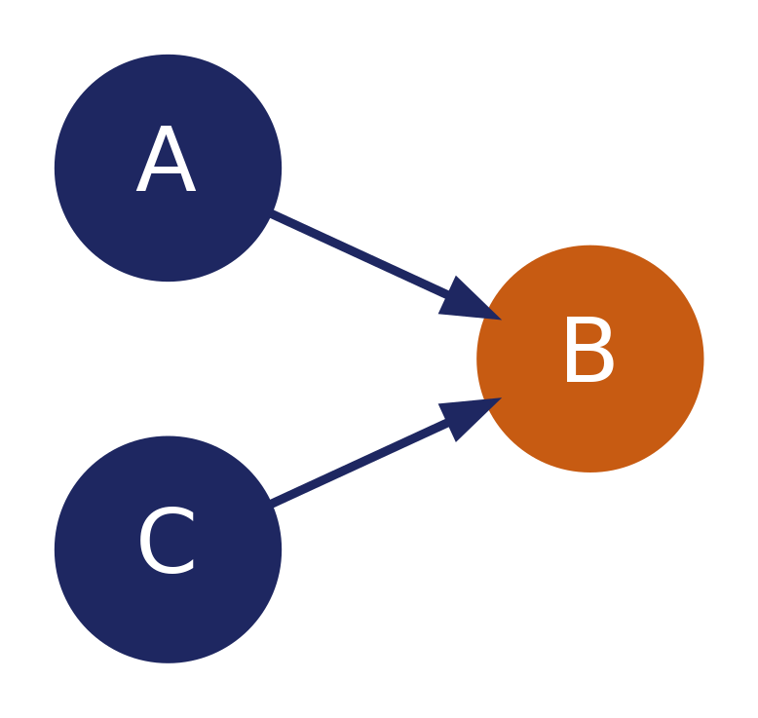
Unshielded collider: middle node reverses the rule
Conditioning on a common effect creates dependence between its causes.
BLOCKED
ACTIVE
B ∉ Z → default: no flow
B (or a descendant of B) ∈ Z → path opens!
10 / 19

Slide 11
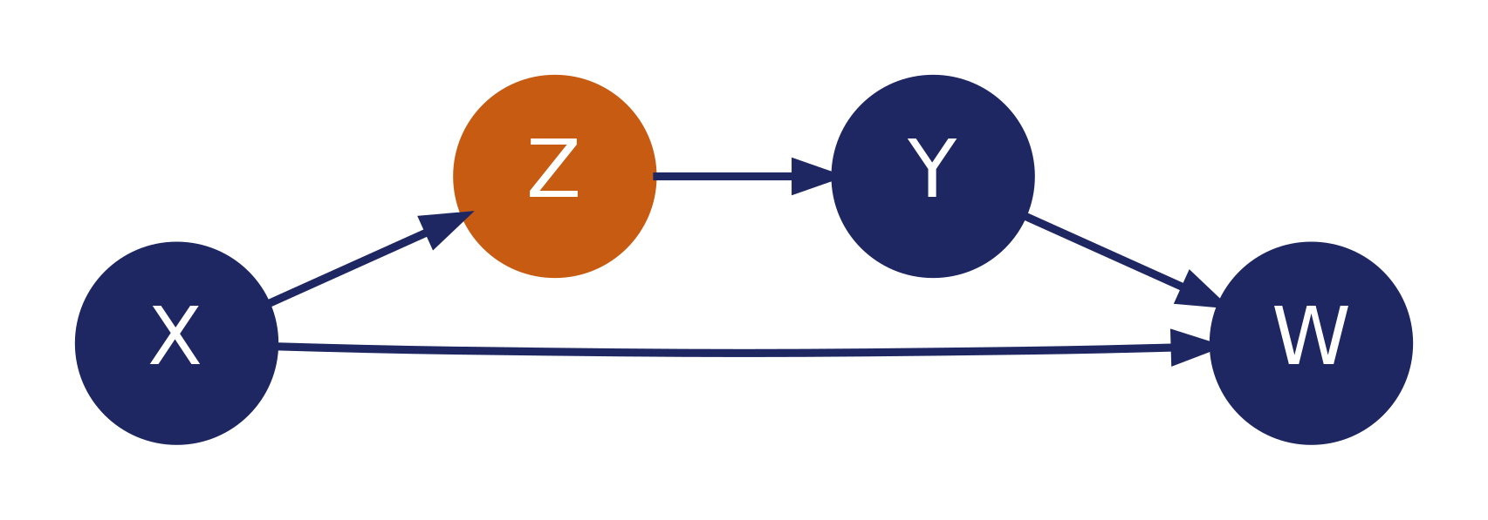
GENERALISING TO WHOLE GRAPHS
d-separation
Example
Are X and Y conditionally independent given a set Z?
● Consider all (undirected) paths from X to Y.
● A path is ACTIVE if every triple on it is active.
Conditioning on Z makes the chain X → Z → Y inactive;
the path through W is blocked because W is an unshielded collider.
● A path is INACTIVE if at least one triple is inactive.
● If every path from X to Y is inactive, X and Y are d-separated given Z.
11 / 19

Slide 12

BRIDGING STRUCTURE & STATISTICS
Foundational Assumptions
Causal Markov
Every d-separation implied by the graph corresponds to a true CI in the data.
d-separation ⇒ CI
Faithfulness
Every CI in the data corresponds to a d-separation in the true graph.
CI ⇒ d-separation
Causal sufficiency
Every common cause of measured variables is also measured.
No hidden common causes
Acyclicity
The true graph is a DAG.
No directed cycles
→ CI tests can reveal graph structure
12 / 19

Slide 13
ALGORITHM
Peter-Clark (PC) algorithm
Use CI tests to learn graph structure, up to a Markov equivalence class.
1
Start with the fully connected undirected graph.
2
For each pair (A, C), search for a set S of variables adjacent to A or C such that A ⫫ C | S. If such S is found, remove edge between A and C.
3
Orient v-structures: for unshielded colliders A — B — C with B ∉ SepSet(A, C), orient A → B ← C.
4
Apply Meek's rules R1–R3 recursively until no further changes.
Output:
Complete Partially DAG (CPDAG): directed edges where the data force orientation, otherwise undirected.
13 / 19
Notes:
All 4 assumptions apply.

Slide 14
WHY ONLY A CPDAG?
Some edges can’t be oriented
Markov equivalence class: PC orients every v-structure; everything else stays undirected.
These three are indistinguishable:
A
B
C
THE EXCEPTION
An unshielded collider IS identifiable
A
B
C
same skeleton,
no collider
A
B
C
A
B
C
A → B ← C behaves oppositely under conditioning: conditioning on B opens the path. That asymmetry is detectable, so PC can orient it.
PC outputs
A
B
C
14 / 19

Slide 15
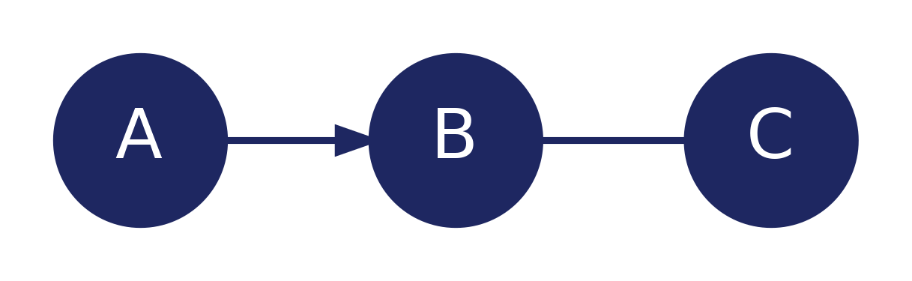
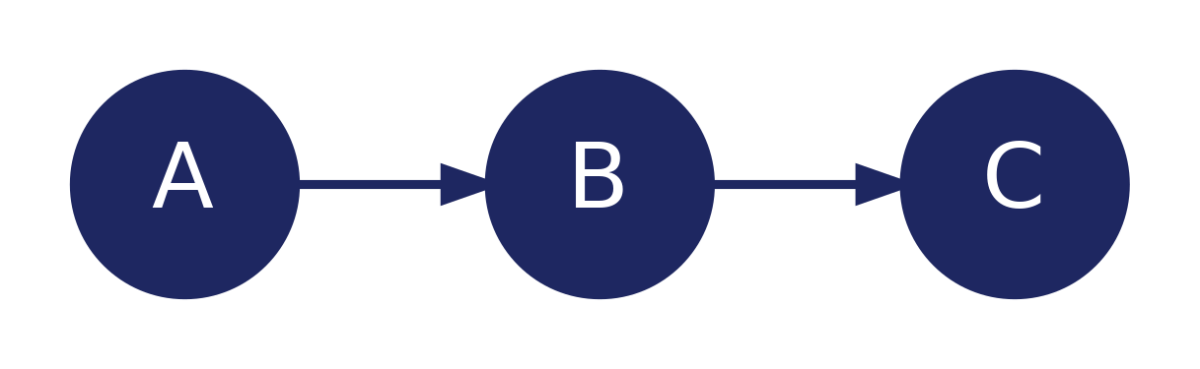
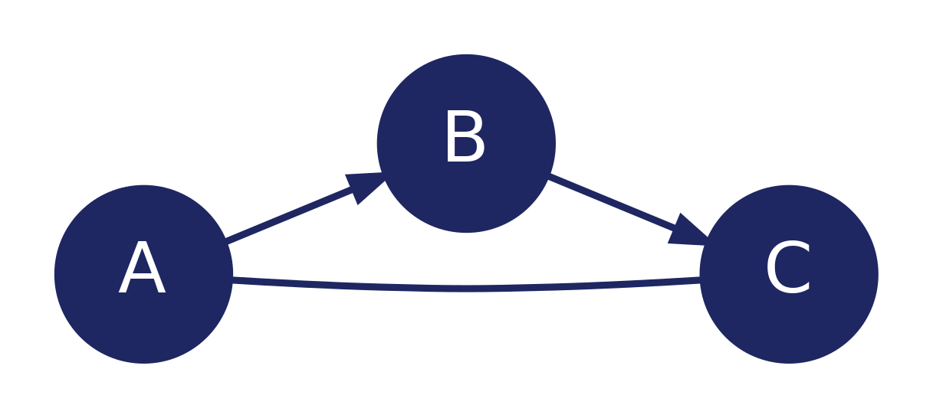
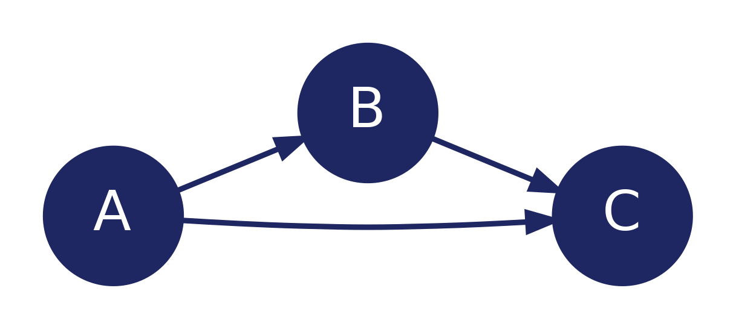
ALGORITHM
Meek's orientation rules
After v-structures, propagate orientations to avoid new colliders and cycles. R1–R3 are sound and complete for the CPDAG (Meek, 1995).
R1
⇒
If A → B — C and A, C not adjacent, then B → C.
Why: otherwise we'd create a new unshielded collider.
R2
⇒
If A → B → C and A — C, then A → C.
Why: otherwise we'd create a directed cycle.
15 / 19

Slide 16
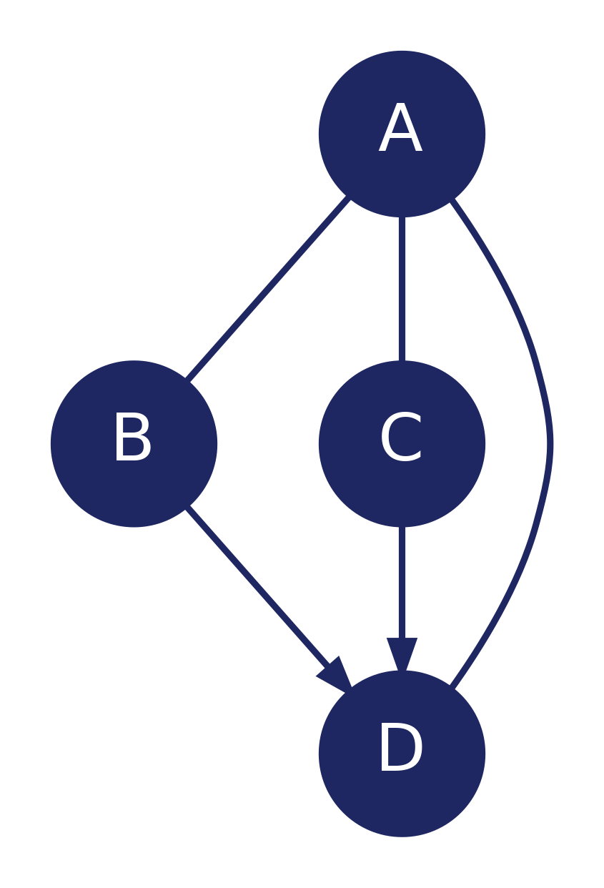
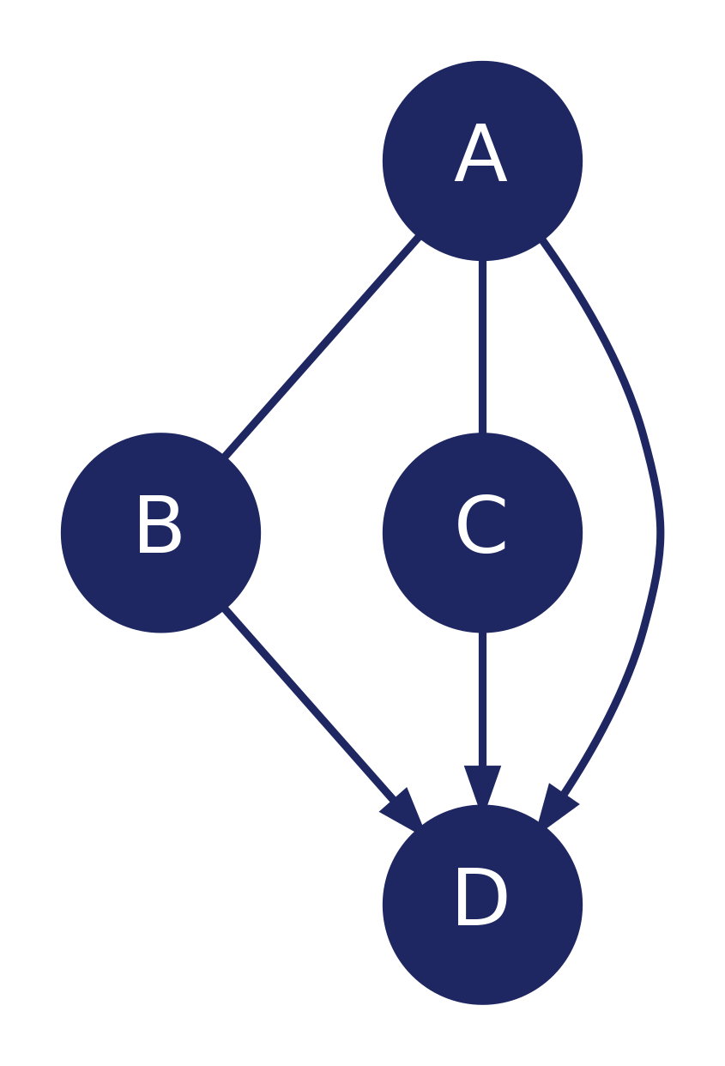
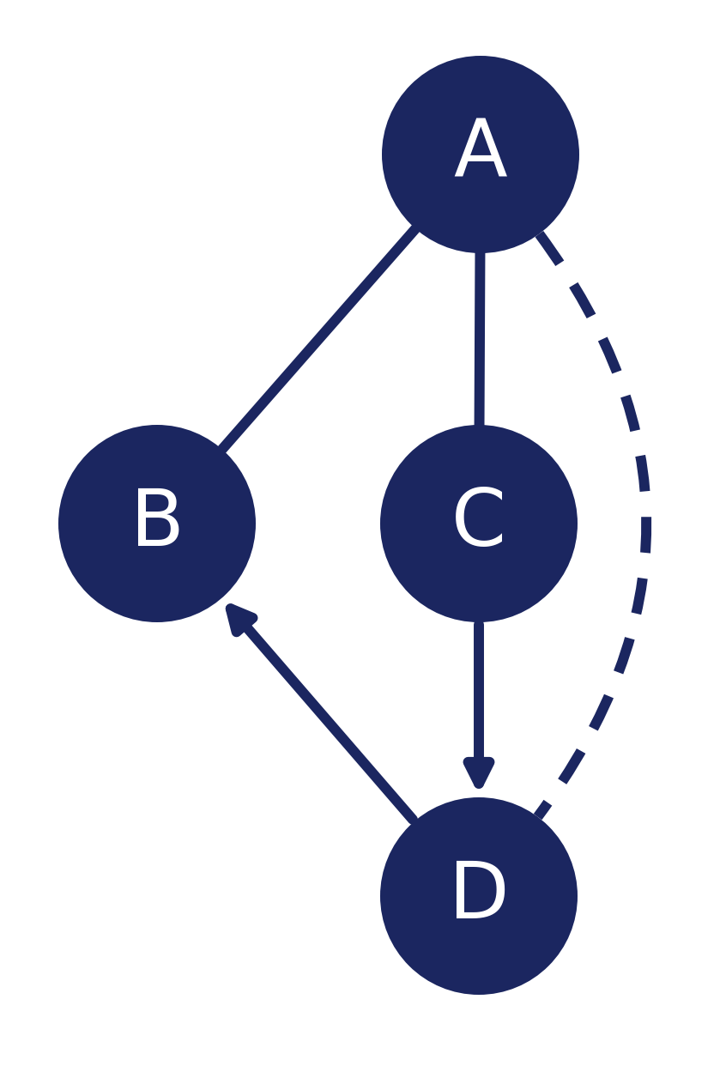
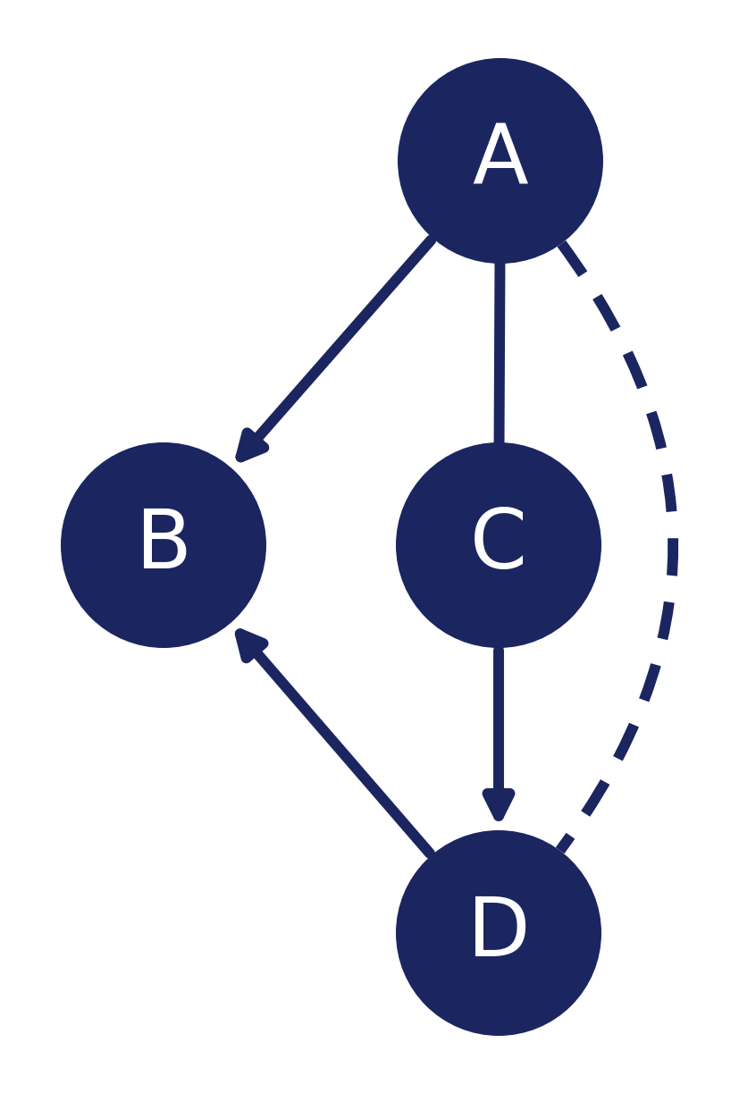
ALGORITHM
Meek's orientation rules (continued)
R3
⇒
If A — B, A — C, B → D ← C with A — D and B, C not adjacent, then A → D.
R4
⇒
If A — B, A — C, C → D, D → B, with A ⋯ D and B, C not adjacent, then A → B.
Why: the reverse would force a new unshielded collider at A (two applications of R2).
Dashed = orientation immaterial (next slide). R4 only fires with background knowledge; R1–R3 alone already give the CPDAG.
16 / 19

Slide 17
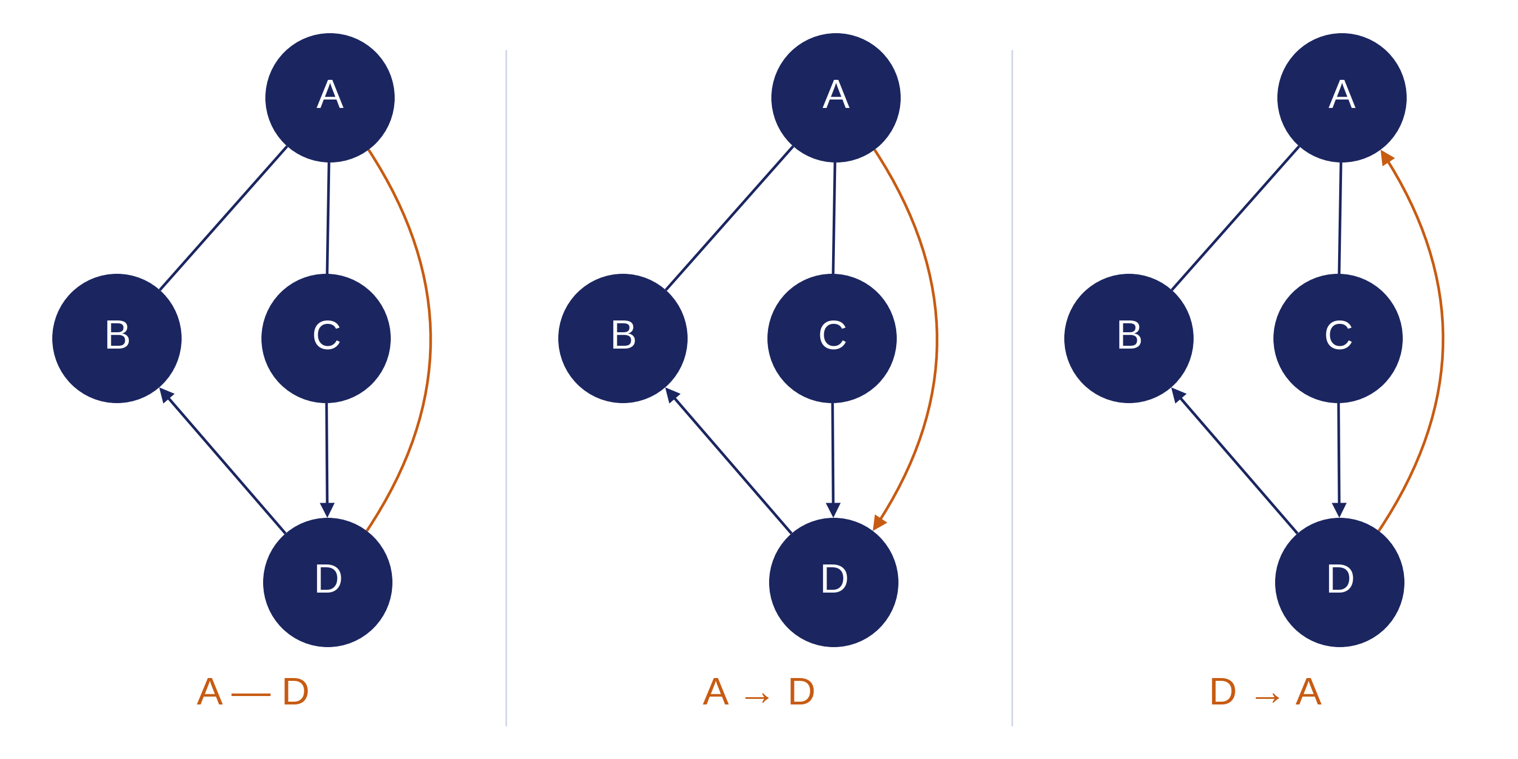
The dashed edge is a wildcard
Meek draws one edge of R4 dashed. R4 declines to constrain that edge.
● Dashed: A and D are adjacent, direction unspecified. It matches all three panels.
● Solid without arrowheads is a stronger condition: the edge must actually be unoriented, so it matches the first panel only.
● Never in an output graph! Dash lives only inside a rule, never in a CPDAG.
All three match the R4 schematic, and in each one R4 forces A → B.
17 / 19

Slide 18
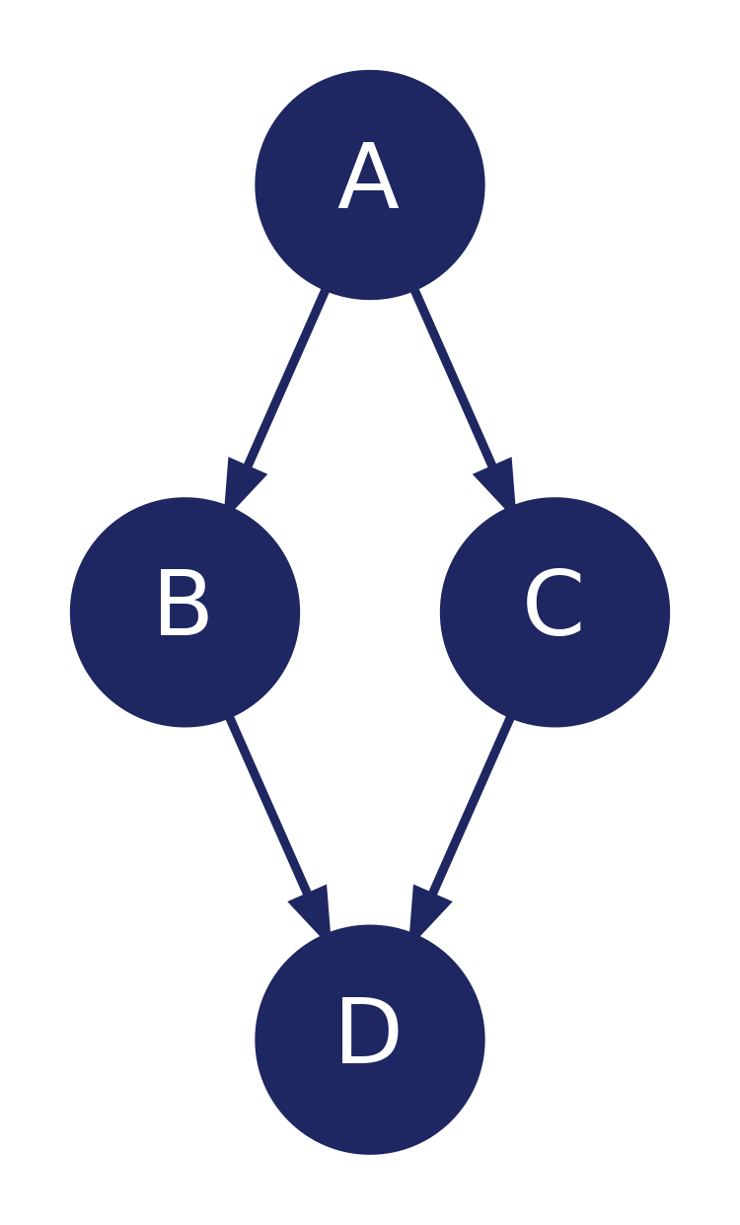
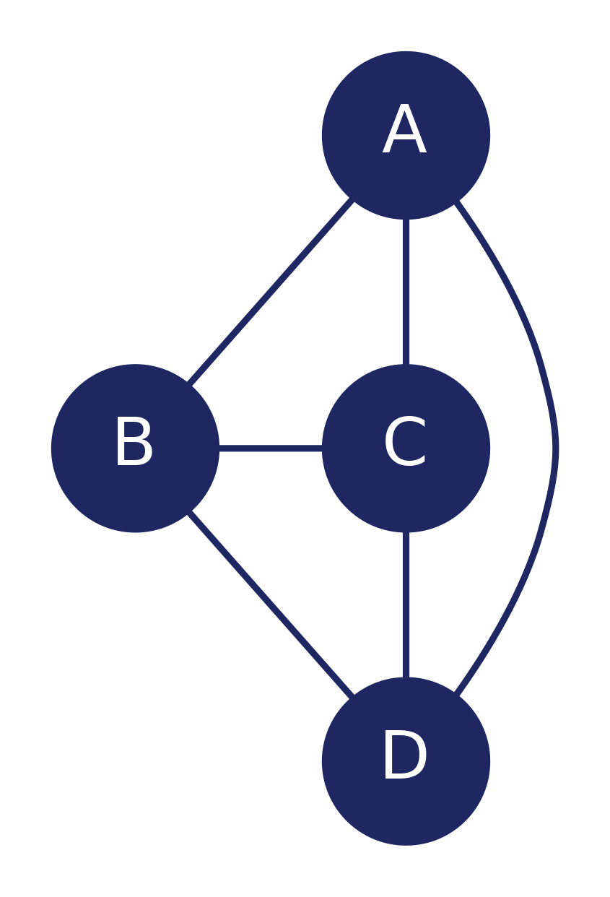
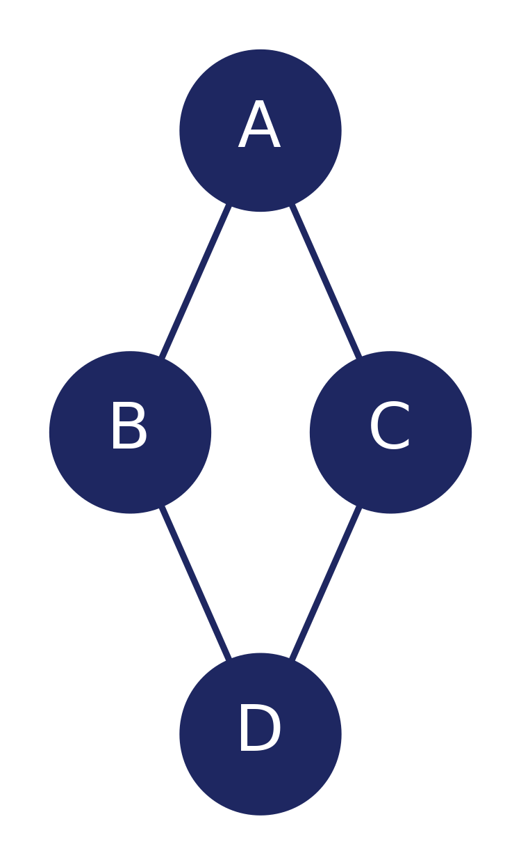
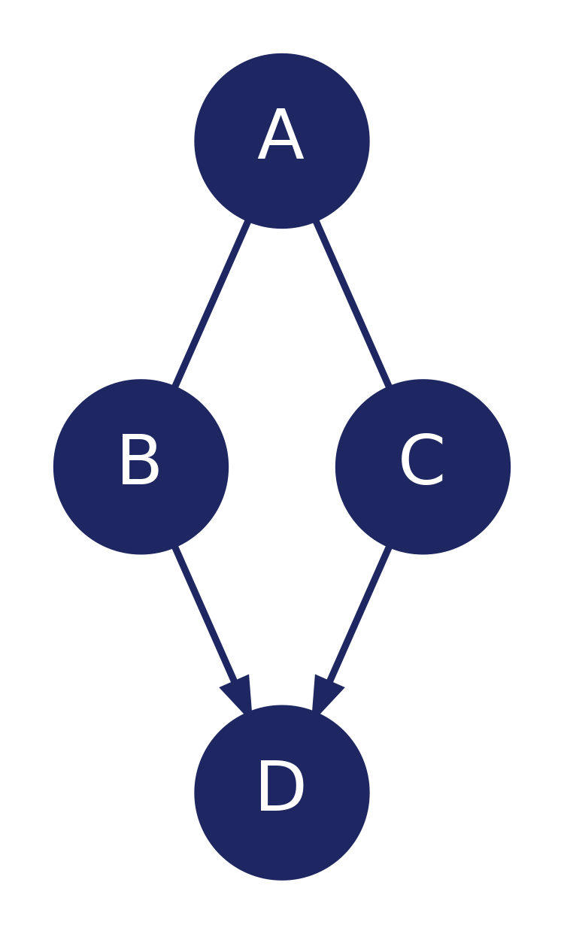
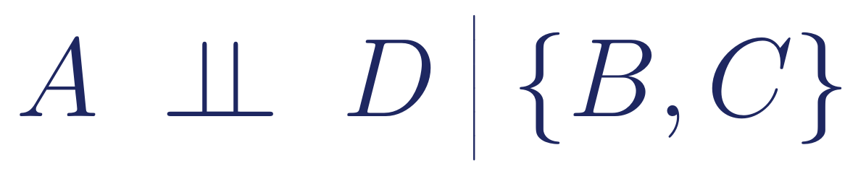
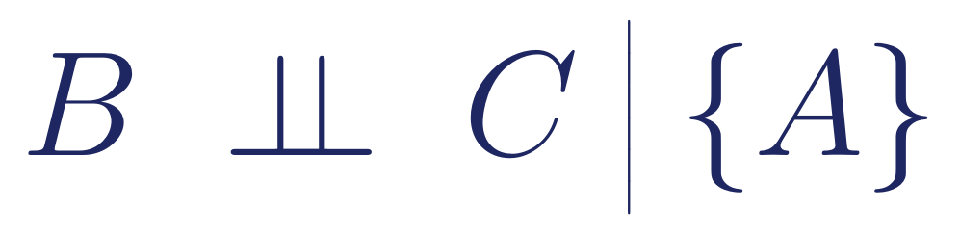

WORKED EXAMPLE
PC algorithm in action
Suppose the true DAG is the one on the left. We start from a complete graph and recover the structure.
True DAG
Start: Complete Undirected
After CI tests
After v-structures
Removed edges via CI tests:
18 / 19

Slide 19
Summary
Causal structure
is a DAG: arrows = direct causes.
Markov + faithfulness
assumptions tie graph structure to data: CI ⇔ d-separation.
d-separation
is the triple rules applied to every path.
PC algorithm
uses CI tests to recover a CPDAG, then Meek's rules propagate orientations.

