Slide 1
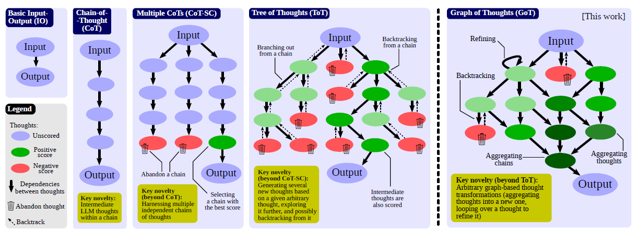
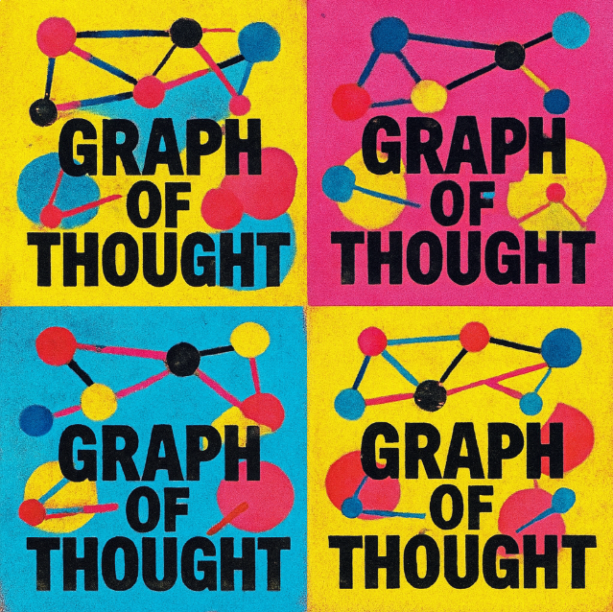
Graph of Thoughts: Solving Elaborate Problems with Large Language Models
By Besta et al. (2024)
Presentation by TJ LaGrow
TReNDS Center MLBBQ
10/10/2025
Besta, Maciej, et al. "Graph of thoughts: Solving elaborate problems with large language models." Proceedings of the AAAI conference on artificial intelligence. Vol. 38. No. 16. 2024.
Notes:
From AAAI 2024, pre-refinement with the use of. Coming out of Zerich and Warsaw. I thought it’d be interesting to

Slide 2
Overview
Overview / Why this might be Interesting
Tables and Graphs in the Paper
Example Prompts
Skepticism
Any updates / Discussion

Slide 3
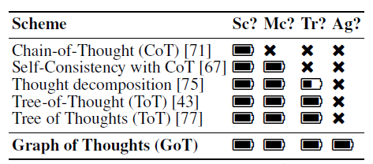
Big picture
Most “prompted reasoning” schemes are either a single chain (CoT), multiple independent chains (CoT-Self-Consistency), or a search tree (ToT). Those structures don’t let partial solutions feed back into earlier steps or merge results from different branches. GoT generalizes the control-flow to an arbitrary directed graph of thoughts so you can
generate candidates,
(2) aggregate multiple partials into a better one,
(3) refine an intermediate result with loops, operations trees don’t natively support.
Notes:
Comparison of prompting schemes, with respect
to the supported transformations of thoughts. “Sc?”:
single chain of thoughts? “Mc?”: multiple chains of
thoughts? “Tr?”: tree of thoughts? “Ag?”: arbitrary graph
of thoughts? “.”: full support, “.”: partial support, “é”:
no support.
We qualitatively compare GoT to other prompting
schemes1 in Table 1. GoT is the only one to enable arbitrary
graph-based thought transformations within a prompt, such
as aggregation, embracing all previously proposed schemes.
----
Most “prompted reasoning” schemes are either a single chain (CoT), multiple independent chains (CoT-Self-Consistency), or a search tree (ToT). Those structures don’t let partial solutions feed back into earlier steps or merge results from different branches. GoT generalizes the control-flow to an arbitrary directed graph of thoughts so you can (1) generate candidates, (2) aggregate multiple partials into a better one, and (3) refine an intermediate result with loops, operations trees don’t natively support.
GoT is a control-flow upgrade for prompted reasoning: it enables aggregation and refinement in a directed graph, not just branching and backtracking. On tasks that decompose and recombine cleanly, GoT beats ToT at similar token budgets, and the latency–volume argument explains why. The trade-off is scoring dependence (sometimes via LLM self-judgment) and unknown gains on today’s reasoning-trained models.

Slide 4
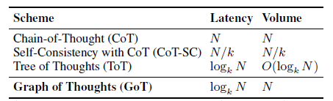
Core Idea
Represent reasoning as a graph $G=\left(V , E\right)$ where each vertex is a “thought” and edges encode dependencies
Provide a small set of operations over the graph: Generate (branch), Aggregate (merge/join results), Improve/Refine (loop on a node), Score (evaluate a thought), and KeepBest (selection).
Why this matters theoretically: the authors define a latency to volume trade-off. “Latency” is number of hops to a final thought; “volume” is how many prior thoughts could have influenced that final thought (i.e., how much computation you can funnel into it). They argue GoT achieves logarithmic latency like ToT but maximal volume, because aggregation lets information from many paths reach the final node.

Slide 5
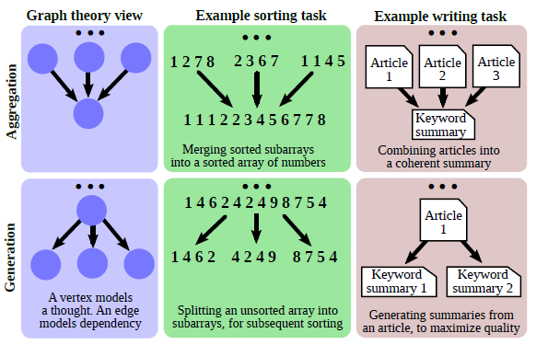
The Model
Two internal structures are helpful in the examples:
A static graph of operations (the template plan for a task, e.g., “split to solve subparts to aggregate to refine”)
A dynamic reasoning state that stores the concrete thoughts, scores, and which candidates survive KeepBest
Notes:
see these instantiated for sorting, set intersection, keyword counting, and NDA-document merging, each with custom scoring functions and prompts.

Slide 6
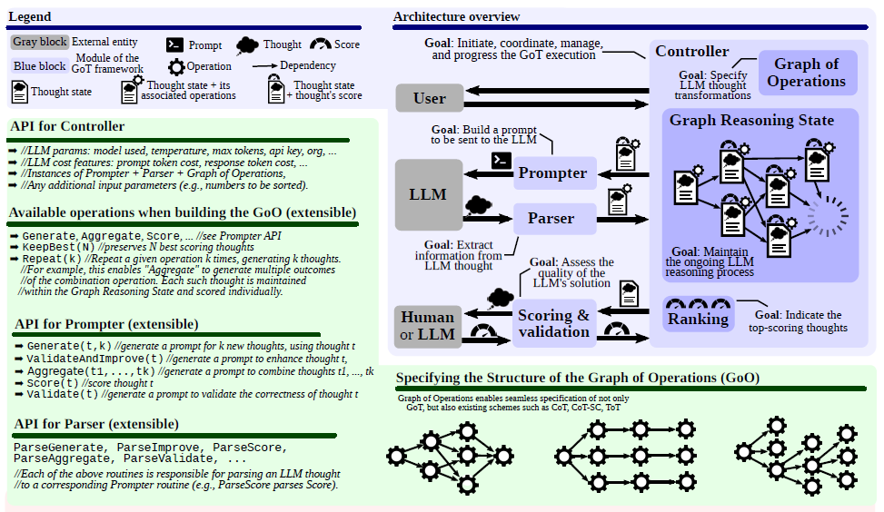
The Model
Notes:
1) Sorting lists (merge-style)
Plan: Split the list, sort sublists (Generate/Improve), then Aggregate via an LLM-guided merge; score penalizes local inversions and dup issues.
Takeaway: The GoT decomposition mirrors merge sort: “split → locally solve → merge → repeat,” giving the model opportunities to correct and combine partial results. Fig. 4 shows the plan.
2) Set intersection
Plan: Split one set into chunks, compute chunk-wise intersections with the other set, then aggregate.
Scoring: counts extras, misses, and duplicates when the LLM outputs the set as a list. Formalized as $X_{1}$(incorrectly included) + $X_{2}$(missing) + $X_{d}$(duplicates). They also define a “positive” scope score from these components.
3) Keyword counting in text
Plan: Split the document into passages, count in each, aggregate counts;
Scoring: sum of absolute errors per keyword (ground-truth known for the synthetic text).
4) Merging multiple NDAs into one
Plan: Iteratively merge partial drafts;
Scoring: the LLM self-scores redundancy and information retention (each averaged over 3 queries), then they take the harmonic mean as the objective. They include an example final NDA and the associated reasoning/score.
When subproblems compose cleanly, you can solve them locally, score them locally, then combine them, aggregation and refinement let the LLM reuse correct fragments and correct small errors without throwing away work from other branches. The latency–volume analysis gives a theoretical intuition: you keep $\log{}$depth while letting all partials potentially influence the final answer via merges, instead of discarding sibling branches as in ToT.

Slide 7
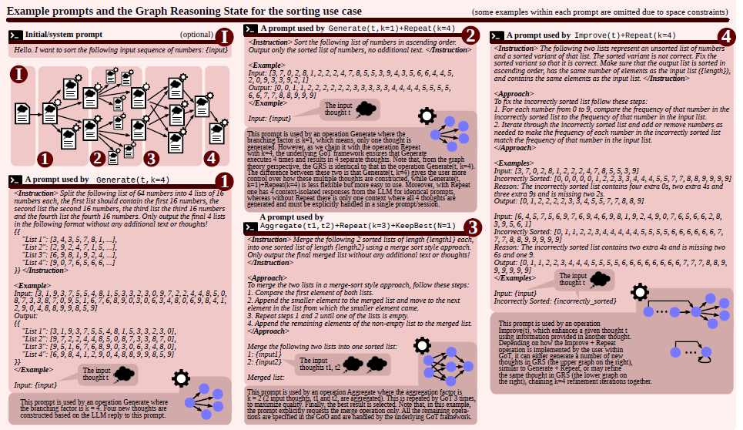
The Model
Notes:
100 inputs per task/baseline; temperature 1.0; 4k context unless noted.
They tune branching factor $k$and depth $L$to equalize total cost across schemes (so wins aren’t just “we used more tokens”). They compare against IO, CoT, CoT-SC (briefly), and ToT/ToT2 (same total responses but different $k,L$).

Slide 8
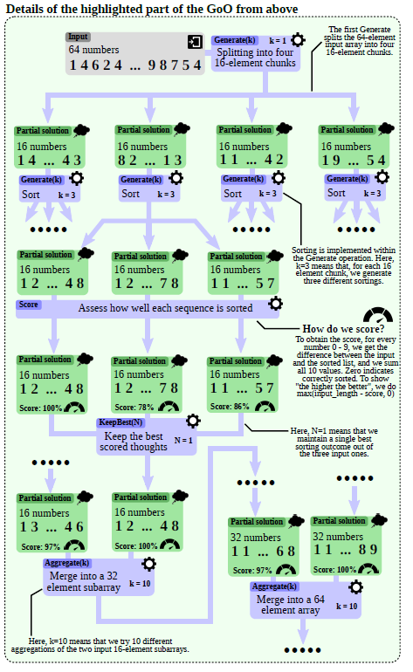
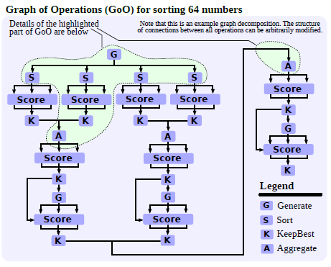
Results
Notes:
An example graph decomposition of the sorting
use case in GoT. All used operations (Generate, Aggregate,
Score, KeepBest) are described in Figure 3

Slide 9
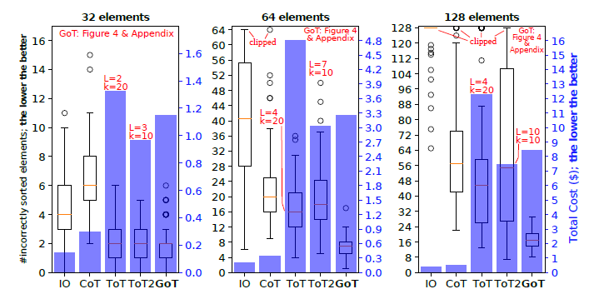
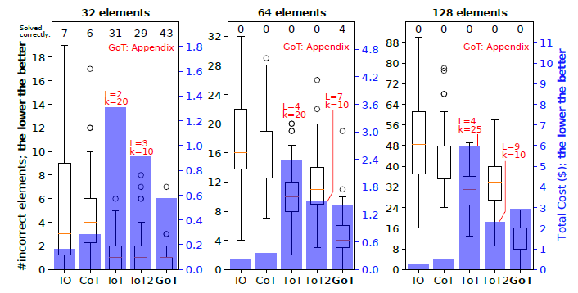
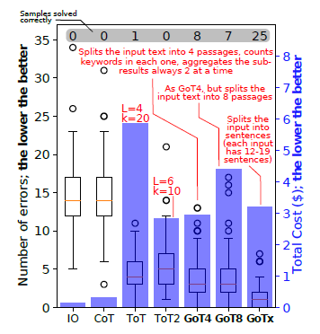
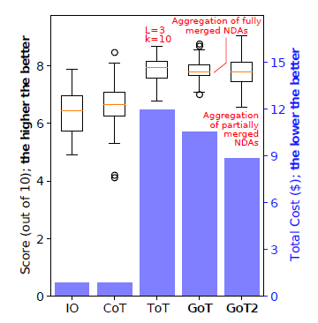
Results
Notes:
Figures 5 through 8
Takeaways, big pictures
Consistent pattern: When tasks can be decomposed and recomposed, GoT improves quality and often lowers or matches cost versus ToT/ToT2 by using score→keep-best→aggregate cycles.
Most benefits on larger instances: As problems grow, single-shot or shallow explorations falter; GoT’s graph operations yield widening margins.
Models & setup. Most experiments use GPT-3.5 (Llama-2 was tried but was slower and performed worse). Each task/baseline uses 100 input samples, temperature 1.0, and ~4k context, with attempts to keep costs comparable by fixing the number of thoughts.
ToT variants. “ToT” uses a higher branching factor k and lower depth L; “ToT2” uses lower k and higher L, exploring a different cost/quality trade-off
GoT advantage hypothesis. GoT decomposes problems into solvable subtasks, scores, keeps best, then aggregates partial results—predicted to improve quality and cost versus ToT.
Figure 5
What’s plotted. Error counts for sorting P∈{32,64,128} elements across IO, CoT, ToT, ToT2, and GoT; bars also show total $ cost per setting.
Takeaways. GoT consistently beats ToT and ToT2 in error rate, at lower cost than ToT and comparable to ToT2. For P=128, GoT reduces median error by ≈62% vs ToT and cuts cost by >31%—a headline result for the paper
Why it helps. Decomposition→per-chunk sorting→merge yields better fidelity (frequency-aware scoring) and lets GoT discard weak partials before aggregation.
Against simple baselines. For P=64, GoT’s median error is ≈65% lower than CoT and ≈83% lower than IO (but costs more than IO/CoT because it explores k thoughts).
Scaling. Benefits grow with problem size: improvements over ToT2 are small at P=32 but ~61% (P=64) and ~69% (P=128) on median error.
Figure 6.
What’s plotted. Error counts for computing $A∩B$under varying set sizes (32/64/128) and overlaps, plus total cost. GoT is compared to IO/CoT/ToT/ToT2.
How it’s scored. Error scope = extras in C + missing items + duplicates (LLMs output lists), then converted to a positive score if needed.
Takeaways. Echoing sorting, GoT drives errors down while staying below ToT’s cost and around ToT2’s, thanks to splitting B, intersecting per-subset, then aggregating cleanly.
Figure 7
What’s plotted. Total counting errors and cost for IO/CoT/ToT/ToT2 versus GoT4, GoT8, and GoTx (different passage split strategies).
Task design & scoring. Text is split into passages; counts per passage are aggregated. Score sums absolute deviations across keywords.
Trade-offs. More, smaller passages reduce per-prompt token load but the static few-shot overhead can dominate as you decompose; the authors show you can shrink the few-shot to recover costs (GoT8 → GoTx)
Figure 8
What’s plotted. A 10-point quality score (harmonic mean of redundancy and information retention, each judged via LLM multiple times and averaged) and cost for IO/CoT/ToT vs GoT(two aggregation strategies).
Design. GoT merges partially or fully merged NDAs through staged aggregation; two bars (“GoT” vs “GoT2”) reflect different aggregation granularity.
Takeaway. GoT achieves higher quality score at acceptable cost, aligning with the claim that aggregation of subresults is easier (and more robust) than end-to-end generation.

Slide 10
Limitations
Evaluator dependence. Two tasks use crisp, programmatic scores (sorting violations; set-error counts). But document merging relies on LLM self-scoring (redundancy/retention). That can drift, anchor on phrasing, or reflect model biases (good enough for a demo, risky for production).
Model coverage. Results are primarily with GPT-3.5-class models (the paper notes weaker performance on other baselines in places; not a comprehensive survey of modern reasoning-RL models). The generality to today’s stronger “reasoning” models isn’t established here.
Task fit. GoT shines where aggregation is well-defined (e.g., merging sorted sublists or set chunks). For tasks with non-decomposable objectives or global constraints, the aggregation step is unclear and GoT can lose its edge

Slide 11
Relevancy
Tree of Thoughts (ToT, 2023): baseline for search over partial solutions; key difference is lack of aggregation/joins. Useful as the comparison point.
SELF-DISCOVER (2024): instead of hand-designing the operations graph, the LLM self-discovers and composes task-intrinsic reasoning modules into a structure to follow, i.e., learned structure vs. GoT’s engineered plan. Good to contrast approaches.
Structure-Guided Prompt (2024): uses graphs inside prompts to guide multi-step reasoning over text; closer to graph-as-content, whereas GoT is graph-as-control-flow.
Reasoning-RL models (2025):
  DeepSeek-R1 shows big reasoning gains using pure RL to incentivize reasoning traces, changing the model, not just the prompt-time controller. This is the state-of-the-art line you should name-drop when asked “why not just use a better model?”
  OpenAI o3 (2025) pushes SOTA on hard reasoning/coding/visual tasks; the narrative is that model-side improvements narrow the gap CoT/ToT/GoT aimed to bridge with prompting alone. So position GoT as complementary orchestration rather than a replacement.
As models get better at internal reasoning, the marginal benefit of complex prompt-time search may shrink on some tasks. Hoewever, for pipeline-like problems with natural merges and cheap evaluators, GoT remains a clean, tool-less way to harness test-time compute.

Slide 12
Thank you!

