Slide 1

Brain Harmony: A Multimodal Foundation Model Unifying Morphology and Function into 1D Tokens
Authors: Zijian Dong, Ruilin Li, Joanna Su Xian Chong, Niousha Dehestani, Yinghui Teng, Yi Lin, Zhizhou Li, Yichi Zhang, Yapei Xie, Leon Qi Rong Ooi, B.T. Thomas Yeo, Juan Helen Zhou
Presentation by Theodore J. LaGrow
TReNDS Center MLBBQ
04/17/2026
Original Article: https://arxiv.org/abs/2509.24693

Slide 2
Overview
Background
Data Details
Model Details
Performance
Limitations
Discussion

Slide 3
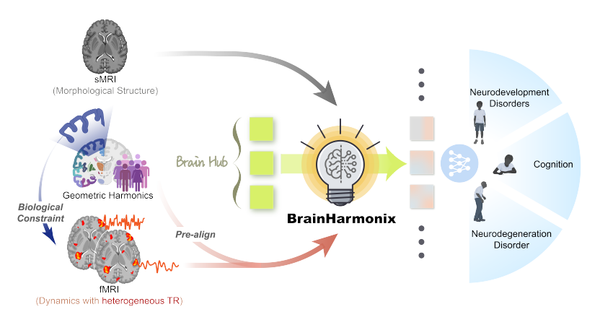
Background
Data Details
Model Details
Performance
Limitations
Discussion
Notes:
Figure 1: Overview of Brain Harmony (BrainHarmonix). Brain morphology from T1-weighted
MRI (sMRI) and functional dynamics from fMRI are unified into compact 1D brain-hub tokens, which
can be readily adapted to downstream tasks via an attached projection head. Specifically, functional
dynamics are pre-aligned with group-level geometric harmonics, with built-in flexibility to handle
heterogeneous repetition times (TRs). This fusion creates a compact yet expressive representation
space that effectively captures the interplay between brain structure and function, supporting a broad
range of downstream applications, including neurodevelopmental and neurodegenerative disorder
classification and cognition prediction.

Slide 4
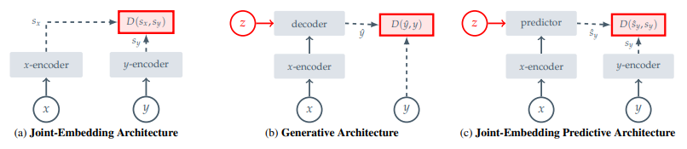
Background
Data Details
Model Details
Performance
Limitations
Discussion
Notes:
Common architectures for self-supervised learning, in which the system learns to capture the relationships between its inputs. The objective is to assign a high energy (large scaler value) to incompatible inputs, and to assign a low energy (low scaler value) to compatible inputs. (a) Joint-Embedding Architectures learn to output similar embeddings for compatible inputs x, y and dissimilar embeddings for incompatible inputs. (b) Generative Architectures learn to directly reconstruct a signal y from a compatible signal x, using a decoder network that is conditioned on additional (possibly latent) variables z to facilitate reconstruction. (c) Joint-Embedding Predictive Architectures learn to predict the embeddings of a signal y from a compatible signal x, using a predictor network that is conditioned on additional (possibly latent) variables z to facilitate prediction.

Slide 5
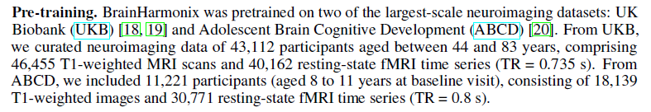
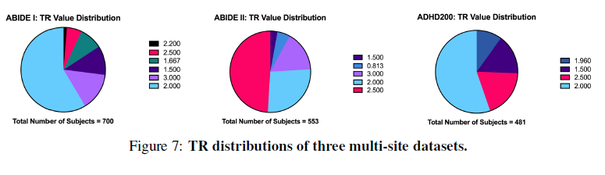
Background
Data Details
Model Details
Performance
Limitations
Discussion
Notes:
Pre-training. BrainHarmonix was pretrained on two of the largest-scale neuroimaging datasets: UK
Biobank (UKB) [18, 19] and Adolescent Brain Cognitive Development (ABCD) [20]. From UKB,
we curated neuroimaging data of 43,112 participants aged between 44 and 83 years, comprising
46,455 T1-weighted MRI scans and 40,162 resting-state fMRI time series (TR = 0.735 s). From
ABCD, we included 11,221 participants (aged 8 to 11 years at baseline visit), consisting of 18,139
T1-weighted images and 30,771 resting-state fMRI time series (TR = 0.8 s).
During the UE stage, a total of 64,594 T1-weighted images from both datasets were utilized for
BrainHarmonix-S pretraining. For fMRI data augmentation, UKB data underwent temporal downsampling
by factors of 1 to 3, resulting in TRs of 0.735 s, 1.47 s, 2.205 s, and 2.94 s. ABCD data
were downsampled by factors of 1 to 2, yielding TRs of 0.8 s, 1.6 s, and 2.4 s. Consequently, the
total number of pretraining samples for BrainHarmonix-F was 252,961 (UKB: 40,162 × 4; ABCD:
30,771 × 3). In the MF stage, we extracted 69,360 matched T1-fMRI pairs from both datasets (one
T1-weighted image could correspond to multiple fMRI runs within a single session). All fMRI
data was parcellated into N = 400 ROIs with Schaefer-400 [21]. Further details regarding data
preprocessing are provided in Appendix A.
Downstream fine-tuning. We evaluated BrainHarmonix on six neuroimaging benchmark datasets.
Three multi-site datasets focused on neurodevelopmental disorder diagnosis (TR distributions are
detailed in Figure 7): Autism Brain Imaging Data Exchange datasets (ABIDE-I and ABIDE-II) for
distinguishing Autism Spectrum Disorder (ASD) from controls, and the Attention Deficit Hyperactivity
Disorder dataset (ADHD-200) for classifying ADHD versus controls. On the other hand,
three datasets assessed neurodegenerative disorders and cognitive function: Parkinson’s Progression
Markers Initiative (PPMI) (TR = 2.5s) for four-class classification involving controls, scans without
evidence of dopaminergic deficit (SWEDD), prodromal cases, and Parkinson’s disease (PD);
Alzheimer’s Disease Neuroimaging Initiative (ADNI) (TR = 3.0s) for classification between controls
and mild cognitive impairment (MCI); and the Lifespan Human Connectome Project Aging (HCP-A)
dataset (TR = 0.8s) for predicting executive function (Flanker task scores). The results were averaged
across three independent runs with distinct data splits (train:validation:test = 6:2:2). We adopted the
data stratification approach in [22] for splitting the neurodevelopmental datasets. Detailed information
regarding class distributions and preprocessing procedures for each benchmark dataset can be found
in Appendix A.

Slide 6
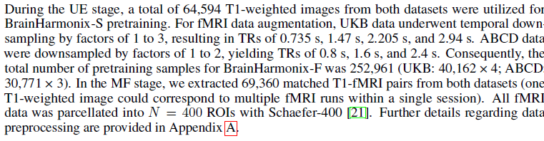
Background
Data Details
Model Details
Performance
Limitations
Discussion
Notes:
Pre-training. BrainHarmonix was pretrained on two of the largest-scale neuroimaging datasets: UK
Biobank (UKB) [18, 19] and Adolescent Brain Cognitive Development (ABCD) [20]. From UKB,
we curated neuroimaging data of 43,112 participants aged between 44 and 83 years, comprising
46,455 T1-weighted MRI scans and 40,162 resting-state fMRI time series (TR = 0.735 s). From
ABCD, we included 11,221 participants (aged 8 to 11 years at baseline visit), consisting of 18,139
T1-weighted images and 30,771 resting-state fMRI time series (TR = 0.8 s).
During the UE stage, a total of 64,594 T1-weighted images from both datasets were utilized for
BrainHarmonix-S pretraining. For fMRI data augmentation, UKB data underwent temporal downsampling
by factors of 1 to 3, resulting in TRs of 0.735 s, 1.47 s, 2.205 s, and 2.94 s. ABCD data
were downsampled by factors of 1 to 2, yielding TRs of 0.8 s, 1.6 s, and 2.4 s. Consequently, the
total number of pretraining samples for BrainHarmonix-F was 252,961 (UKB: 40,162 × 4; ABCD:
30,771 × 3). In the MF stage, we extracted 69,360 matched T1-fMRI pairs from both datasets (one
T1-weighted image could correspond to multiple fMRI runs within a single session). All fMRI
data was parcellated into N = 400 ROIs with Schaefer-400 [21]. Further details regarding data
preprocessing are provided in Appendix A.
Downstream fine-tuning. We evaluated BrainHarmonix on six neuroimaging benchmark datasets.
Three multi-site datasets focused on neurodevelopmental disorder diagnosis (TR distributions are
detailed in Figure 7): Autism Brain Imaging Data Exchange datasets (ABIDE-I and ABIDE-II) for
distinguishing Autism Spectrum Disorder (ASD) from controls, and the Attention Deficit Hyperactivity
Disorder dataset (ADHD-200) for classifying ADHD versus controls. On the other hand,
three datasets assessed neurodegenerative disorders and cognitive function: Parkinson’s Progression
Markers Initiative (PPMI) (TR = 2.5s) for four-class classification involving controls, scans without
evidence of dopaminergic deficit (SWEDD), prodromal cases, and Parkinson’s disease (PD);
Alzheimer’s Disease Neuroimaging Initiative (ADNI) (TR = 3.0s) for classification between controls
and mild cognitive impairment (MCI); and the Lifespan Human Connectome Project Aging (HCP-A)
dataset (TR = 0.8s) for predicting executive function (Flanker task scores). The results were averaged
across three independent runs with distinct data splits (train:validation:test = 6:2:2). We adopted the
data stratification approach in [22] for splitting the neurodevelopmental datasets. Detailed information
regarding class distributions and preprocessing procedures for each benchmark dataset can be found
in Appendix A.

Slide 7
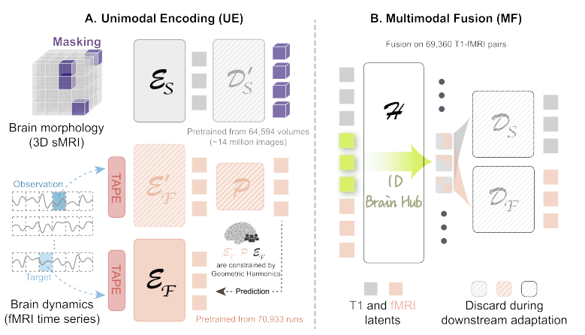
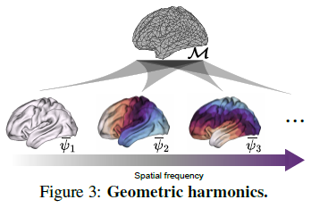
Background
Data Details
Model Details
Performance
Limitations
Discussion
Notes:
Figure 2: Pretraining of Brain Harmony (BrainHarmonix). A. Unimodal Encoding (UE):
BrainHarmonix-S (εS) learns T1 structure via a Masked Autoencoder (MAE); gray cubes represent
visible patches, while purple cubes are masked and reconstructed by the decoder (D′S ).
BrainHarmonix-F (εF ) uses the Joint Embedding Predictive Architecture (JEPA) for fMRI, incorporating
our Temporal Adaptive Patch Embedding (TAPE) for heterogeneous TRs and geometric
harmonics for cortical alignment, with the observation encoder (ε′
F ) and predictor (P) following
standard JEPA. B. Multimodal Fusion (MF): The Harmonizer (H) fuses structural and functional
latents into 1D tokens (in green), then decoder (DS & DF ) reconstruct modality-specific latents.
Figure 3: Geometric harmonics.

Slide 8
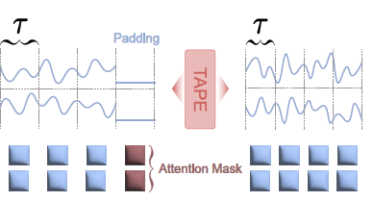

Background
Data Details
Model Details
Performance
Limitations
Discussion
Notes:
Figure 4: Temporal Adaptive Patch Embedding
(TAPE). Tokens represent the same temporal duration
τ . Embedding weights are correspondingly
resized. Shorter time series with fewer tokens
are zero-padded, with attention masks excluding
padded tokens afterwards.

Slide 9
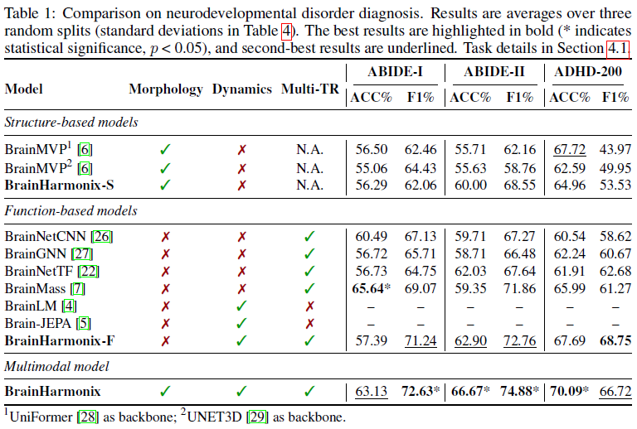
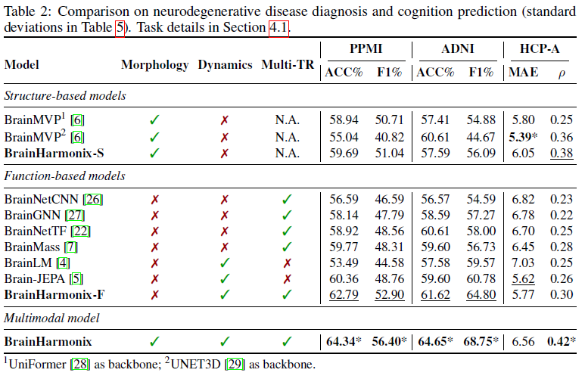
Background
Data Details
Model Details
Performance
Limitations
Discussion

Slide 10
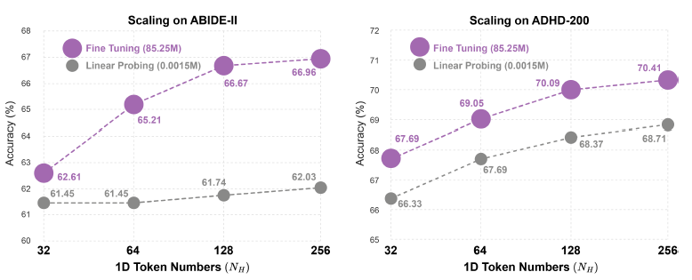
Background
Data Details
Model Details
Performance
Limitations
Discussion
Notes:
Figure 5: Scaling across different numbers of 1D tokens in fine-tuning and linear probing.
We plot both fine-tuning (85.25M trainable parameters) and linear probing (0.0015M trainable
parameters). Increasing the token count from 32 to 256 steadily improves accuracy before reaching a
plateau. Notably, even our linear-probing approach achieves very strong performance, surpassing
prior state-of-the-art results despite using a minimal set of learnable parameters.

Slide 11
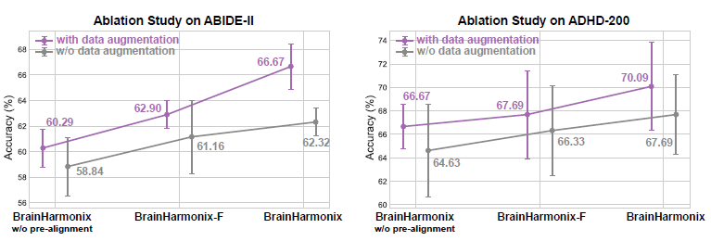
Background
Data Details
Model Details
Performance
Limitations
Discussion
Notes:
Figure 6: Ablation study showing the impact of pre-alignment, data augmentation, and multimodal
fusion. In BrainHarmonix-F without pre-alignment, we sticked to the brain gradient
positioning in Brain-JEPA, while the others (BrainHarmonix-F and BrainHarmonix) were injected
with geometric harmonics on top of brain gradient (Section 4.2). Results were averaged over three
random splits with error bars indicating standard deviations.

Slide 12
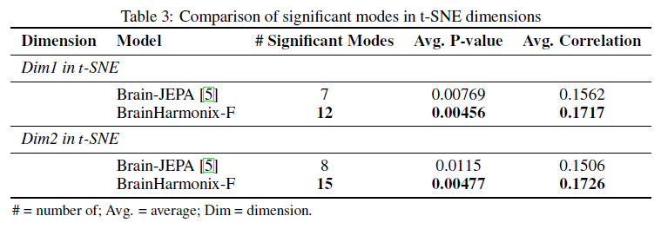
Background
Data Details
Model Details
Performance
Limitations
Discussion

Slide 13
Background
Data Details
Model Details
Performance
Limitations
Discussion
Limitation

Slide 14
Background
Data Details
Model Details
Performance
Limitations
Discussion
Discussion

Slide 15
Thank you!

Slide 16
Appendix

