Slide 1
Causal Discovery
Lecture 2 - Time Series
Presenter: Selim Süleymanoğlu
Consultant: Joanne Wardell

Slide 2
RECAP
In Lecture 1 we recovered a causal DAG from cross-sectional data.
Data
Conditional independence
PC algorithm
rows = subjects
columns = variables
all measured at the same moment
Missing edges in the graph correspond to CIs in the data
Test CIs, prune edges, orient with collider rule + Meek's rules
All of that assumed one time point per subject. What if the data unfolds over time?
2 / 20

Slide 3
MOTIVATION
Real data often has a time axis
Brain imaging
Climate
Economics
fMRI: every few seconds, 100+ regions of interest measured simultaneously.
Daily temperature, pressure, humidity at thousands of stations over years.
Quarterly GDP, inflation, unemployment across decades.
In each case, the same variables are remeasured at many time points.
This unlocks a powerful constraint: causes precede effects in time.
3 / 20
Notes:
Many measurements are not snapshots — they're sequences.

Slide 4
EXAMPLE
A tiny time series
Three variables X, Y, Z measured at every time point.
t | X | Y | Z
1 | 0.42 | 1.1 | 0.31
2 | 0.55 | 1.22 | 0.45
3 | 0.71 | 1.4 | 0.62
4 | 0.66 | 1.55 | 0.74
5 | 0.8 | 1.71 | 0.89
t: time index
X, Y, Z: variables, each with one value per t.
Row t = 3 is one snapshot of the world at time point 3.
What we want to know: which variables cause which others? This is called causal discovery.
4 / 20

Slide 5
The unrolled time-series graph
Make every (variable, time) into a node. Edges only go forward in time.
t-2
t-1
t
t+1
X
Y
Z
Every node is (variable, time). An arrow X at t-1 → Y at t means
“X one second ago directly causes Y now”.
5 / 20
Notes:
It goes infinitely in both directions.

Slide 6
TWO KINDS OF EDGES
Lagged vs. contemporaneous
Time order resolves most causal ambiguity, but not all of it.
Lagged edge
Contemporaneous edge
X
Y
X
Y
t – 1
t
t
t
Direction is given by time: cause came first.
X is referred to as a lagged parent of Y.
Both X and Y at the same t. No time hint.
Hard part: needs CI tests + Meek's rules.
Always orientable.
Lag: The difference between the time stamps of the destination and the source of an edge.
6 / 20

Slide 7
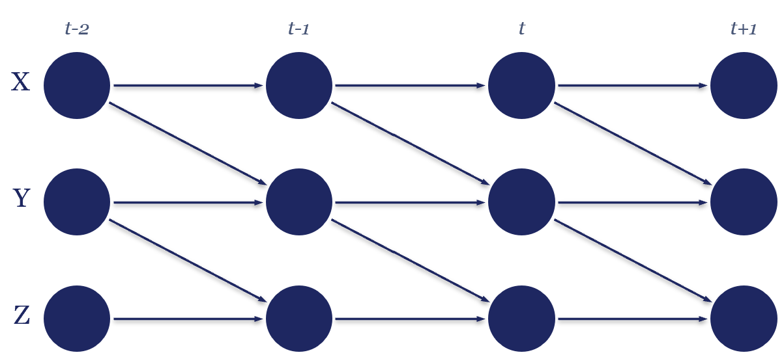
ASSUMPTION
Causal stationarity: Lag is periodic.
Why this assumption matters:
We only need to define edges for one time window of length lag + 1; they repeat.
If structural stationarity is violated we get artifacts. A real concern in fMRI.
7 / 20
Notes:
Time series: temporal corr. Always have to look at two rows.
PC: all edges instantaneous. Does not analyse time series.

Slide 8
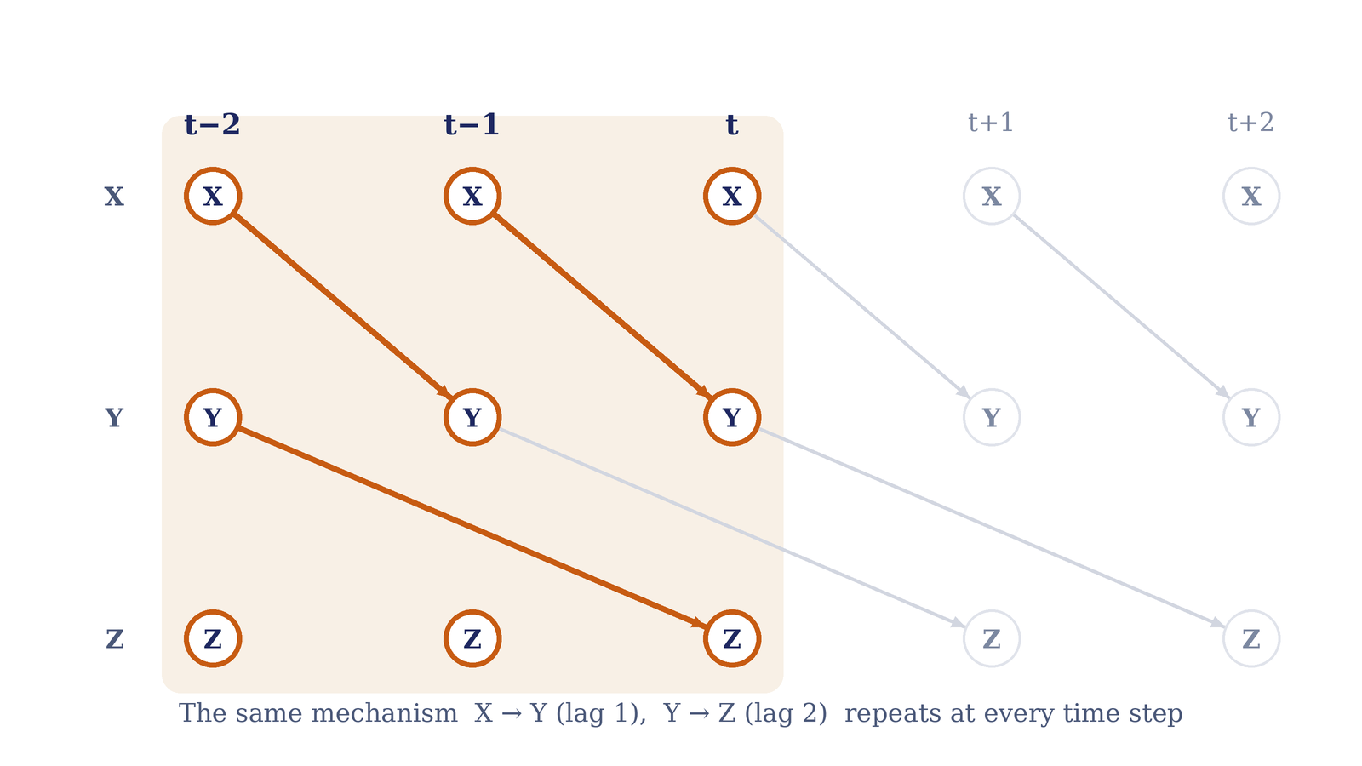
8 / 20

Slide 9
Standard PC doesn't scale
Variable count explodes
Wasted CI tests
Autocorrelation saps power
Even under stationarity the candidate parents set is every (variable, lag) pair:
N(τ_max+1) possible parents per node.
Standard PC would test CI of every pair
ignoring that lagged edges are oriented by time.
Time series are usually autocorrelated.
Many adjacencies means PC minimises over more cond. sets, so the statistic it lands on is small. Hence high FN, FP.
This is the problem PCMCI is built to fix.
τ_max = highest lag we choose to solve
9/ 20
Notes:
PC's cost is driven by maximum degree. For p variables with max degree k, the number of CI tests is roughly p²(p−1)^(k−1)/(k−1)!. Polynomial in p for fixed k, exponential in k. PC has always been fine on large sparse graphs; that's the whole design.
"The statistic" = the CI test statistic. val_matrix

Slide 10
Adapting PC to time
Lagged edges
Contemporaneous edges
Direction is fixed by time: past → present.
PC's collider rule and Meek's rules become trivial.
Decide: does the edge exist?
→ Reduce the question to: "who are the lagged parents of Y_{t}?"
Both endpoints sit at the same t.
Need the full machinery: CI tests + collider rule + Meek.
→ Solved separately, after the lagged parents are found.
10 / 20

Slide 11
PCMCI Algorithm
Narrow down each variable's lagged parents, then test edges using those parents as the conditioning set.
1
PC₁ - find a superset of lagged parents per variable
A scaled-down PC that only looks at lagged candidate parents.
Output: for each variable Y, a list of (X, lag) pairs that might directly cause Y.
2
MCI - momentary conditional independence test
For every candidate edge from step 1, do one final CI test, conditioning on the lagged parents of both endpoints. This removes indirect associations and gives the final graph and p-values.
11 / 20
Notes:
This list is deliberately conservative, tolerates some false positives to keep false negatives as low as possible.

Slide 12
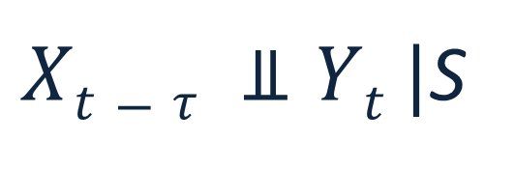


PCMCI - STEP 1
PC₁: who are $Yt$'s lagged parents?
Run PC's pruning phase for the variable $Yt$ in question.
For each variable Y in the system:
The CI test at each step:
Initialise candidates: all (X, lag) with lag = 1, ..., τ_max
Start with the strongest correlations.
Iteratively test Y ⊥ (X, lag) | S with growing conditioning sets S ⊆ candidates.
Drop (X, lag) the moment a separating S is found.
Keep the survivors as $\hat{P}(Y)$, the lagged parent superset.
$Xt−τ ⫫Yt |$S
where τ is lag of interest
Output: $\hat{P}(Y)$
A small set of (X, lag) pairs that are the strongest candidate lagged parents of Y. Used as the conditioning set in step 2.
12 / 20

Slide 13
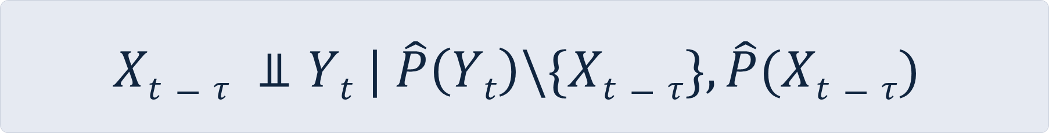
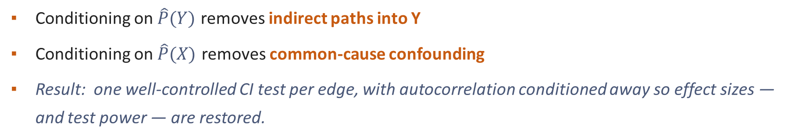
PCMCI - STEP 2
MCI
Condition on the lagged parents of BOTH endpoints
$$Xt−τ ⫫Yt | \hat{P}\left(Yt\right)\backslash \{Xt−τ\}, \hat{P}(Xt−τ)$$
Momentary Conditional Independence test:
Why condition on both sides:
Conditioning on $\hat{P}(Y)$ removes indirect paths into Y
Conditioning on $\hat{P}(X)$ removes common-cause confounding
Result: one well-controlled CI test per edge, with autocorrelation conditioned away so effect sizes — and test power — are restored.
13 / 20
Notes:
to break confounding paths and condition away autocorrelation.
spurious correlation from a shared parent

Slide 14
MCI CONDITIONING
The MCI conditioning set
Testing X → Y at lag 1. Orange = the parents of BOTH endpoints, the set we condition on.
t−2
t−1
t
Reading this picture
X
Navy dashed edge: the candidate edge being tested, X→Y at lag 1.
Orange nodes: the conditioning set, the lagged parents of both endpoints.
Navy nodes: the two endpoints of the candidate edge.
Grey nodes: not used in this particular test.
Y
Z
14 / 20

Slide 15
PCMCI output
A graph, a strength matrix, and a p-value matrix.
Graph
val_matrix
p_matrix
An N × N × (τ_max + 1) array. Each entry says whether X at timestamp τ has a directed edge to Y at timestamp 0.
Same shape, holding the test statistic (e.g. partial correlation) for each edge. Use it as a measure of edge strength.
Same shape, holding the p-value of each MCI test. Threshold this at alpha (with or without FDR) to decide which edges count.
Important: The strength values are CI test statistics (not causal effect sizes). For interventional effect estimates, see causal-effect tools in Tigramite.
15 / 20

Slide 16
PCMCI example case
What PCMCI recovers on simulated data
A longer simulated series (600 steps) with a known X → Y → Z structure planted in — PCMCI recovers exactly it, and nothing spurious.
self-loops = autocorrelation (own past)
val_matrix
p_matrix
X → Y
val 0.53
p < 1e-40
X
Y
Z
Y → Z
val 0.50
p < 1e-38
lag 1
lag 1
self-loops
val 0.4–0.5
(autocorr.)
Recovered: X → Y → Z, each at lag 1
No X → Z edge.
X and Z are correlated, but only through Y. Conditioning on Y’s lagged parents screens it off — exactly what MCI is for.
Strengths are CI test statistics, not effect sizes (Slide 16).
16 / 20

Slide 17
VARIANT
PCMCI⁺: handles contemporaneous links
Plain PCMCI finds only lagged edges. PCMCI⁺ recovers the full lagged + contemporaneous graph, and is the recommended default.
Use PCMCI⁺ when the sampling rate is slow relative to causal propagation
e.g. fMRI TR ≈ 2s, but neural causal effects propagate in milliseconds.
What’s added on top of PCMCI:
Run PC₁ first (same as before) to find lagged parents.
Then a contemporaneous PC phase: a skeleton phase over lag-0 adjacencies, but each test is an MCI test conditioning on the lagged parents of both endpoints. So autocorrelation is controlled here too.
Apply collider rule + Meek’s rules to orient lag-0 edges. Contemporaneous links are recovered only up to their Markov equivalence class, so some stay undirected.
17 / 20

Slide 18
Simulated vs real data
Time series are everywhere. E.g., resting-state fMRI datasets
Our simulated toy series
BSNIP
3 variables, 5 time points
Hand-crafted to demonstrate the algorithm.
Small enough to enumerate every CI by hand.
53 ICA components - the variables
230 timepoints per scan - TR ≈ 2 seconds
939 subjects
18 / 20

Slide 19
PCMCI on real data
Tigramite’s ‘multiple’ mode handles many subjects as separate realizations of one process.
Usage
Hyperparameters
dataframe = DataFrame(
data,
analysis_mode='multiple',
var_names=var_names,
)
pcmci = PCMCI(
dataframe=dataframe,
cond_ind_test=ParCorr(),
)
results = pcmci.run_pcmci(
tau_max=1,
pc_alpha=0.05,
alpha_level=0.01,
max_conds_dim=5,
)
tau_max: max lag to test. Start at 1.
pc_alpha: regularization for PC₁ pruning.
alpha_level: threshold for the final graph.
max_conds_dim: cap on conditioning set size - the biggest runtime knob.
Start with a subset of subjects to validate before the full run.
cond_ind_test: ParCorr assumes linear, Gaussian dependence; swap in GPDC or CMI for nonlinear effects. The graph is only as good as this fit.
19 / 20

Slide 20
Overview
We can now do causal discovery on time series, assuming stationarity, faithfulness + Markov, a chosen CI test, and causal sufficiency.
Today’s additions
Lecture 3: when assumptions break
Time series = sequences of multivariate measurements.
Time-series graph + stationarity make pooling possible.
PCMCI = PC₁ lagged-parent pruning + MCI test per edge.
PCMCI⁺ recovers lagged + contemporaneous links (the default).
PCMCI assumes causal sufficiency: no hidden common causes.
In brain imaging that’s optimistic - many drivers are unobserved.
Next: FCI (Fast Causal Inference) and how it handles latents.
20 / 20
Notes:
Causal sufficiency is fragile.

