Slide 1



MLOPs in the cloud and beyond
Prathyush Reddy Girish Mittapalle

Slide 2
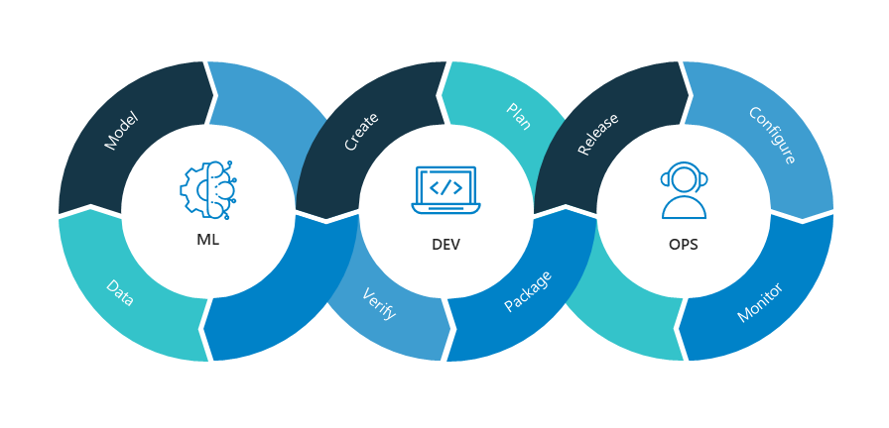
MLops - What?
MLOps stands for Machine Learning Operations.
MLOps is a core function of Machine Learning engineering, focused on streamlining the process of taking machine learning models to production, and then maintaining and monitoring them

Slide 3
Why MLops?
Accelerate the development, deployment, and management of machine learning models
Reduce time-to-market
Monitor and improve the performance of machine learning models
Improve the quality of models
Helps to scale ML workflows to handle lage datsets and models easily.
Reproducibility of experiments is easy using version controls.
Build and manage machine learning projects efficiently

Slide 4

Automating ML Workflows using SageMaker

Slide 5
What is Sagemaker?
A fully managed service that enables Data Scientists and developers to quickly and easily build machine-learning based models into production smart applications.

Slide 6
EC2 | SAGEMAKER
EC2 instances are general-purpose virtual machines that can be used for a wide range of computing tasks. | SageMaker is a specialized service for machine learning (ML) workflows.
EC2 instances are essentially virtual machines that you have to configure, manage, and maintain yourself. | SageMaker is a fully managed service. AWS takes care of the underlying infrastructure, including ML frameworks, libraries, and scaling.
When you use EC2 for machine learning, you need to set up your own machine learning environment, install the necessary libraries, and manage dependencies. | SageMaker provides pre-configured Jupyter notebooks and also offers built-in support for popular ML frameworks, making it easier to develop and train ML models.
While EC2 instances can be scaled vertically (by changing the instance type) or horizontally (by launching additional instances), you are responsible for managing the scaling process. | It provides built-in tools for training distributed models across multiple instances and supports automatic model deployment, making it easier to scale your ML workloads.
EC2 is suitable for a wide range of use cases, including web hosting, application servers, database hosting, and general-purpose computing tasks. | SageMaker is specifically designed for machine learning tasks such as data preparation, model training, hyperparameter tuning, and model deployment.

Slide 7
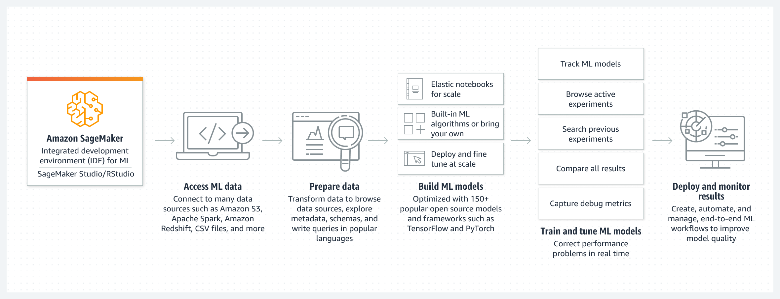
How it works: Amazon SageMaker MLOps

Slide 8
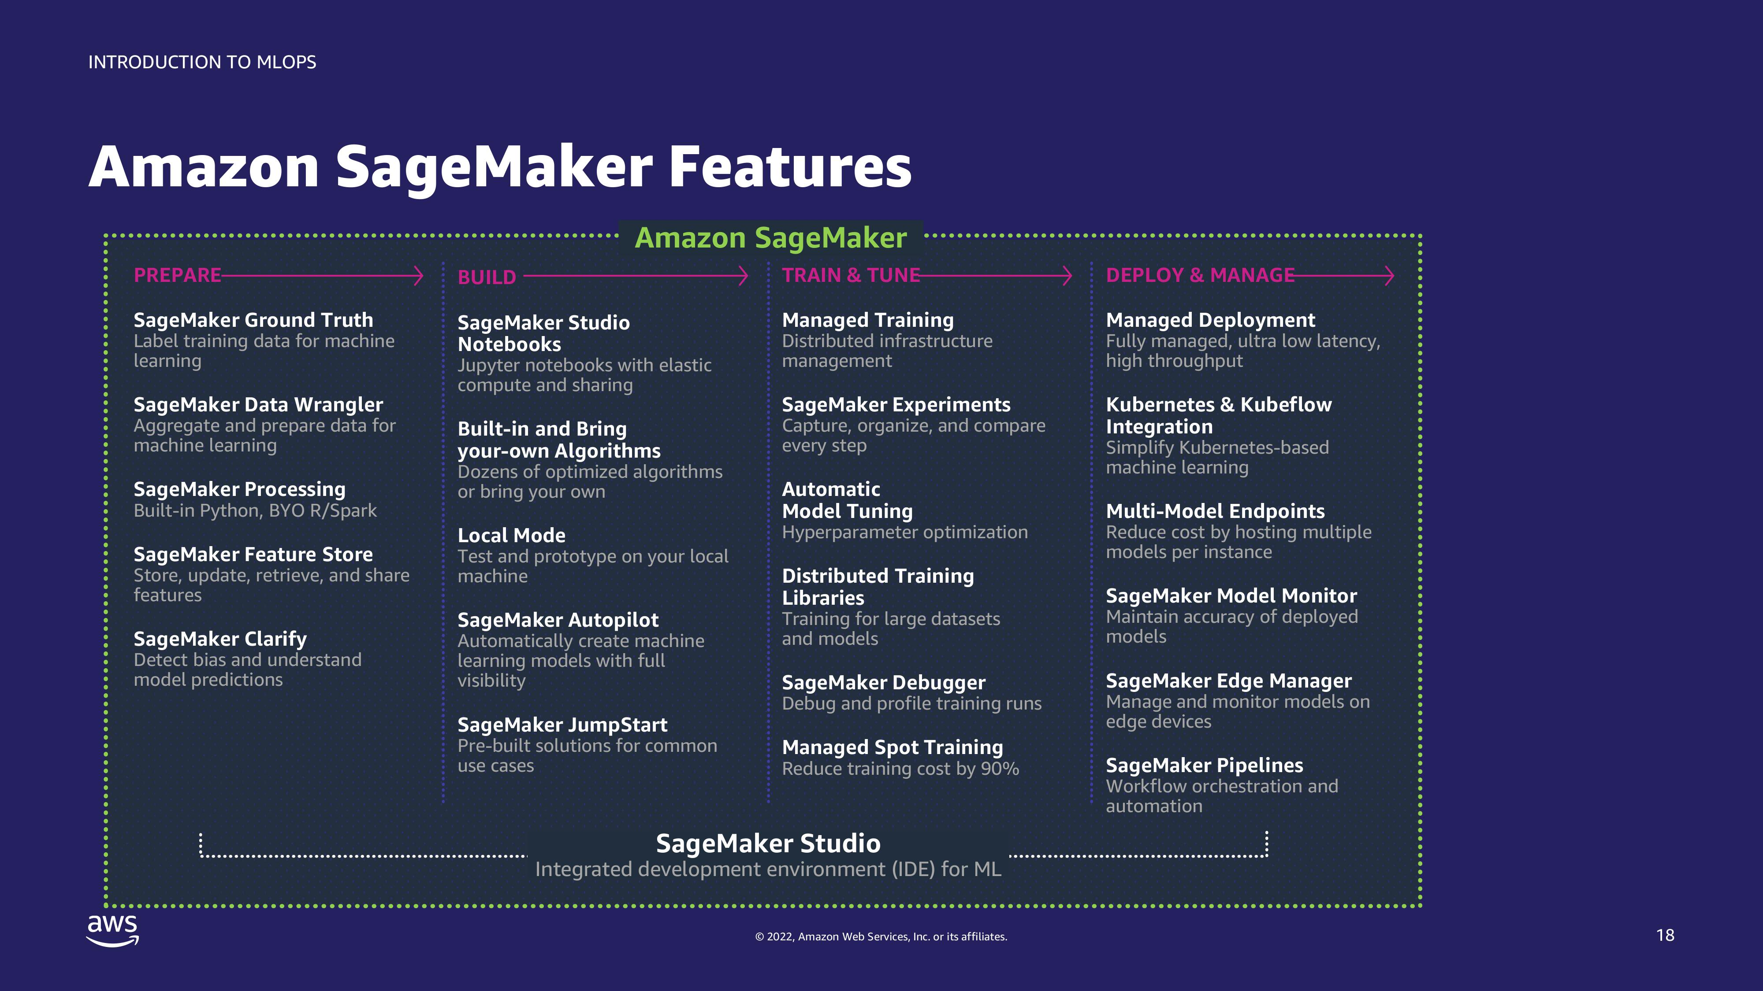
Amazon SageMaker Features

Slide 9

LETS START THE DEMO

Slide 10
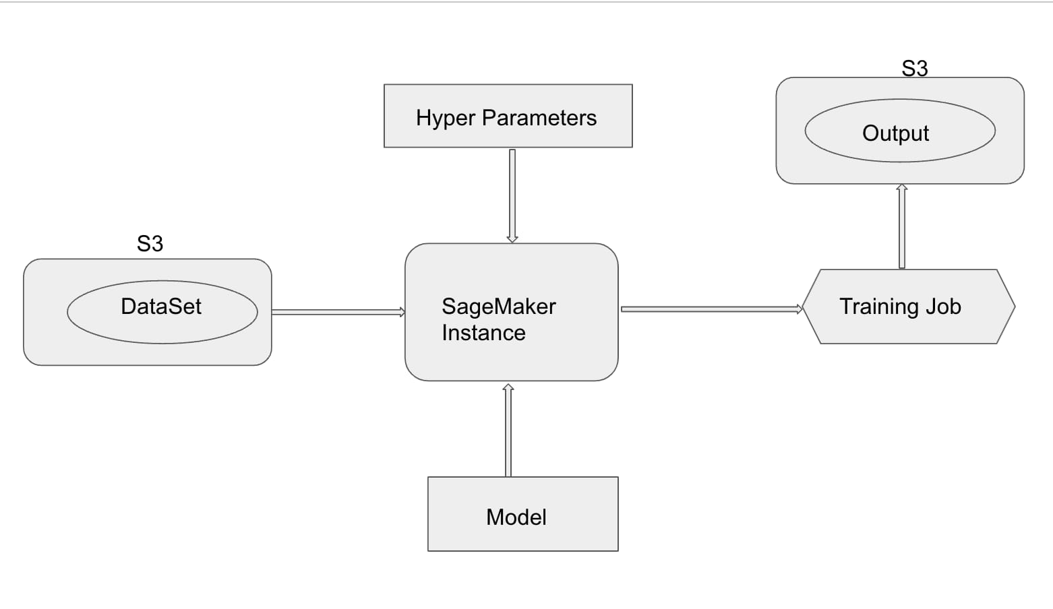
DEMo Architecture

Slide 11
References
https://www.databricks.com/glossary/mlops
https://www.arrikto.com/mlops-explained/
https://neptune.ai/blog/mlops

Slide 12

Thank You

