Slide 1
Causal Discovery
Lecture 3 - Fast Causal Inference (FCI)
What if some variables are not measured?
Presenter: Selim Süleymanoğlu
Consultant: Joanne Wardell

Slide 2
RECAP
PCMCI rested on four assumptions
FCI breaks the first one.
1. Causal sufficiency every common cause of two measured variables is itself measured
DROPPED TODAY
2. Stationarity the mechanism does not change over time
3. Faithfulness + Markov independencies in data match separations in the graph
4. A chosen CI test e.g. partial correlation for linear, Gaussian dependence
2 / 27

Slide 3
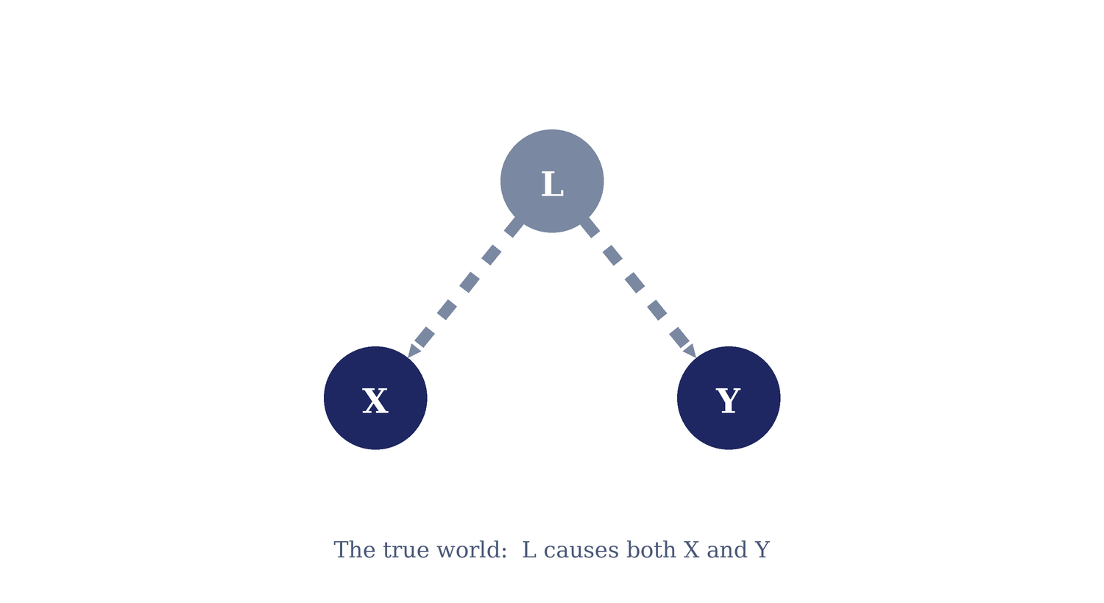
THE PROBLEM
What a hidden cause does
Drop the hidden variable and its confounding leaks out as a false edge.
3 / 27

Slide 4
WHY A DAG ISN'T ENOUGH
Different worlds, same data
With latents allowed, several causal structures imply the exact same observed independencies.
X → Y
X ← L → Y
both
direct cause
hidden common cause
direct + hidden cause
If all three can produce the same set of CIs among the observed variables, no CI-based method can tell them apart.
The output must say which features are shared by all of them and leave the rest undecided.
4 / 27
Notes:
If all three can produce the same set of CIs among the observed variables, no CI-based method can tell them apart. The output must say which features are shared by all of them and leave the rest undecided.

Slide 5
Mixed graph: A graph where every edge is directed (→), bidirected (↔), or undirected (—) and there is at most one edge per node pair.
Ancestral graph:
No directed cycle
No almost directed cycle i.e. no B ↔ A with A ∈ An(B) (a bidirected edge between a vertex and its own ancestor is forbidden)
For any undirected edge V1—V2, V1 and V2 have no parents or spouses
5 / 27

Slide 6
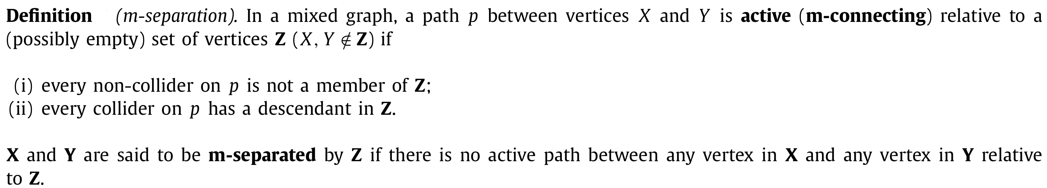
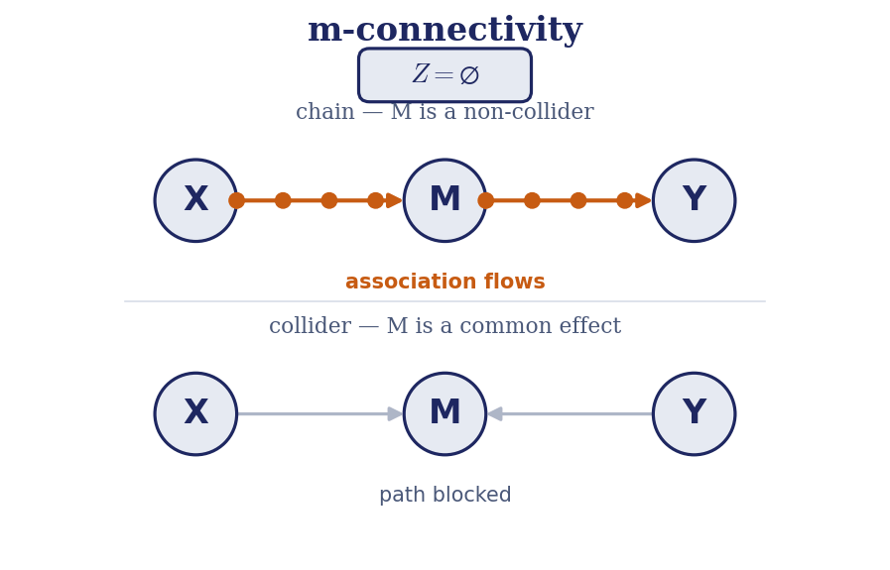
6 / 27

Slide 7
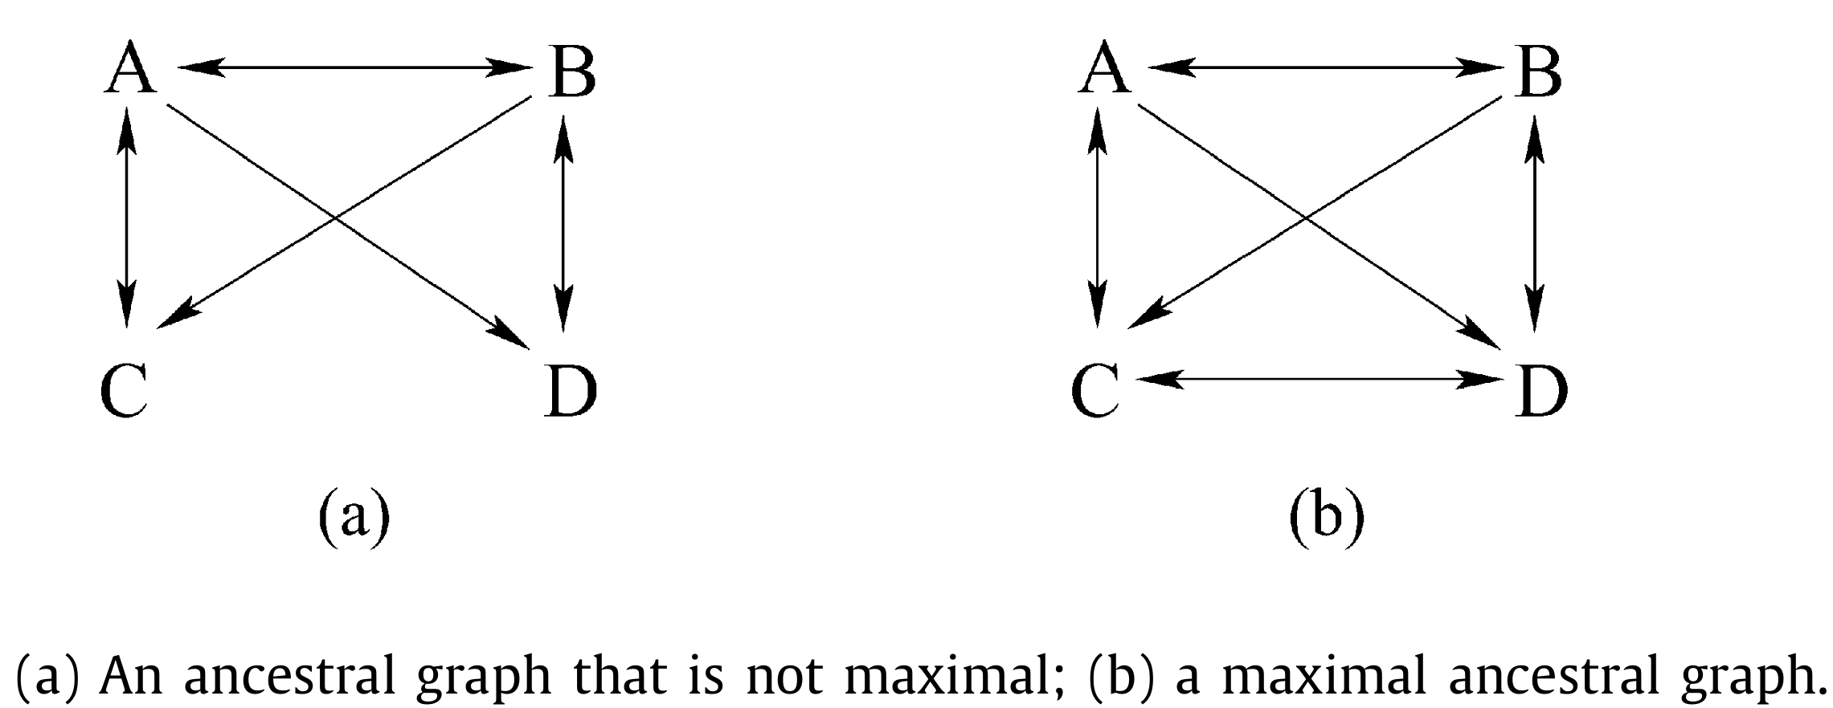
Maximality: An ancestral graph is said to be maximal if for any two non-adjacent vertices, there is a set of vertices that m-separates them.
Maximal Ancestral graph (MAG): An ancestral graph that is also maximal.

Slide 8
Partial Ancestral graph (PAG): One graph representing a whole Markov-equivalence class of MAGs. Marks are tail, arrowhead, or circle;
  tails and arrowheads are shared by every MAG in the class,
  circles mark where they disagree.
The circle mark “○”
An endpoint drawn as a circle means undetermined: across the equivalence class it could be a tail or an arrowhead.
8 / 27

Slide 9
MAGs
A MAG keeps only the observed variables but adds a second edge type to encode latents.
Two kinds of edge
What “maximality” gives
Every missing edge corresponds to a real CI.
Edges encode ancestry. X → Y can hide a longer path.
Built from a true DAG by hiding the latent variables.
MAGs can also encode selection bias; the time-series version (Lecture 4) assumes it away.
X → Y : X is an ancestor (cause) of Y — possibly indirect.
X ↔ Y : neither causes the other; a hidden common cause confounds them.
9 / 27
Notes:
Look up def of Maximal, selection bias

Slide 10
READING A PAG
Each endpoint is a tail (–), an arrowhead (>), or a circle (○).
X → Y
X is an ancestor of Y in every MAG in the class.
X ↔ Y
Neither is an ancestor of the other. There is a latent common cause.
X ○→ Y
Y is not an ancestor of X, but whether X causes Y or they’re confounded is undecided.
X ○–○ Y
Fully undetermined.
10 / 27

Slide 11
WORKED EXAMPLE
From hidden truth to PAG
FCI never sees the DAG. Its input is the data’s independencies over X, Y, Z, W; its output is the PAG.
L
X
Y
FCI
X
Y
Z
W
Z
W
True DAG. Unseen by the algorithm. L=latent.
PAG = FCI’s output
The artifact edge becomes X ↔ Y: FCI reports “confounded, not causal,” exactly the thing a plain DAG could not express.
11 / 27

Slide 12
FCI in four phases
Source. Constraint-based, like PC but latent-aware.
Start from the fully connected graph; remove an edge when some conditioning set makes the pair independent.
1
Skeleton
2
Collider orientation
Orient unshielded triples A ○–○ B ○–○ C as colliders when B is not in their separating set. Provisional — these serve only to make Possible-D-Sep computable.
3
Possible-D-Sep removal
Re-test edges against the larger Possible-D-Sep sets, then reset every edge to ○–○ and re-determine colliders from the updated separating sets.
4
Orientation rules
Apply the FCI rules to place every forced arrowhead and tail.
12 / 27
Notes:
Time series: temporal corr. Always have to look at two rows.
PC: all edges instantaneous. Does not analyse time series.

Slide 13
FCI PHASE 1
Build the skeleton
Prune edges by CI, recording separating sets.
Start fully connected: every pair of observed variables joined by a circle–circle edge X ○–○ Y.
For growing conditioning-set size n = 0, 1, 2, … test each adjacent pair against subsets of their neighbours.
When a separating set is found, delete the edge and store the set in Sepset(X, Y) to be reused for orientation.
This outer loop over n is exactly the part anytime-FCI will let us cut short.
13 / 27
Notes:
Identical in spirit to PC.

Slide 14
FCI PHASE 2
Orient the colliders
The same collider logic as PC, now drawn with circle endpoints.
Take every unshielded triple A ○–○ B ○–○ C (A and C not adjacent).
If B is not in Sepset(A, C), the path goes through a collider: put arrowheads into B.
Circle tails stay circles — we only commit the arrowheads the data forces.
A
C
B
A ∗→ B ←∗ C when B ∉ Sepset(A,C)
∗ is a metasymbol for any endpoint mark.
14 / 27

Slide 15
FCI PHASE 3
Possible-D-Sep (the latent complication)
Why FCI needs a second, more expensive pruning that PC does not.
With latents, two variables can be independent only when conditioning on nodes that are not their graph neighbours. PC would miss these.
FCI computes Possible-D-Sep(X, Y): nodes reachable by a path where every consecutive triple is either a collider or a triangle.
It re-tests each surviving edge against subsets of this larger set, removing more false edges and updating the separating sets.
This is where FCI's cost explodes: Possible-D-Sep can be large, and the conditioning sets it generates are exactly the low-power, high-cost tests anytime-FCI targets.
15 / 27

Slide 16
FCI PHASE 4
Orientation rules
Collider rule step F — arrowheads into an unshielded middle node
No cycles step G(i) — an arrowhead rather than a directed cycle
Away from collider step G(ii) — a tail, to avoid a new unshielded collider
Propagate arrowhead step G(iv) — one arrowhead across a directed edge
Double collider step G(iii) — an arrowhead, using a fourth vertex
Discriminating path step G(v) — a collider or a definite non-collider
Applied repeatedly until nothing changes. Given an oracle each rule only adds certainty and never reverses an earlier mark — but on finite samples two rules can demand opposite marks at the same endpoint, which is why tigramite writes a conflict mark x–x instead.
16 / 27
Notes:
A discriminating path is
a specific path configuration that FCI uses to resolve one stubborn ambiguity: given a triple where it can't otherwise tell whether the middle node is a collider, the path provides the missing leverage.

Slide 17
The next three slides state rules using notation that never appears in a PAG itself.
∗ does two different jobs. In a rule's antecedent it matches any mark. The rule fires whichever of –, > or ○ sits there. In a rule's consequent it means leave that mark exactly as it was. So “orient α ∗→ γ” says: write an arrowhead at γ, touch nothing at α. That is why every rule writes at most one endpoint.
Sepset(α, β) is a record, not a concept. It is the conditioning set that made α and β independent at the moment their edge was removed. Not “any set that separates them”. The collider rule and the discriminating-path rule both test membership in that set; querying others by majority vote gives different answers and costs completeness.
Underlining marks a vertex, not an endpoint. K ∗–∗ J ∗–∗ H with J underlined says J is a definite non-collider on that path. This is Spirtes' device only — Zhang drops it and orients a tail instead. Do not mix the two conventions.
17 / 27

Slide 18
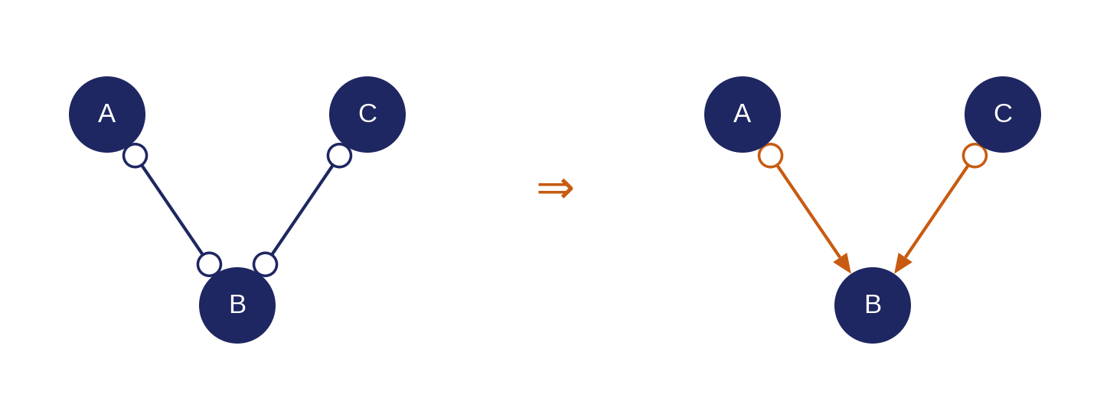
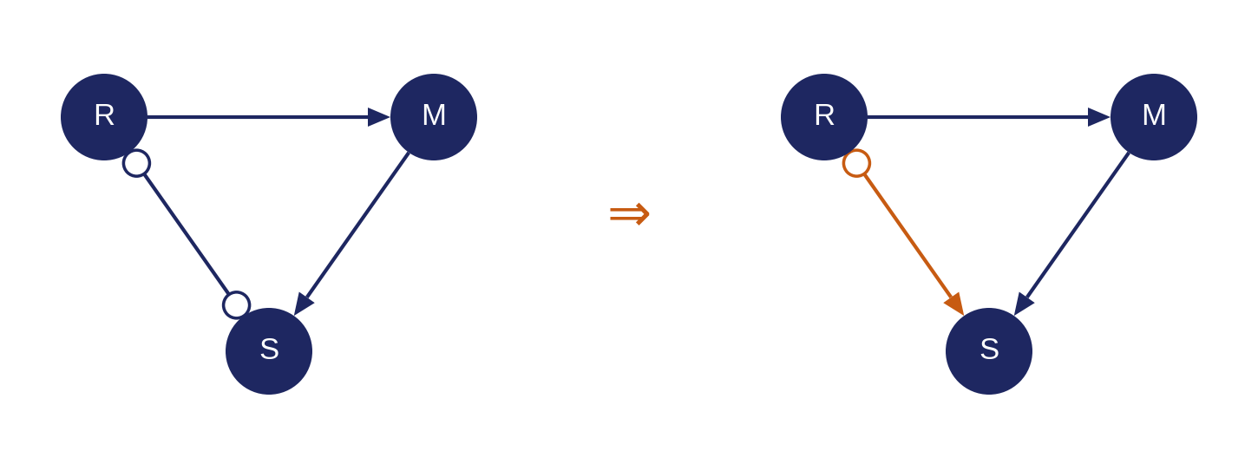
FCI PHASE 4
Orientation rules
Spirtes (2001) states the orientation phase as step F plus five rules in step G. Orange marks the endpoint each rule writes.
1. Collider rule step F · Zhang R0
For every unshielded triple A ○–○ B ○–○ C: if B ∉ Sepset(A,C), put an arrowhead at B from both sides.
The only rule here that reads the separating sets rather than the graph.
2. No cycles step G(i)
If a directed path runs R ⇒ S and R ∗–∗ S is an edge, put an arrowhead at S.
Otherwise the edge would close a directed cycle. Generalises Zhang's R2 to paths of any length.
18 / 27

Slide 19
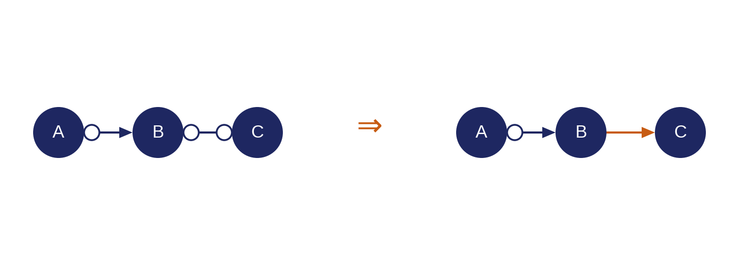
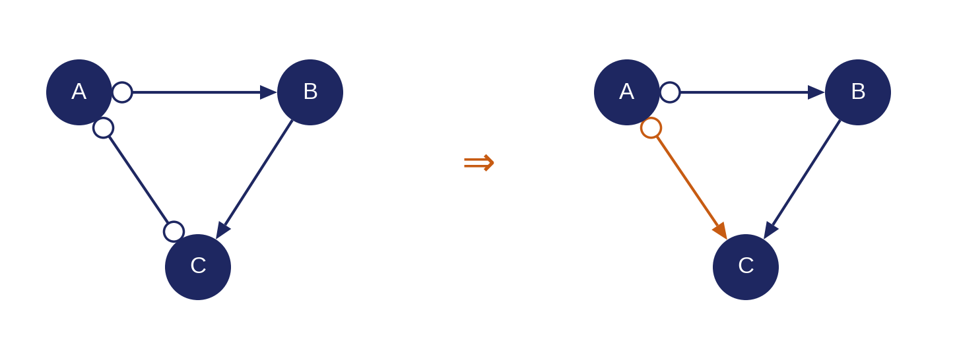
FCI PHASE 4
Orientation rules
Each rule writes exactly one endpoint and leaves the other end as it found it. That is what the ∗ in a rule's conclusion means.
3. Away from collider step G(ii) · Zhang R1
If A ∗→ B ○–∗ C and A, C are not adjacent, orient B → C — tail at B, arrowhead at C.
Otherwise B would become a new unshielded collider. The 2001 write-up omits the non-adjacency clause; Zhang's R1 states it, and the rule is unsound without it.
4. Propagate arrowhead step G(iv) · Zhang R2
If A ∗→ B → C and A ○–∗ C, put an arrowhead at C.
It adds one mark only. It does not claim A is an ancestor of C — the A end stays a circle.
19 / 27

Slide 20
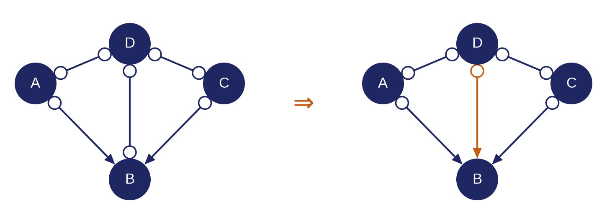
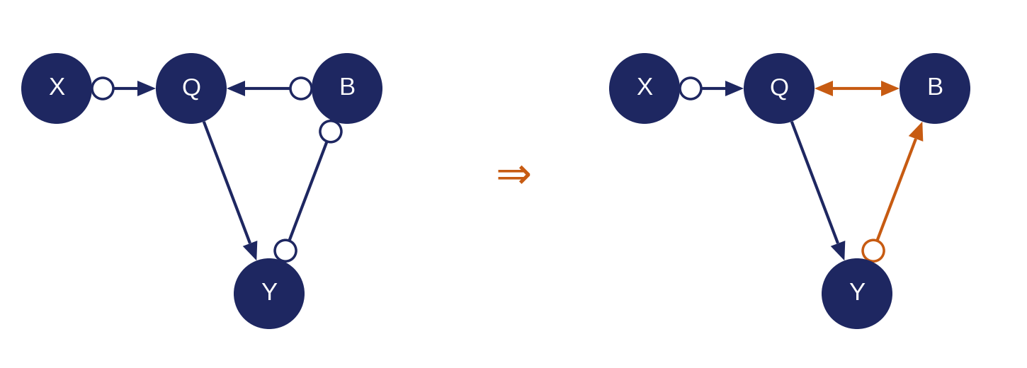
FCI PHASE 4
Orientation rules
The last two rules need more than a triple: first four vertices, then a whole path.
5. Double collider step G(iii) · Zhang R3
Collider at B via non-adjacent A and C, with D adjacent to A, C and B and a non-collider on ⟨A,D,C⟩: put an arrowhead at B.
6. Discriminating path step G(v) · Zhang R4
On a discriminating path for B: if B ∈ Sepset(X,Y), mark B a definite non-collider; otherwise orient Q ∗→ B ←∗ Y.
Nonlocal. The leverage comes from the path, not from B's neighbours. This is the expensive one. It can make LPCMCI stall in ER-09/ER-10.
20 / 27

Slide 21
Four terms Zhang's rules need (Source)
R5–R10 are stated in a slightly larger vocabulary than Spirtes' six.
Zhang's PAGs add – and ○– to the four on slide 7. Both can only arise under selection bias, which is exactly what R5–R7 are for. Assume selection bias away and we stay in the four-type world.
Invariant vs variant mark. A mark is invariant when every MAG in the class agrees on it. A PAG is sound if all its non-circle marks are invariant; it is maximally informative if, in addition, every circle really is variant. Completeness is the claim that no circle hides an invariant mark.
Uncovered path. A path is uncovered when every consecutive triple along it is unshielded. Keep the words apart: unshielded is for triples, uncovered is for paths.
Potentially directed path. A path that could be turned into a directed path by resolving its circles: No edge points into its earlier endpoint or out of its later one. R9 and R10 range over uncovered p.d. paths; weakening this to “directed” breaks completeness.
21 / 27

Slide 22
What Spirtes' six rules leave out
Spirtes (2001) says plainly that it was not known whether FCI's PAG captures every ancestor relation shared across the O-equivalence class.
Zhang (2008) settled it by adding rules R8, R9 and R10 that write tails. Spirtes' six write arrowheads almost exclusively; the tail rules are what was missing.
  R8: A → B → C with A ○→ C gives A → C.
  R9 and R10 recover tails from uncovered potentially-directed paths.
R5–R7 exist only to handle selection bias. Lecture 4 assumes it away, so the operative set is R0–R4 plus R8–R10.
22 / 27

Slide 23
COST
FCI is worst-case exponential
The price of latent-awareness lands in the conditioning and path search.
The number of CI tests can grow exponentially with the number of variables. Possible-D-Sep produces large conditioning sets.
Large conditioning sets are doubly bad: slow to compute and statistically low-powered, so accuracy drops on finite samples.
The orientation rules add their own path enumeration, which is super-polynomial on dense graphs.
Sound and complete in the large-sample limit; but feasibility is the practical constraint.
23 / 27

Slide 24
MAKING IT TRACTABLE
Anytime FCI
Spirtes (2001): you can stop early and still be correct — just less informative.
Cap the conditioning-set size: halt the outer loop at some n. This drops exactly the largest, lowest-power tests.
The output stays sound: Every orientation it reports is still correct in the large-sample limit.
It is merely less complete: More endpoints stay as circles. The graph answers “can’t tell” more often.
Orientation can likewise be interrupted: once an edge is oriented, FCI never reverses it.
24 / 27

Slide 25
FCI's output
Which variables are definitely not ancestors of others (arrowheads).
Where a latent confounder must exist (bidirected edges).
Which questions are simply undecided (circles).
Doesn’t effect sizes. A PAG carries no intervention magnitudes.
It’s an equivalence class.
For effects under latents, we need explicit identification methods downstream.
25 / 27

Slide 26
NEXT LECTURE
Lecture 4: FCI meets time series
LPCMCI = FCI's latent machinery + PCMCI's autocorrelation trick.
Back to time series but now allowing unobserved component series: e.g., realistic brain-imaging
The graph becomes a time-series PAG (DPAG): FCI's edge marks, unrolled across lags.
LPCMCI reuses FCI's orientation rules and adds PCMCI's default conditions to condition autocorrelation away.
26 / 27

Slide 27
RECAP
Dropping causal sufficiency forced a richer graph and a more careful algorithm.
Today’s ideas
Lecture 4
Latents break the DAG; MAGs add the bidirected edge ↔.
PAGs represent the Markov equivalence class; the circle = undecided.
FCI: skeleton → colliders → Possible-D-Sep → rules.
Anytime FCI trades completeness for tractability, soundly.
LPCMCI: latent causal discovery for time series.
FCI rules + PCMCI default-conditions, on a time-series PAG.
27 / 27

