Slide 1
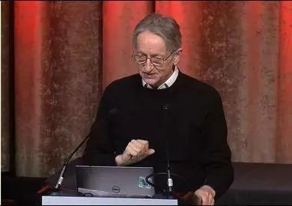

An introduction to stacked capsule autoencoders
Paper by: Adam R. Kosiorek Sara Sabour, Yee Whye Teh, Geoffrey E. Hinton
Presenter: William Ashbee
Some Presentation slides borrowed from G. Hinton and S. Sabour

Slide 2

What to expect from this presentation
Expect
More of an overview of capsules, so we know roughly what problem they are trying to solve
Discussion about capsules from people who read the paper or have prior knowledge
Don’t expect
A detailed description of every equation, section of paper, and architectural module (I tried, but didn’t have time)
This Photo by Unknown Author is licensed under CC BY-SA

Slide 3
Stacked Capsule Auto-Encoders (introduction)
Capsules are an attempt to correct all of problems of CNNs.
Every year there’s a different version of capsules.
The NeuralPS 2019 differs in many ways from previous versions in ICLR 2018 and NIPS 2017
Previous versions used discriminative learning and used matrices to represent part-whole relationships.
The 2019 version uses unsupervised learning and uses matrices to represent whole-part relationships

Slide 4
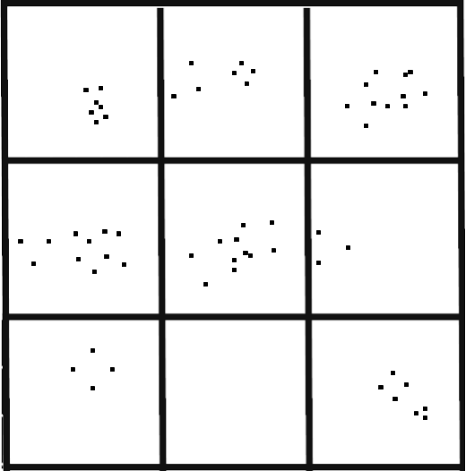
An exercise is to attempt to remember these patterns
Then attempt to draw from memory.
Draw
From
Memory
Notes:
Let’s start with a test. Take a look at these 9 pictures for 5 seconds with the intention of drawing them from memory accurately.

Slide 5
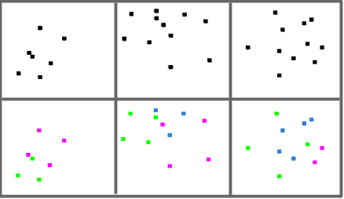
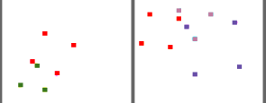
One will typically attempt to remember larger patterns when drawing from memory
Groups of 3 or 4 pixels
Sparse
Pattern
Recognition
Notes:
Ok probabely you had tried figuring out patterns and rather than memorizing the location of points you memorized the pose of the patterns to replicate the points.
Now if I ask you how did you group the points to replicate the scene accurately, probably this is your answer. Rather than grouping by vicinity or binning… which will be less accurate.
By the end of this tutorial we will know how to build an system that will do similar grouping unsupervised like this just to be efficient and accurate in reconstruction.

Slide 6








Clutter
Train
Test
(5,9)
(4,9)
(8,7)
(8,4)
(?,?)
(?,?)
(?,?)
(?,?)
(6,0)
(7,1)
(8,6)
(2,7)
Notes:
Another example of image understanding beyond simple pattern matching is in the face of occlusion. With a training set like this, How can we have a system that successfully parse this images and identify the two digits in each.

Slide 7
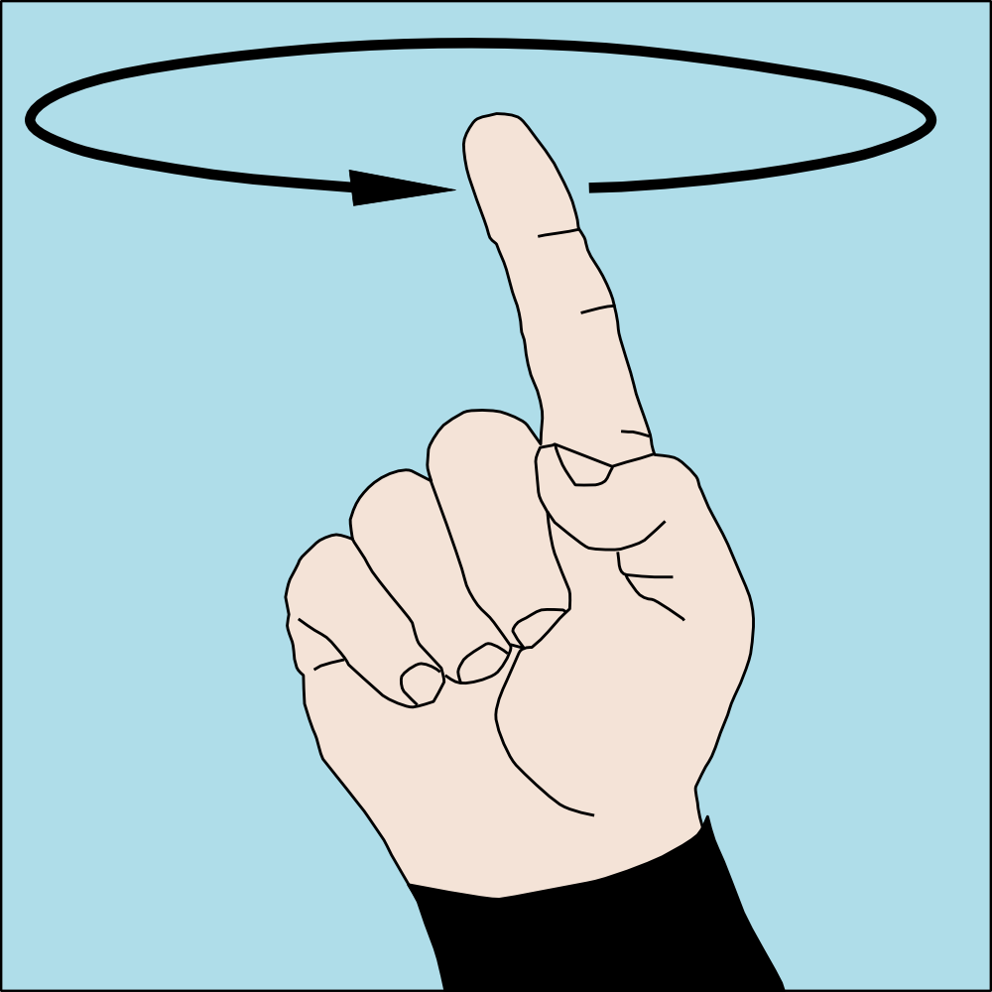












Viewpoint
Train
This Photo by Unknown Author is licensed under CC BY-SA
Test
Notes:
Last but not least how efficient can our models be dealing with different viewpoints. Assume we only get training images were objects have roughly alighned viewpoints. What is our best chance at correctly classifying them from new viewpoints?

Slide 8

Viewpoint Equivariance
Cohen and Welling. "Group equivariant convolutional networks." ICML. 2016.
This Photo by Unknown Author is licensed under CC BY-SA
Convolutional Neural Networks are translation equivariant by gridding.
Should we grid the rotation, scale, and other dimensions As well?
Notes:
A way for your model to solve this task is to have viewpoint equivarience. If you change your input your output changes accordingly. For example CNNs without stride and pooling replicate their computation over the grid of pixel positions equally and are translation equivarient. So if you move the house around it will not hurt a CNN much. But we now that a camera can take a picture from any viewpoint, should we grid all those degrees of freedom or maybe find some new basis functions and replicate filters or computations there? If we are not a fan of replicating computation or paramters we should find out what stays constant.

Slide 9
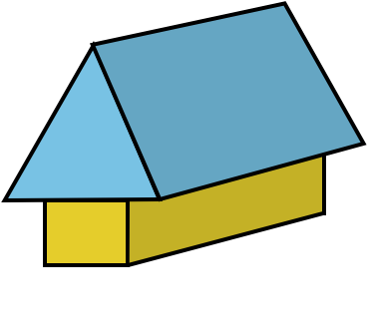
What stays constant?
Notes:
If you want to learn a single matrix or two about houses, apply it exactly the same way on all three images what is that constant. Computer graphics answer (for example photoshop vs illustrator) is to go beyond pixel space into vector space. What do I mean?

Slide 10
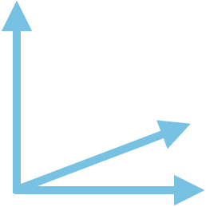

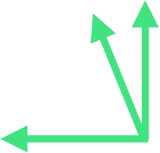
What stays constant?
Notes:
Put a coordinate frame on all the detectable objects, house , roof and the wall. Now look for the constant again. Can you see it?

Slide 11

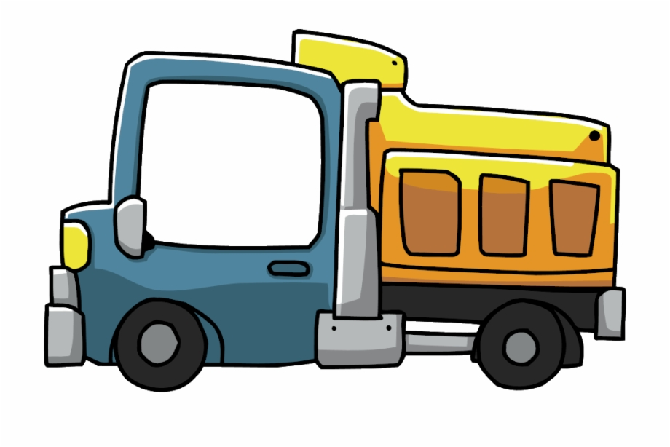
Coordinate frame
Learn how to transform coordinate frames.
Coordinate frame: capture scale, position, rotation: Geometrical aspects.
Math terms: Coordinate frame representation is a vector or a matrix (a point in ).
Math terms: Coordinate frame relation is a Transformation Matrix.
Notes:
But what is a coordinate frame? We want it to carry the viewpoint information like rotation and scale. If I ask you to put these coordinate frames on this truck and its parts you will probably imagine sth like this. How you put it is not important as long as it is consistant. For representing it mathematically we should ask how many degrees of freedom we have for putting them. I would say it needs at least 6 dimensions. So we can represent it with a vector or a matrix. What we need to learn then is The relationship between two coordinate frames which can be represented with a matrix. So now that we have decided to carry around this information in addition to whether something exists or not let’s call the bundle a Capsule.

Slide 12


Capsule
A group of neurons. Encapsulating properties of single entity.
How the entity exists: instantiation parameter.
Pose vectors
Whether the entity exists.
This Photo by Unknown Author is licensed under CC BY-SA-NC
Notes:
From now on we call a group of neurons which show both whether an entity exists and how it exists a Capsule. It can be just 6 neurons together viewed as a vector. Or 17 neurons together or 16 viewe. The core is that we call a bunch of neurons that are semantically grouped a capsule.

Slide 13
How to detect objects?
An object exists if there is agreement between multiple part predictions.
A House Exists!
Notes:
So a house exists if it has both walls and roof. We know how to transform roof capsule into a house capsule. We also know how to transform a wall capsule into a house capsule. But the house capsule only activates if both of the predictions are the same. What do we mean by this agreement or being same function?

Slide 14
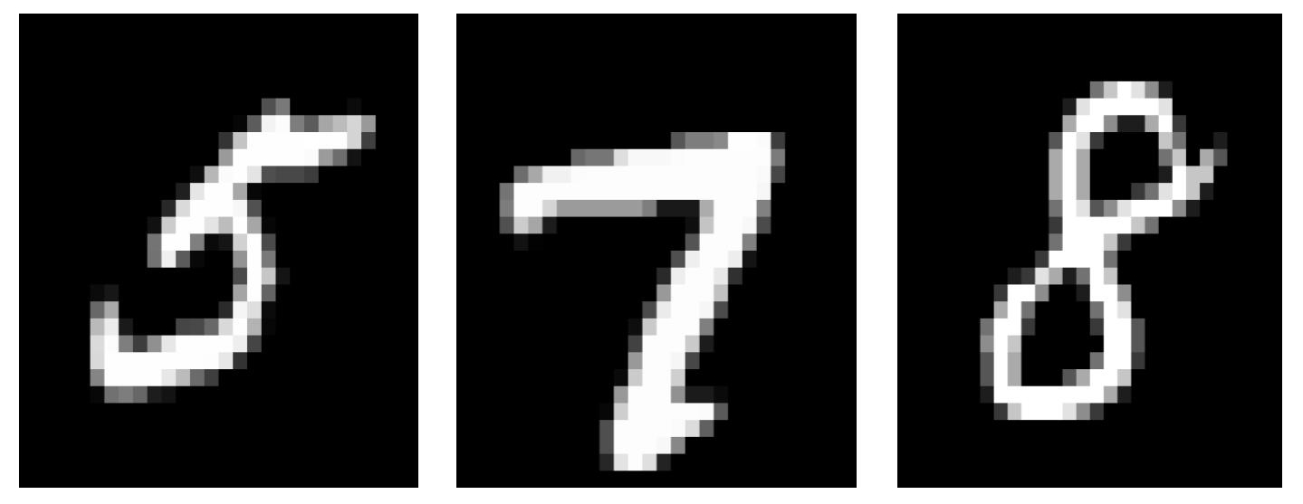
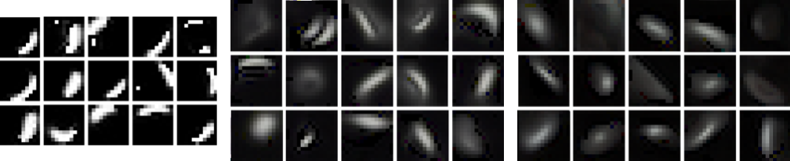
Agreement
Find agreement between predictions for capsule coordinate frames.
Notes:
So assume that you have a model that can detect these 7 parts and fill the first layer capsules with their coordinate frames. Each of the second level capsules are responsible for a higher part, for example like this and this.

Slide 15
Agreement
Find agreement between predictions for capsule coordinate frames.
Notes:
So assume that you have a model that can detect these 7 parts and fill the first layer capsules with their coordinate frames. Each of the second level capsules are responsible for a higher part, for example like this and this.

Slide 16
Agreement
Find agreement between predictions for capsule coordinate frames.
Notes:
So assume that you have a model that can detect these 7 parts and fill the first layer capsules with their coordinate frames. Each of the second level capsules are responsible for a higher part, like these parts.

Slide 17
Agreement
Find agreement between predictions for capsule coordinate frames.
Notes:
So assume that you have a model that can detect these 7 parts and fill the first layer capsules with their coordinate frames. Each of the second level capsules are responsible for a higher part, like these parts.

Slide 18

Agreement
Find agreement between predictions for capsule coordinate frames.
Notes:
If this was our image then some of the active lower capsules belong to this capsule

Slide 19
Agreement
Find agreement between predictions for capsule coordinate frames.
Notes:
If this was our image then some of the active lower capsules belong to this capsule and some of them belong to the other one. So we need to figure out who belongs to who otherwise we cannot find strong agreements. It is doable but we can be better. So we need to extract the parse tree of the scene.

Slide 20
Agreement and Assignment
Find agreement between predictions for capsule coordinate frames.
Layerwise Non-linearity
Smart Sparsity
Notes:
So we need to extract the parse tree of the scene. then a capsule will only sends its prediction to its parent. Claiming the parenthood is a layerwise nonlinearity because the parents compete with each other and the result is a smart sparsity regularizer. This is substantially different from traditional CNNs. because now in each layer

Slide 21
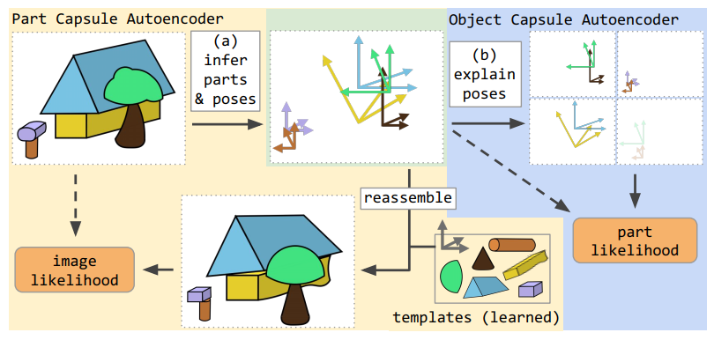
Stacked Capsule Autoencoder
(a) part capsules segment the input into parts and their poses. The poses are then used to reconstruct the input by affine-transforming learned templates.
(b) object capsules try to arrange inferred poses into objects, thereby discovering underlying structure. SCAE is trained by maximizing image and part log-likelihoods subject to sparsity constraints.

Slide 22
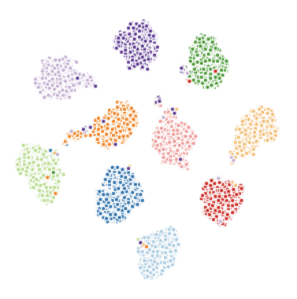
Unsupervised learning with SCAE
SCAEs learn to explain different object classes with separate object capsules, thereby doing unsupervised classification.
TSNE embeddings of object capsule presence probabilities for 10000 MNIST digits.
Individual points are color-coded according to the corresponding digit class

Slide 23

Pause!
This Photo by Unknown Author is licensed under CC BY-SA

Slide 24
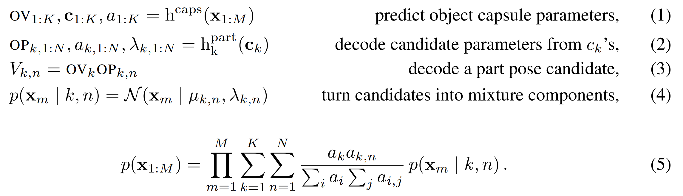
Constellation Autoencoder (CCAE)
Notes:
Let X 1-M be a set of two-dimensional input points, where every point belongs to a constellation
We first encode all input points (which take the role of part capsules) with Set Transformer hcaps based on attention mechanisms—into K object capsules An object capsule k consists of a capsule feature vector ck, its presence probability ak [0, 1]
3 × 3 object-viewer-relationship (OV) matrix, which represents he affine transformation between the object (constellation) and the viewer Every object capsule uses a separate multilayer perceptron (MLP) hpart k to predict N ≤ M part candidates from the capsule feature vector ck
Each candidate consists of the conditional probability ak,n element of [0, 1] that a given candidate part exists, an associated scalar standard deviation λk;n, and a 3 × 3 object-part-relationship (OP) matrix, which represents the affine transformation between the object capsule and the candidate part
Candidate predictions µk;n are given by the product of the object capsule OV and the candidate OP matrices.
We model all input points as a single Gaussian mixture, where µk,n and λk,n are the centres and standard deviations of the isotropic Gaussian components
The model is trained without supervision by maximizing the likelihood of part capsules in Equation (5) subject to sparsity constraints

Slide 25
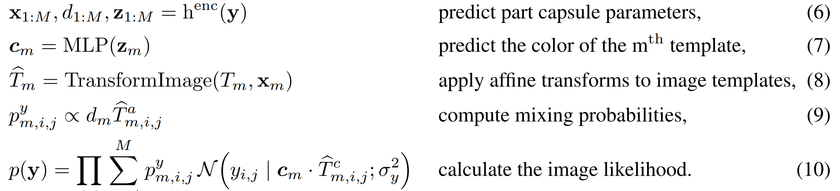
Part Capsule Autoencoder (PCAE)
Notes:
Explaining images as geometrical arrangements of parts requires 1) discovering what parts are there in an image and 2) inferring the relationships of the parts to the viewer (their pose)
For the CCAE a part is just a 2D point (that is, a (x, y) coordinate), but for the PCAE each part capsule m has a six-dimensional pose xm (two rotations, two translations, scale and shear), a presence variable dm element of [0, 1] and a unique identity
Let y element of [0, 1]h×w×c be the image
We limit the maximum number of part capsules to M
use an encoder to infer their poses xm, presence probabilities dm, and special features zm element of R^cz
Templates Tm element of [0, 1]ht×wt×(c+1) are smaller than the image y but have an additional alpha channel which allows occlusion by other templates The image is modelled as a spatial Gaussian mixture ? Not sure what this means, didn’t have time to look it up.
Training the PCAE results in learning templates for object parts, which resemble strokes in the case of MNIST

Slide 26
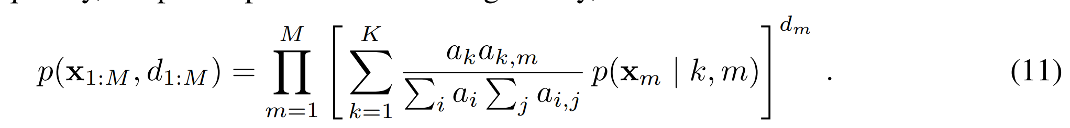
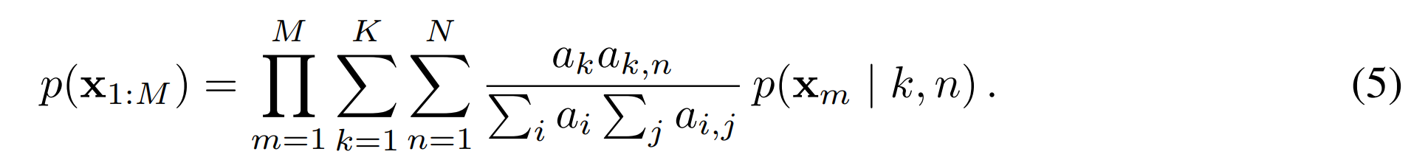
Object Capsule Autoencoder (OCAE)
Notes:
Having identified parts and their parameters, we would like to discover objects that could be composed of them
To do so, we use concatenated poses xm, special features zm and flattened templates Tm (which convey the identity of the part capsule) as an input to the OCAE, which differs from the CCAE in the following ways
Firstly, we feed part capsule presence probabilities dm into the OCAE’s encoder—these are used to bias the Set Transformer’s attention mechanism not to take absent points into account
Secondly, dms are also used to weigh the part-capsules’ log-likelihood, so that we do not take log-likelihood of absent points into account.
This is implemented by raising the likelihood of the mth part capsule to the power of dm
The OCAE is trained by maximising the part pose likelihood of Equation (11)
Therefore, every part-pose is explained as an independent mixture of predictions from object-capsules—where every object capsule makes exactly M candidate predictions Vk;1:M, or exactly one candidate prediction per part.

Slide 27
Achieving Sparse and Diverse Capsule Presences
Stacked Capsule Autoencoders are trained to maximise pixel and part log-likelihoods
If not constrained, however, they tend to either use all of the part and object capsules to explain every data example or collapse onto always using the same subset of capsules, regardless of the input (they are unstable without sparsity constraints)
See paper for a detailed discussion of sparsity constraints used to stabilize capsule training.

Slide 28
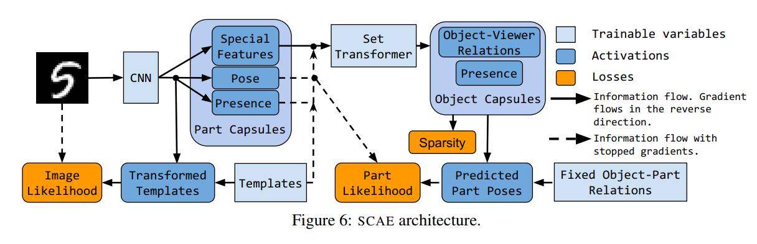
Full architecture

Slide 29
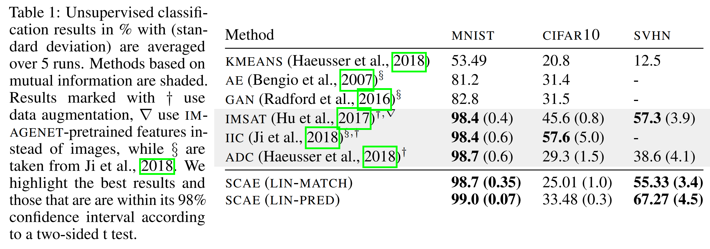
Unsupervised Classification Results

Slide 30
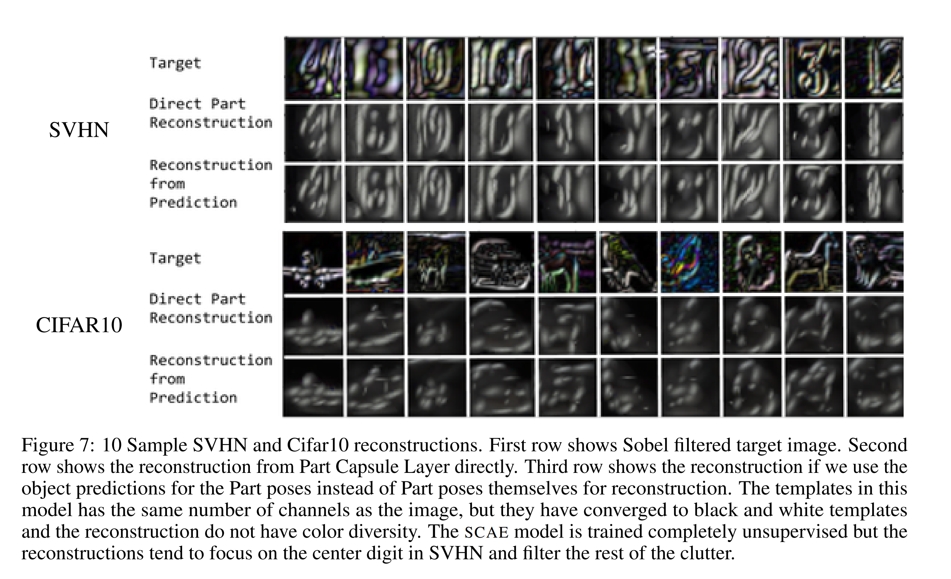
Reconstructions

Slide 31

Discussion
This Photo by Unknown Author is licensed under CC BY-NC-ND

