Slide 1
From genes to trajectories: mapping genetic influences on Huntington’s disease progression
Presented by Jordan Clemsen

Slide 2
Background

Slide 3
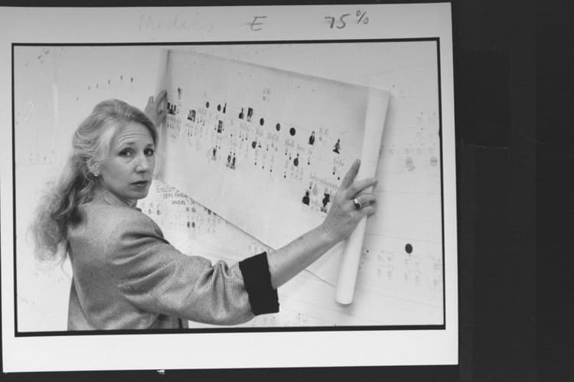
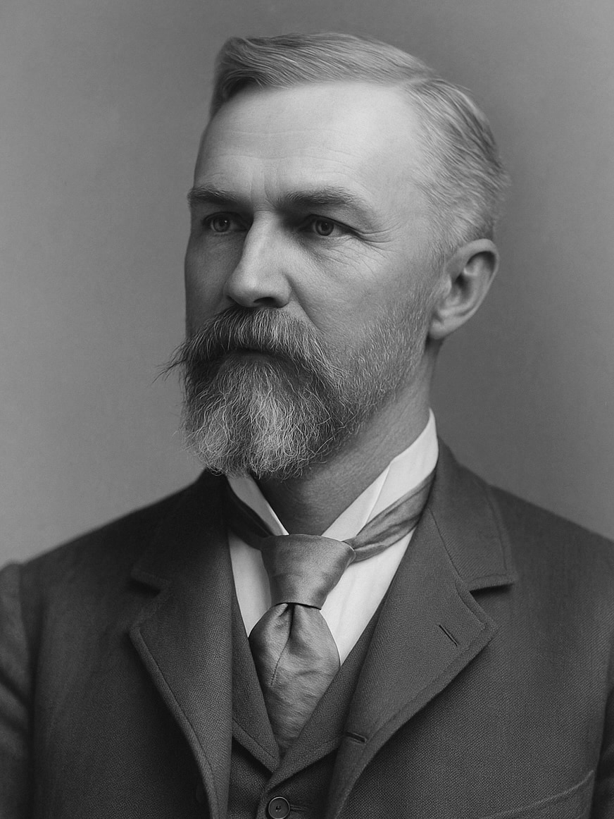
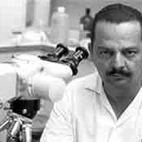
Huntington's disease history
1872 George Huntington
Chorea
Hereditary nature
Américo Negrette
Later confirmed in New York
Nancy Wexler
Chromosome 4 HTT 1979
disease burden score J/P. Penney in 1997
CAP = Age at Study Entry × (CAG Length – L) / K by Zhang et al. (2011)
(Park, 2026)
(Cadogan, 2025)
(Moscovich et al., 2011)

Slide 4
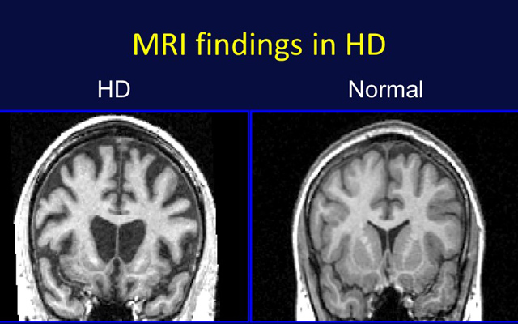
Huntington's disease pathology
CAG length x >= 27–35
Unremarkable 3-26ish
HD-ISS Stage 0,1,2,3
DNA Poly stutters
Enlarged caudate and putamen
Neurodegeneration due to mechanism unknown
Symptoms are vast!!
Treatment is symptomatic
COD suicide otherwise aspiration pneumonia
(UC San Diego Health System Named Center of Excellence for Huntington’s Disease, n.d.)

Slide 5
Methods
Do CAG length and these SNPs change how quickly a person moves between predefined clinical stages of Huntington’s disease?

Slide 6
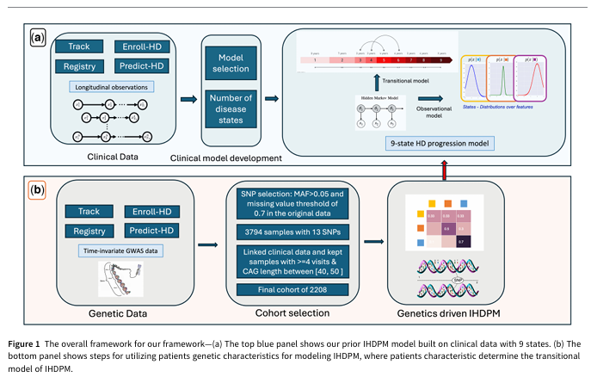
Building the clinico-genomic cohort
Enroll-HD, REGISTRY, TRACK-HD/TRACK-ON, PREDICT-HD
GWA12345
4,179 subject
Filter by linked genetic and clinical data, frequency/missingness and At least 4 longitudinal visits and CAG 40–50 to 2,208
13 SNPs
(Dey et al., 2026)

Slide 7
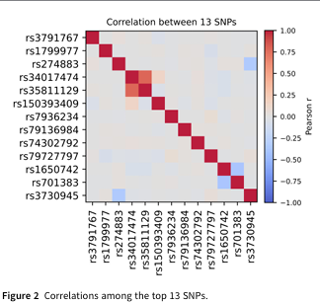
Converting 44 clinical measures into 9 clinical factors
Bayesian latent-variable analysis on some clinical scores
Integrated Huntington’s Disease Progression Model 9 factor scores
Xsubk​∣S=s∼N(μsubs,subk​,σsubs,subk​)the Sig is squared
Clinical = k
State = s
(Dey et al., 2026)

Slide 8
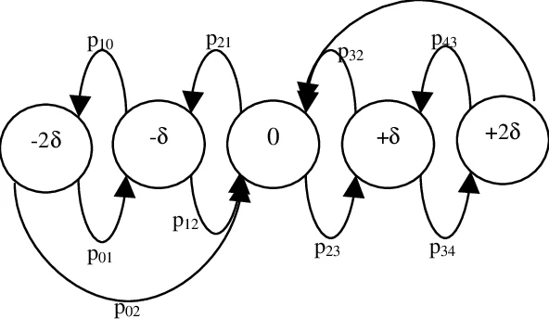
continuous-time hidden Markov model
Instantaneous state change
Obervervation model = P(Xt​∣St​)
qsubisubj​ (two state transition)
Genrator matrix for collected between states = A(δ)=exp(δQ)
exp(δQ) matrix exponential
Z transition matrix
Log of qsubisubj​(Z)=βsubisubjTsup​Z
Every state now has its own vector for genetics!!

Slide 9
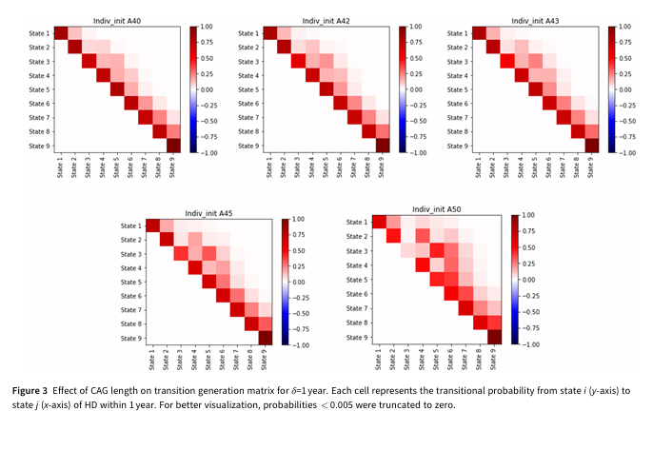
unobserved disease trajectories
Beyond clinical
Expectation-maximization algorithm
  Log likelihood expected function v then log maximization
Gives
  The probability that a participant occupied each state at each visit
  The probability of each state-to-state transition
  The expected number of transitions occurring during an interval
  The expected amount of time spent in each state
Viterbi algorithm
  Initialization
  Recursion
  termination
Most likely state path
Van Loan method
  Computes integrals for each matrix exponentials
Newton–Raphson optimization method
  Current apporx with derivative to 2nd order hessian derivative (please Google this!)
This updates the model
(Dey et al., 2026)

Slide 10
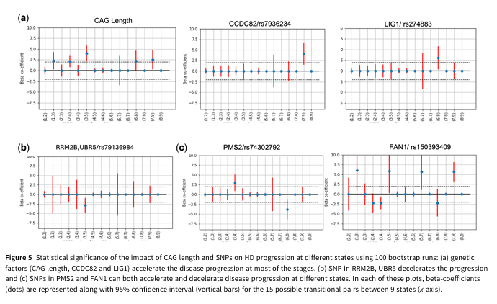
inference
Compare models
held-out predictive log-likelihood
80% training and 20% testing
Basically, less negative means better fit
Resampling to 95% confidence intervals
Hypothesis testing to compare, but w/o posthoc
Computed transition matrix (1,Z)=exp[Q(Z)]
They also ran PCA on genetic vectors and applied agglomerative clustering
(Dey et al., 2026)

Slide 11
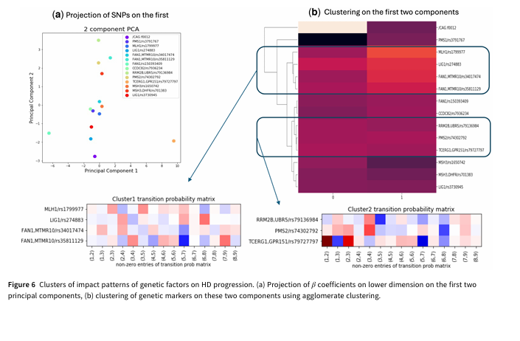
(Dey et al., 2026)

Slide 12
Results

Slide 13
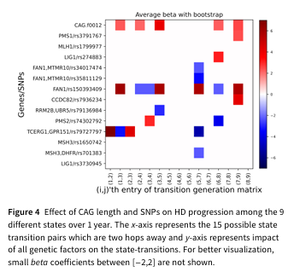
Conclusion
Higher CAG profiles broader and faster forward movement
Lower-CAG profiles remain in the same state more often
CCDC82, LIG1, RRM2B/UBR5, PMS2, and FAN1 distinct phases
MLH1, LIG1, and FAN1 clusters
(Dey et al., 2026)

Slide 14
References
Cadogan, M. (2025, February 3). George Huntington. Life in the Fast Lane • LITFL. https://litfl.com/george-huntington/
Dey, S., Sun, Z., Warner, J., Koski, E., Eyigoz, E., Sathe, S., Sampaio, C., & Hu, J. (2026). From genes to trajectories: Mapping genetic influences on Huntington’s disease progression. Bioinformatics, 42(3), btag072. https://doi.org/10.1093/bioinformatics/btag072
Gupta, R., Puri, A., & Ramamritham, K. (2005). Executing incoherency bounded continuous queries at web data aggregators (p. 65). https://doi.org/10.1145/1060745.1060758
Moscovich, M., Munhoz, R., Becker, N., Barbosa, E., Espay, A., Weiser, R., & Teive, H. (2011). Américo Negrette and Huntington’s disease. Arquivos de Neuro-Psiquiatria, 69, 711–713. https://doi.org/10.1590/S0004-282X2011000500025
Park, A. (2026, April 20). Nancy Wexler Looks Back on a Life Spent Unraveling the Mystery of Huntington’s Disease. Time. https://time.com/article/2026/04/17/huntingtons-disease-pioneer-nancy-wexler-memoir/
Special Characteristics of HD Data – Enroll. (n.d.). Retrieved July 26, 2026, from https://enroll-hd.org/for-researchers/analyzing-data/special-characteristics-of-hd-data-2/
UC San Diego Health System Named Center of Excellence for Huntington’s Disease. (n.d.). Retrieved July 26, 2026, from https://today.ucsd.edu/story/uc_san_diego_health_system_named_center_of_excellence_for_huntingtons_disea
Warner, J. H., Long, J. D., Mills, J. A., Langbehn, D. R., Ware, J., Mohan, A., & Sampaio, C. (2022). Standardizing the CAP Score in Huntington’s Disease by Predicting Age-at-Onset. Journal of Huntington’s Disease, 11(2), 153–171. https://doi.org/10.3233/JHD-210475

