Slide 1


N-BEATS: NEURAL BASIS EXPANSION ANALYSIS FOR INTERPRETABLE TIME SERIES FORECASTING
Boris N. Oreshkin, Dmitri Carpov, Nicolas Chapados, Yoshua Bengio link
Notes:
[1905.10437] N-BEATS: Neural basis expansion analysis for interpretable time series forecasting (arxiv.org)

Slide 2

Outline
Introduction
Problem Statement
Method
Interpretability
Trend
Seasonality
Results
Further work
NBEATSx
N-HiTS

Slide 3
Introduction
Time-series forecasting has a lot of applications.
A lot of statistical models are available for TS analysis, prediction, forecasting. E.g., ARIMA, HMM
Machine learning methods are not developed for TS data. Compare Decision tree with ARIMA. Though can be used to reflect TS data.
Feature generation. Mean, median etc.
Deep learning has models that has a concept of sequence/time. Layers, residual networks, RNNs.
Un-Interpretability is a problem of DL.
Who’s to blame for this?
Can DL beat statistical models for TS data and provide interpretability?

Slide 4
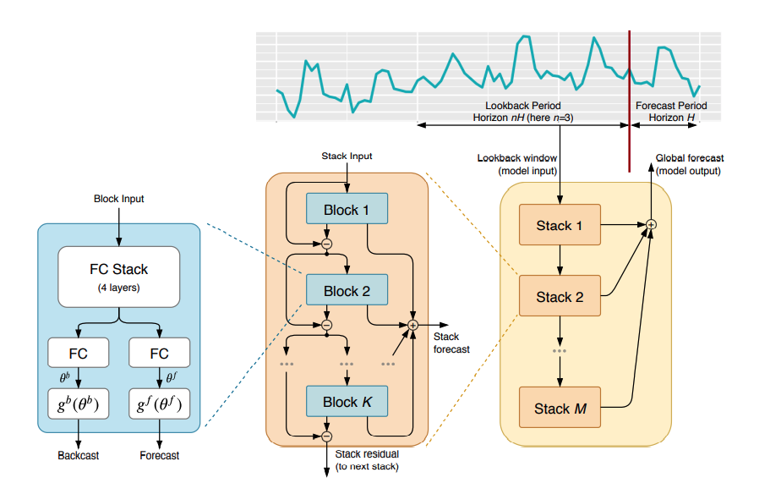

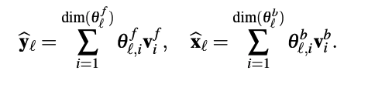

Method: N-BEATS
are expansion coefficients.
V^{f} and V^{b} are the basis vector supplied by g^{f} and g^{b} respectively.
They can be learnable or can be set to certain functional forms.
$θ$^{f} and $θ$^{b}

Slide 5


Interpretability
Generic architecture
V is learnable with dimensions H * len ($θ$). No constraints are imposed -> No structure seen in output -> No interpretability. ☺
Interpretable architecture

Slide 6
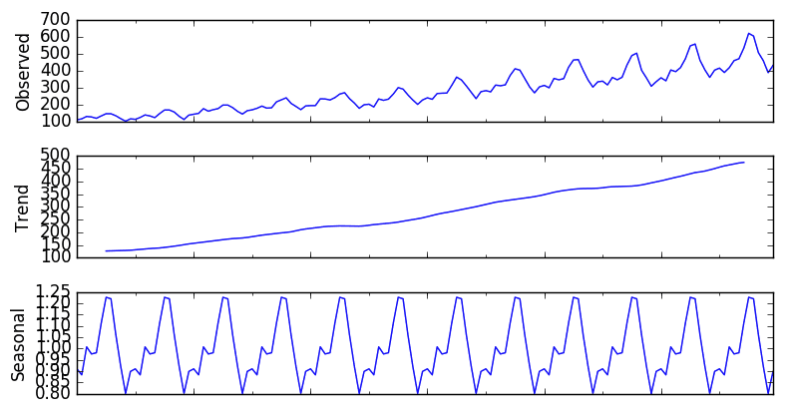
Interpretability
Add structure to basis layers at stack level. What structures?
Trend
Seasonality

Slide 7
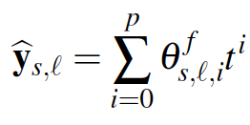

Trend
Is mostly monotonic. Or at least varies slowly.
So, constrain g^{f} and g^{b} to be polynomial of small degree, varying slowly across the forecast window.

Slide 8


Seasonality
Seasonality is a regular, cyclical and reoccurring fluctuation.
Constrain g^{f} and g^{b} to belong to a class of periodic function. y_{t} = y_{t} - $∆$. Fourier series.

Slide 9
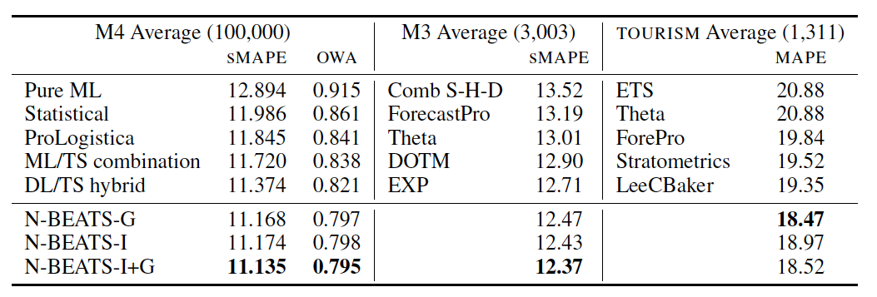
Results - Numerical

Slide 10
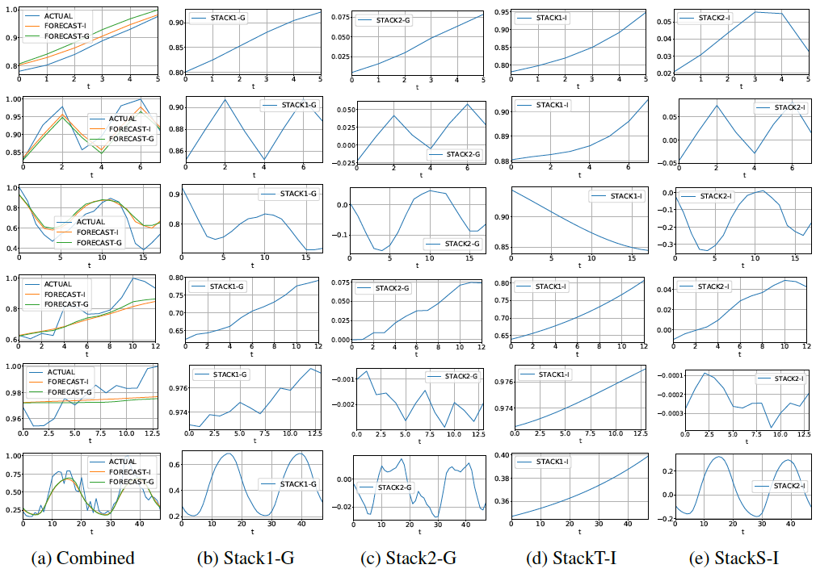
Results - interpretability

Slide 11
Further work
Neural basis expansion analysis with exogenous variables: Forecasting electricity prices with NBEATSx (link)
N-HiTS: Neural Hierarchical Interpolation for Time Series Forecasting (link)

Slide 12
Why this paper?

