Slide 1
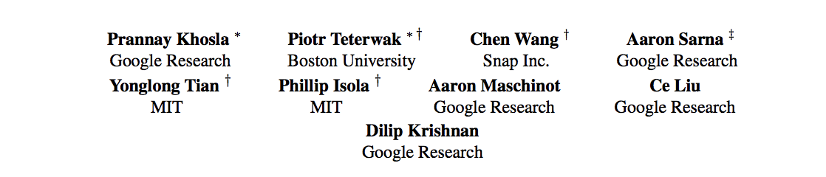

Supervised Contrastive Learning [paper]
Presented By: Md Mahfuzur Rahman

Slide 2
Contrastive Learning
Contrastive learning is to learn a representation space in which similar data samples stay close to each other while dissimilar ones are far apart, by constructing similar and dissimilar pairs from the dataset.
intends to achieve
maximization of mutual information between different views of the data.
Notes:
1. Construct a dataset with positive and negative pairs.
2. Optimize the model in such a way that puts the positive pairs close, and negative pairs apart.

Slide 3
Main Idea
This paper extends the self-supervised batch contrastive approach to the fully-supervised setting, allowing us to effectively leverage label information.
Clusters of points belonging to the same class are pulled together in embedding space, while simultaneously pushing apart clusters of samples from different classes.
SelfSupCL: 1 positive, multiple negatives
SupCL: many positives, many negatives

Slide 4
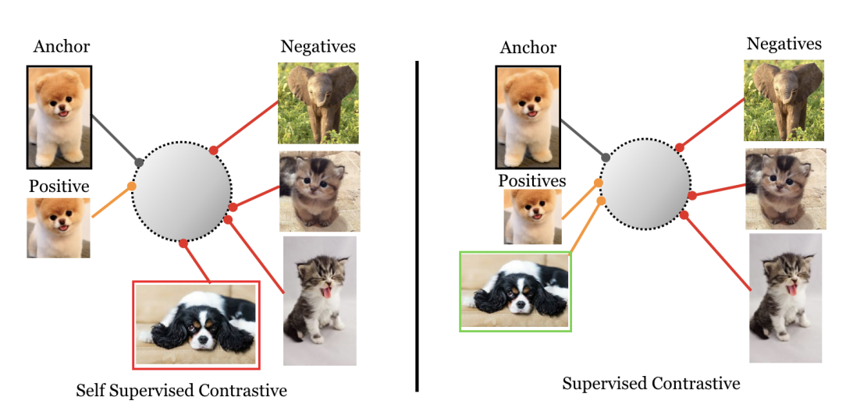
Pair Selection for Contrastive Learning

Slide 5
Main Contributions
A novel extension to the contrastive loss function that allows for multiple positives per anchor, thus adapting contrastive learning to the fully supervised setting. Analytically and empirically, it shows not all formulation performs equivalently.
The proposed loss provides consistent boosts in top-1 accuracy for many datasets. It is also more robust to natural corruptions.
The gradient of the proposed loss function encourages learning from hard positives and hard negatives.
Proposed loss is less sensitive than cross-entropy to a range of hyperparameters.

Slide 6
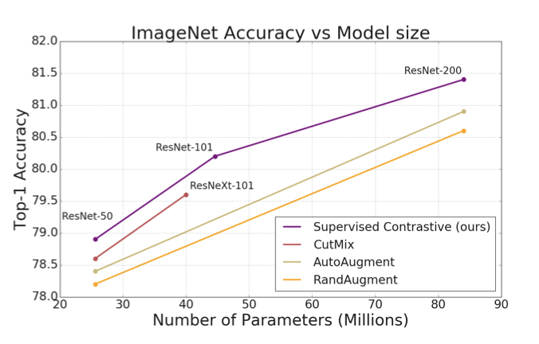
Results At a Glance
SupCon loss consistently outperforms cross-entropy with standard data augmentations.

Slide 7
Training Procedure
Given an input batch of data:
Apply data augmentation twice to obtain two copies of the batch. Use Aug(.) module
Forward propagate both copies through the encoder network. Use Enc(.) module.
For training, further propagate through a projection network. Use Proj(.) module
Calculate SupCon loss on the outputs of the projection network.
For classiﬁcation, train a linear classiﬁer on top. Use Cross-Entropy loss.

Slide 8
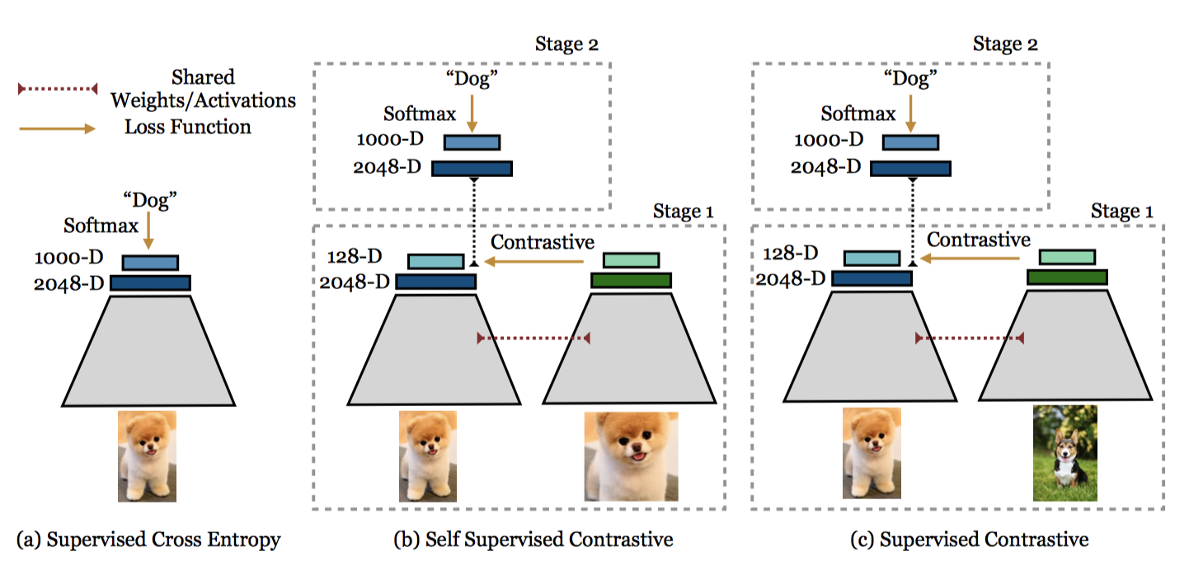
Comparison of Training Procedure

Slide 9


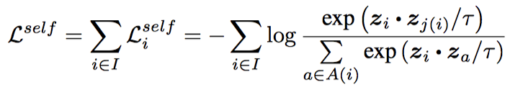
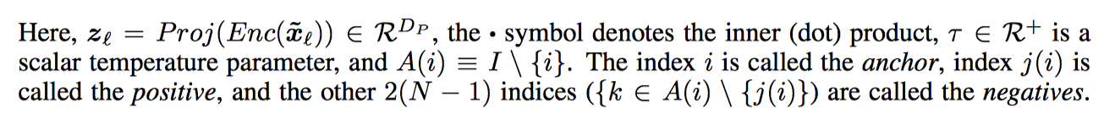
Self-Supervised Formulation
Original Batch:
Two Copies of Augmentation:
Notes:
Our loss can be seen as a generalization of both the triplet and N-pair losses; the former uses only one positive and one negative sample per anchor, and the latter uses one positive and many negatives.
Tau basically determines the magnitude of the gradient of L, upon which the efficacy of training depends.
Paper says: Smaller temperature beneﬁts training more than higher ones, but extremely low temperatures are harder to train due to numerical instability.

Slide 10
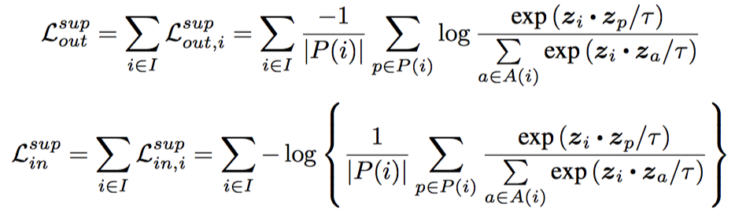

Supervised Contrastive Formulation

Slide 11

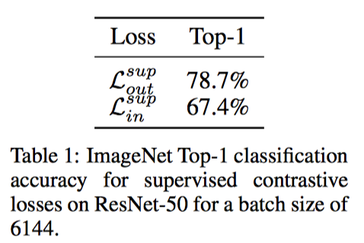
contributes only an additive constant to the overall loss
are more susceptible to bias in the positives.

Slide 12
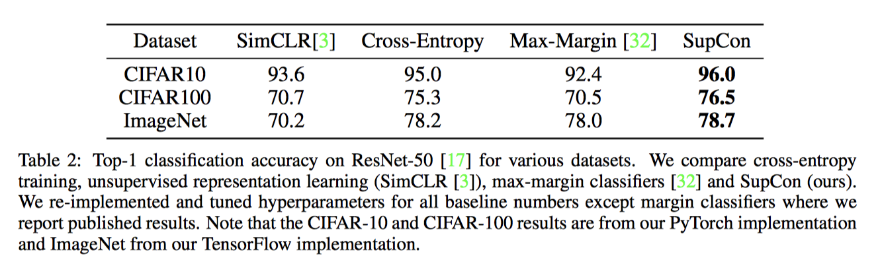
Experimental Results
Enc(·) ResNet-50, ResNet-101, and ResNet-200
Aug(·) data augmentation module: AutoAugment [5]; RandAugment [6]; SimAugment [3], and Stacked RandAugment [49]

Slide 13
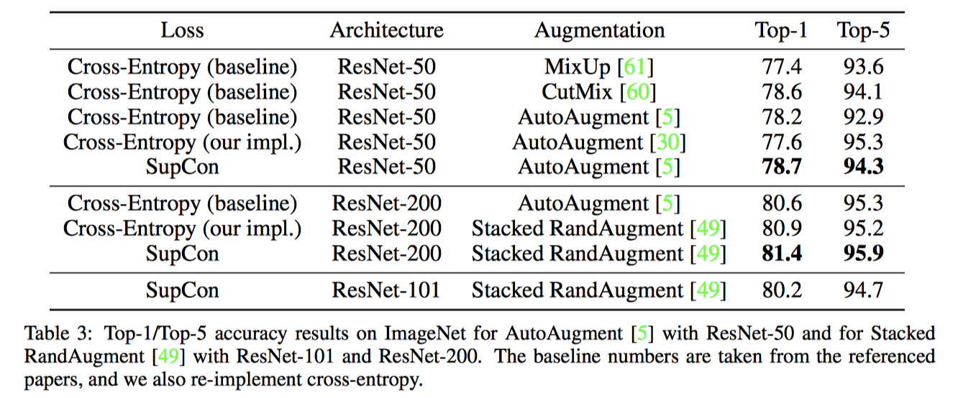
Experimental Results (contd.)

Slide 14
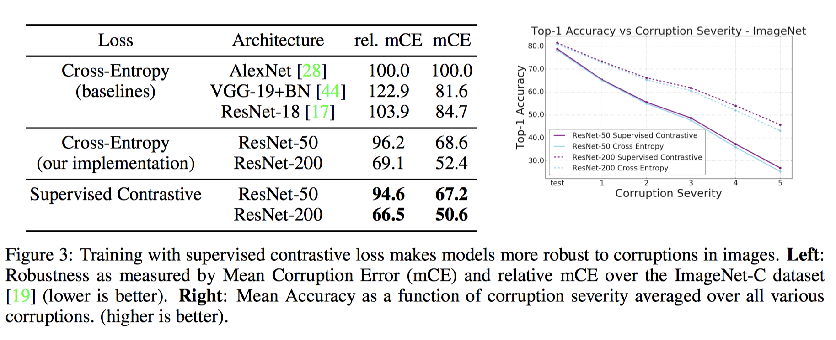
Robustness Experiments

Slide 15
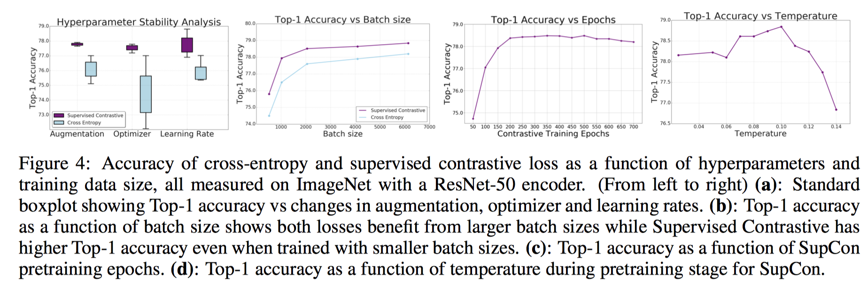
Effects of Hyperparameters

Slide 16
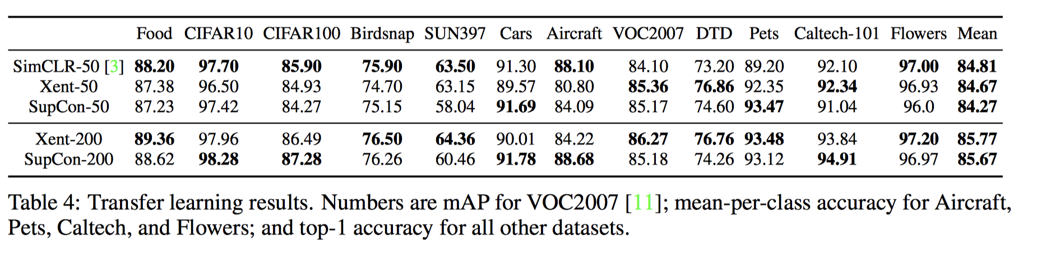
Transfer Learning Performance
Notes:
while better ImageNet models are correlated with better transfer performance, the dominant factor is architecture.

Slide 17
Conclusions
supervised contrastive learning is a technical advancement in the ﬁeld of supervised classiﬁcation;
supervised contrastive learning can improve both the accuracy and robustness of classiﬁers

Slide 18
Questions?

