Slide 1
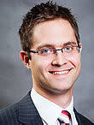
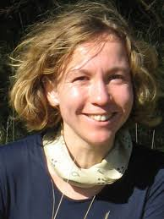



Causal Inference in Audiovisual Perception
Authors: Agoston Mihalik, Uta Noppeney
Presenter: Selim Suleymanoglu

Slide 2
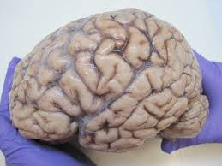
How does the decide whether audiovisual signals come from the same source?
Integrate signals from a common cause
Segregate signals from separate causes
Identify brain regions responsible for causal inference

Slide 3
Experimental design
Day | Purpose
1 | Sound recording + localization testing
2, 3 | AV disparity calibration in mock scanner (individually adjusted to ~70% accuracy so physical congruency could be dissociated from participants’ causal judgments)
4 | Retinotopic localizer scans
5 | Final adjustments
5, 6 | Main fMRI causal-inference experiment
Notes:
10 participant. Psychtoolbox
Plexiglass screen
Eyelink Remote system. 1000 Hz
MRI: 3T Philips Achieva

Slide 4
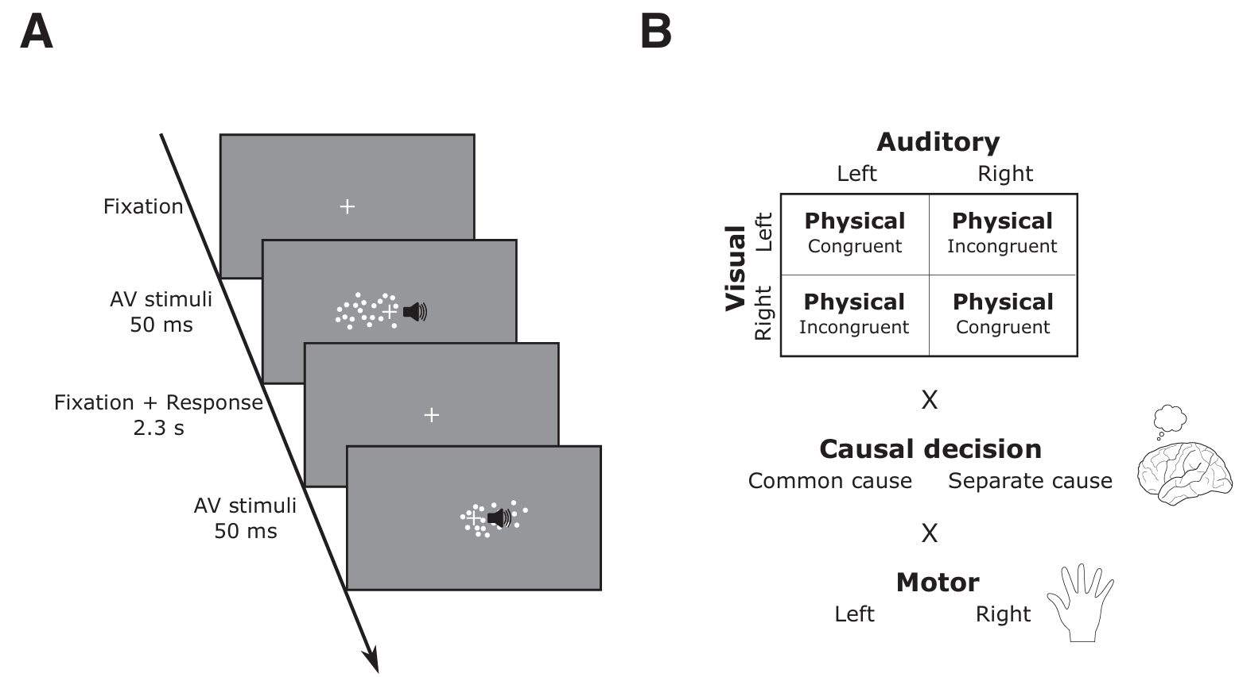
Experimental design
10 participants
10-12 runs
240 trials + 20 null trials per run
Notes:
10 participant. Psychtoolbox
Plexiglass screen
Eyelink Remote system. 1000 Hz
MRI: 3T Philips Achieva

Slide 5
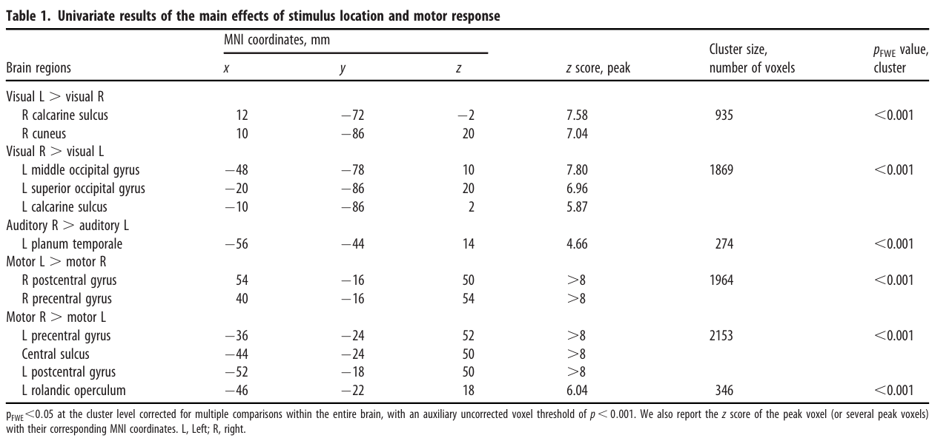
Sanity check

Slide 6
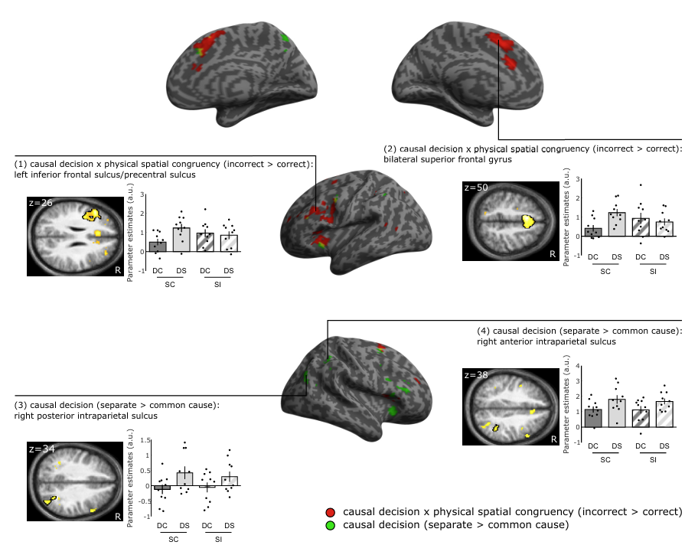
Green = participant’s subjective causal interpretation “these are separate sources”
vs
“these are one source”
Red = conflict between physical congruency and
participant judgment
Notes:
Stimuli that were judged to come from separate (relative tocommon) causes increased activations in a wide spread right lateralized system including the intraparietal sulcus, the superior and inferior frontal sulci, and the insula.

Slide 7
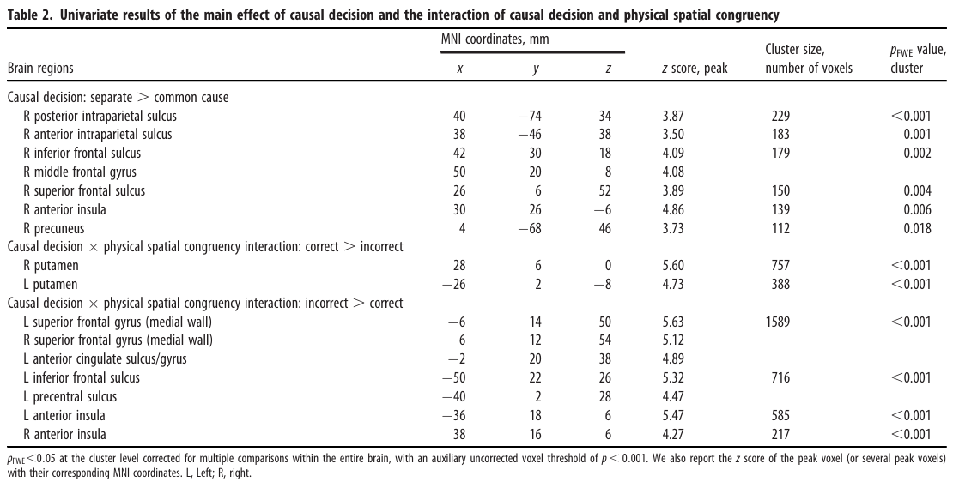

Slide 8
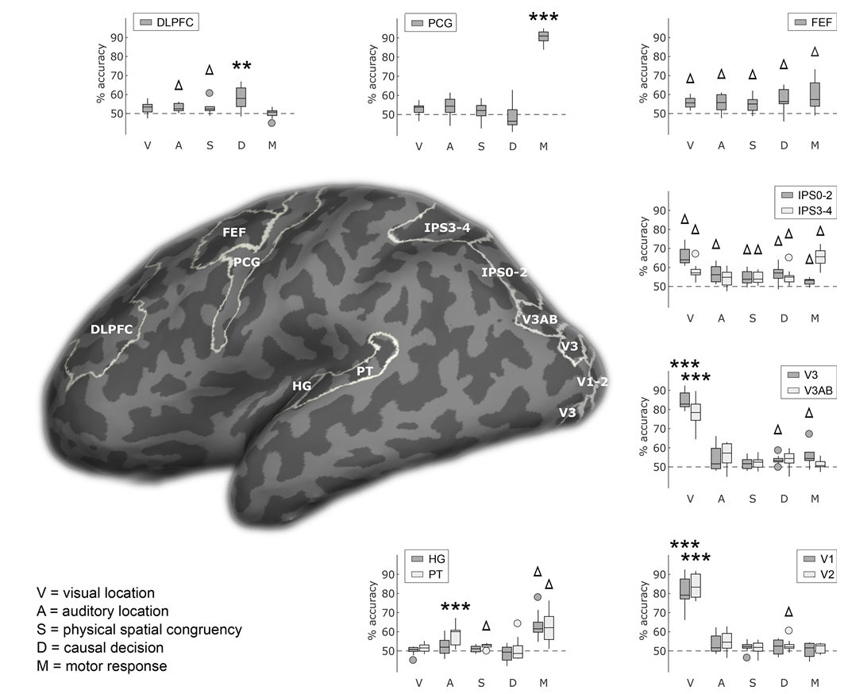
Findings
• Lower-level sensory regions encode visual/auditory location
• IPS and FEF integrate multiple information sources
• DLPFC most strongly encodes causal decisions
Notes:
Dashed line = chance level, 50%
Higher accuracy = region contains more info
PCG = precentral gyrus

Slide 9
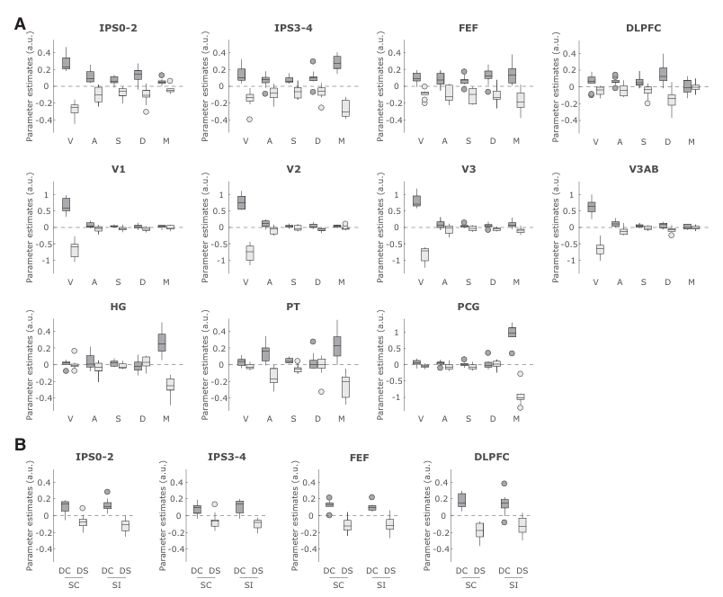
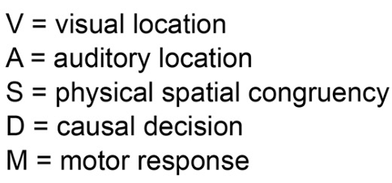
BOLD patterns support the decoding results. Dots for outside of 1.5 interquartile range
DC = common cause decision
DS = separate cause decision
SC = spatially congruent
SI = spatially incongruent

Slide 10
Reaction times
SC,DC = 0.89 ± 05 s
SI,DS = 0.93 ± 06 s
SC,DS = 1.02 ± 06 s
SI,DC = 0.96 ± 06 s

Slide 11
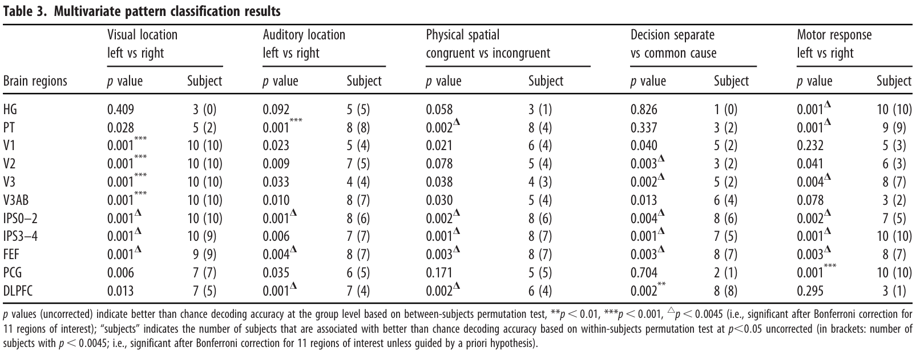

Slide 12
More findings
Bilateral putamen activations Fast.
PFC (e.g., bilateral superior frontal gyri and insulae, inferior frontal sulcus) Slow. Interpreted as greater executive demand.
DLPFC doesn’t make the causal decision alone; DLPFC activity patterns are most selectively informative about that decision.

