Slide 1
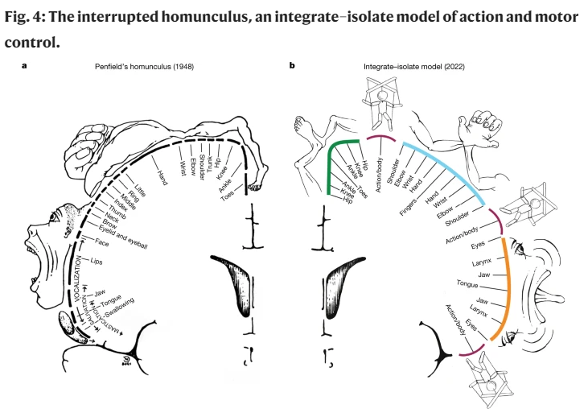
New Homunculus, Who Dis? A somato-cognitive action network alternates with effector regions in motor cortex By Gordon et al. (April, 2023, Nature)
Presentation by TJ LaGrow
TReNDS Center MLBBQ
7/28/2022
Gordon, Evan M., et al. "A somato-cognitive action network alternates with effector regions in motor cortex." Nature (2023): 1-9.
Notes:
The paper suggests that there are two intertwined behavioral control systems in the human primary motor cortex (M1). One system is made up of effector-specific circuits responsible for precise, isolated movements of specialized body parts like fingers, toes, and the tongue, which are used for complex tasks like speaking or manipulating objects.
The second system, called the SCAN (somato-cognitive action system), is more integrative and is involved in whole-body control, integrating motor control, autonomic response, and action planning. The SCAN comprises specific regions in the M1, SMA (supplementary motor area), thalamus, posterior putamen, and postural cerebellum. It is functionally connected to regions linked to free will, movement intentions, and processing of somatosensory, pain, and interoceptive visceral signals.

Slide 2
Penfield and Medical Students
Notes:
Penfield and colleagues mapped human M1 with direct cortical stimulation, eliciting movements from about half of sites, mostly of the foot, hand and mouth

Slide 3
Data & Methods
Data
3 subject for task
UK Biobank, HCP, WU 120
Neonates, Infants, Macaques, and Stroke Patients
Methods
Seed-Based FC, Precision Functional Mapping (PFM)
Using Infomap to dectect classical, large-scale networks
FC analysis of subcortical regions
Looking at the Lag-Structure of the FC
Notes:
Functional connectivity with adjacent postcentral gyrus
Functional connectivity with middle insula
Functional connectivity with cerebellum
Functional connectivity with putamen
Functional connectivity with thalamus

Slide 4
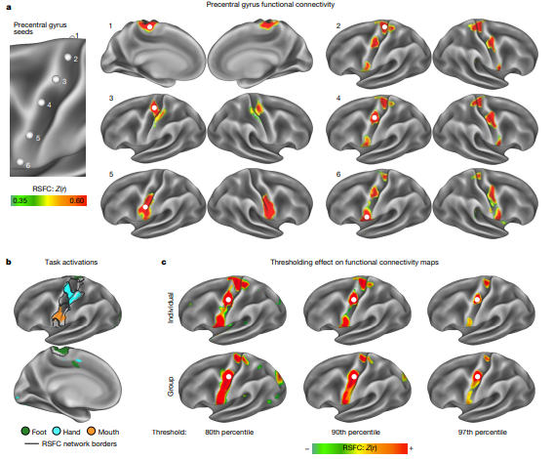
Figure 1
Notes:
Fig. 1 | Precision functional mapping of primary motor cortex. a, RSFC seeded from a continuous line of cortical locations in the left precentral gyrus in a single exemplar participant (P1; 356 min resting-state fMRI). The six exemplar seeds shown represent all distinct connectivity patterns observed (see Supplementary Video 1 for complete mapping). Functional connectivity seeded from these locations illustrated classical M1 connectivity of regions representing the foot (1), hand (3) and mouth (5), as well as an interdigitated set of strongly interconnected regions (2, 4 and 6). See Extended Data Fig. 1a and Supplementary Video 2 for all highly sampled participants, Extended Data Fig. 1b for within-participant replications, and Extended Data Fig. 1c for group-averaged data.
b, Discrete functional networks were demarcated using a whole-brain, data-driven, hierarchical approach (Methods) applied to the resting-state fMRI data, which defined the spatial extent of the networks observed in Fig. 1 (black outlines). Regions defined by RSFC were functionally labelled using a classic block-design fMRI motor task involving separate movement of the foot, hand and tongue (following ref. 31; see ref. 29 for details). The map illustrates the top 1% of vertices activated by movement of the foot, hand and mouth in the exemplar participant (P1; see Extended Data Fig. 1d for other participants).
c, The inter-effector connectivity pattern became more distinct from surrounding effector-specific motor regions as connectivity thresholding increased from the 80th to the 97th percentile. RSFC thresholds required to detect the inter-effector pattern were lower in individual-specific data (top) than in group-averaged data (bottom; ABCD study, n = 3,928).

Slide 5
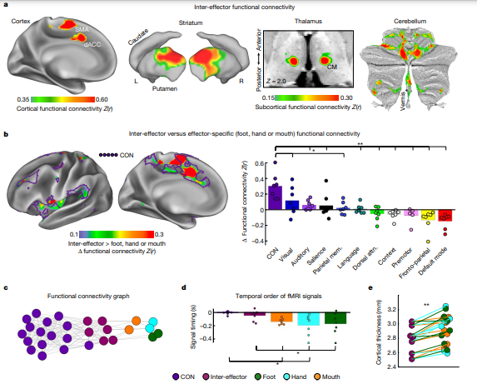
Figure 2
Notes:
Fig. 2 | Functional connectivity and cortical thickness of the M1 inter-effector motif.
a, Brain regions with the strongest functional connectivity to the left middle inter-effector region (exemplar seed) in cortex, striatum, thalamus (horizontal slice; CM nucleus) and cerebellum (flat map) in the exemplar participant (P1). See Extended Data Fig. 3 for other participants.
b, Left, brain regions more strongly functionally connected to inter-effectors than to any foot, hand or mouth regions (P1; Supplementary Fig. 2a for other participants). Purple outlines show the CON (individual-specific). Central sulcus is masked as it exhibits large differences by definition. Right, connectivity was calculated between every network and both the inter-effector and effector-specific M1 regions. The plot shows the smallest difference between inter-effector and any effector-specific connectivity, averaged across participants. This difference was larger for CON than for any other network (two-tailed paired t-tests, *P < 0.05, FDR-corrected; **P < 0.01, FDR-corrected). Coloured circles
represent individual participants.
c, Inter-network relationships visualized in network space using a spring-embedding plot, in which connected regions are pulled together and disconnected regions are pushed apart. Connecting lines indicate a functional connection (Z(r) > 0.2) (P1; see Supplementary Fig. 2b for all participants).
d, Inter-effector and effector-specific regions were tested for systematic differences in the temporal ordering of their infra-slow fMRI signals34. The plot shows signal ordering in CON, inter-effector and effector-specific regions, averaged across participants (standard error bars; two-tailed paired t-test *P 0.05, uncorrected). Coloured circles represent individual participants. Prior electrophysiology work suggests that later infra-slow activity (here, CON) corresponds to earlier delta-band (0.5–4 Hz) activity
e, In each participant (filled circles), inter-effector regions exhibited lower cortical thickness than all effector-specific regions (two-tailed paired t-test **P ≤ 0.01, FDR-corrected). Attn., attention; mem., memory

Slide 6
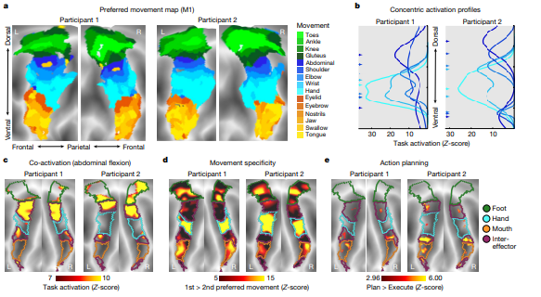
Figure 3
Notes:
Fig. 3 | Individual-specific task activations in M1.
a, Task fMRI activations (P1 and P2) during a movement task battery, including movement of the toes, ankles, knees, gluteus, abdominals, shoulders, elbows, hands, eyebrows, eyelids, tongue and swallowing (244 min per participant). Each cortical vertex is coloured according to the movement that elicited the strongest task activation (winner takes all) and is shown on a flattened representation of the cortical surface. Background shading indicates sulcal depths.
b, Activation strength for each movement was computed along the dorsal–ventral axis within M1. A two-peak Gaussian curve was fitted to each movement activation (Methods). Fitted curves are shown for movement of abdominals, shoulder, elbow, wrist and hand. Peak locations (arrows on left) were arranged concentrically around the hand peak. See Extended Data Fig. 7 and Supplementary Fig. 4 for all movements.
c, Inter-effector regions were co-activated during abdominal contraction.
d, Inter-effector regions exhibited more generalized evoked activity during movements. Movement specificity was computed as the activation difference between the first- and second-most preferred movements for the six conditions that most activated each discrete region (toes, abdominal, hand, eyelid, tongue and swallowing).
e, Event-related task fMRI data during an action planning task with separate planning and execution phases for movements of the hands and feet (Methods). M1 activity in the planning phase was higher than in the execution phase in the intereffector but not the effector-specific regions.

Slide 7
Figure 4
Notes:
Fig. 4 | The interrupted homunculus, an integrate–isolate model of action and motor control.
a, Penfield’s classical homunculus (adapted from ref. 2), depicting a continuous map of the body in primary motor cortex.
b, In the integrate–isolate model of M1 organization, effector-specific—foot (green), hand (cyan) and mouth (orange)—functional zones are represented by concentric rings with proximal body parts surrounding the relatively more isolatable distal ones (toes, fingers and tongue). Inter-effector regions (maroon) sit at the intersecting points of these fields, forming part of a somato-cognitive action network for integrative, allostatic whole-body control. As with Penfield’s original drawing, this diagram is intended to illustrate organizational principles, and must not be over-interpreted as a precise map.

Slide 8
Summary
Traditional homunculus representation is interrupted by regions with distinct connectivity, structure, and function, alternating with effector-specific areas (foot, hand, and mouth).
These intervening regions (inter-effector regions) exhibit decreased cortical thickness and strong functional connectivity to each other, as well as to the cingulo-opercular network (CON). The CON is critical for action, physiological control, arousal, error processing, and pain.
The structure of intermingling action control-linked and motor effector regions was confirmed in the three largest fMRI datasets. Similar structures were suggested in macaque monkeys and in pediatric fMRI, indicating cross-species homologues and developmental precursors of the inter-effector system.

Slide 9
Summary
A range of motor and action fMRI tasks showed concentric effector somatotopies (representation of different parts of the body in the brain), separated by the CON-linked inter-effector regions.
Inter-effector regions lacked movement specificity and were activated during action planning and axial body movement (like moving the abdomen or eyebrows).
Combining these findings with previous studies, the authors suggest M1 contains a system, named the somato-cognitive action network (SCAN), for whole-body action planning.
In the M1, two parallel systems intertwine: the effector-specific regions for isolating fine motor control, and the SCAN for integrating goals, physiology, and body movement.

