Slide 1
INTRODUCTION TO
Dynamical
Systems
Fixed points · phase curves · bifurcations · slow–fast dynamics
after Strogatz (2015) and Izhikevich (2007)
Notes:
Roadmap: build the geometric toolkit, apply it to Strogatz's firefly entrainment problem, then show the same mathematics governs neural excitability in Izhikevich's framework.

Slide 2
THE SETUP
A state, and a rule that moves it
STATE
RULE
FLOW
x ∈ ℝⁿ
ẋ = f(x)
x(t)
Everything you need to know about the system right now.
How the state changes. Deterministic, time-independent.
The trajectory traced out. A curve through state space.
The central move is geometric: stop trying to solve the equations, and instead ask what the trajectories look like.
Strogatz, Nonlinear Dynamics and Chaos, 2nd ed., Ch. 1–2

Slide 3
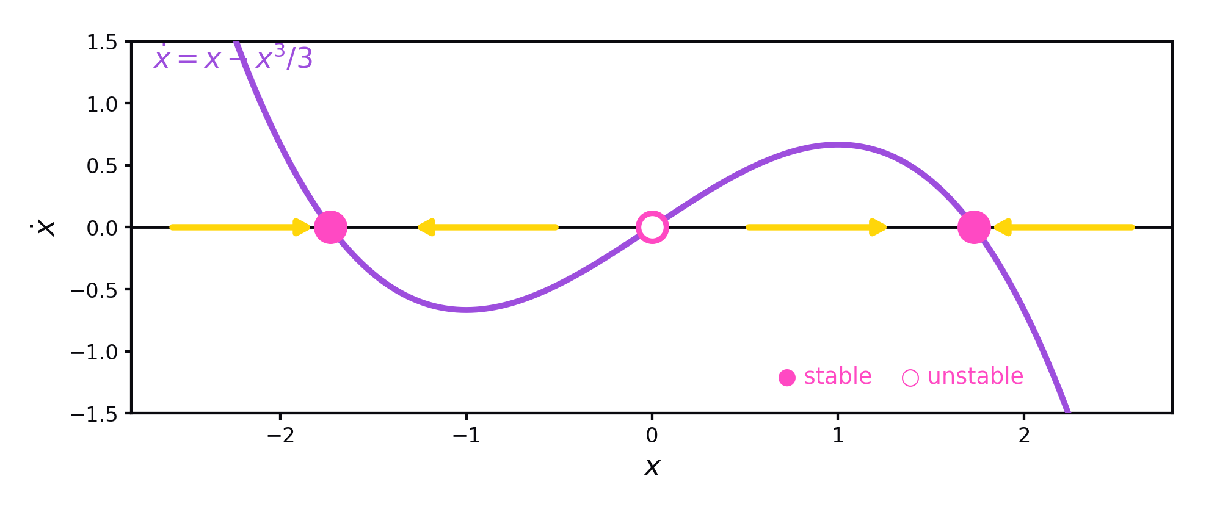
ONE DIMENSION
Fixed points and their stability
Fixed points are where ẋ = 0. Flow is rightward where ẋ > 0, leftward where ẋ < 0 — so stability is read straight off the sign of the slope. In 1D there is no overshoot and no oscillation: trajectories are monotonic and must settle on a fixed point or run off to infinity.
Strogatz, 2nd ed., §2.1–2.4

Slide 4
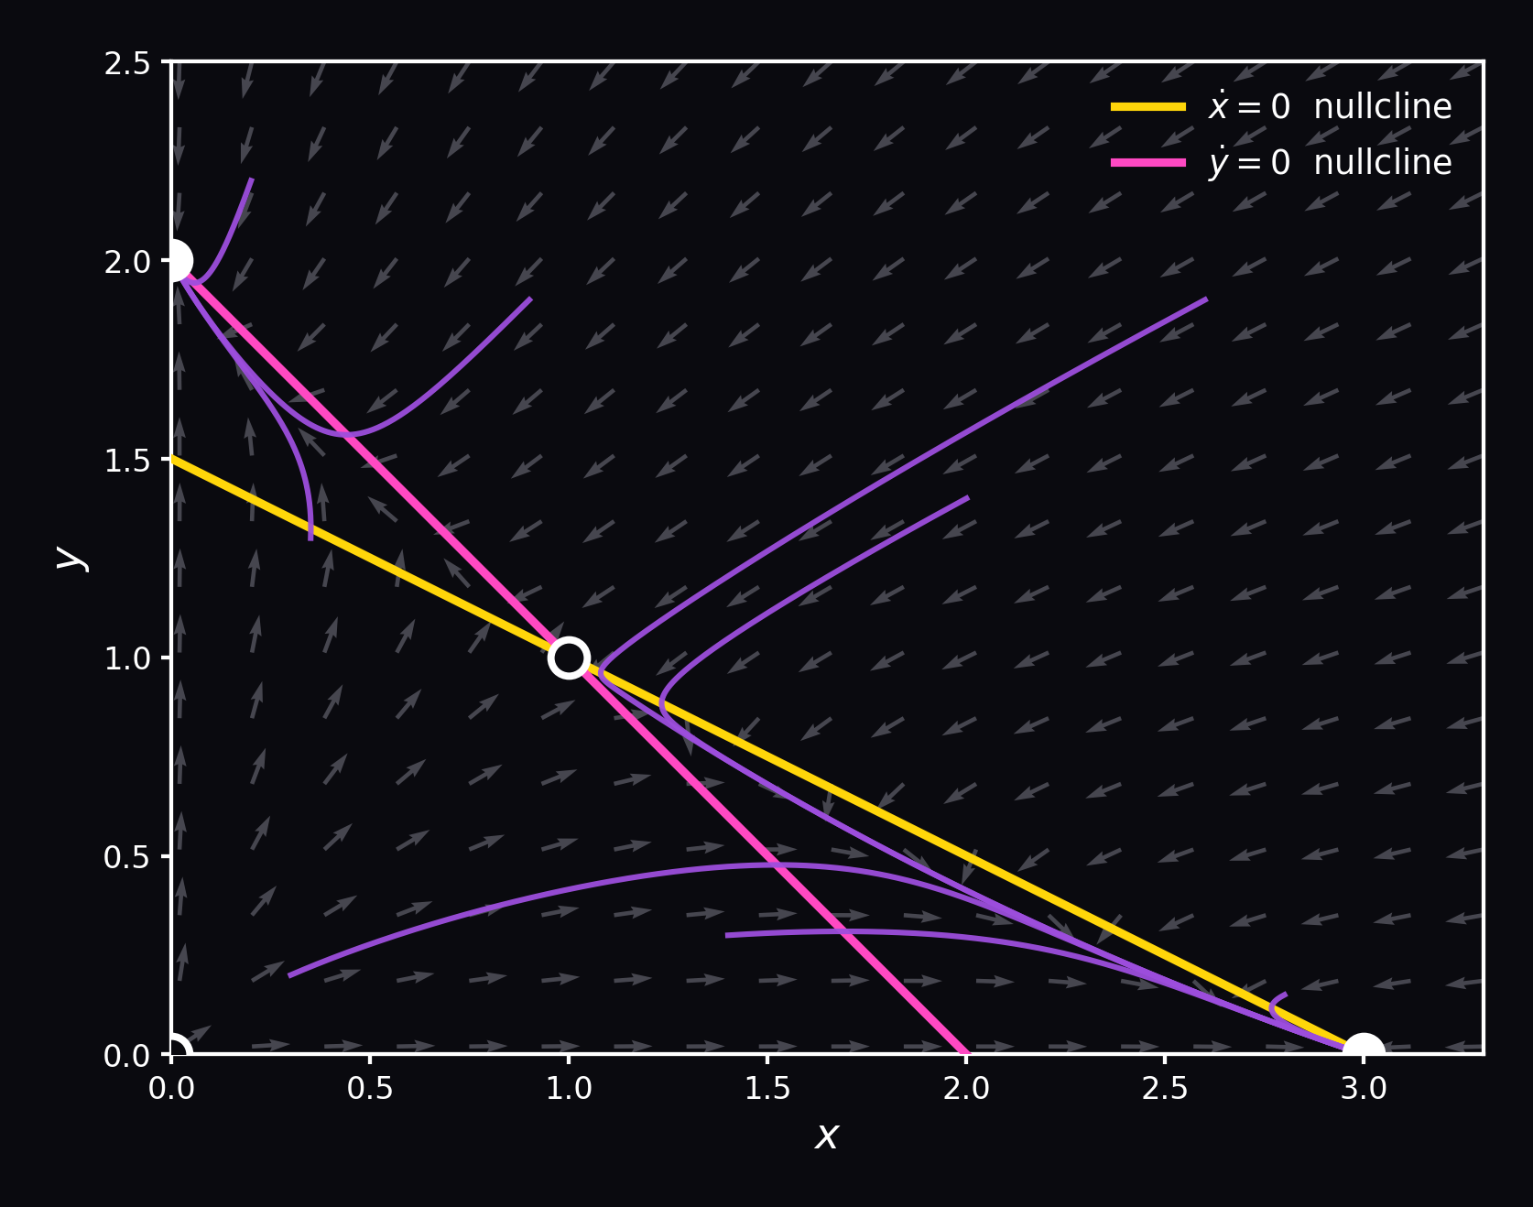
TWO DIMENSIONS
Phase curves and nullclines
Nullclines
Curves where one component of the velocity vanishes. Their intersections are the fixed points.
Trajectories
Phase curves never cross. The whole qualitative story is in how they are organised.
Separatrices
Stable manifolds of saddles — they partition the plane into basins of attraction.
Poincaré–Bendixson: in the plane, bounded trajectories must approach a fixed point or a closed orbit. No chaos until three dimensions.
Strogatz, 2nd ed., Ch. 5–7

Slide 5
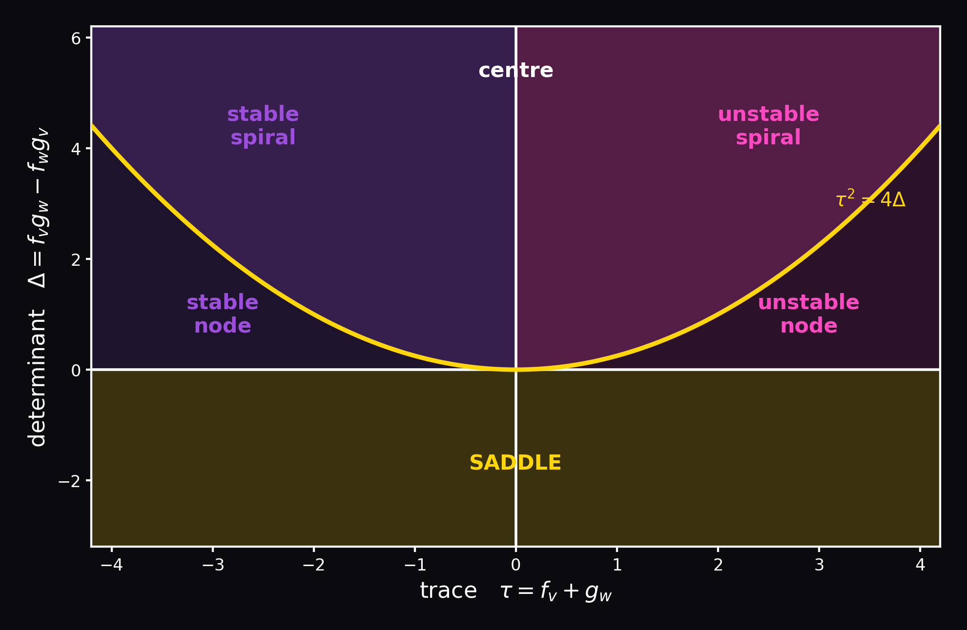
EQUILIBRIUM ANALYSIS
Linearise, then classify
1. Solve f(v*, w*) = g(v*, w*) = 0
2. Evaluate the Jacobian there:
J = ∂f/∂v ∂f/∂w
∂g/∂v ∂g/∂w
3. Read off two numbers:
τ = tr J Δ = det J
Δ < 0 → saddle. Δ > 0: τ < 0 stable, τ > 0 unstable; τ² < 4Δ spirals, τ² > 4Δ nodes.
Stability is decided before you ever solve anything — the eigenvalues of a 2×2 matrix carry the whole local picture.
Strogatz, Nonlinear Dynamics and Chaos, 2nd ed., §5.2 and §6.3

Slide 6
QUALITATIVE CHANGE
Bifurcations: when the picture reorganises
Saddle-node
Two fixed points collide and annihilate. The system loses its resting state entirely.
Why it matters
A parameter drifts slowly, nothing seems to happen — and then the system's whole repertoire changes at once.
This is the mechanism behind a neuron starting to fire, a laser switching on, a population collapsing.
The firefly example on the next slides is the simplest case: a saddle-node.
Hopf
A fixed point loses stability and spawns a limit cycle. Onset of oscillation.
Homoclinic
A limit cycle collides with a saddle and its period diverges.
Strogatz, 2nd ed., Ch. 3 and §8.1–8.4

Slide 7
STROGATZ §4.5
Fireflies
Along tidal rivers in southeast Asia, thousands of male fireflies settle in the mangroves at dusk and begin to flash — at first raggedly, then, within minutes, in near-perfect unison, whole trees pulsing together.
No conductor. No leader. Each insect sees only its neighbours.
The question
If each firefly can nudge its own rhythm in response to a flash it sees, when does a population lock together — and when does it fail to?
Strogatz, 2nd ed., §4.5; experimental observations after Hanson (1978)

Slide 8
STROGATZ §4.5
From biology to one equation
1
Phases
θ(t) is the firefly's flash phase, Θ(t) the stimulus phase. Alone, θ̇ = ω and Θ̇ = Ω.
2
Coupling
The firefly speeds up when the stimulus leads, slows when it lags: θ̇ = ω + A sin(Θ − θ)
3
Phase difference
Let φ = Θ − θ. Subtracting: φ̇ = (Ω − ω) − A sin φ
4
Nondimensionalise
With τ = At and μ = (Ω − ω)/A: φ′ = μ − sin φ
One dimensionless parameter μ — detuning relative to coupling strength — now controls everything.

Slide 9
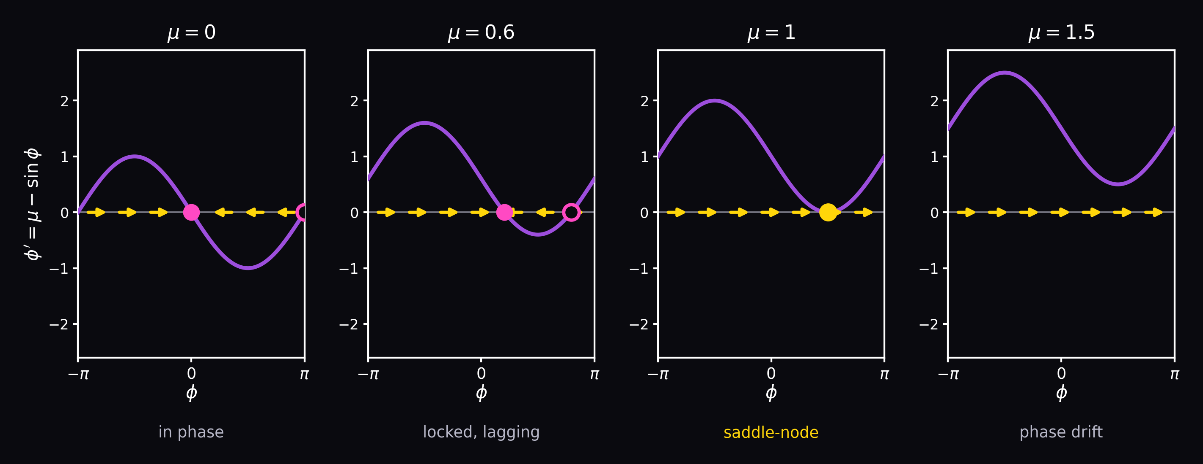
THE NONUNIFORM OSCILLATOR
φ′ = μ − sin φ as μ increases
Fixed points satisfy sin φ* = μ, so they exist only for |μ| ≤ 1. At μ = 0 the firefly flashes exactly in time. As μ grows it stays locked but lags by φ* = arcsin μ. At μ = 1 the stable and unstable points collide and annihilate — a saddle-node bifurcation. Beyond it, φ drifts forever: phase walkthrough, slow near π/2 and fast near −π/2.
Strogatz, 2nd ed., §4.5

Slide 10
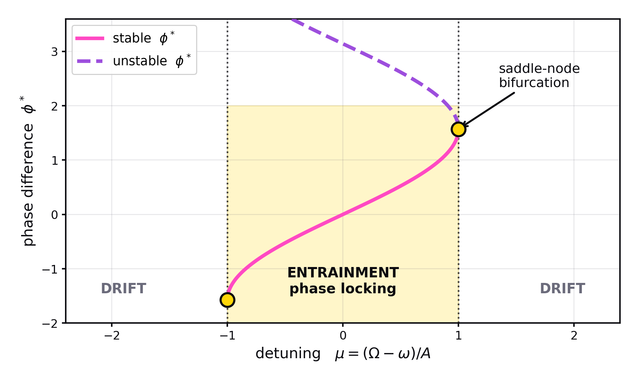
THE RESULT
The entrainment window
|Ω − ω| ≤ A
the locking condition
A firefly entrains to any stimulus whose frequency falls within ±A of its own. Stronger coupling widens the window; greater detuning pushes you out of it.
Outside the window the oscillators still interact — the drift is markedly nonuniform — but they never lock.
This is the Adler equation, and it recurs across synchronised systems: Josephson junctions, phase-locked loops, circadian entrainment to daylight.
Strogatz, 2nd ed., §4.5

Slide 11
SEPARATION OF TIMESCALES
When one variable is much faster
Fast subsystem
ε ẋ = f(x, y)
ẏ = g(x, y)
x relaxes almost instantly onto the slow manifold f(x, y) = 0 — the x-nullcline.
Slow subsystem
with 0 < ε ≪ 1
y then creeps along that manifold, dragging the system with it.
Jumps
Where the manifold folds, the state has nowhere nearby to go and jumps — fast — to a distant branch.
The payoff: a two-dimensional problem decomposes into two one-dimensional ones, and the resulting dynamics — long quiet stretches punctuated by abrupt transitions — is exactly what spiking looks like.
Strogatz, 2nd ed., §7.5; Izhikevich (2007), Ch. 4 and 8

Slide 12
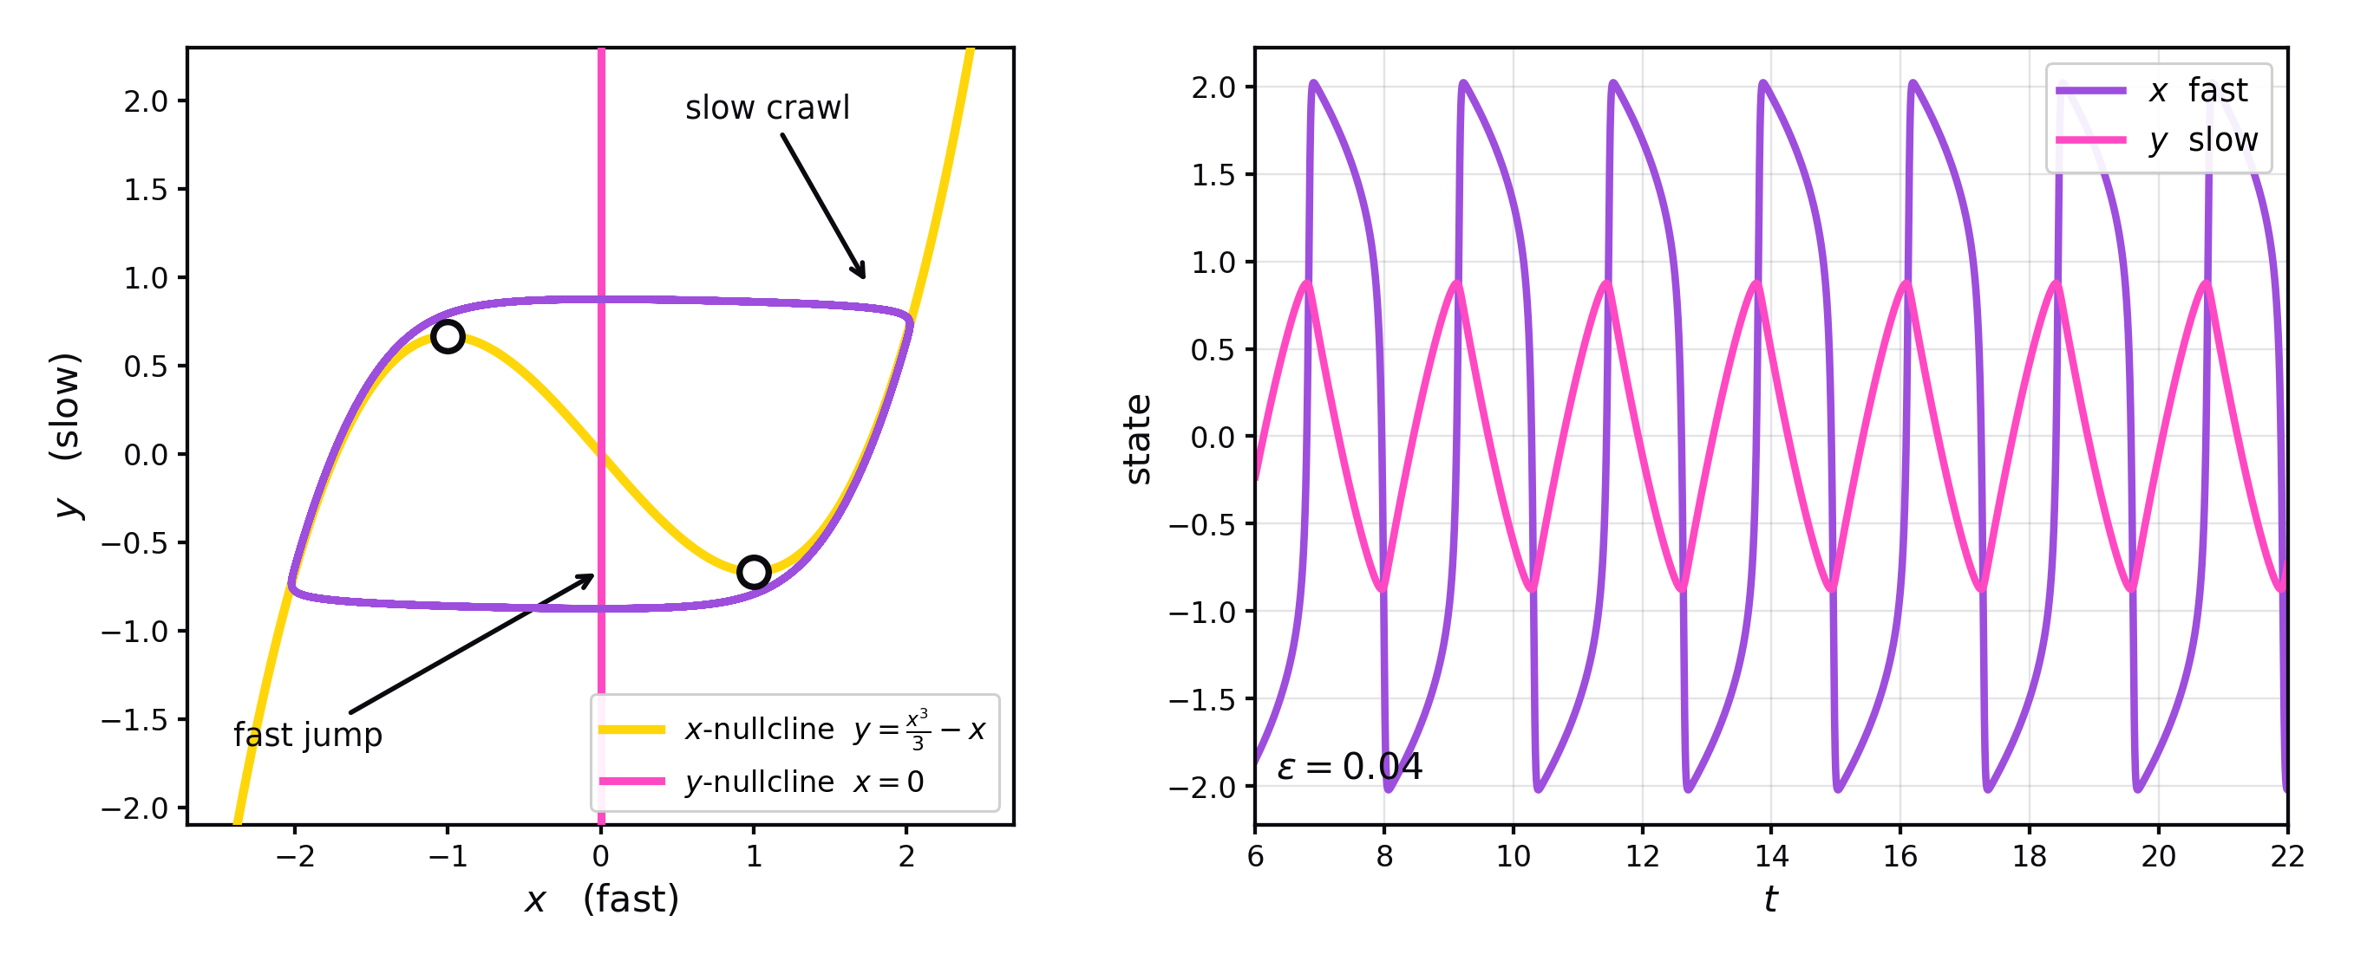
RELAXATION OSCILLATIONS
Van der Pol: slow crawl, fast jump
The trajectory clings to the cubic x-nullcline (yellow) while y drifts slowly, then falls off the fold and shoots across to the other branch in a time of order ε. The time series makes the asymmetry plain: x is nearly square-wave, y nearly triangular. Same mechanism, different system — this is a neuron's spike in disguise.

Slide 13
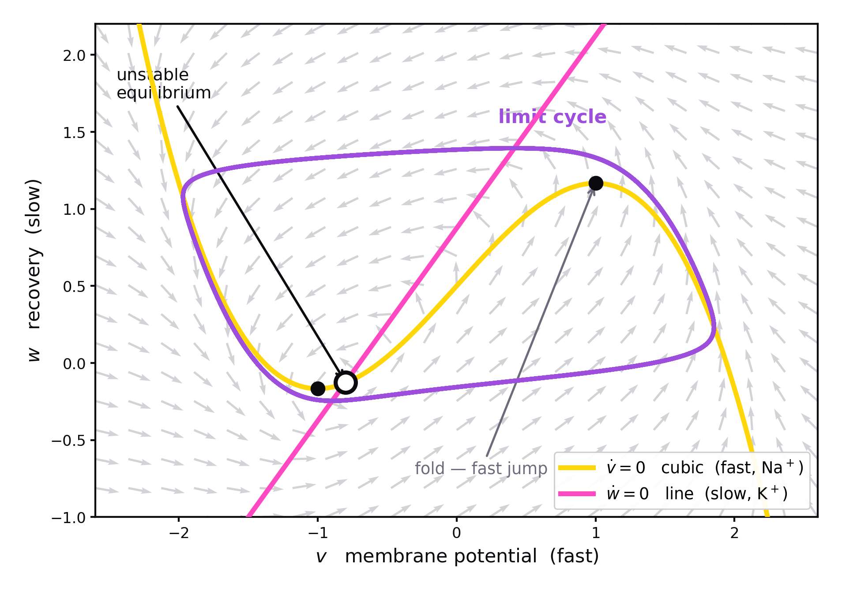
FITZHUGH–NAGUMO
A neuron's two timescales: Na⁺ and K⁺
v̇ = v − v³/3 − w + I
ẇ = ε (v + a − b w)
ε ≪ 1 separates the timescales
v — FAST — Na⁺
Sodium channels activate almost instantly. Na⁺ rushes in, depolarising the membrane, and the inward current is regenerative — more depolarisation opens more channels. That positive feedback is the cubic term, and it produces the spike upstroke.
w — SLOW — K⁺
Potassium channels open with a delay, and Na⁺ channels inactivate on the same slow timescale. K⁺ flows out, repolarising the cell. w lumps both into one recovery variable — negative feedback that always arrives late.
Fast positive feedback plus delayed negative feedback is the whole recipe for excitability — the same structure as van der Pol, with ion channels supplying the physics.
Izhikevich (2007), Ch. 4; Strogatz, 2nd ed., §7.5 (van der Pol); FitzHugh (1961), Nagumo et al. (1962)

Slide 14
THE CONNECTION
The firefly bifurcation is the neuron's
FIREFLY
NEURON
φ′ = μ − sin φ
Class I excitability
SAME BIFURCATION
Past μ = 1 the fixed point is gone and φ circulates forever — the firefly free-runs.
saddle-node on an invariant circle
Past threshold current the rest state is gone and v circulates forever — the neuron fires repetitively.
Because the fixed points vanish on the circle itself, the period diverges as the bifurcation is approached — which is why Class I neurons can fire at arbitrarily low rates near threshold. The firefly's phase walkthrough and the neuron's slow repetitive firing are the same phenomenon, written in different variables.
Izhikevich (2007), Ch. 6–7; Izhikevich, Int. J. Bifurcation & Chaos 10:1171 (2000)

Slide 15
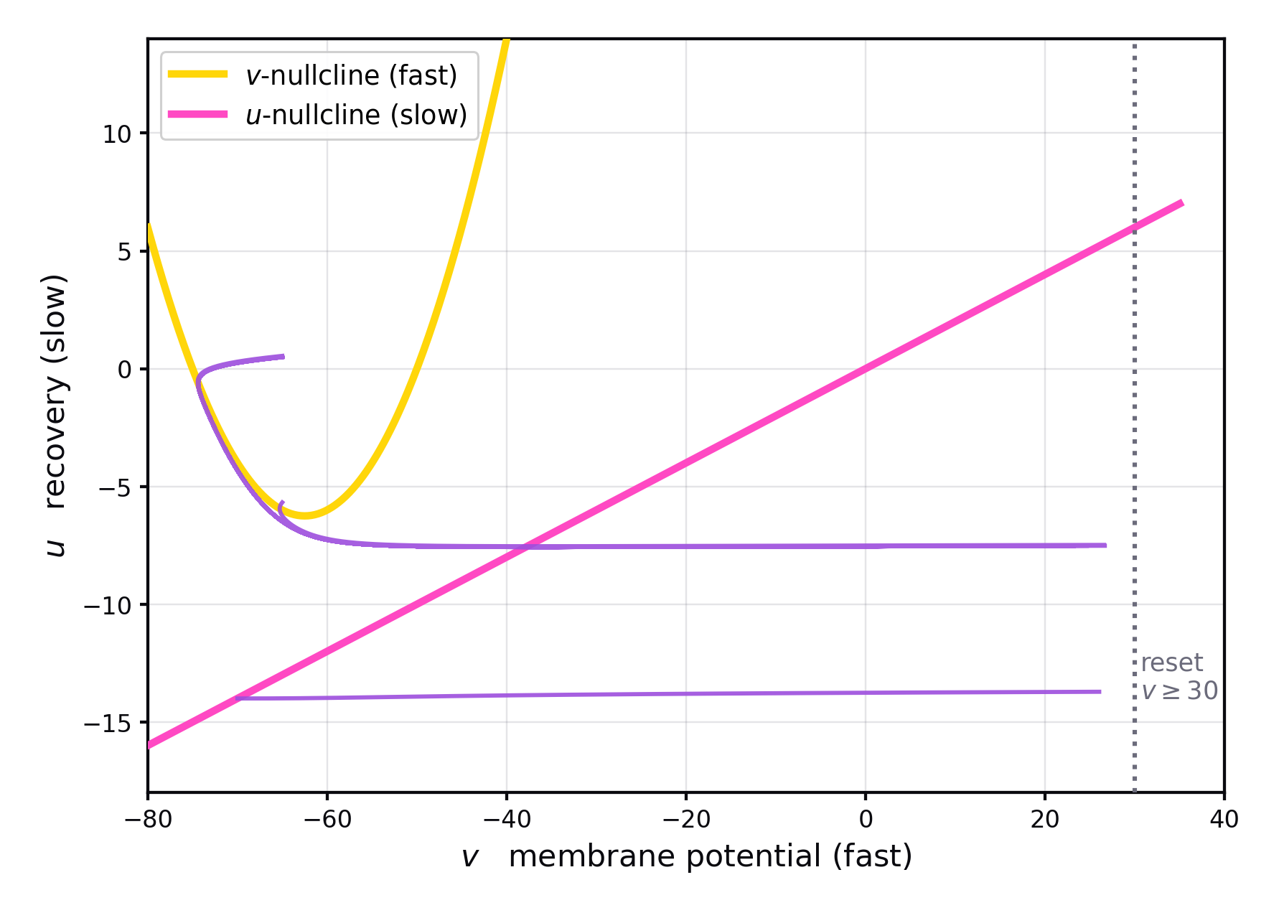
IZHIKEVICH (2003, 2007)
A neuron as a slow–fast system
v̇ = 0.04v² + 5v + 140 − u + I
u̇ = a(bv − u)
if v ≥ 30 mV: v ← c, u ← u + d
v is fast — the quadratic term drives the spike upstroke. u is slow — the parameter a sets its timescale, and it supplies negative feedback standing in for K⁺ activation and Na⁺ inactivation.
The v-nullcline is a parabola, the u-nullcline a line. Their intersections give the rest state; losing them gives repetitive firing. The reset rule closes the spike that the quadratic alone would send to infinity.
Izhikevich, IEEE Trans. Neural Networks 14(6):1569–1572 (2003)

Slide 16
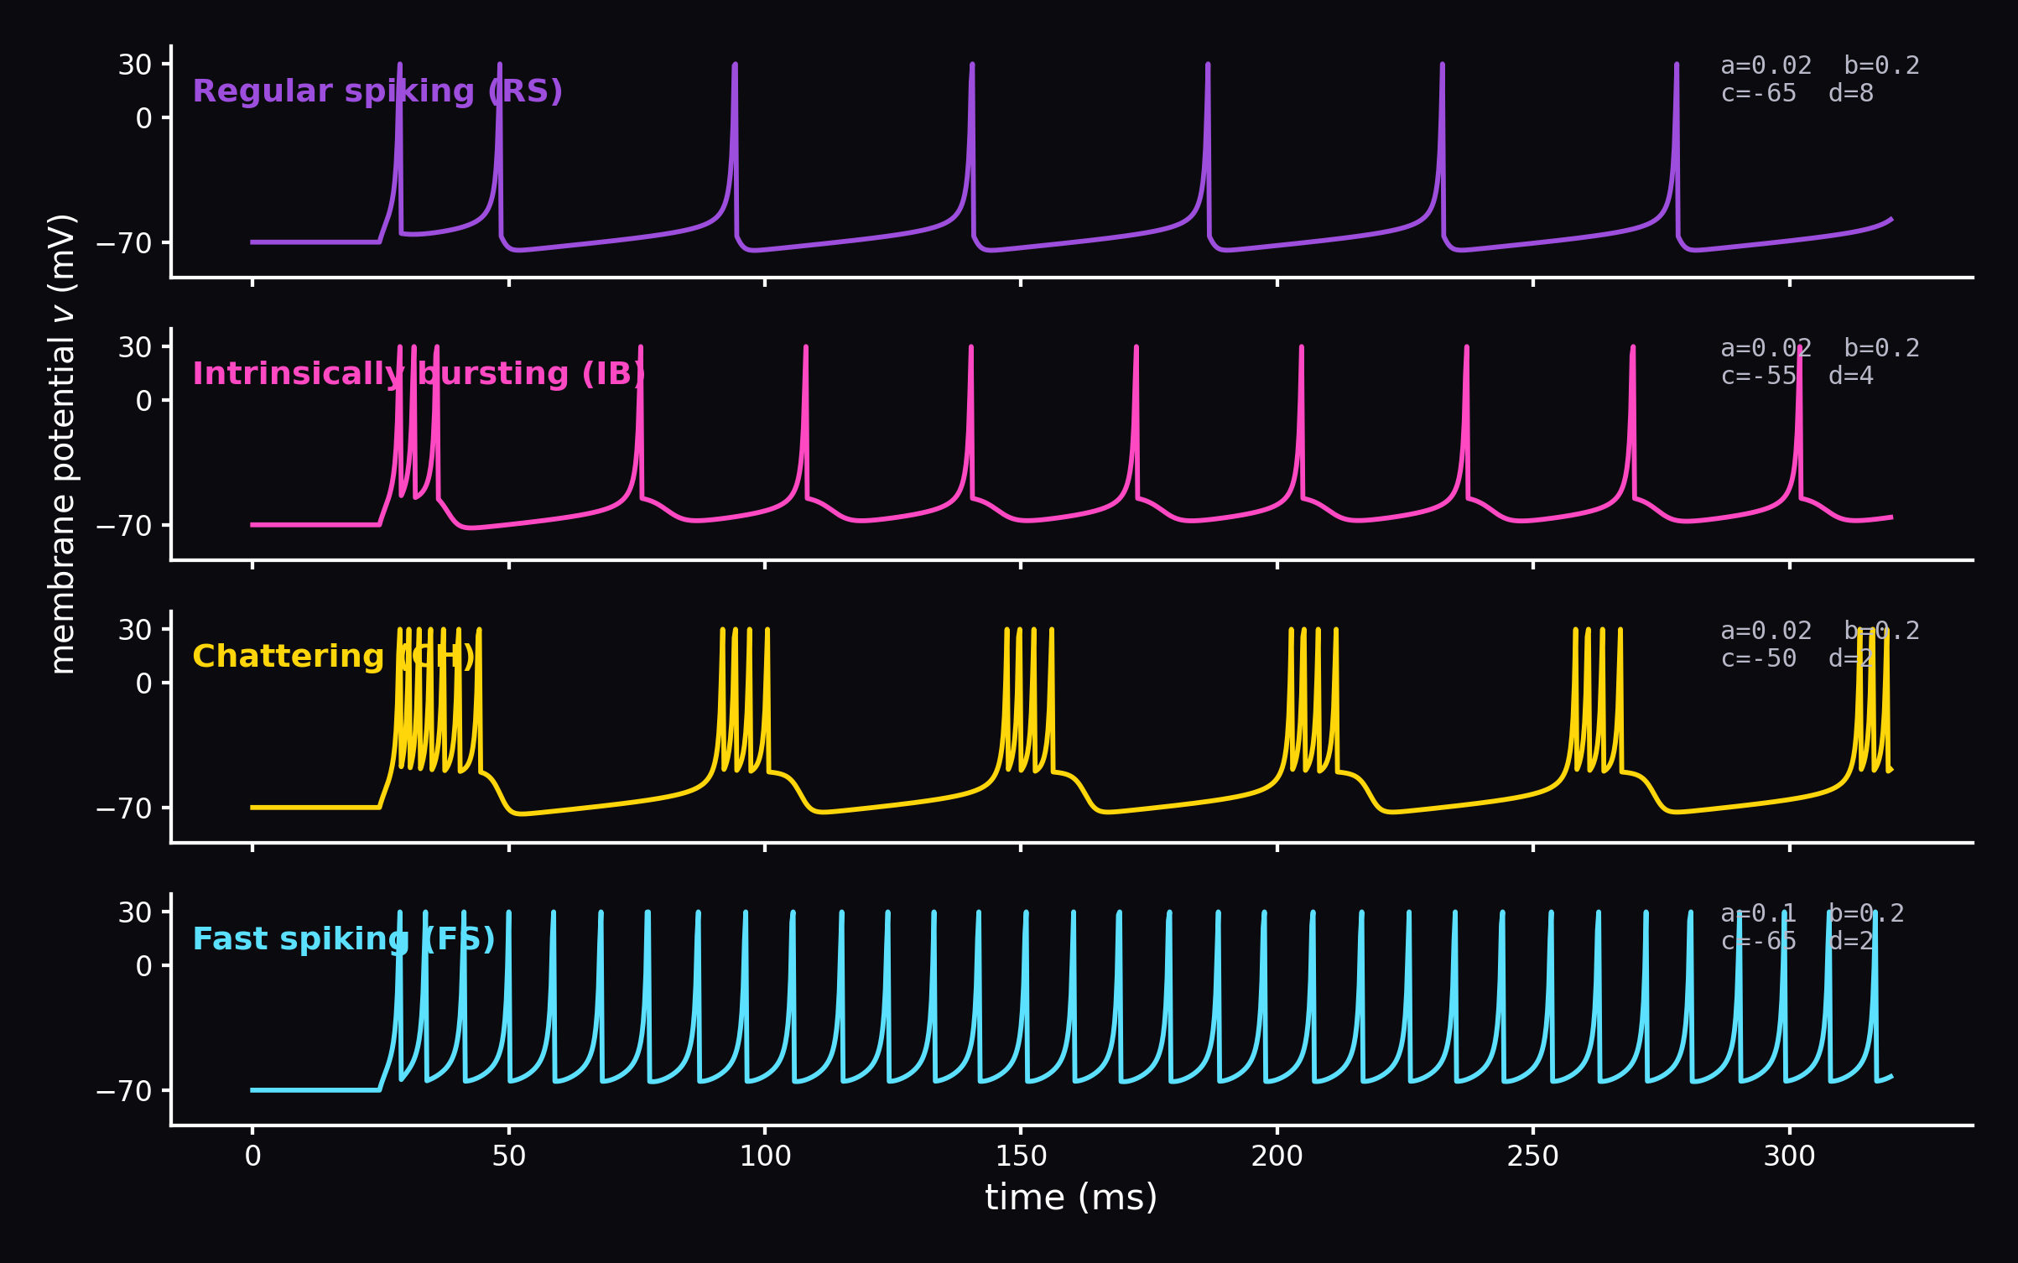
FOUR PARAMETERS, MANY BEHAVIOURS
What the model produces
Changing only a, b, c and d reproduces most of the firing patterns recorded in cortex — regular spiking, bursting, chattering, fast spiking. The richness comes from the geometry, not from biophysical detail: this model has two state variables, where Hodgkin–Huxley has four.

Slide 17
SOURCES
References
Strogatz, S. H. (2015)
Nonlinear Dynamics and Chaos: With Applications to Physics, Biology, Chemistry, and Engineering, 2nd ed. Westview Press.
Fireflies §4.5 · relaxation oscillations §7.5 · bifurcations Ch. 3, 8
Izhikevich, E. M. (2007)
Dynamical Systems in Neuroscience: The Geometry of Excitability and Bursting. MIT Press.
Fast–slow decomposition Ch. 4, 8 · excitability classes Ch. 6–7
Izhikevich, E. M. (2003)
Simple model of spiking neurons. IEEE Transactions on Neural Networks 14(6), 1569–1572.
doi:10.1109/TNN.2003.820440
Figures generated from the models themselves (matplotlib); no figures are reproduced from the sources.

