Slide 1
Causal machine learning for healthcare and precision medicine
Pedro Sanchez¹ , Jeremy P. Voisey² , Tian Xia¹ , Hannah I. Watson² , Alison Q. O’Neil^{1,2} and Sotirios A. Tsaftaris¹
¹ School of Engineering, University of Edinburgh, Edinburgh, UK
² AI Research, Canon Medical Research Europe, Edinburgh, Lothian, UK
04/28/2023

Slide 2
Introduction
Explored how causal inference can be incorporated into different aspects of CDS systems
Illustrated how CML can be advantageous in clinical scenarios
Discussed some important challenges present in healthcare applications
High-dimensional and unstructured data
Generalization to out-of-distribution samples
Temporal relationships
Reviewed some papers which offer the potential toward addressing those challenges

Slide 3
CML Alleviate Challenges in Healthcare
How to acquire the necessary information to causally reason about treatments and outcomes.
Generalizable across deployment environments such as different hospitals, cities or countries.
Considering temporal information and combine multimodal information.
Interestingly, it is the connection between CI and ML that can help alleviate these challenges.
CI adds an extra layer of understanding about a system with expert knowledge, which improves information merging.

Slide 4
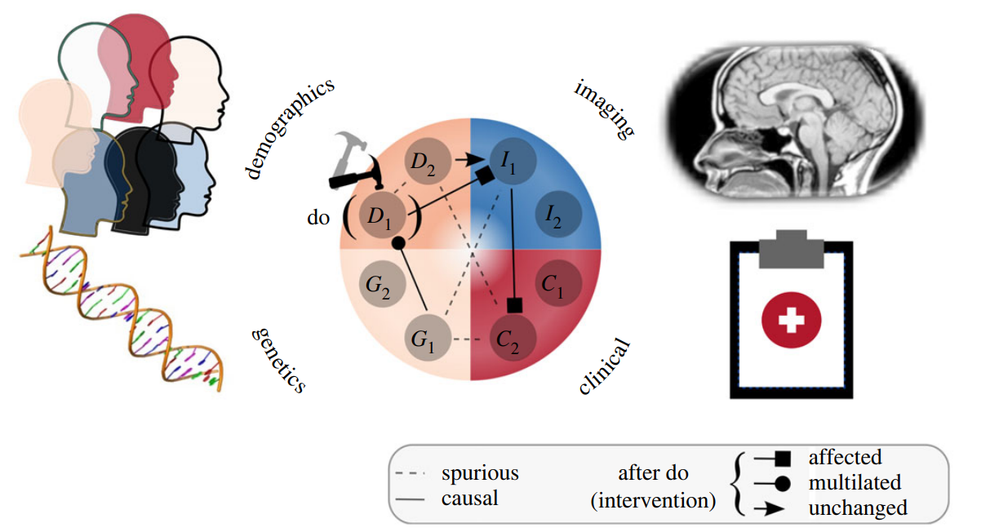
Hypothetical Example
CDS systems targeted at precision medicine (also known as personalized medicine) need to answer complex queries about how individuals would respond to interventions.
CML can be used to discover which relationships between variables are spurious and which are causal.

Slide 5
Why should we consider a causal framework in healthcare?
Predicting a disease with almost perfect accuracy for a given patient is not what precision medicine is trying to achieve.
Extract actionable information from observational patient data in order to make interventional (treatment) decisions.
Needs to estimate the treatment effect to make actionable decisions at the patient level.
When using observational datasets, by definition, we never observe the counterfactual outcome.

Slide 6
What is causality?
Definition: if A is a cause and B is an effect, then B relies on A for its value. As causal relations are directional, the reverse is not true; A does not rely on B for its value. The notion of causality thus enables analysis of how a system would respond to an intervention.
Two ways of defining and reasoning about causal relationships:
Structural causal models (SCMs) and
Potential outcomes.

Slide 7
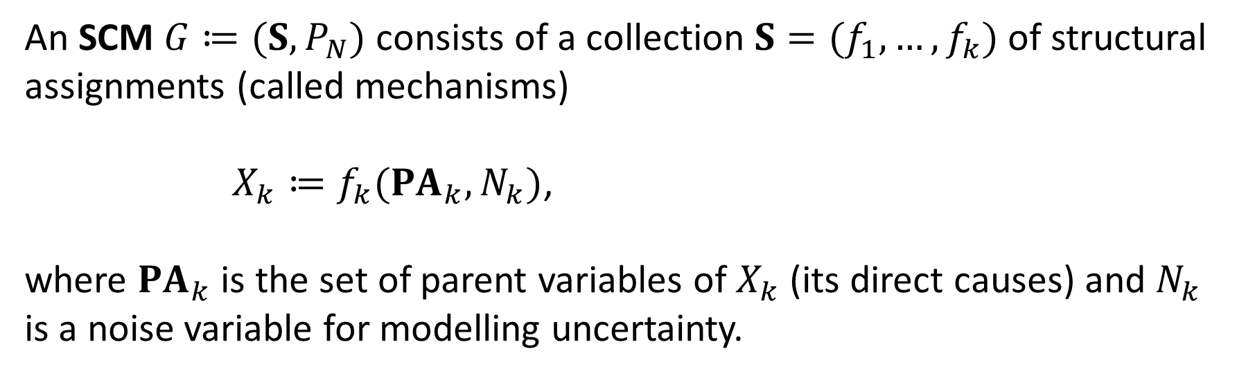
Structural causal models (SCMs)
Mathematical formalism around the so-called do-calculus and SCMs pioneered by the Turing Award winner Judea Pearl.
Model the data generation process and incorporate assumptions about a given problem.
An SCM $G≔(S, P_{N})$ consists of a collection $S=(f_{1},…,f_{k})$ of structural assignments (called mechanisms)
$X_{k}≔f_{k}({PA}_{k},N_{k})$,
where ${PA}_{k}$ is the set of parent variables of $X_{k}$ (its direct causes) and $N_{k}$ is a noise variable for modelling uncertainty.

Slide 8
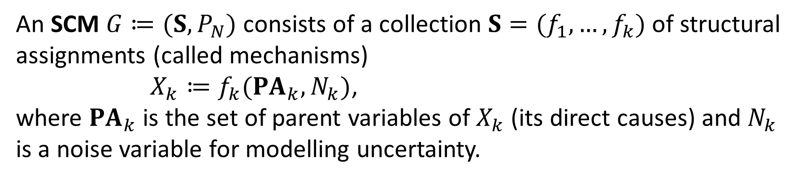
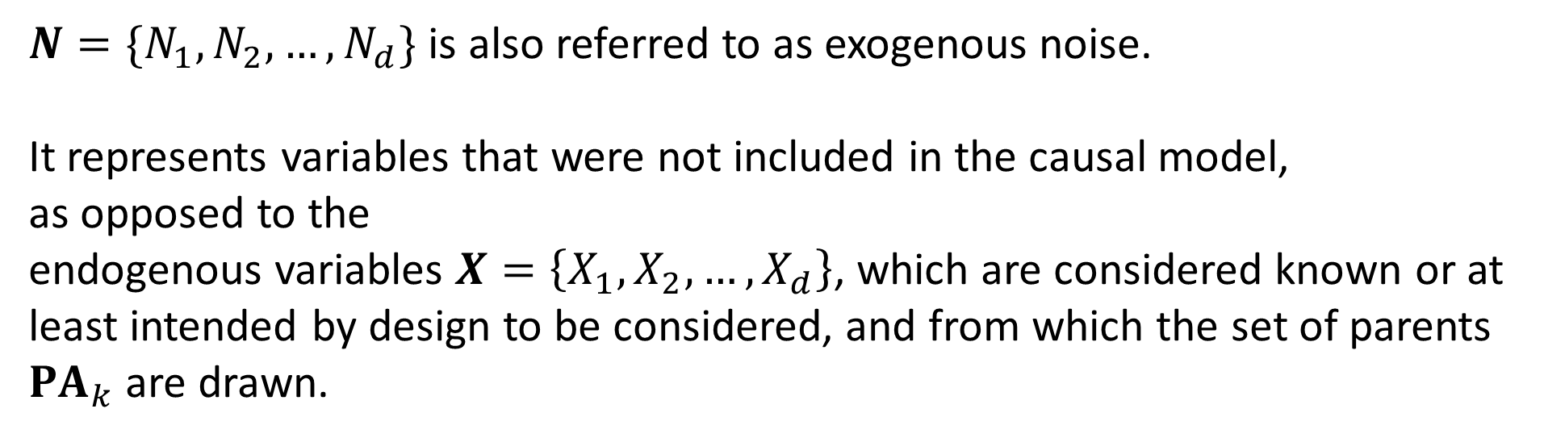
Structural causal models (SCMs)
An SCM $G≔(S, P_{N})$ consists of a collection $S=(f_{1},…,f_{k})$ of structural assignments (called mechanisms)
$X_{k}≔f_{k}({PA}_{k},N_{k})$,
where ${PA}_{k}$ is the set of parent variables of $X_{k}$ (its direct causes) and $N_{k}$ is a noise variable for modelling uncertainty.
$N=\{N_{1},N_{2},…,N_{d}\}$ is also referred to as exogenous noise.
It represents variables that were not included in the causal model,
as opposed to the
endogenous variables $X=\left\{X_{1},X_{2},…,X_{d}\right\}$, which are considered known or at least intended by design to be considered, and from which the set of parents ${PA}_{k}$ are drawn.
Notes:
This model can be defined as a direct acyclic graph (DAG) in which the nodes are the variables and the edges are the causal mechanisms.

Slide 9
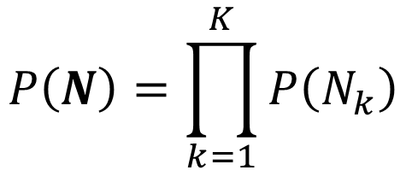
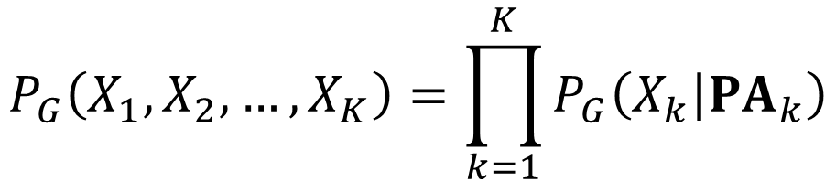
Structural causal models (SCMs)
Exogenous variables N are mutually independent with the following joint distribution,
$$P\left(N\right)=\prod_{k=1}^{K}{P\left(N_{k}\right)}$$
The joint distribution over the endogenous variables X can be factorized as a product of independent conditional mechanisms,
$$P_{G}\left(X_{1},X_{2},…,X_{K}\right)=\prod_{k=1}^{K}{P_{G}\left(X_{k} | {PA}_{k}\right)}$$

Slide 10
Structural causal models (SCMs)
Thus, SCM allows us to go beyond,
associative predictions
interventional and
counterfactual queries

Slide 11
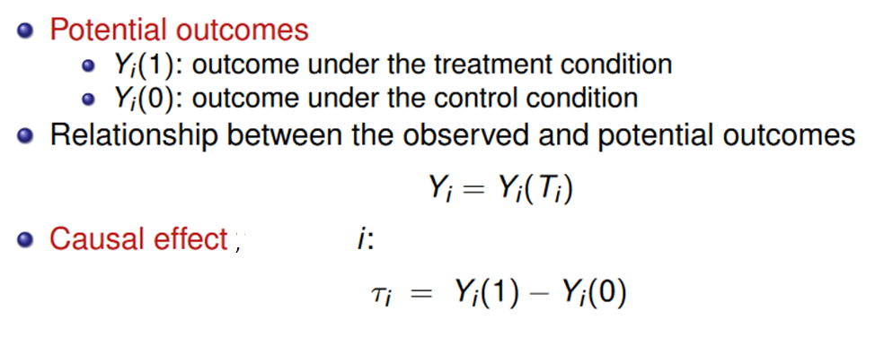
Potential outcomes
Graphical SCMs are powerful for modelling assumption or identifying if an intervention is even possible or not.
Potential outcomes literature is more focused on quantifying the effect of interventions.

Slide 12
Alzheimer’s disease: Practical Example of CML
Recent attempt to understand AD from a causal perspective takes into account many biomarkers and uses domain knowledge for deriving ground truth causal relationships.
chronological age
magnetic resonance (MR) images of the brain, and
AD diagnosis
In this scenario, we can assume that age is a confounder of brain morphology, measured by the MR image, and AD diagnosis.

Slide 13
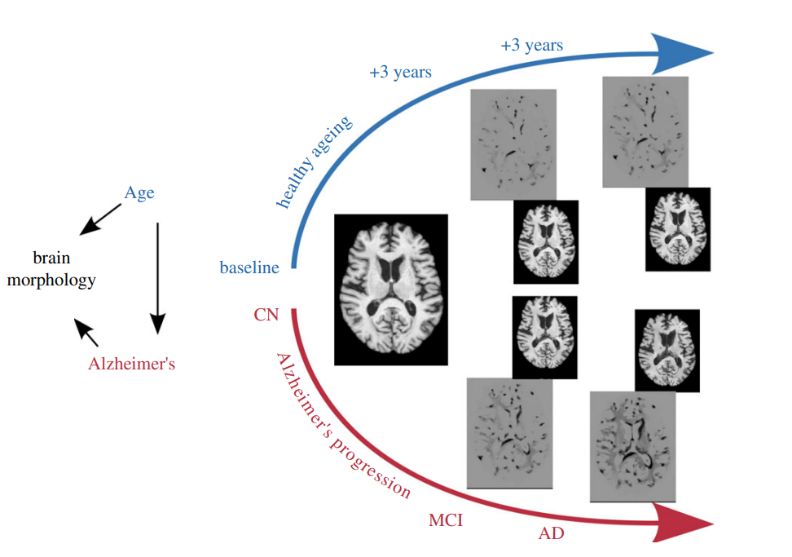
Alzheimer’s disease: Practical Example of CML
By observing qualitatively the difference between the baseline and synthesized images. They see that ageing and AD have similar effects on the brain.
Both variables change the volume of brain when intervened on independently.

Slide 14
Modeling the data generation process
By representing the variables of a particular problem and their causal relationships as a causal graph, one can model
domain shifts, such as population shift (different cohorts),
acquisition shift (different sites or scanners) and
annotation shift (different annotators), and
data scarcity (imbalanced classes)

Slide 15
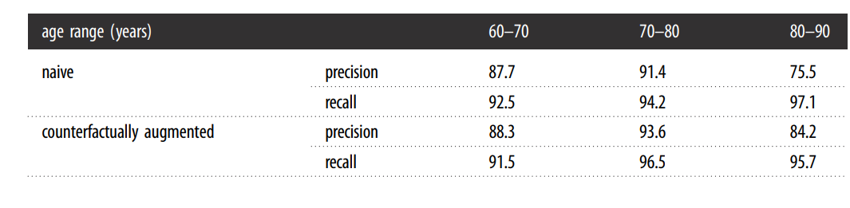
Modeling the data generation process
Illustration of how a naively trained classifier (a neural network) fails when the data generation process and causal structure are not identified. We highlight that the group with worse performance is the older cognitively normal patients due to the confounding bias. After training with counterfactually augmented data, the classifier’s precision for the worse performance age group improved.

Slide 16
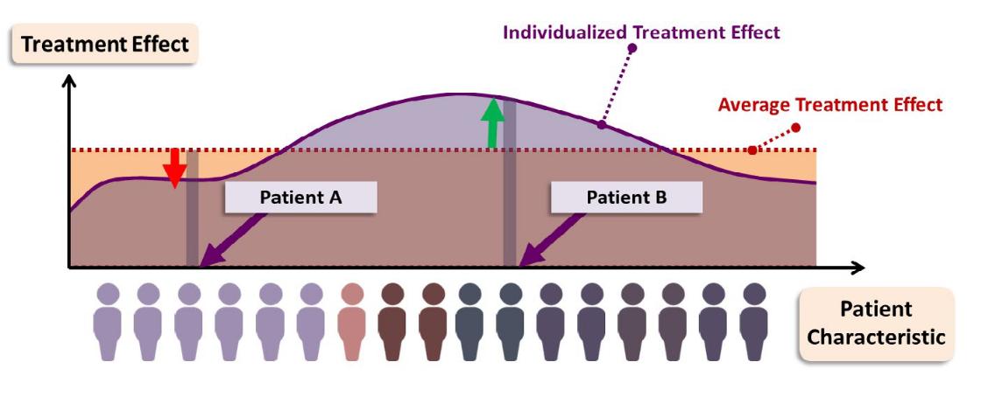
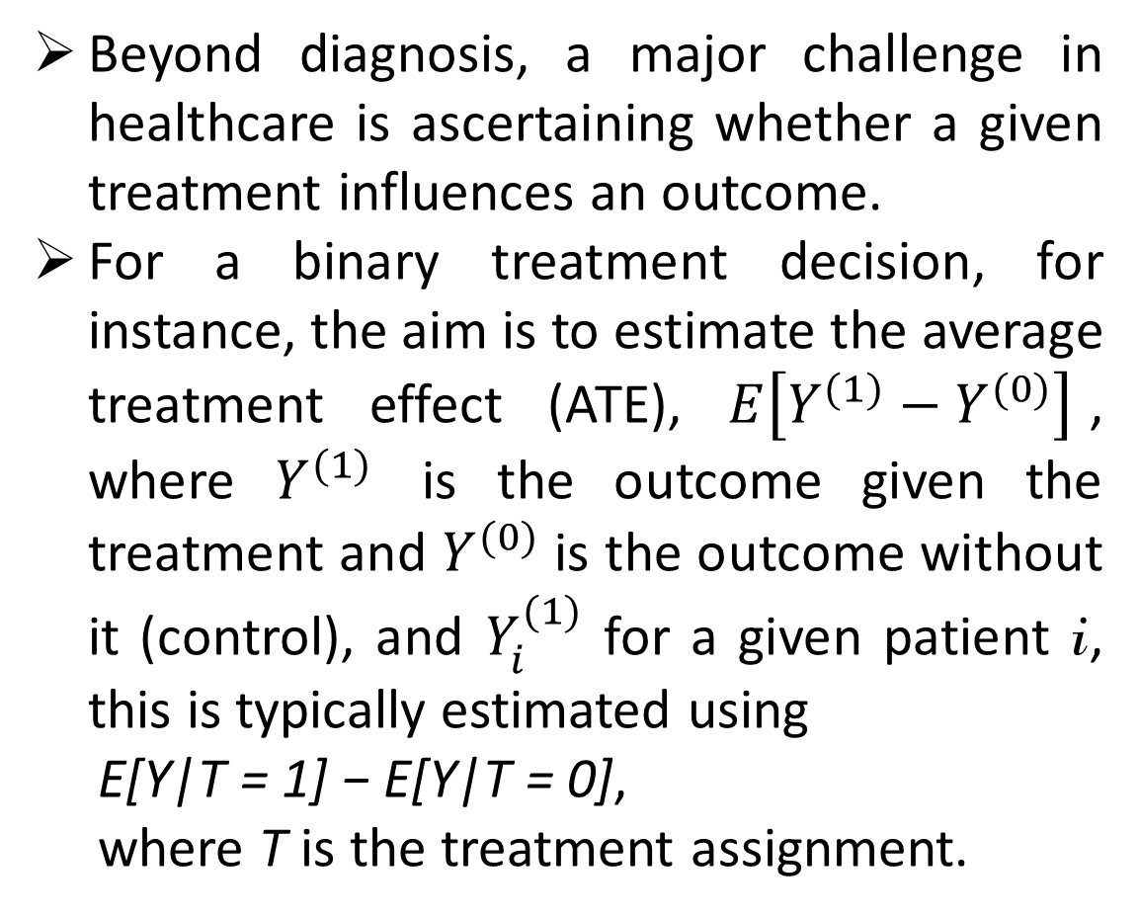
Treatment effect and precision medicine
Beyond diagnosis, a major challenge in healthcare is ascertaining whether a given treatment influences an outcome.
For a binary treatment decision, for instance, the aim is to estimate the average treatment effect (ATE), $E\left[Y^{(1)}−Y^{(0)}\right]$, where $Y^{(1)}$ is the outcome given the treatment and $Y^{(0)}$ is the outcome without it (control), and $Y_{i}^{(1)}$ for a given patient i, this is typically estimated using
E[Y|T = 1] − E[Y|T = 0],
where T is the treatment assignment.

Slide 17
Causal machine learning for complex data
Multi-modal data
Psychiatric disease has multiple causes arising from complex interactions
Data derived from several data sources and modalities, including patient demographics, clinical measurements, genetic data and imaging exams.
New ways of measuring biomarkers are increasingly accessible and affordable, but integrating this information is not trivial.
Performing interventions with complex data representations and functions is challenging.

Slide 18
Causal machine learning for complex data
Temporal data
Environmental factors over time contribute to different disease trajectories in AD.
Inferring causality from time-series data is at the core of CML.
CI methods need to model patient history and treatment timing.
Estimating trajectories under different possible future treatment plans (interventions) is extremely important.
Early work has used temporal CI in neuroscience , but the application of temporal CI in combination with ML for understanding and dealing with complex disease remains largely unexplored.

Slide 19
Causal machine learning for complex data
Out-of-distribution with unstructured and high-dimensional data
Challenge of integrating different modalities and temporal information increases when unstructured data is used
Generalization is one of the biggest challenges.
Distribution shifts are often caused by a change in environment (e.g. different hospitals).
Causal relationships are stable across different environments [1].
In a causal learning, the prediction should be invariant to distribution shifts.
[1] Peters J, Bühlmann P, Meinshausen N. 2016 Causal inference by using invariant prediction: identification and confidence intervals. J. R. Stat. Soc. B (Stat. Methodol.) 78, 947–1012. (doi:10. 1111/rssb.12167)

Slide 20
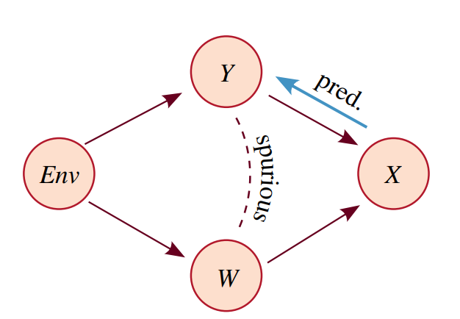
Causal machine learning for complex data
Out-of-distribution with unstructured and high-dimensional data
Imagine a prediction problem where the goal is to learn P(Y|X )
We consider an environment variable Env which controls the relationship between Y and W. Env is a confounder Y ← Env → W and X is caused by the two variables Y → X ← W.
Reasoning about generalization of a prediction task with a causal graph. Anti-causal prediction and a spurious association that may lead to shortcut learning are illustrated.

Slide 21
Causal machine learning for complex data
Out-of-distribution with unstructured and high-dimensional data
P(X|Y), which represents the causal mechanism, Y → X, is independent of P(Y|Env); however, P(Y|X ) is not, as P(Y|X ) = P(X|Y)P(Y|Env)/P(X ).
Thus, P(Y|X) changes as the environment changes.
Another (or many others) generating factor W is often correlated with Y, which might cause the predictor to learn the relationship between X and W instead of the P(Y|X ).
Reasoning about generalization of a prediction task with a causal graph. Anti-causal prediction and a spurious association that may lead to shortcut learning are illustrated.

Slide 22
ML settings based on the causal perspective by comparing data availability at train and test time
Out-of-distribution with unstructured and high-dimensional data
Classical supervised learning uses the strong assumption that the data from train and test sets are independent and identically distributed (i.i.d.).
Semi-supervised learning is a case where part of the training samples are not paired to annotations.
Continual (or Lifelong) learning considers the case where data from different environments are added after training, and the challenge is to learn new environments without forgetting what has initially been learned.

Slide 23
ML settings based on the causal perspective by comparing data availability at train and test time
Out-of-distribution with unstructured and high-dimensional data
In domain adaptation, only unpaired data from the test environment is available during training.
Domain generalization aims at learning how to become invariant to changes of environment, such that a new (unseen in training data) environment can be used for the test set.

Slide 24
Research directions in causal machine learning
CML according to the three categories
Causal representation learning;
Causal discovery; and
Causal reasoning.

Slide 25
Research directions in causal machine learning
Causal representation learning
High-dimensional and unstructured data are not organized in units that can be directly used in current causal models.
The idea is to reinforce a hierarchy of latent variables following the causal model, which in turn should follow the real data generation process.
Learn to extract low-dimensional informative (causal) variables and their causal relation.

Slide 26
Research directions in causal machine learning
Causal discovery
Most real data are observational and discovering causal relationships between the variables is more challenging.
In some settings, we have many input variables and the goal is to construct the graph structure that best describes the data generation process.
Causal discovery is the task of learning the direction of causal relationships between the variables.
Given a set of variables, it learns the causal relationships between them

Slide 27
Research directions in causal machine learning
Causal discovery
Still an open area of research, and some of the major challenges in discovering causal effects from observational data are the inability to,
Identify all potential sources of bias (unobserved confounders)
Select an appropriate functional form for all variables (model misspecification)
Model temporal causal relationships.

Slide 28
Research directions in causal machine learning
Causal reasoning
Given a set of variables and their causal relationships, analyse how a system will react to interventions.
Using causal models for quantifying the effect of interventions and pondering about the best decision is known as causal reasoning.
In SCM, counterfactual estimation with deep learning-
Generative models such as normalizing flows,
Variational autoencoders and
Diffusion probabilistic models or twin networks which augment the original SCM resulting in both factual and counterfactual variables represented simultaneously.

Slide 29
Research directions in causal machine learning
Causal reasoning
In the potential outcomes framework, a number of approaches have been proposed to estimate personalized treatment effect from observational data, include-
Bayesian additive regression trees
Double ML,
Regularization of neural networks with integral probability metrics or orthogonality constraints,
Gaussian processes,
Generative adversarial networks or energy-based models

Slide 30
Conclusion
Described the importance of considering CML in healthcare systems.
Highlighted the need to design systems that take into account the data generation process.
A causal perspective on ML contributes to the goal of building systems that are not just performing better (e.g. achiever higher accuracy), but are able to reason about potential effects of interventions at population and individual levels.
Discussed key pressing challenges in precision medicine and healthcare, using multi-modal, high-dimensional and unstructured data.

