Slide 1
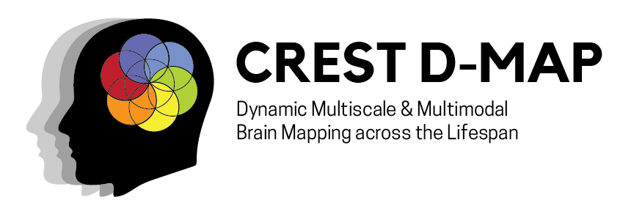







Robust Group PCA for Separable Noise:
Improving for Subject-Level PCA
Co-authors: Samuel Oriola, Calvin McCurdy, Bradley T. Baker, Xinhui Li, Vince D. Calhoun, Rogers F. Silva
Presented By: Samuel Oriola
Full Paper: S. Oriola, C. McCurdy, B. T. Baker, V. D. Calhoun and R. F. Silva, "Robust Group PCA for Separable Noise: An Argument for Subject-Level PCA," 2025 IEEE EMBS International Conference on Biomedical and Health Informatics (BHI), Atlanta, GA, USA, 2025, pp. 1-7, doi: 10.1109/BHI67747.2025.11269552.
keywords: {Neuroimaging;Noise;Noise reduction;Stars;Functional magnetic resonance imaging;Robustness;Spatial resolution;Principal component analysis;Testing;Noise level;Group PCA;ICA;Data Analysis;Functional MRI;Multivariate},

Slide 2
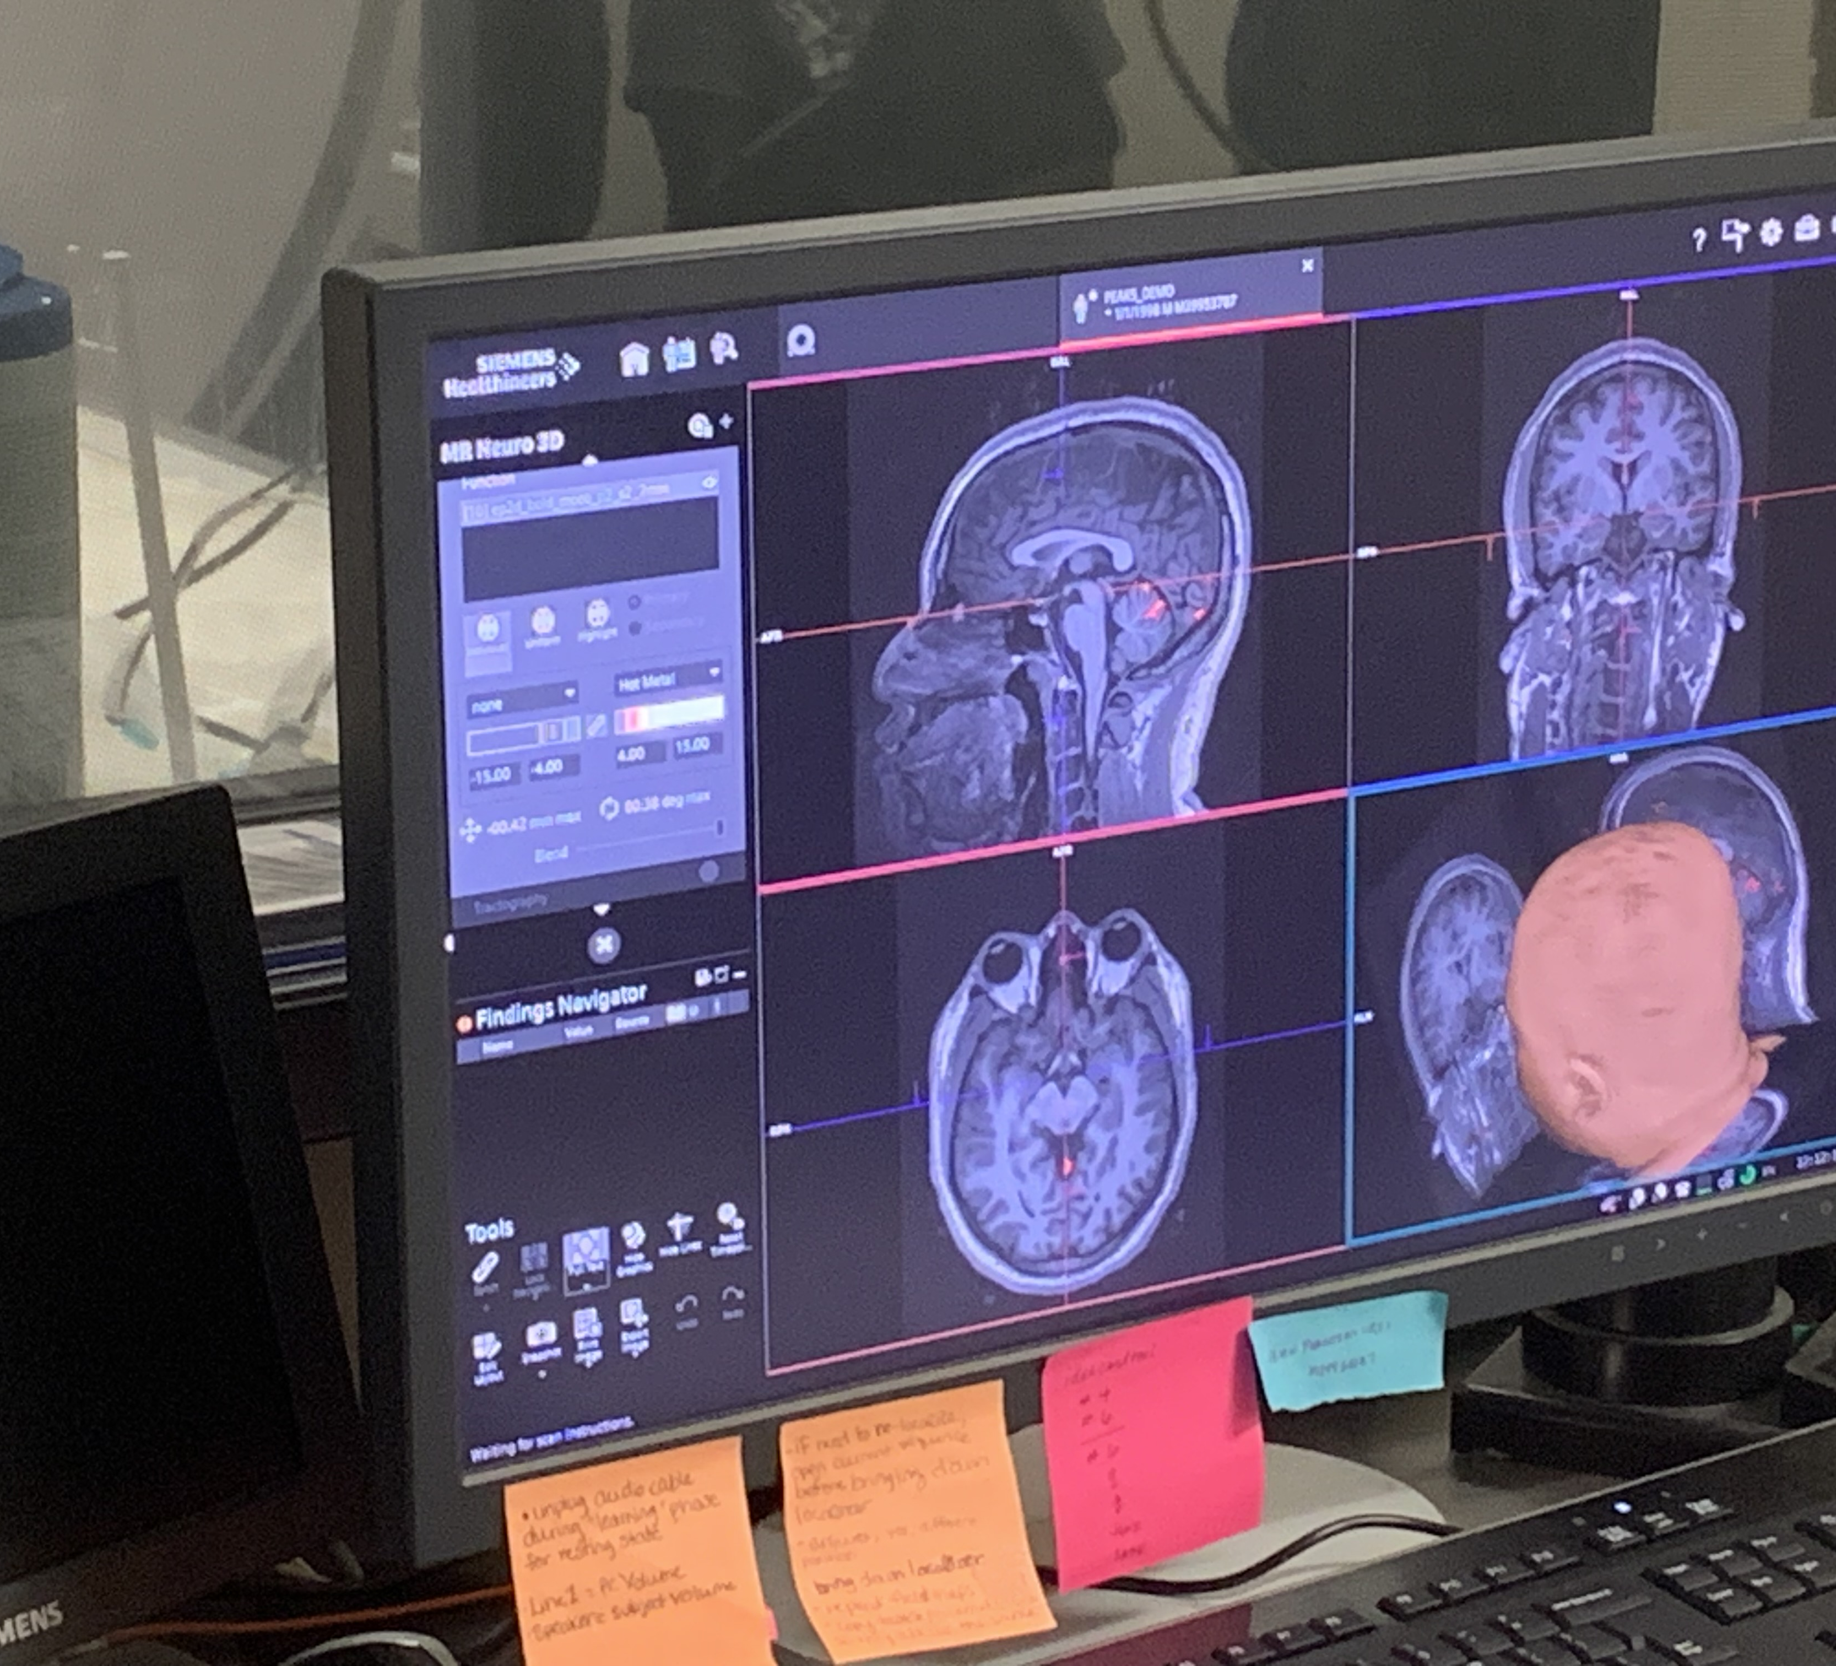
Introduction
What is functional magnetic resonance imaging (fMRI)?
Ten years ago, big data with fMRI studies was 1,000 subjects it's now 100,000 subjects
Why is it difficult to obtain a group-level representation?

Slide 3
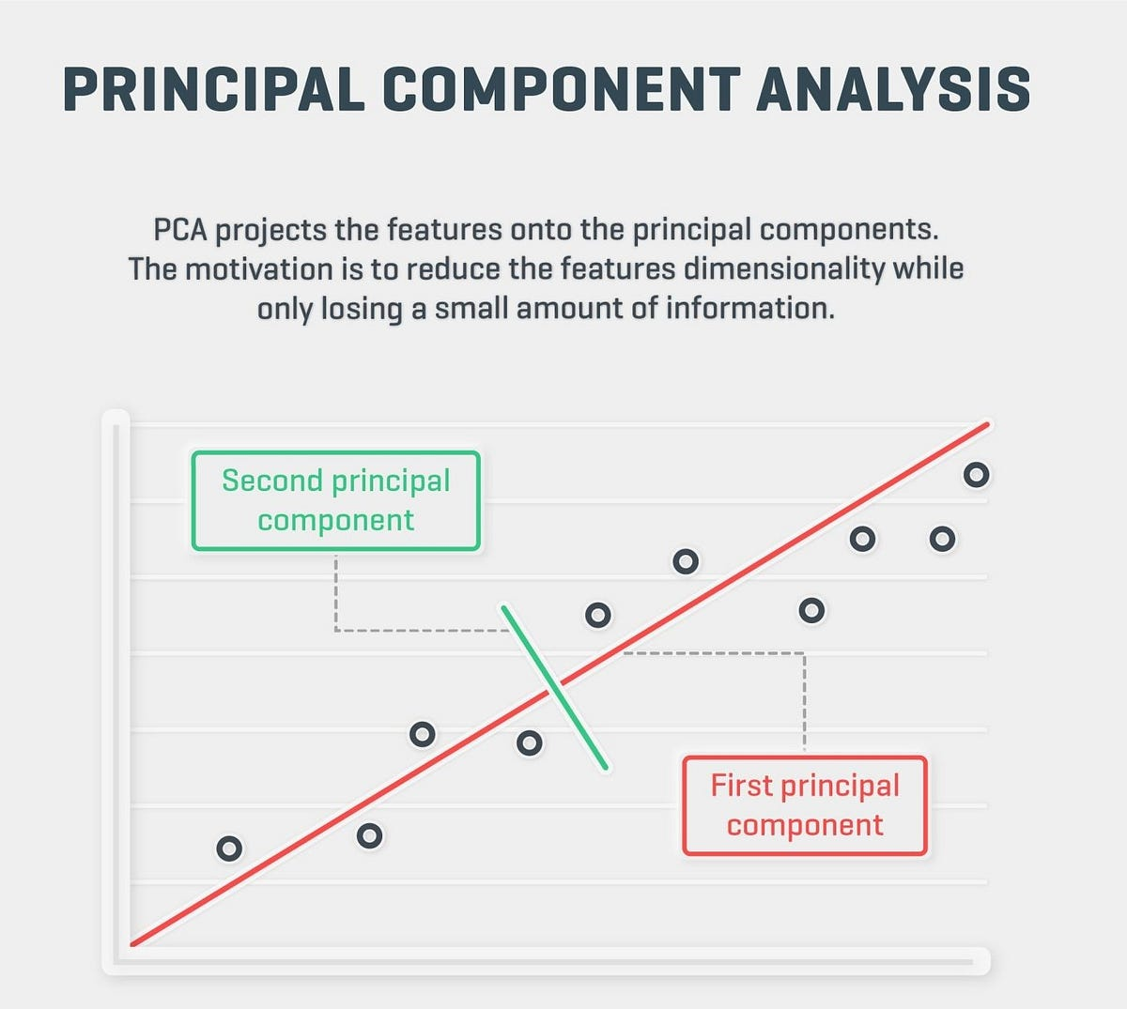
(Group) Principal Component Analysis
Principal Component Analysis (PCA) is a technique that reduces the dimensionality of the data (brain scans/spatial maps) by treating low variance components as noise that can be discarded
in the data (Initial steps in the GIFT toolbox)
General steps for PCA: Compute cov matrix - EVD - Select top components - Project on the corresponding principal axes
High Variance
Low Variance
Feature 2:
Feature 1:
Notes:
But we are probably not doing that For our simulation we remove the mean and make std dev 1

Slide 4

But There is a Lack of Consensus
Different gPCA implementations
Quantify loss of subject-specificity and bias by method
Improving gPCA can enhance the accuracy of downstream analyses in neuroimaging toolboxes.

Slide 5
What Do We Do?
We compare three different gPCA methods to quantify their ability to recover subject-specific variability in various scenarios of signal similarity and noise level
GOAL: identify best practices for optimal group-level representation

Slide 6
Methods
Generative Model for gPCA using Singular Value Decomposition (SVD) for Separable Noise.
What are sources? What is separable noise? What is orthogonal? What is the variance profile? Why so many confusing terms?
m

Slide 7
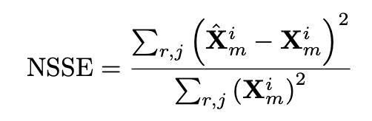
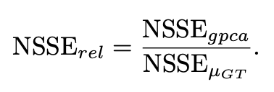
Performance Metric: Sum of Square Error
  The way we measure error for a single subject and source is Normalized Sum of Squares Error (NSSE)
  How do we get the ground truth mean?
  What is Relative Normalized Sum of Squared Error?

Slide 8
Results for Separable Noise

Slide 9
Results for Hard Noise

Slide 10
Recap
The ground-truth mean captures sources with high similarity very well by, but not so for sources with low similarity across subjects.
gPCA post subject PCA whitening with no data reduction completely matches the ground truth mean performance in extreme levels of simple/separable noise.
There is no prevailing method in the hard/non-separable noise case

Slide 11


Initial Recommendations
Do little to no data reduction for gPCA with subject-level whitening.
1
Utilize subject-level normalization to eliminate variance profile effects in simple concatenation gPCA.
2

Slide 12
Conclusion
In Simple Noise: Subject-level PCA with whitening and no data reduction perfectly matches ground-truth mean performance, even in scenarios of extreme noise.
The ground truth mean can lead to biased inferences about subjects that deviate from the population average, and no gPCA method uniformly outperforms the ground truth mean.
Future work will explore more challenging noise scenarios
such as correlated noise, and evaluate the performance of gPCA
methodology on real data.

Slide 13

Special Thanks to YOU for Listening!
Also special thanks to my mentor Rogers Silva, my PI Vince Calhoun, my co-authors, Calvin McCurdy and Brad Baker, and Xinhui Li the TReNDS lab, the programs that have funded this work and GSURC for hosting me!

Slide 14
Questions?
I know questions are awkward and hard for conferences so here are some free questions to ask ;)
Why are you focused on these particular gPCA methods?
If the true source mean is biased against atypical subjects, why still use it?
What would happen if you added more subjects?
What is the real-world translation of gPCA and this simulation?
What went wrong in this project? What is not shown?
What was the most exciting part of the research or the least exciting part?

