Slide 1
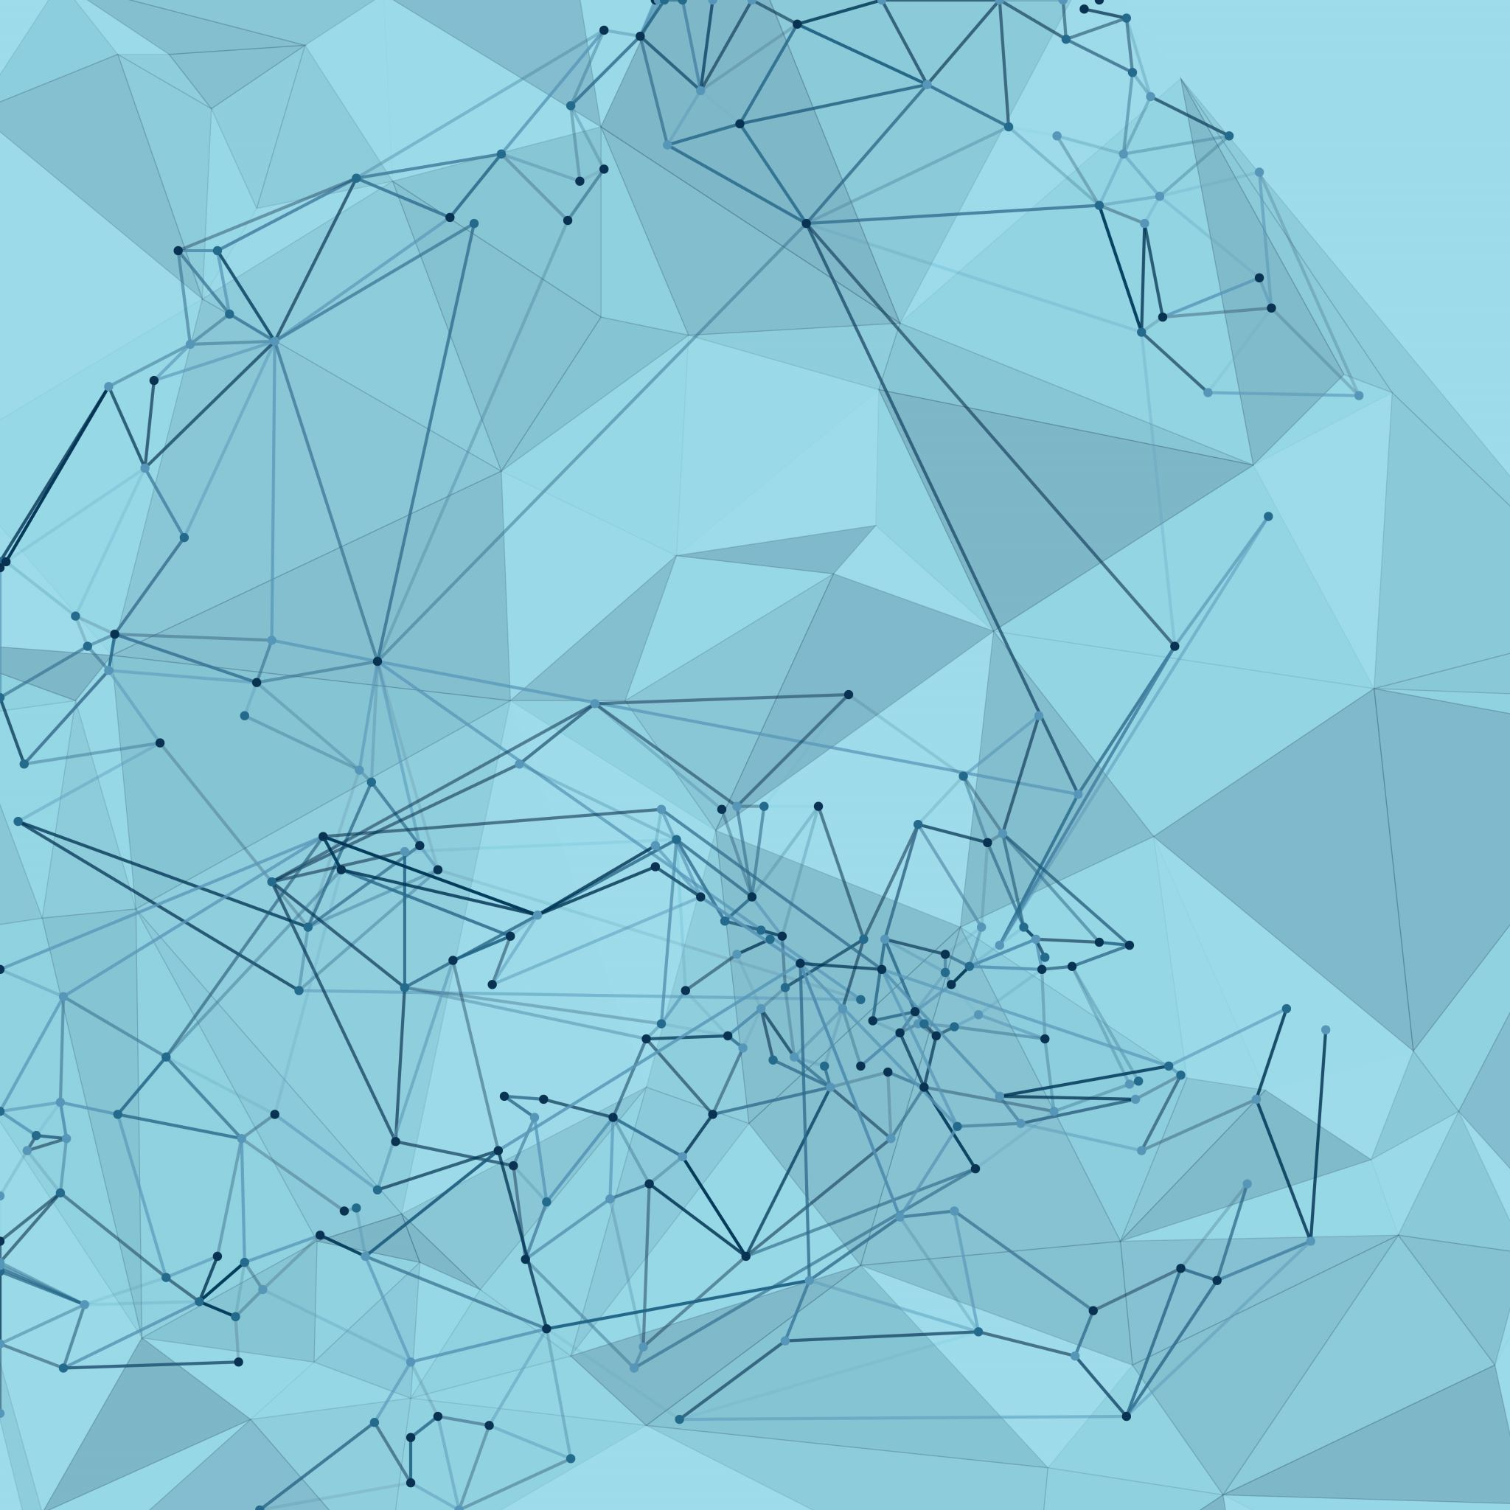
Causality-Inspired Spatial-Temporal Explanations for Dynamic Graph Neural Networks
Kesen Zhao, Liang Zhang
Presented by Selim Suleymanoglu

Slide 2
Dynamic GNNs
Offer strong predictive power
Suffer from low transparency and limited interpretability
Interpretability Needs:
Spatial: Identify which subgraphs drive predictions
Temporal: Recognize critical time steps influencing outcomes

Slide 3
Limitations of Existing Methods
Most explanation methods (e.g., GNNExplainer, XGNN) target static graphs
They do not address the complex spatial-temporal correlations in dynamic graphs
Challenge: How to separate useful (causal) information from spurious (trivial) patterns

Slide 4
Research Objective
Develop an explainer for DyGNNs that meets two criteria:
Fidelity: Explanations must closely mimic the target model’s behavior
Interpretability: Explanations should be human-understandable
Approach: Leverage causality to disentangle complex relationships

Slide 5
Proposed Approach
Key Idea: Construct a Structural Causal Model (SCM) for dynamic graphs
Disentangle Relationships:
Trivial vs. Causal (via contrastive learning)
Static vs. Dynamic (via a dynamic correlating module)
Outcome: Generate spatial-temporal explanations via soft masks

Slide 6
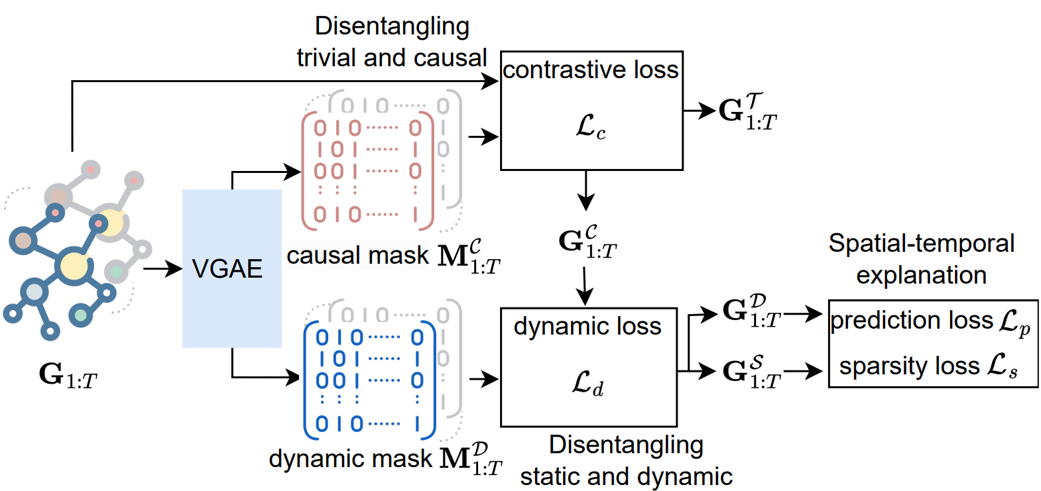
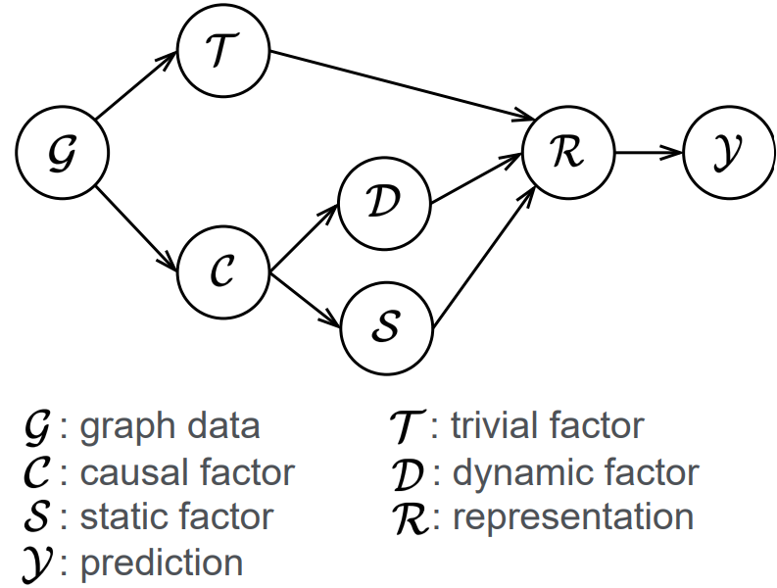
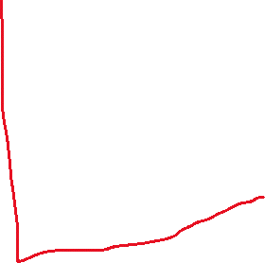
Overview of proposed DyGNNExplainer
Notes:
Each element of the mask represents an attention score, typically falling within the range of [0, 1 Variational graph auto-encoder extracts, maps

Slide 7
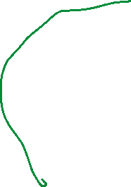
Structural Causal Model (SCM)
Key Causal Relationships in the SCM
T ← G → C: Differentiates trivial vs. causal info in G
R Generation: Uses both T and C to form representations
Splitting C: Into dynamic (D) and static (S) components
Backdoor Paths:
Confounding from trivial (T) and static (S) factors can mislead predictions
No hidden vars to average out
Notes:
G: Dynamic graph dataT: Trivial relationships (spurious patterns)C: Causal relationships (essential info)D: Dynamic relationships (time-evolving aspects)S: Static relationships (time-invariant cues)R: Node representationsY: Predictions

Slide 8
Backdoor Adjustment
Objective: Block confounding paths that affect prediction Y
Need to merge estimations to remove bias introduced by T and S
Notes:
G: Dynamic graph dataT: Trivial relationships (spurious patterns)C: Causal relationships (essential info)D: Dynamic relationships (time-evolving aspects)S: Static relationships (time-invariant cues)R: Node representationsY: Predictions

Slide 9
Disentangling Trivial and Causal Relationships
Contrastive Learning Module:
Enforces semantic similarity between the original graph and its causal part
Increases the semantic distance from trivial (spurious) relationships
Outcome: A clearer separation of useful (causal) features from noise

Slide 10
Disentangling Static and Dynamic Relationships
Dynamic Correlating Module:
Captures temporal evolution by linking neighboring subgraphs
Differentiates between time-varying (dynamic) and time-invariant (static) factors
Outcome: Spatial-temporal granularity in explanations

Slide 11

Dynamic VGAE-Based Framework
Encoder-Decoder Architecture:
Encoder: Maps node attributes and structure into latent representations
Decoder: Generates soft masks (M_{t}^{C} for causal, M_{t}^{D} for dynamic)
Purpose:
Estimate masks that reveal important subgraph structures
Provide spatial explanations (via causal-and-dynamic masks)
Offer temporal insights (by analyzing subgraph evolution)

Slide 12


Loss Functions & Optimization
Key Losses:
Contrastive Loss: For disentangling trivial vs. causal features
Dynamic Loss: To capture temporal evolution and enforce independence
Prediction Loss: Ensures fidelity to the target DyGNN
Sparsity Loss: Promotes interpretability by focusing on key graph parts
Joint Optimization: Balances prediction performance with explanation quality

Slide 13
Experimental Setup
Datasets:
Synthetic dynamic graphs (designed for interpretability tasks)
Real-world dynamic datasets
Evaluation Metrics:
Fidelity of explanations pertains to the accuracy of the explanations provided by target methods. To gauge this, compare the predicted labels of explanatory subgraphs with the predicted labels of the original graphs as generated by the target model.
Interpretability (clarity of spatial and temporal masks)
Baselines: Comparisons with existing static-graph explainers

Slide 14
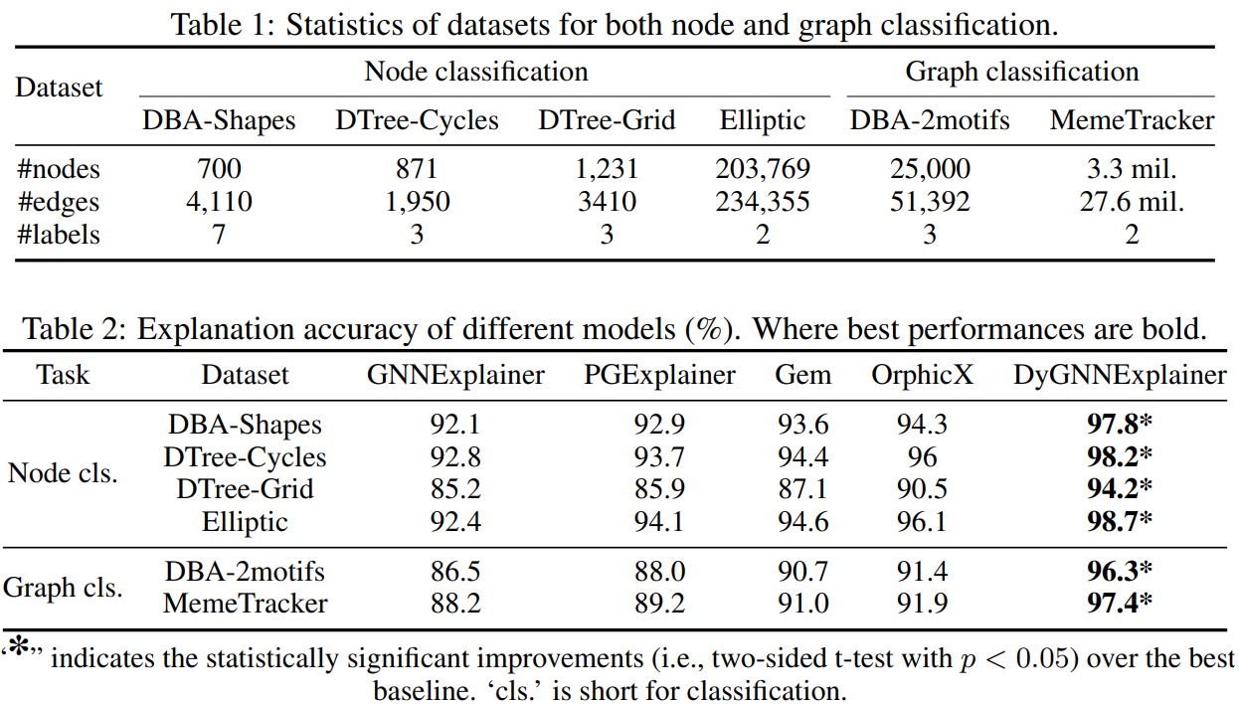



Results & Performance

Slide 15
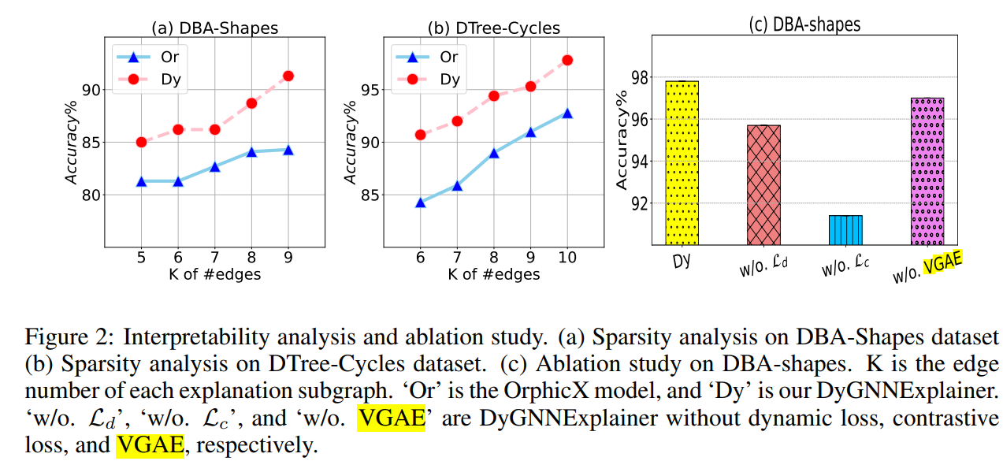
Results & Performance

Slide 16
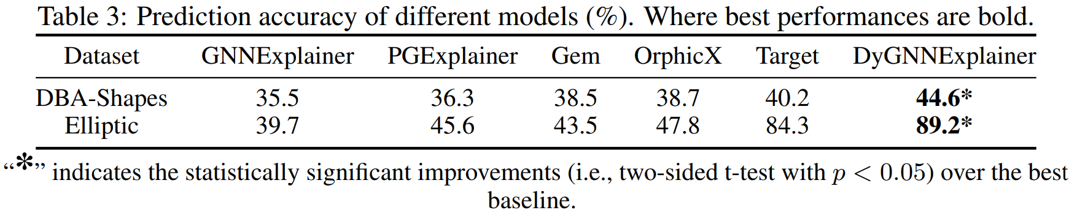
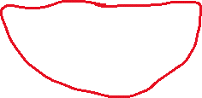
Results & Performance
Improvements Observed:
Improved prediction fidelity when explanations are applied
Clearer spatial-temporal patterns captured by the masks
Key Findings:
The proposed method outperforms baselines in both synthetic and real scenarios
Provides robust insights into the dynamic causal structure

Slide 17
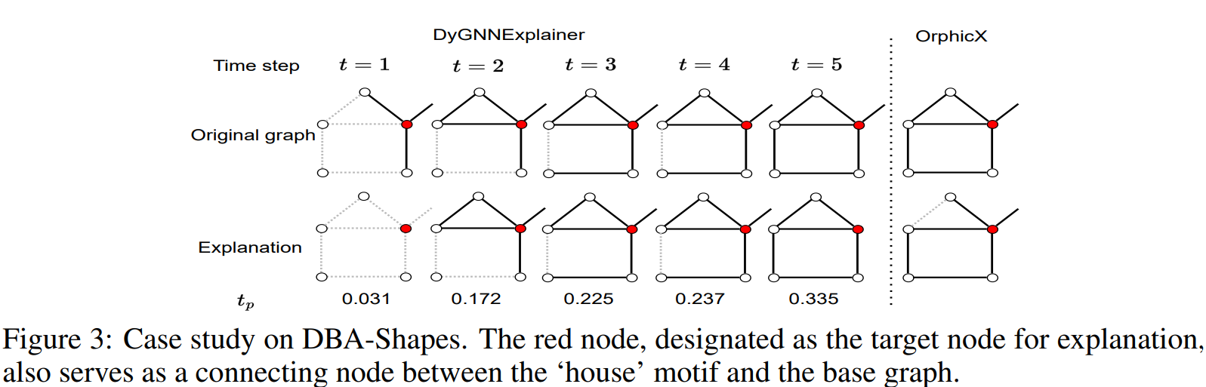
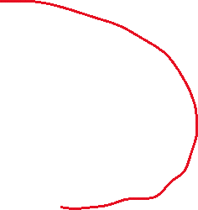
OrphicX erroneously attributes an edge outside of the ‘house’ motif

