Slide 1
Parallel Multi-Dimensional LSTM, With Application to Fast Biomedical Volumetric Image Segmentation(2015)
Marijn F. Stollenga
Wonmin Byeon
Marcus Liwicki
Juergen Schmidhuber

Slide 2
Abstract & introduction
Compare to CNN. MD-RNN can predict the entire context of each pixel in a few sweeps through all pixels.
previous MD-LSTM variants were hard to parallelize on GPUs. This paper re-arrange the traditional cuboid order of computations in MD-LSTM in pyramidal fashion.
Pyramid-LSTM need less sweeps, and can get more features.
LSTM

Slide 3
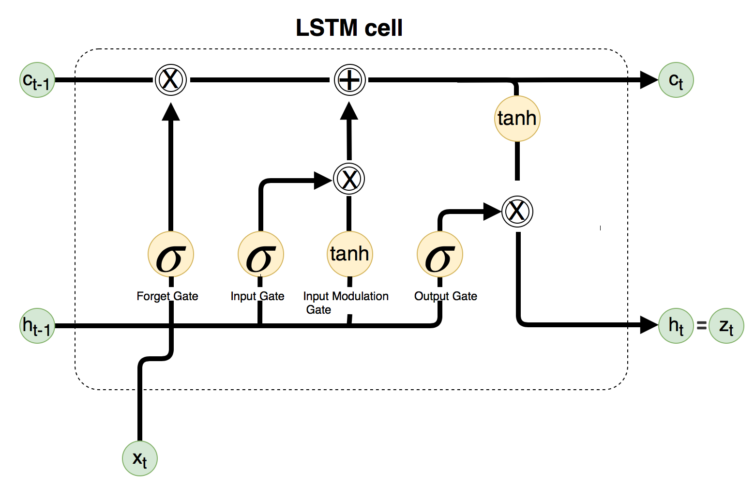
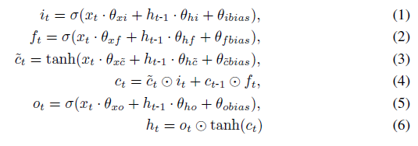
LSTM

Slide 4
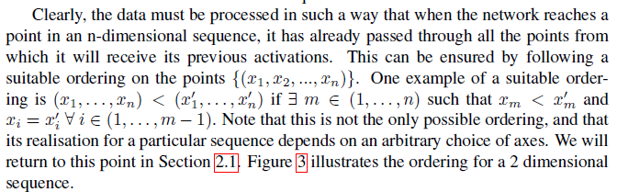
MDRNN
Multi-Dimensional Recurrent Neural Networks(2007, Alex Graves, Santiago Fern´andez, J¨urgen Schmidhuber)

Slide 5
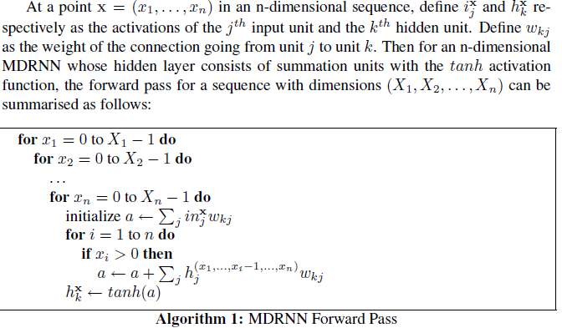
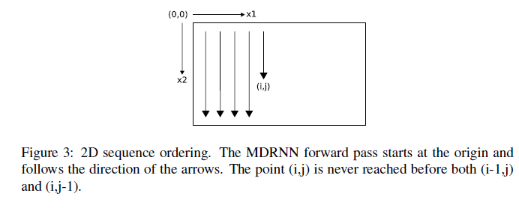
MDRNN

Slide 6
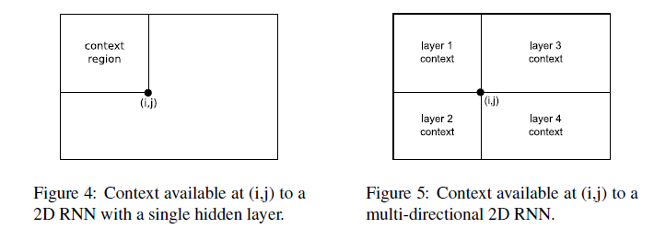
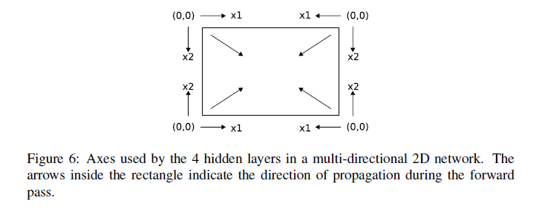
Multi-directional mdrnn

Slide 7
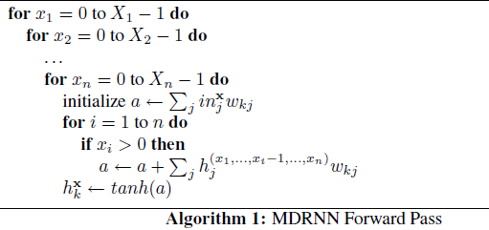
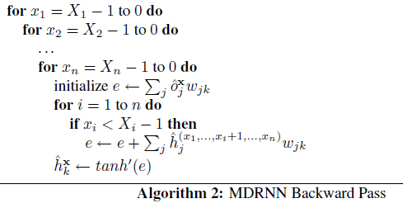
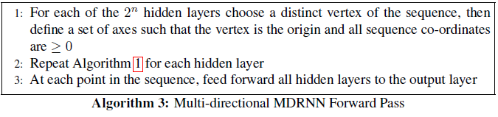
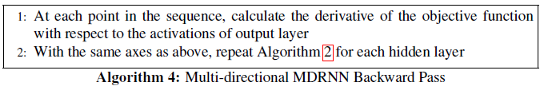
process

Slide 8
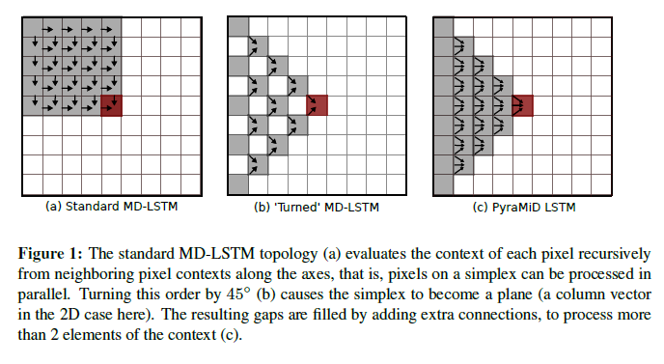
Pyramid_lstm

Slide 9
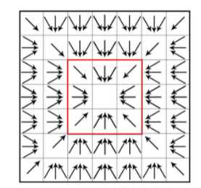
2 times teatures than MDLSTM

Slide 10
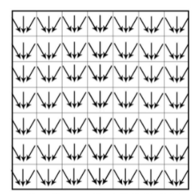
Improve the efficiency of parallel computing on GPU

Slide 11
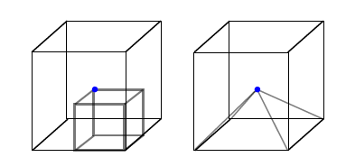
COMPARISON
MD-LSTM start from a point, sweep a cube every time. And the length is gradually increase until cover the whole data.
Prymid-LSTM start from a face, And the face gradually move through its direction until cover the whole data.

Slide 12
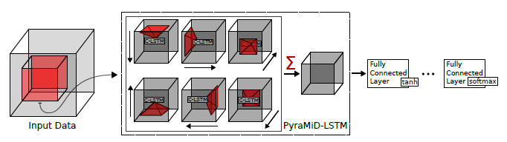
In 3D. Define the direction D = [:,:,1], [:,:,-1] …...[-1,:,:]
The input data will be processed by the C-LSTM from the 6 directions. Then bring to a fully connect layer, tanh as the activation function.

Slide 13
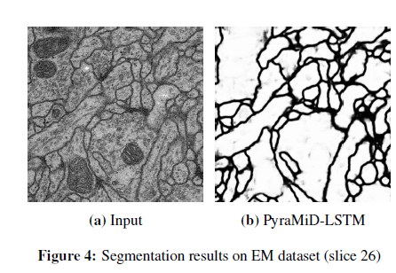
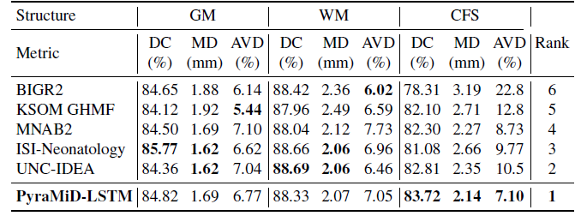
Results
https://mrbrains13.isi.uu.nl/results.php

