Slide 1
Disruption of the gut microbiota-inflammation-brain axis in unmedicated bipolar disorder II depression
Jordan Clemsen

Slide 2
Background

Slide 3
What is the central dogma of molecular biology?

Slide 4
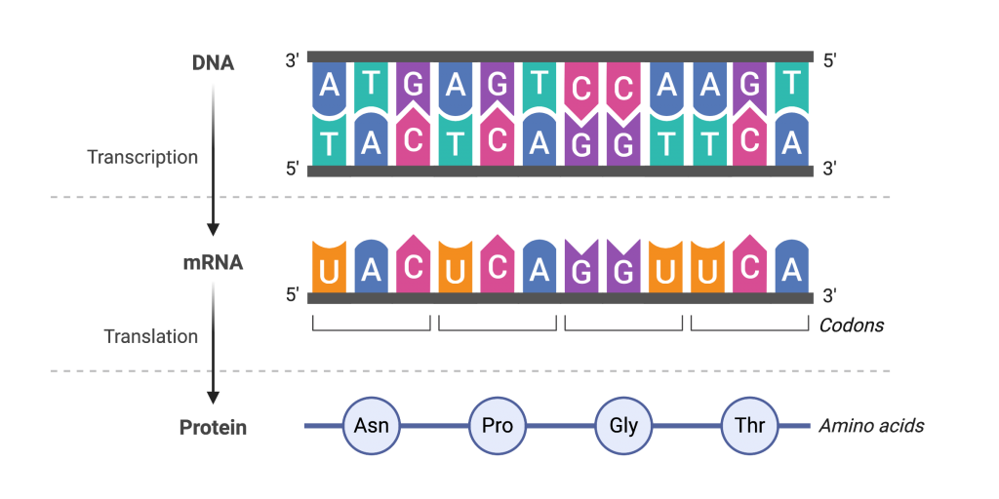
Central dogma
4 base pairs
ATGC = DNA
AUGC = Rna
To proteins
Transcription
Translation
Codons UUG, AUG, etc.

Slide 5
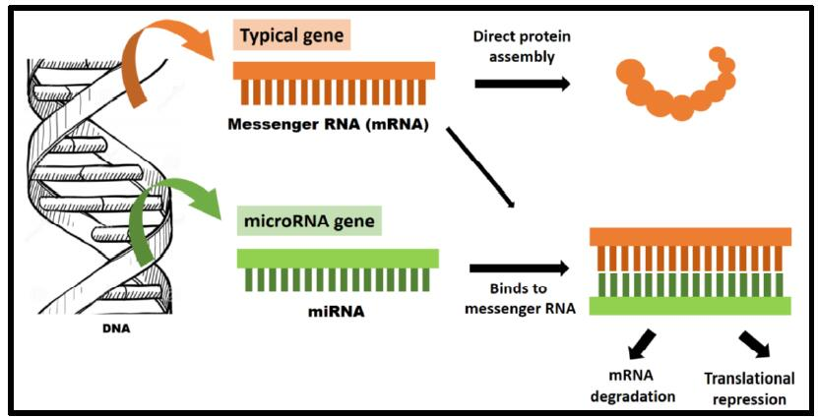
mirna
Hairpin structure
Attaches to mRNA
Upregulated or down
Genes that code miRNA
Numerous
Nobel prize 1993

Slide 6
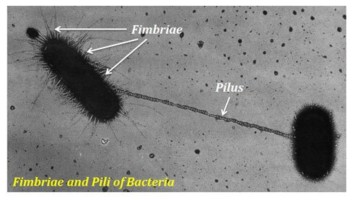
Bacteria
More than bacteria
Plasmid
Pilus
Endospore
Vast
Fermentation

Slide 7
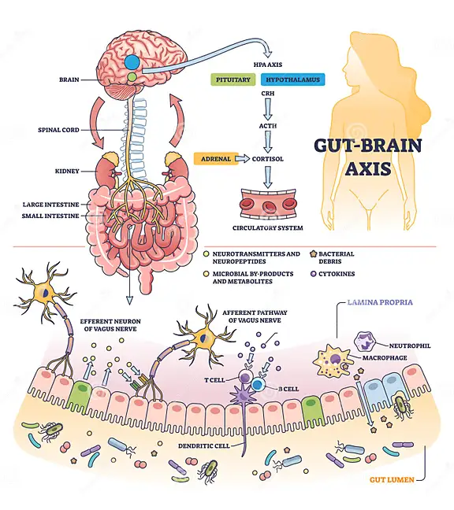
Microbiome
Enteric nervous system
Neurotransmitters
Fermentation
Lacto -> H0
Space
Breast feeding
miRNA!!! = humans

Slide 8
If you had a functioning pilus and a plasmid, etc. What gene(s) would you share and why?

Slide 9
Study

Slide 10
Why?
BD2 symptoms
Reduced dALFF, dFC
Outliers
Proinflammatory biota
DMN corr to biota
Unmedicated changes of biota not documented

Slide 11
Methods I
65 BD vs 65 cont
Met DSM-5 criteria
HDRS >21
YMRS <7
3T MRI
Blood
Fecal samples

Slide 12
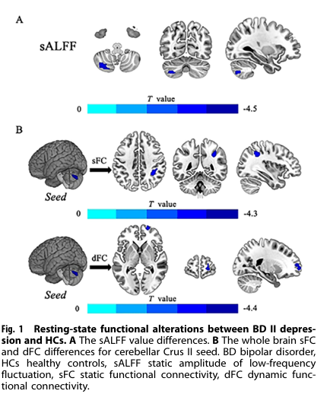
Imaging I
Time series -> fast Fournier transform
Voxel = root of power, AVRG
Smoothed 6mm kernel
sFC from clusters of ALFF
ALFF to whole brain voxel
Pearson corr = mean time and voxel
Corr maps -> z, by Fishers
Smoothed
Sliding Window from TDA toolkit (50)
Validated by using 30 and 70

Slide 13
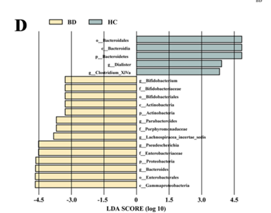
Microbiology
Cytokines (IL-2, IL-4, IL-6, IL-8, IL-10, TNF-α
MagPure stool DNA kit B
PCR V4 of the 16s rRNA the Illumina protocol, the Illumina MiSeq platform
(Short RNA seq)
Vserch for +
ASV mapped
RDP database
Shannon and Simpson
PCoA
LEfSe

Slide 14
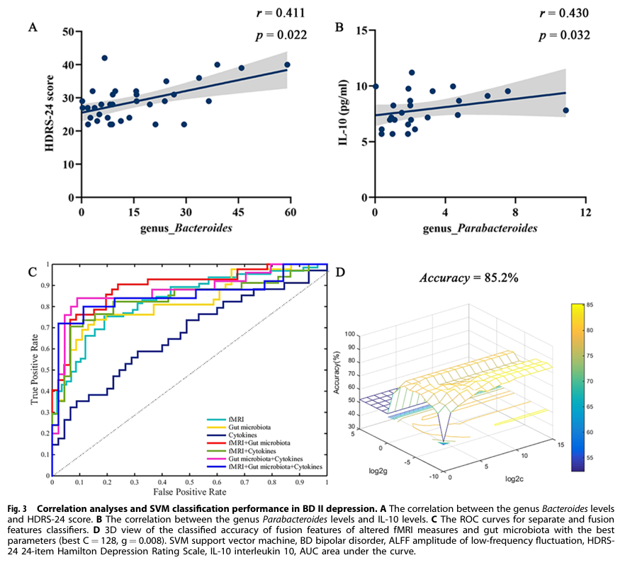
Statistics
Indep T and Mann-Whitty u test
Demograph and mood
ALFF two tailed t test
GRF theory between clusters
One sample test for each ROI
Two tailed t test whole brain
Cytokines Shapiro-Wilk test, Independent-sample t-test and MannWhitney U test
GRBF, LIBSVM software for SVM
80% accuracy microbiota and rs-fmri
+pro and anti cytokines with BD

Slide 15
Jordan’s suggestions

Slide 16
Critiques
Only 1 year
1%
130 sample size
ICA?
Social microbe exchange
Virome
Mycobiome
Embark study reported 90%<
Other body area biomes

Slide 17
What are your thoughts?

