Slide 1




Correlation to Causality
Authors: Marta Rotari, Murat Kulahci
Presenter: Selim Suleymanoglu

Slide 2
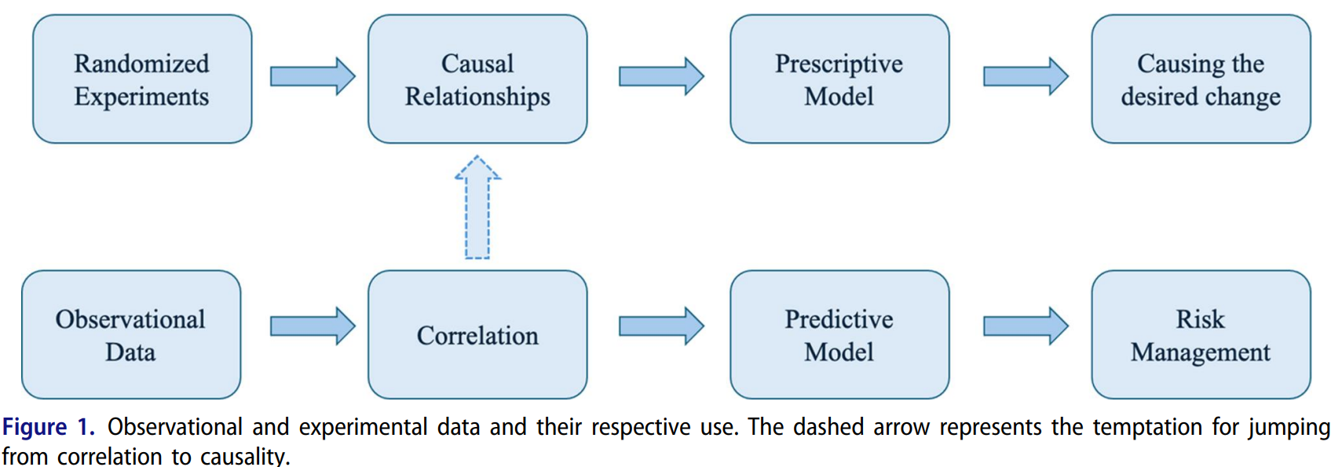

Our animal instinct
Notes:
With rich observational data, our natural tendency to infer causality from association becomes especially strong.

Slide 3
Correlation
a statistical measure that describes how strongly two variables move together, and in which direction.
Causation
a relationship where changing one variable directly produces a change in another.
Correlation does not imply causation.
Causation usually implies correlation (Brown et al., 2020).
Notes:
1st stage: Estimate propensity score for each patent. 2nd: Compare outcomes (e.g., invention disruption) between patents with and without public sector support, but only among those with similar propensity scores—thus mimicking a randomized experiment.

Slide 4
HOWEVER

Slide 5
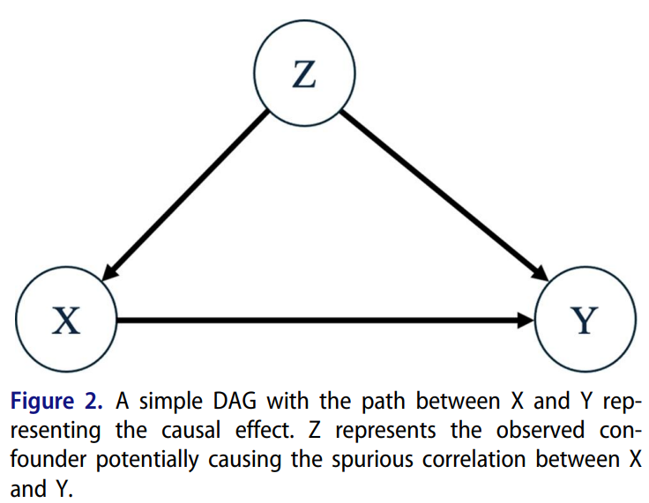
Observational data breaks this simple link
Hidden confounders create correlations without causation
True causal effects can be masked (noise, cancellation, nonlinearities)
Feedback loops blur direction

Slide 6
Proposed approach
Real processes are highly complex, high-dimensional
Pure causal modeling is often infeasible
Pure randomized experiments are also infeasible due to too many variables
Compromise: Combine observational data and experiments
What do we have now?
What else can we do?

Slide 7
Step 1. What do we have now?
GOAL: Reduce many inputs to a small candidate set.
HOW:
Use existing observational data + predictive models
+ domain expertise to screen* variables
      *Use observational data to eliminate most variables and keep a small subset of candidates
Notes:
Retrospective. Use existing observational data to screen variables
In parametric models as in multiple linear regression (MLR) with imposed assumptions on the error term, hypothesis testing can be performed on the model coefficients using a pre-defined significance level.

Slide 8
Step 2. What else can we do?
If Step 1 is ambiguous: collect improved observational data
Engineers guide sensor* choice, placement, and sampling
If candidates are clear: run randomized experiments
From “trivial many” to “vital few” via experimental design
*whatever devices are needed to better observe the shortlisted variables.

Slide 9
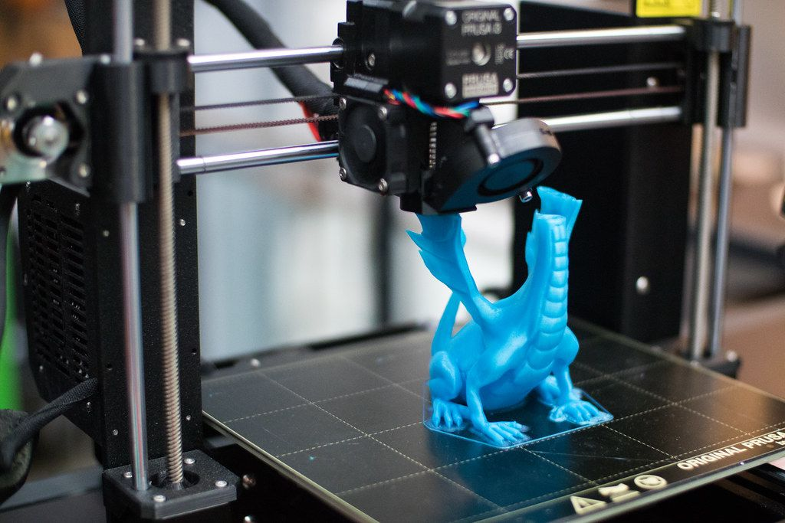

Case study: Additive manufacturing (AM)
GOAL: identify 3D printing machine parameters and in-production measurements that affect product quality.
18 production batches
53 process variables collected from sensors
Image courtesy anyonego.com

Slide 10
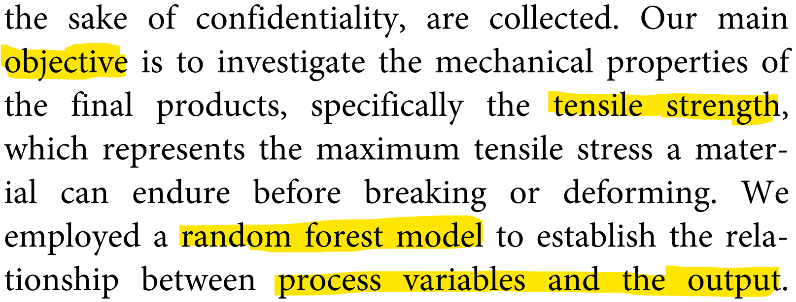
Case study: Additive manufacturing

Slide 11
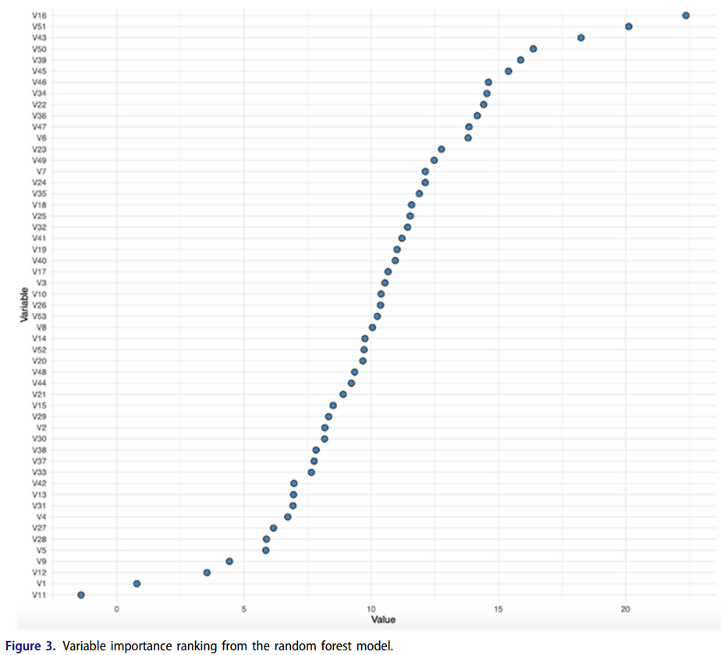

Slide 12
HOWEVER

Slide 13
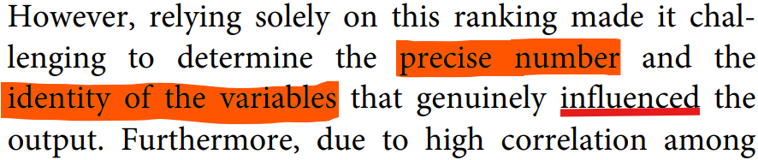
Case study: Additive manufacturing
To address this issue and select the most relevant variables, they employed the Conditional Boruta model, specifically developed to handle correlated variables.

Slide 14
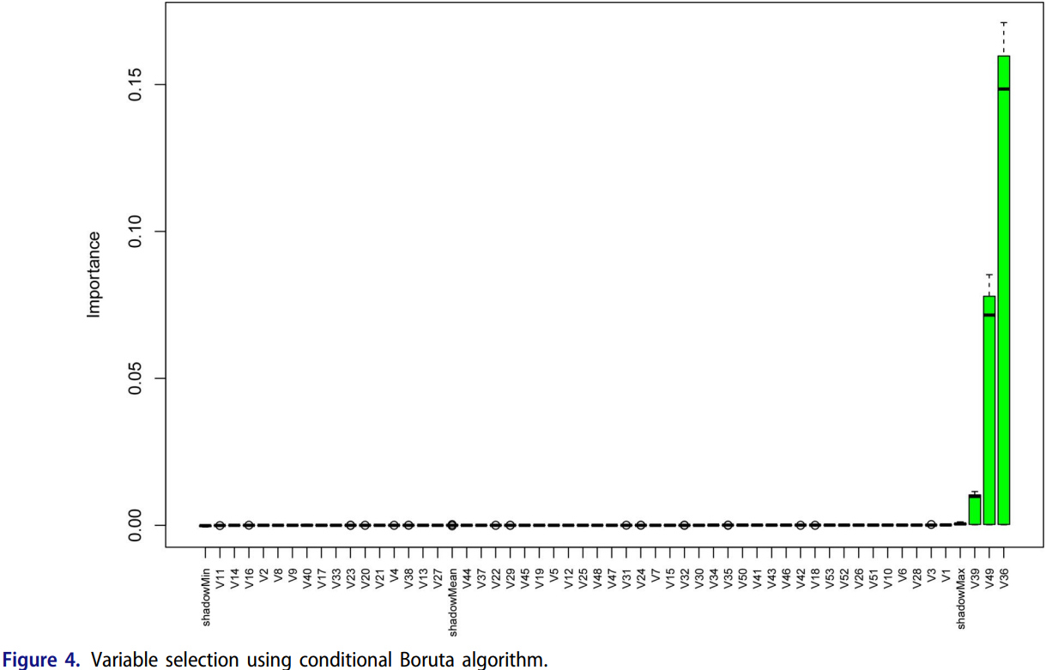








Slide 15


Case study: Additive manufacturing
using
OF COURSE ☺

Slide 16




Case study: Additive manufacturing
to the process parameters of the AM equipment.
They told us what the three Vs are btw
Observational screening

Slide 17

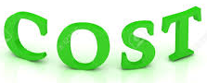
Case study: Additive manufacturing
Now call the three Vs Factors 1, 2, 3 for confidentiality in
2³ full factorial design (two numerical settings for each factor). No replications due to the

Slide 18
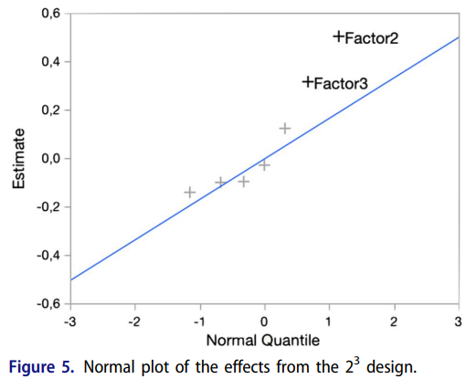
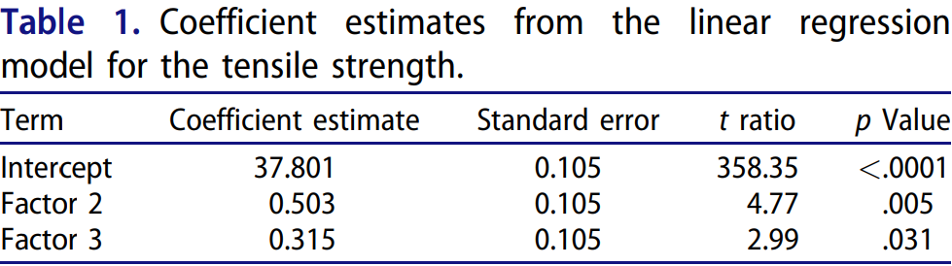
The main effects of Factors 2 and 3 are tentatively identified as significant.
Experimentation

Slide 19
Conclusion
Pure randomized experiments are infeasible in complex manufacturing
Pure observational causality tools also struggle with high-dimensional processes
So they propose:
Use observational data for screening + experiments for confirmation
Move from descriptive → predictive → prescriptive models
Combine data with domain expertise to enable causal learning

Slide 20
THANK YOU

Slide 21
References
Presented Paper:
Rotari, M., & Kulahci, M. (2025). Correlation to causality. Quality Engineering, 37(1), 162-172.
Others:
Brown, S. F., Schultz, B. D., Clickner, R. P., & Weitz, S. (2020). Data Analysis of Lead in Soil (HUD Survey Data). In Lead Poisoning (pp. 13-19). CRC Press.
https://anyonego.com/what-exactly-is-3d-printing-and-why-is-it-so-cool/

