Slide 1
The lung microbiome regulates brain autoimmunity
Jordan Clemsen

Slide 2
Background

Slide 3
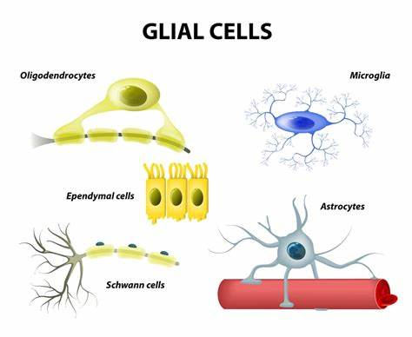
Glia
Different types
Astrocytes
Oligodendrocytes
Radial Glia
Microglia
Controversy

Slide 4
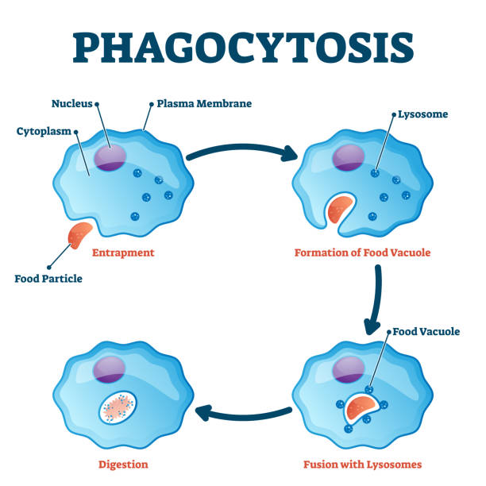
T cells
Hematopoietic stem cells
Produce Cytokines
Phagocytosis
Adaptive immunity
Cytokines, innate

Slide 5
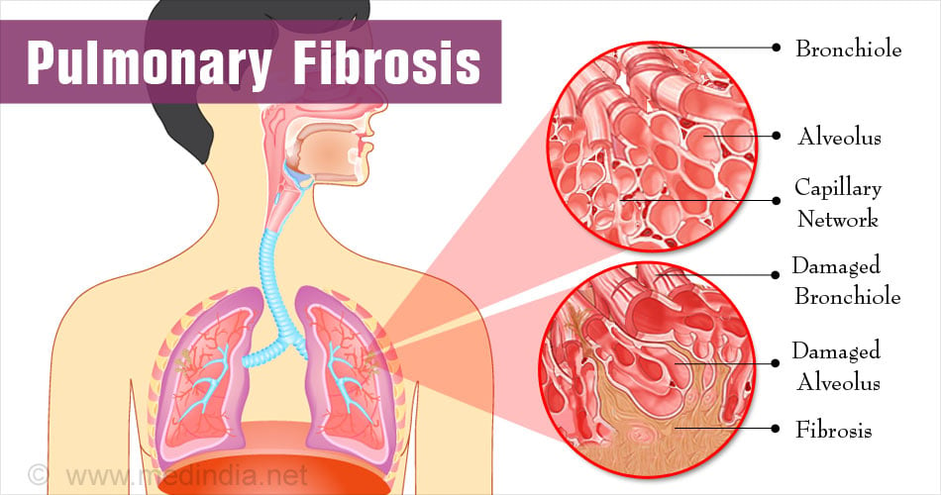
Lung Immunology
Van Der Waals bonds
Oxygen Blood
Neutrophils
Cytokines
Fibrosis

Slide 6
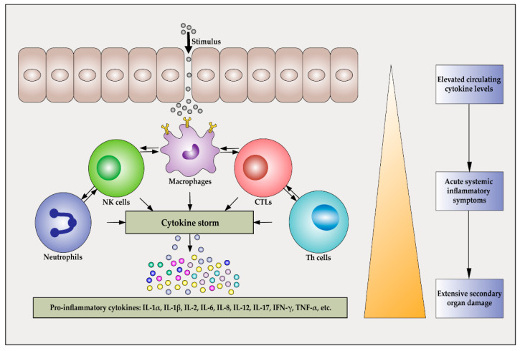
Lung Microbiome
Influenza type A
Endosome
Proinflammatory ex: TNF α
Sometimes anti-inflammatory IL-6
Goblet cells produce mucus

Slide 7
Study

Slide 8
Infusion
Manipulation of Microbiome
1mg of neomycin
MBP Specific Cells
6 hours, Immunized
Normal EAE mice/Control Group
Again, but Neomycin in the gut
Minimal changes, 10 more concentration EAE
Florescent cells

Slide 9
Immune with CNS?
Different T cell num in lung vs CNS
PCR of Cytokines, unremarkable
Subcutaneous injection -> lung, remarkable
BALF replaces Neomycin
Microbial transfers reduces EAE, with extra control group
T cell in CNS reduced
BBB
Flow cytometry
Not significant regulation of genes
No evidence of leaky BBB

Slide 10
Cytokines and Microglia?
Cytokines
Reduced expression levels of CXCL9, CXCL10, CXCL11
Decreased inflammation
Tested functionality of microglia
Genes Mx1, Mx2, Rsad2, Oas1a and Irf7 were upregulated
Il6st and Irf8 were down regulated

Slide 11
Microbiome
PCA on BALF
Shannon, Anova
Gram-negative Bacteroidetes were the most abundant phylum of bacteria at 37%
Prevotellaceae, Muribaculaceae and Rikenellaceae, at 7%
Anaerobes, resistant neomycin
LPS in BALF
Penetrates BBB
LPS in CNS

Slide 12
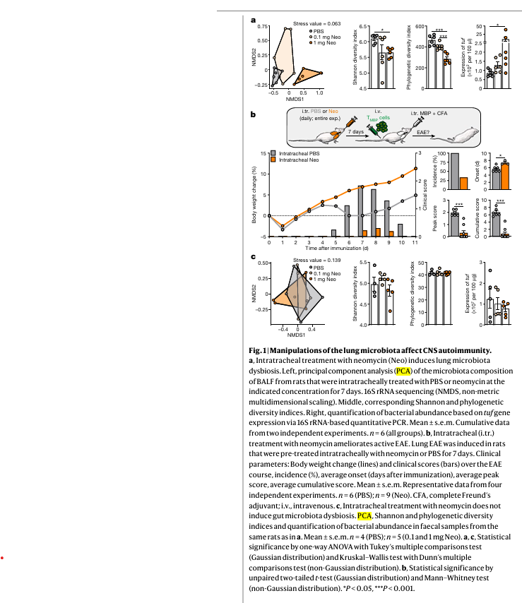
Figure 1
A, Left, PCA of the microbiota composition of BALF
A, Right, quantification of bacterial abundance based on tuf gene expression via
B, procedure
C , One-way ANOVA and Kruskal–Wallis test

Slide 13
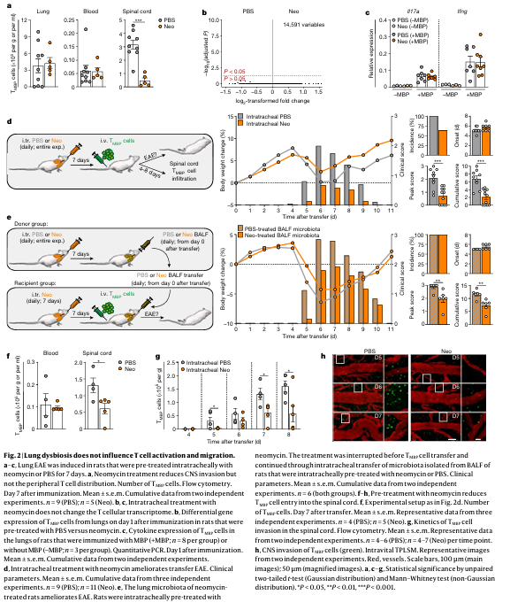
Figure 2
A, Neomycin involving the brain
B,T cell transcriptome does not change with neomycin
B, Differential gene expression
C, Cytokine expression
D, Clinical parameters
F, 2nd transfers of microbiota
G, Kinetics of T cells
H, CNS invasion of T cells

Slide 14
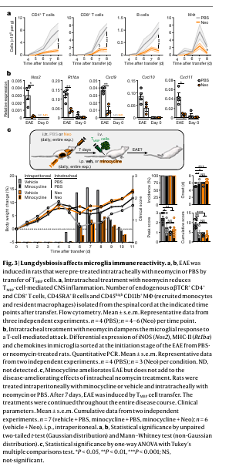
Figure 3
A, Neomycin reduces inflammation
B, T cell response decreed with neomycin
Two tailed t test and ANOVA

Slide 15
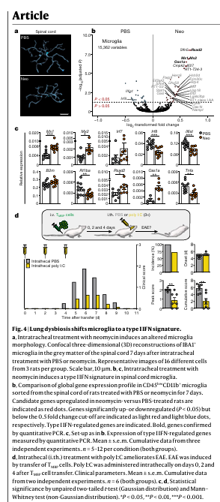
Figure 4
A, Reconstructions of microglia in grey matter
B,(global) and C, Gene expression microglia spinal cord with control
D, Clinical features after transfer

Slide 16
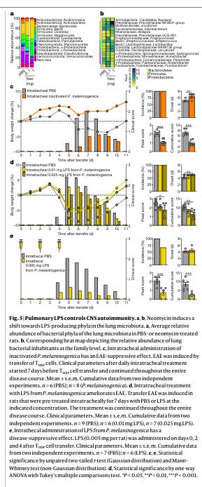
Figure 5
A, Average microbiota in the lung
B, Heatmap of families
C, With clinical features
D, Treatment with LPS
E, One way ANOVA multiple comparison test.

