Slide 1

Contrast with Reconstruct: Contrastive 3D Representation Learning Guided by Generative Pretraining
ICML 2023
Authors : Qi, Zekun et al. Presenter: Mrinal Mathur
https://github.com/qizekun/ReCon

Slide 2
SELF-SUPERVISION
Traditional supervised learning approaches heavily rely on the amount of annotated training data available.
SELF-SUPERVISION: Deep Learning without the need for expensive annotations and learn feature representations where data itself provides supervision.
Mainly two parts: Generative Learning and Contrastive Learning
Notes:
Even though there’s a plethora of data available out there, the lack of annotations has pushed researchers to find alternative approaches that can leverage them.
This is where self-supervised methods plays a vital role in fueling the progress of deep learning without the need for expensive annotations and learn feature representations where data itself provides supervision.

Slide 3
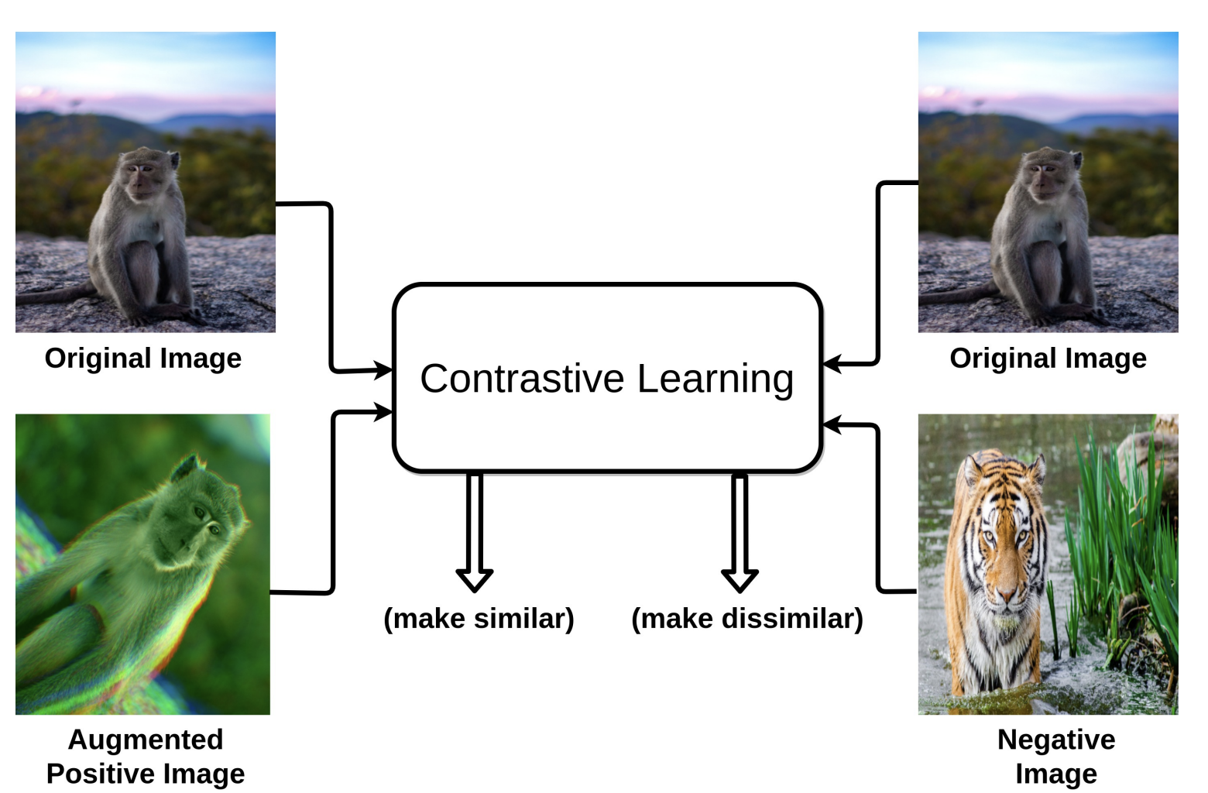
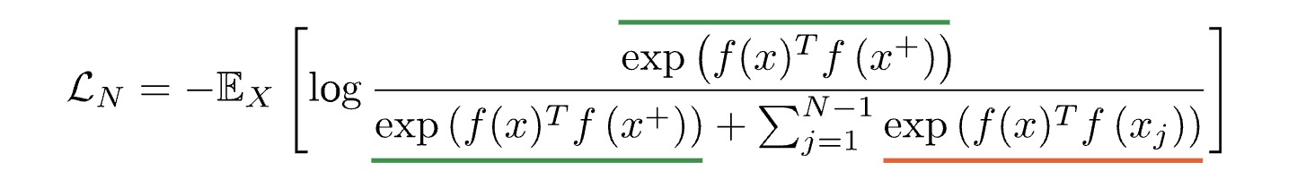
CONTRASTIVE LEARNING
contrastive learning (CL) is a discriminative approach that aims at grouping similar samples closer and diverse samples far from each other.
Similarity metric is used to measure how close two embeddings are for example, InfoNCE
Notes:
Especially, for computer vision tasks, a contrastive loss is evaluated based on the feature representations of the images extracted from an encoder network. For instance, one sample from the training dataset is taken and a transformed version of the sample is retrieved by applying appropriate data augmentation techniques

Slide 4
Contrast with Reconstruct
Mainstream 3D representation learning approaches are built upon contrastive or generative modeling pretext tasks.
There are two issues:
contrastive models are data-hungry that suffer from a representation over-fitting issue;
generative models have a data filling issue that shows inferior data scaling capacity compared to contrastive models
In (Contrast with Reconstruct) ReCON, they combine these two paradigms and achieves a new state-of-the-art in 3D representation learning that trains generative modeling as guidance for contrastive learning while sharing both merits
Notes:
Mainstream 3D representation learning approaches are built upon contrastive or generative modeling pretext tasks, where great improvements in performance on various downstream tasks have been achieved.

Slide 5
Paradigm Problem
Representation over-fitting (contrastive): Contrastive models fail to bring generalization when the pretraining data is lacking while generative models bring significant improvements with only ∼ 25% data.
Data filling (generative): Contrastive models present a better potential with scaled-up data, while generative models only provide a little improvement.
To address the above-mentioned issues, propose Contrast with Reconstruct (RECON)
Notes:
However, compared to 2D vision and NLP, 3D vision is faced with a challenging data desert issue due to collection difficulty. Though under this low-data regime, numerous 3D SSRL methods have bee
It shows that contrastive models can easily find shortcuts with trivial representations that over-fit the limited data (He et al., 2020), and generative models are less data-hungry that learn decent initialization with very few data
It shows that contrastive learning may bring superior data-scaling capacity when the pretraining data is sufficient. This is observed in 2D where contrastive models surpass generative models (Dong et al., 2022) that have less scaling capability (Xie et al., 2022b).

Slide 6
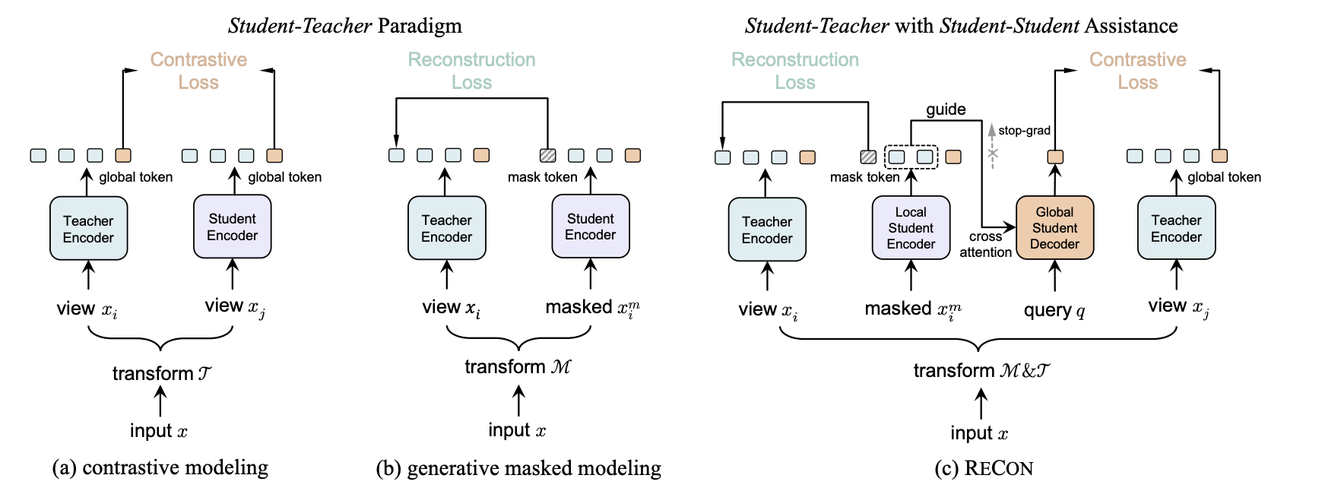
Concept Comparison
Notes:
we illustrate the methods in a unified view of knowledge distillation (see Sec. 3.1). (a) Contrastive students are trained to learn invariance from the teacher. (b) Generative masked modeling encourages students to reconstruct clean signals provided by the teacher. (c) RECON unifies the two paradigms by learning from multi-teachers, where the generative local student is also a “teacher” that guides the contrastive global student

Slide 7
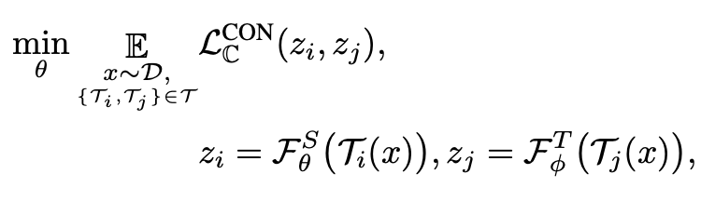
RECON: Contrastive Modeling
Key insight of contrastive learning: Invariance learning
Knowledge Distillation : A student network learning the invariance knowledge transferred from the encoded views of the teacher.
The optimization target can be written as:
Notes:
using an encoder-decoder style RECONblock based architecture, where the overall representation learning is formulated as distillation with both teachers with student-student assistance.
where the abstraction of semantics is generally invariant or equivarito multiple transformed views like augmentations or modalities

Slide 8


RECON: Contrastive Modeling ...
The teacher parameters φ can be the same as θ with or without stop-gradient. For multi-modal inputs , φ can be different from θ that encodes views from other modalities.
{Ti(·), Tj (·)} ∈ T are two transformations of the input data that belongs to constructed transformation pairs T , where Tj (·) constructs the positive or negative3 invariance targets, respectively
• L_CON C (·, ·) is the distance function defined in some metric space C.
Notes:
To avoid representation collapsing (He et al., 2020), InfoMax-Principle (Hjelm et al., 2019; Bachman et al., 2019) based metrics like MINE (Belghazi et al., 2018), InfoNCE (van den Oord et al., 2018) are often used (He et al., 2020; Tian et al., 2020c; Zhang et al., 2022a). For methods using positive-only transformations, the metric function can be feature correlation measurement

Slide 9
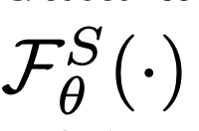
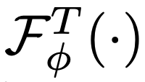
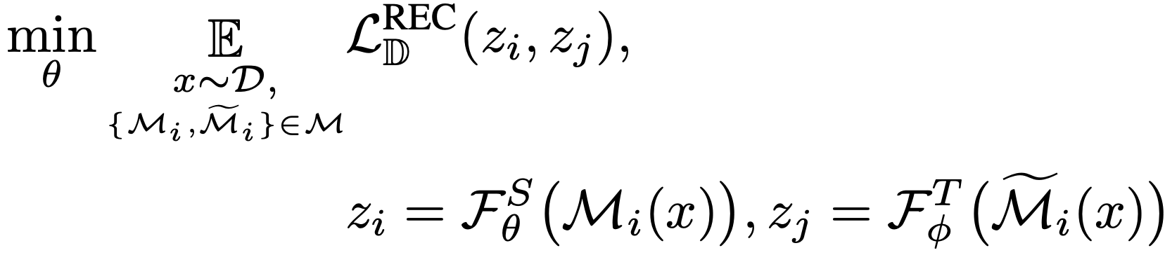
RECON: Generative Masked Modeling
Similarly, given input data x ∼ D with distribution D, the student network as F_S θ (·) with parameters θ and F T φ (·) as the teacher network with parameters φ. generative masked modeling can be formulated as follows:
Notes:
• L REC D is a distance function defined in some metric space D. It can be `2 distance (He et al., 2022), crossentropy (Devlin et al., 2019; Bao et al., 2022), or Chamfer-Distan
• {Mi ,Mfi} ∈ M are the masking corruptions where Mi(·) samples a subset of the input tokens and performs maski, and Mfi(·) correspondingly samples the subset while without maski

Slide 10


RECON: Ensemble Representation Distillation
The student is trained with merits from both contrastive and generative aspects. The overall loss L RECON is defined as follows:
Notes:
Ensemble distillation is known to be more informative and instructive , which encourages the student network to learn ensembled and disentangled knowledge representation

Slide 11
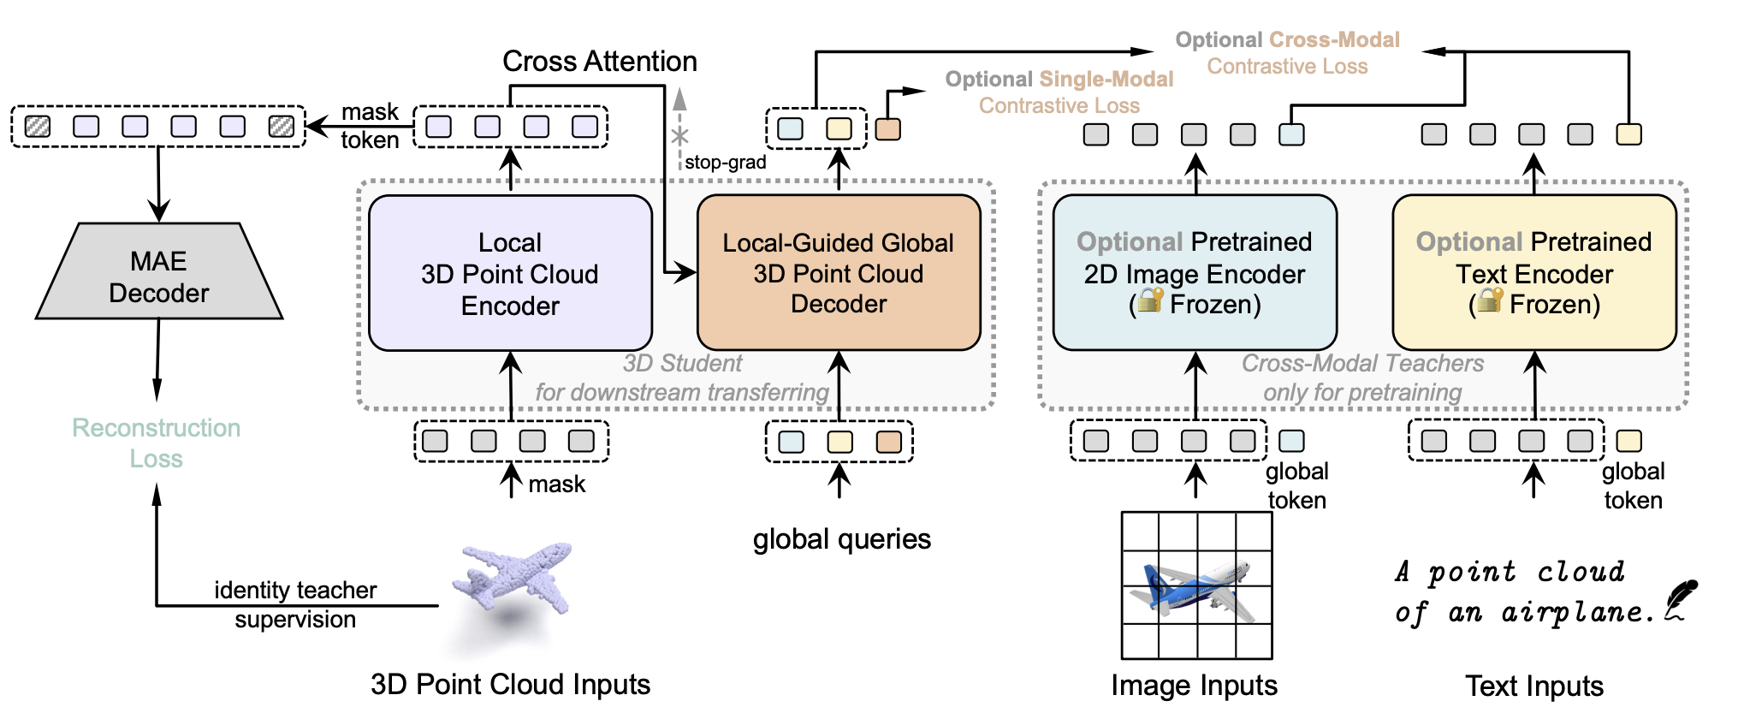
Architecture
Notes:
RECON can be applied to either single-modal 3D point clouds inputs or cross-modal inputs with rendered RGB images and text descriptions, which will be encoded as sequential tokens. The 3D token embeddings are then masked for generative reconstruction for the local 3D encoder, where the encoded intermediate embeddings are fed to the global 3D decoder with stop-gradient (stop-grad) through cross-attention. The global queries are learnable and supervised by global contrastive learning.
. Due to limited 3D data, the contrastive model can easily learn trivial representations as shortcuts, and this could lead to noisy training signals, which may harm generative student learning. Hence, to avoid the task conflicts between these two students, we use stop-gradient for every CA connection to cut the misleading training signal from global contrast to local reconstruction
. The reconstruction-oriented representations that focus on local patterns are used as semantic guidance for global contrastive learning.
, we conduct dense masked modeling with an encoder, which produces features to guide global contrastive learning through a sparse query-based decoder. The encoder and decoder share the same Transformer architecture, and they are layer-wisely associated with cross attention (CA). Due to limited 3D data, the contrastive model can easily learn trivial representations as shortcuts, and this could lead to noisy training signals, which may harm generative student learning. Hence, to avoid the task conflicts between these two students, we use stop-gradient for every CA connection to cut the misleading training signal from global contrast to local reconstruction.
As a result, the contrastive student is trained with a good data scaling capacity without the risk of representation over-fitting, and the pattern difference issue is avoided with no task conflicts.

Slide 12
Experiments
3D Real-World Object Recognition : ScanObjectNN is one of the most challenging 3D datasets, which covers ∼15K real-world objects from 15 categories.
3D Synthetic Object Recognition: ModelNet is one of the most classical datasets for synthetic 3D object recognition.
3D Zero-Shot Recognition : ModelNet for zero-shot evaluation similar to CLIP

Slide 13
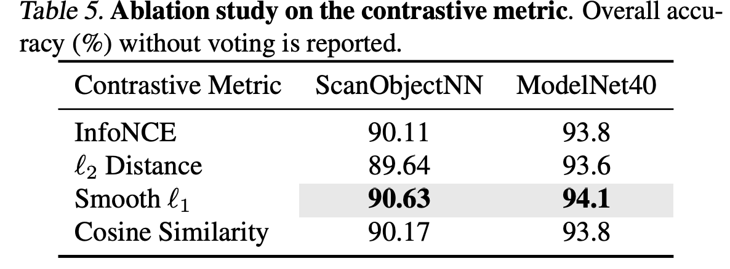
Experiments

Slide 14
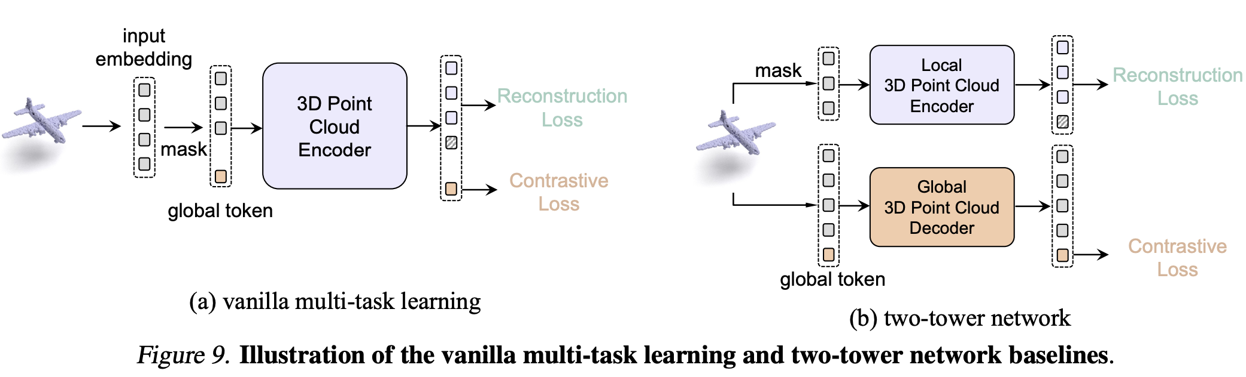
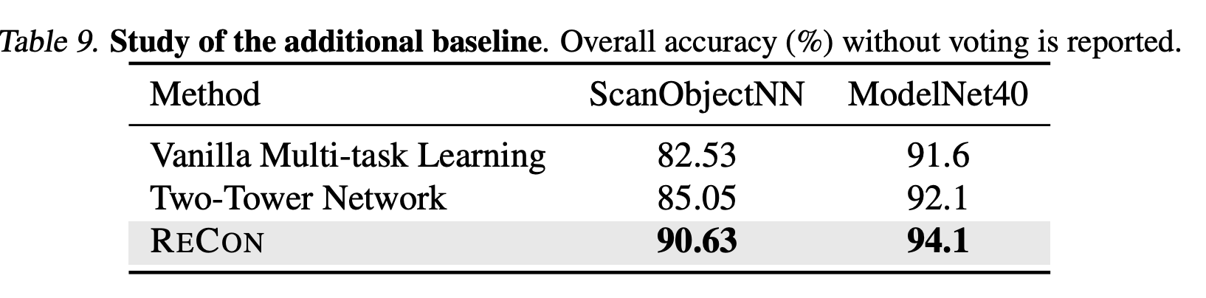
Experiments

Slide 15
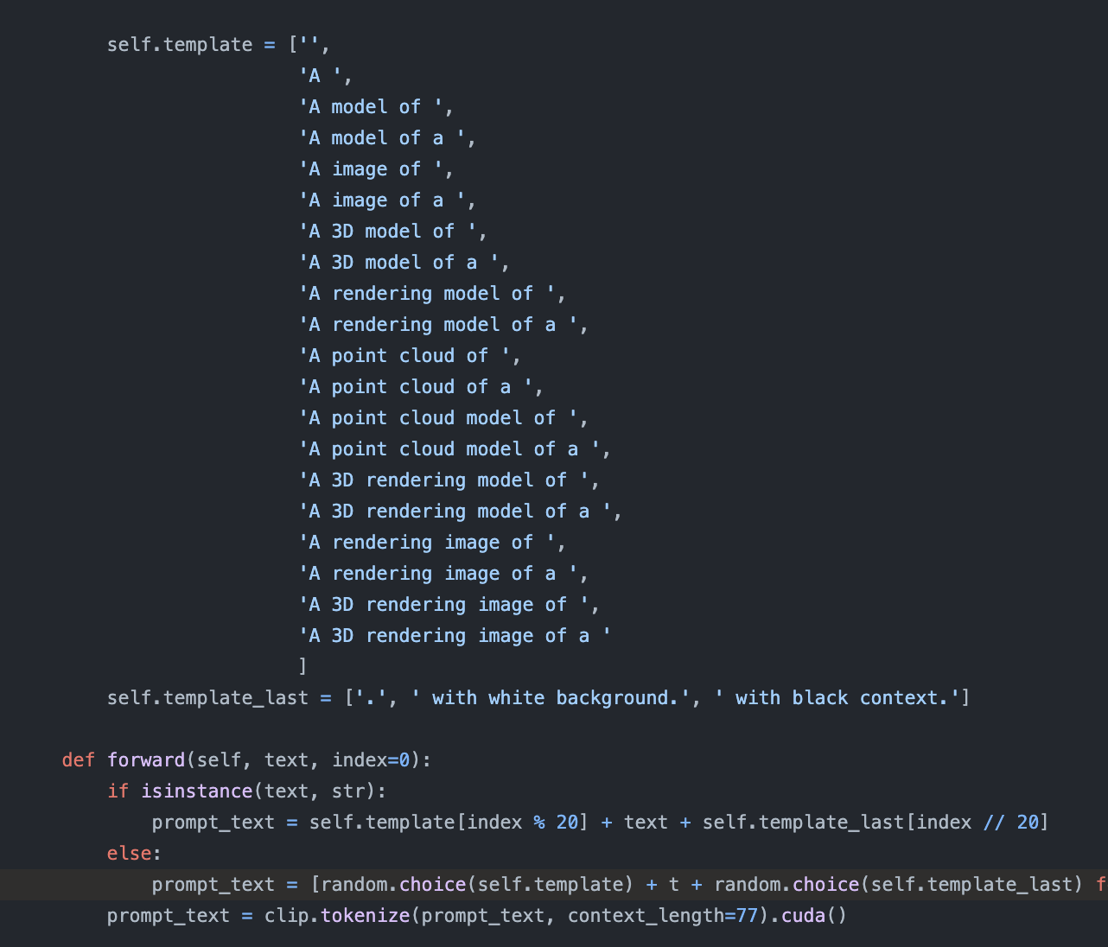
Limitations 1: Prompt

Slide 16
Limitation 2: Architecture

Slide 17
Summary
They propose a contrast with reconstruct (RECON) model, which enjoys the merits of both generative masked modeling and contrastive modeling, while scalable to multimodal data to facilitate stronger 3D representation learning.

Slide 18

Questions?

