Slide 1
DB Interactions During Game flow
CSPB 3308 !Jeopardy Project

Slide 2
Problem: Fitting constraint validation INTO the unittest framework
Specific DML programs that insert into the tables created during the DDL step are still under construction, but the tables must be tested to make sure they work as designed.
Do I:
  Make a dummy program, dbDMLStubs.py, that contains mock functions only to test constraints so that I can write a unittest for it?
  Wait for backend connectors to specific gameplay events to exist? (Might ship some DB components that don’t actually work in MVP.)

Slide 3
New SQL ERD (v4)
Previous designs caused problems because two weak entities (GameQuestion & PlayerAnswer) had a foreign key relationship!

Slide 4
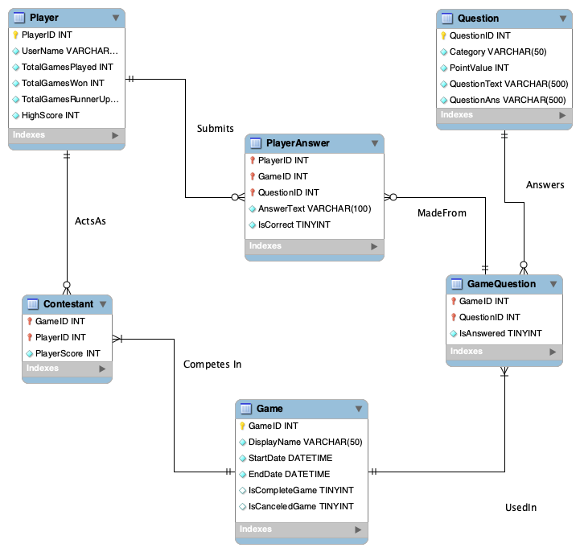
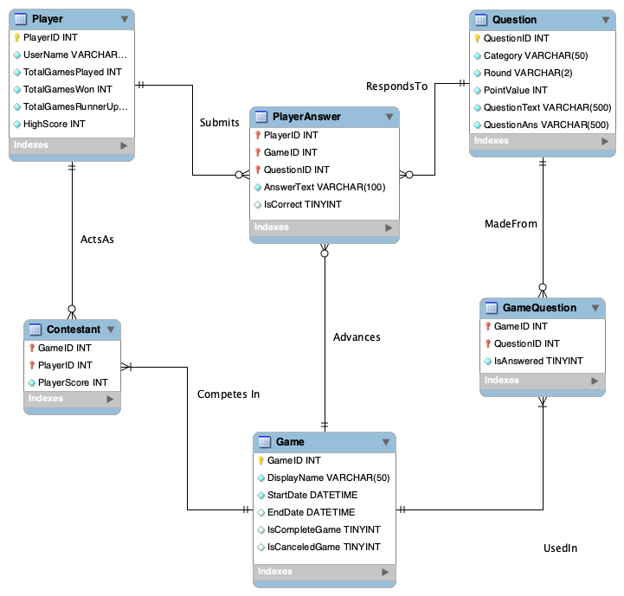
V4: Added Attribute GameCode
V2
V3 – new!

Slide 5
Game flow events from PAGE_TESTING.MD

Slide 6
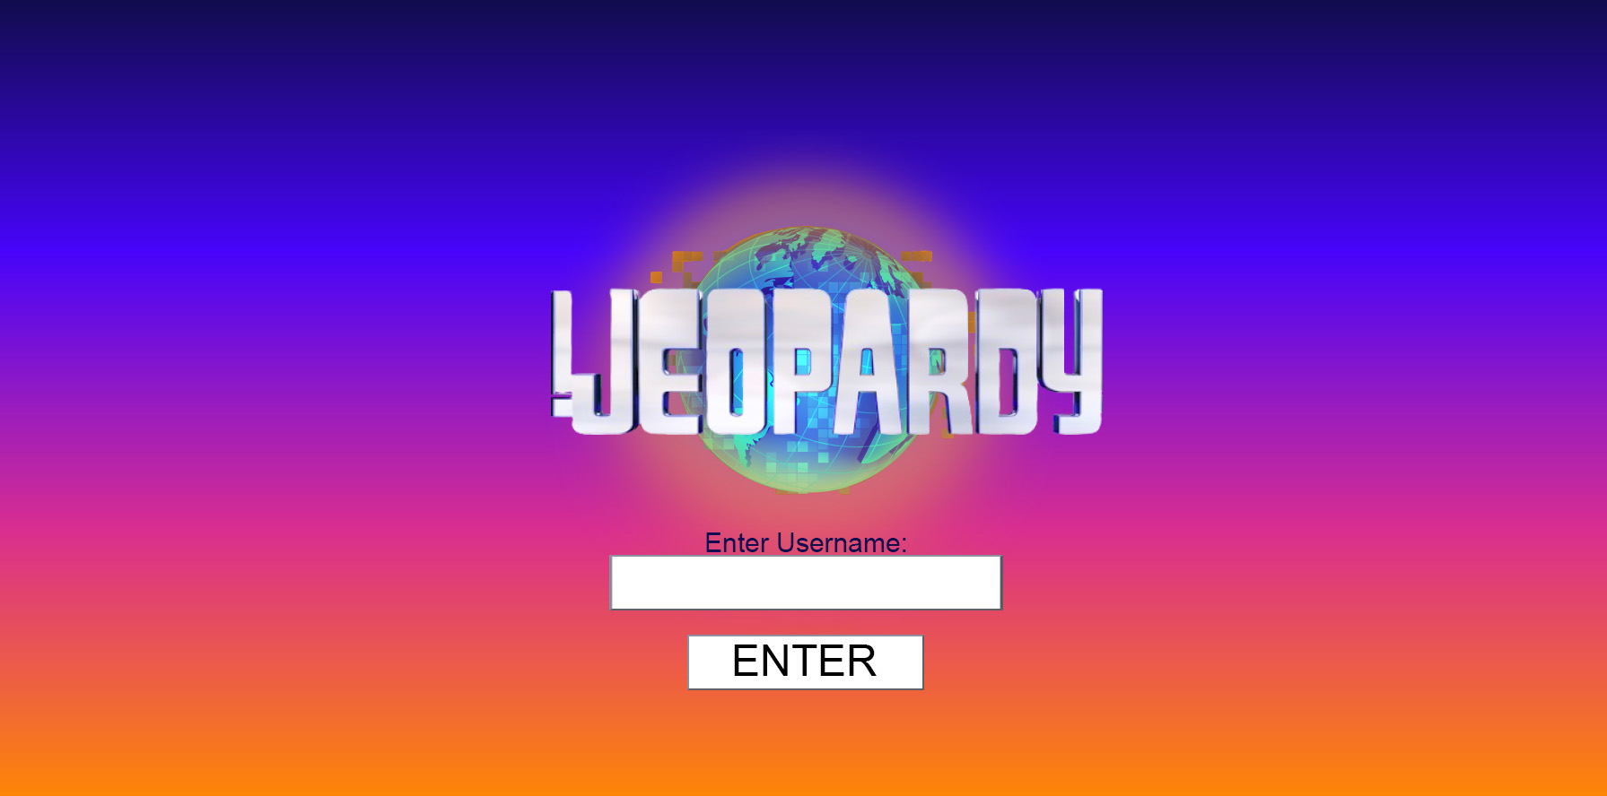
Event: User inputs Username into title screen
For MVP, treat this as a sign-in field; receive string, check if name is in DB.
  If not, INSERT INTO Player (UserName)
  If so, UNIQUE constraint works and prevents existing user scores from being overwritten by INSERT INTO. Downstream gameplay events will ALTER TABLE Player WHERE UserName={input string}
Separate login/register fields are outside the MVP.

Slide 7
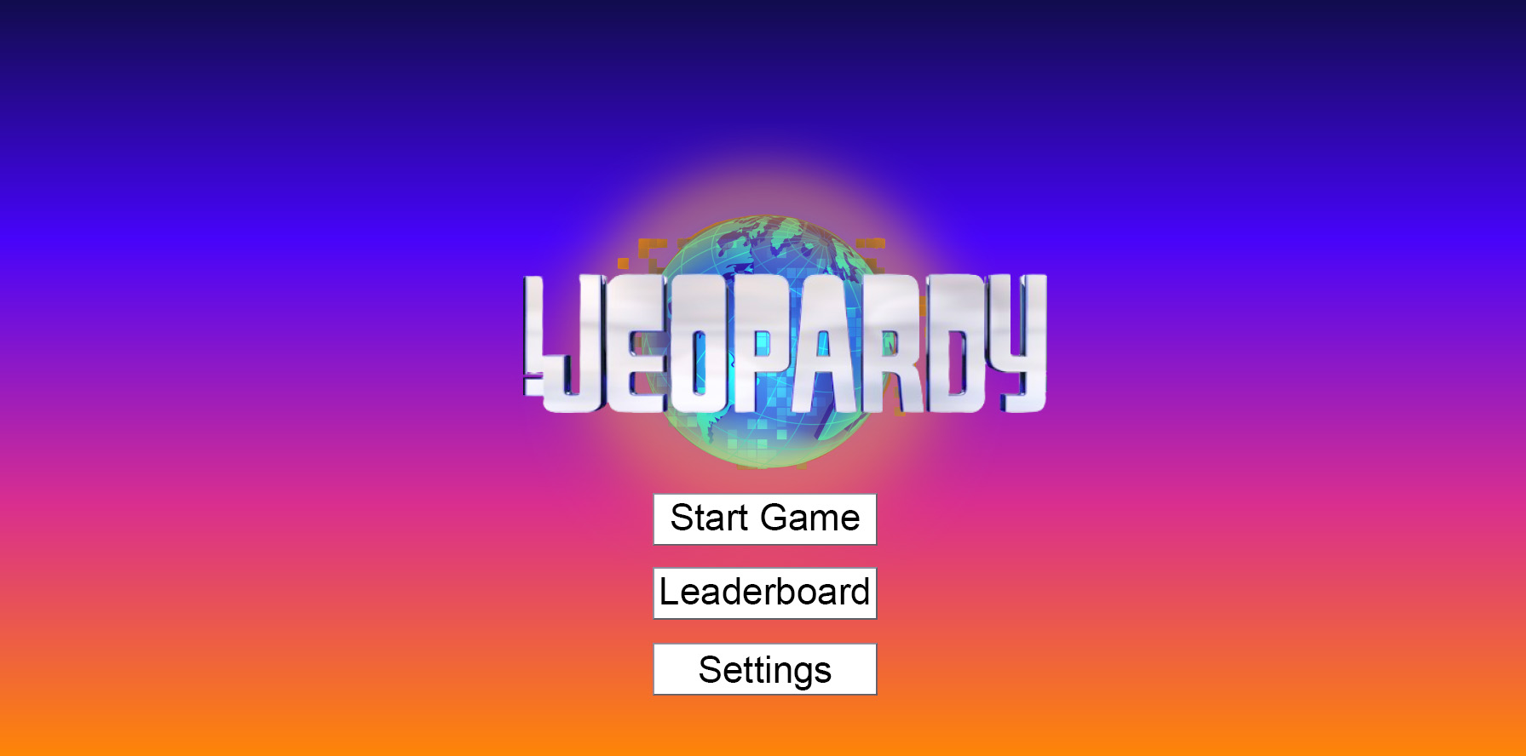
Event: User clicks Start Game
A new row is inserted into Game.
A new row is inserted into Contestant where PlayerID is the current player and GameID is the row that was just created above (the default PlayerScore is 0).
A set of J, DJ, and FJ questions are queried from Question; each QuestionID gets associated with the GameID created above in a new GameQuestion Row. By default, IsAnswered is ‘N’.
  For the MVP, this is just Game_6692. Random selection and player-chosen categories are stretch goals.

Slide 8
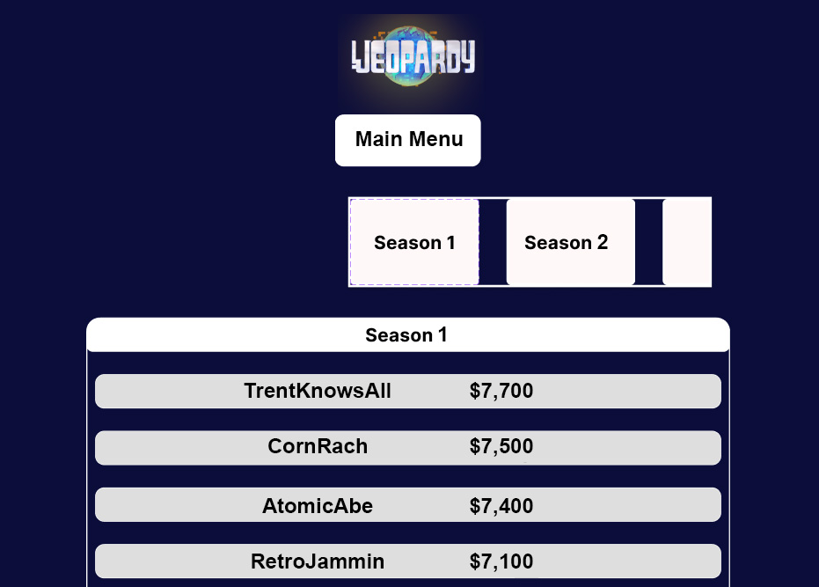
Event: User clicks Leaderboard
A query is run to SELECT UserName FROM Player ORDER BY HighScore DESC LIMIT 5 to get the top 5 players in descending order. This info is passed to the front end for display.

Slide 9
Event: User clicks Settings
Not utilized in MVP; this seems to be where the randomized or user-selected questions feature would be implemented in the stretch goals. I think it might change the args passed around in Start Game but I don’t think it touches the DB on its own.

Slide 10
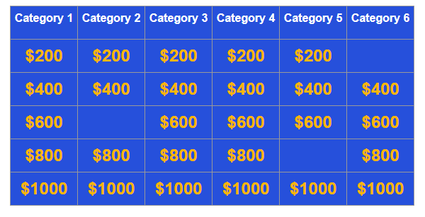
Event: User selects a Question Tile
Nothing happens to the DB for this specific event; the question, value, and category arrays to populate the board have already been extracted by the backend and passed to the frontend.

Slide 11
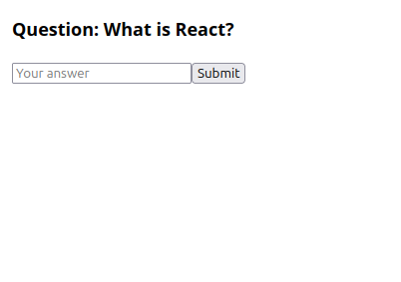
Event: User inputs an answer to a specific question
The backend can pass this answer string to the AnswerText attribute of PlayerAnswer where the PlayerID, GameID, and QuestionID match the current game tile.
This storage feature is probably not essential for the MVP; the two use-cases I envisioned for it are:
  Storing submitted answers in a Durable way to be ACID-compliant with power failures/crashes
  Capturing the kind of data that would be used for internal data analytics/customer service in a real app (e.g., what kinds of correct-ish answers is our algorithm scoring as wrong and making customers unhappy? What kinds of questions is essentially nobody getting right, and should we deprioritize these categories for future expansions?)

Slide 12
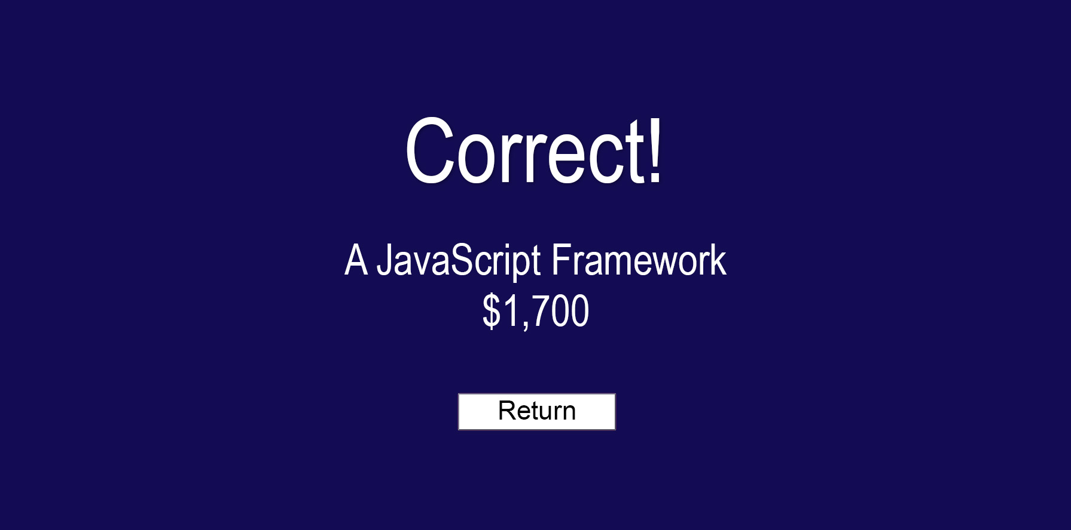
Event: Backend scores user answer to a specific question as in/correct
Attribute IsCorrect in PlayerAnswer where PlayerID, GameID, and QuestionID match current event is set to ’N’, or ‘Y’, respectively.
Attribute PlayerScore in Contestant where PlayerID and GameID match current event is credited/debited appropriately. (Doesn’t require a complex join to Question if Backend captured the point values when it originally queried the board contents from Question.)
  If PlayerScore increased, the DB internally fires a TRIGGER and automatically checks if the new PlayerScore exceeds their HighScore and updates it if so. No action from the backend required other than the score update above.

Slide 13
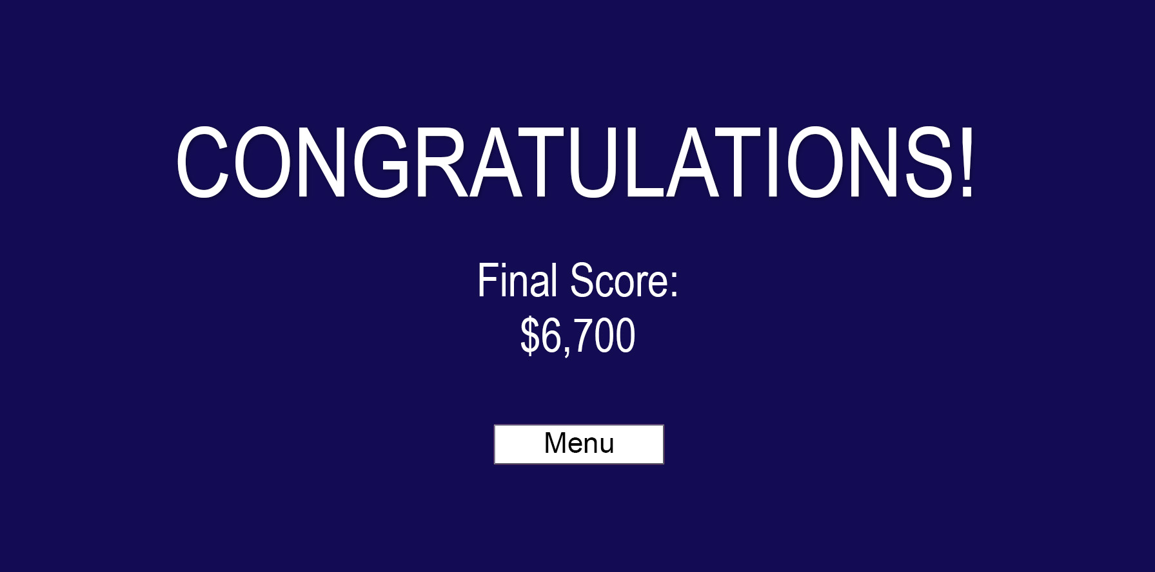
Event: User clears board and reaches Game Over Screen
If DB internally fired a TRIGGER after the backend did Final !Jeopardy answer scoring, HighScore is already up-to-date and no further action is required here.
Attribute IsCompleteGame in Game is set to ‘Y’. EndDate is set to DATETIME(‘now’).

