Slide 1

Trentino: platform for SOA based distributed embedded systems
Emeric Kwemou (CT RTC ITP SYI-DE)

Slide 2
Trentino: platform for SOA based distributed embedded systems
Enable development with SOA based architecture
Standard SOA based development model using SCA
Enable vertical integration
Simplify application management
Configurable monitoring of applications
Simplify integration testing
Advanced component lifecycle management ( e.g. heartbeats)
Enable plugging in variety of industry protocols
Out of the box test framework
Deploy, start, stop , remove applications
Simplify reusability of services and resources
Service discovery support
Provide embedded application as a service
Trentino platform goals

Slide 3
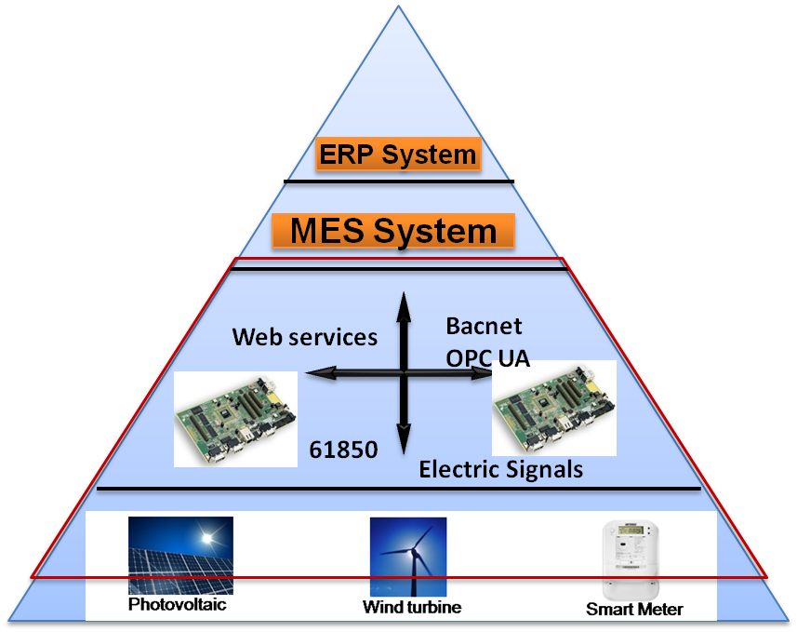
Trentino platform provides light-weight connectivity for distributed embedded systems up to enterprise IT
Features summary
Status & Next Steps
Standardized SOA-based integration from field devices up to execution systems & enterprise IT
Application management (e.g. start/stop/update)
Service lifecycle management
Service discovery & reusable common services
pluggable communication infrastructure
Supports cloud-based solutions
Implemented as Open Source Software http://trentino.sourceforge.net/
V0.1 08/2011 initial research prototype
V0.2 09/2012 quality enhancement
V0.7 05/2013 features for IC SG field proto-type (e.g. service life cycle mgmt.)
V0.8 09/2013 extensions for IC BT and I IA SC prototypes, e.g. versioning
Roadmap
2012/13
provide new customer-driven features
2013/14 service platform for strategic customers
SOA = Service Oriented Architecture

Slide 4
Trentino runtime features
Contribution management
Package : dll, resource
Lifecycle Management
Pluggable Communication Infrastructure
Apache Thrift
Service Discovery & Common services
Stop
Start
Update / upgrade
Install
Configurable Component scope (Stateless, composite)
Callback method (On Init, On destroy, Heartbeat)
Component Dependency Injection
Preferences /Logging
Lazy and eager discovery
Distributed service discovery
Authentication / Authorization
Trentino Communication Engine
IPC with shared Memory
Bacnet, KNX , …
Standard based
SOA Runtime

