Slide 1

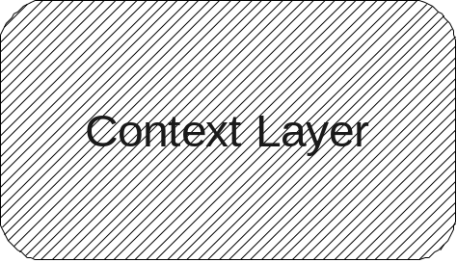
Homograph Units
M1
M1
M2
M2
M3
M3
Response / Meaning Units
Hidden Layer
H1
H2
H3
I
F
I
F
Context Units
F = Frequent
I = Infrequent

