Slide 1
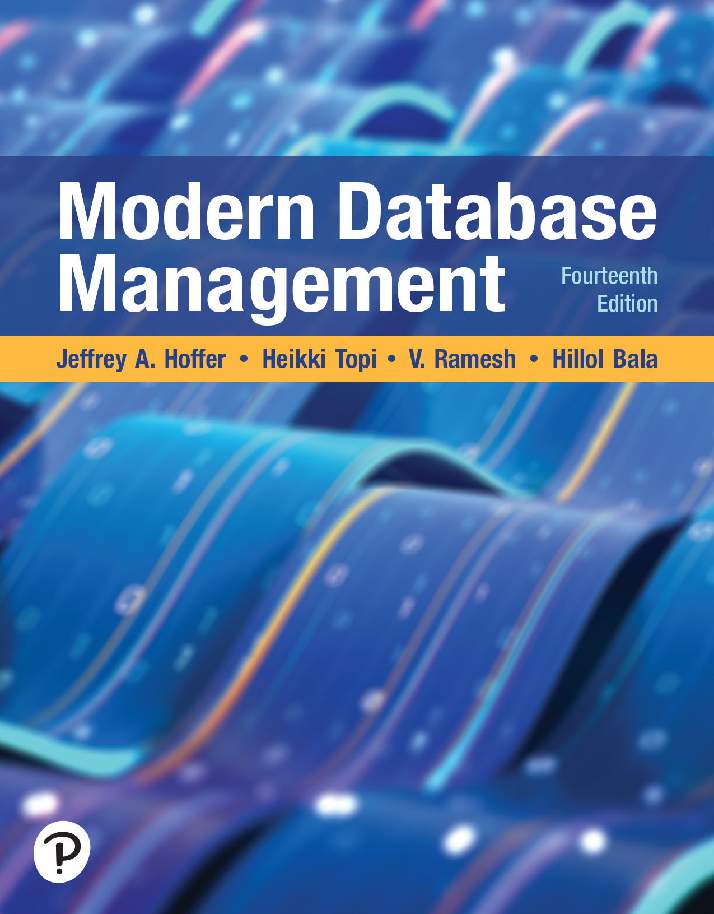

Modern Database Management
Fourteenth Edition
Chapter 5
Introduction to S Q L
Copyright © 2026, 2022, 2018 Pearson Education, Inc. All Rights Reserved
Notes:
Welcome everyone to Chapter 5 of our Modern Database Management course. Today we're diving into one of the most fundamental and powerful tools in database management - SQL, or Structured Query Language. This chapter is where theory meets practice, and you'll finally get your hands on the language that drives virtually every relational database system in the world today.
Think of SQL as the universal language of databases - just like English might be considered a global language for business communication, SQL is the global language for talking to databases. Whether you're working at a Fortune 500 company, a startup, or building your own applications, SQL will be an essential skill in your toolkit.

Slide 2
Learning Objectives
5.1 Concisely define chapter key terms
5.2 Interpret the history and role of S Q L in database development
5.3 Define and implement a database using the S Q L data definition language
5.4 Establish referential integrity using S Q L
5.5 Write single-table queries using S Q L commands
5.6 Discuss the S Q L:1999 and S Q L:2016 standards
Notes:
Let me walk you through what we'll accomplish by the end of this chapter. These six learning objectives build upon each other systematically:
5.1 - Define key terms: We'll establish a solid vocabulary foundation. Terms like RDBMS, DDL, DML, schema, and catalog aren't just academic jargon - they're the building blocks of how database professionals communicate.
5.2 - Interpret SQL's history and role: Understanding where SQL came from helps you appreciate why it's designed the way it is. We'll trace its evolution from IBM's research labs in the 1970s to today's ubiquitous standard.
5.3 - Define and implement databases using DDL: This is where you learn to CREATE tables, establish data types, and build the structural foundation of databases. Think of this as becoming the architect of your data.
5.4 - Establish referential integrity: You'll learn to create relationships between tables that maintain data consistency automatically. This prevents orphaned records and ensures your data makes sense.
5.5 - Write single-table queries: This is often students' favorite part - learning to ask questions of your data using SELECT statements. You'll start simple and work up to complex analytical queries.
5.6 - Discuss modern SQL standards: We'll explore how SQL:1999 and SQL:2016 have evolved to handle modern data challenges like JSON, analytics, and temporal data.

Slide 3
S Q L Overview
Structured Query Language—often pronounced “Sequel”
The standard for Relational Database Management Systems (R D B M S)
R D B M S: A database management system that manages data as a collection of tables in which all relationships are represented by common values in related tables
Notes:
Let's start with the basics. SQL stands for Structured Query Language, and you'll hear people pronounce it both as "S-Q-L" and "sequel" - both are correct. I prefer "sequel" because it's faster to say, but either way works in professional settings.
SQL is the standard for Relational Database Management Systems, or RDBMS. Now, what exactly is an RDBMS? It's a database management system that organizes data as a collection of tables where relationships are represented by common values, not physical links or pointers.
Think about it this way: imagine you have a filing cabinet system where related documents are kept in separate folders, but they're connected by consistent reference numbers rather than physical clips or strings. That's essentially how an RDBMS works - tables are like folders, and foreign keys are like those reference numbers that create logical connections.
This approach is incredibly powerful because it allows for flexible queries, data integrity, and efficient storage while remaining conceptually simple enough for humans to understand and work with.

Slide 4
History of S Q L
1970—E. F. Codd develops relational database concept
1974-79—System R with Sequel (later S Q L) created at I B M Research Lab
1979—Oracle markets first relational D B with S Q L
1981—S Q L/D S first available R D B M S system on D O S/V S E
  Others followed: I N G R E S (1981), I D M (1982), D G/S G L (1984), Sybase (1986)
1986—A N S I S Q L standard released
  Major A N S I standard updates in 1989, 1992, 1999, 2003, 2006, 2008, 2011, 2016
Today—S Q L is supported by most major database vendors
Notes:
SQL has a fascinating origin story that explains why it became so dominant. In 1970, Dr. Edgar F. Codd at IBM published his groundbreaking paper "A Relational Model of Data for Large Shared Data Banks." This wasn't just an academic exercise - it revolutionized how we think about data storage and retrieval.
From 1974 to 1979, IBM's research team in San Jose, California, developed System R to prove that Codd's relational model could work in practice. They created a language called "Sequel" (later renamed SQL for trademark reasons) to interact with this system.
Here's where it gets interesting: Oracle, then called Relational Software, actually beat IBM to market in 1979 with the first commercial SQL database. This shows how compelling the SQL approach was - it sparked immediate commercial interest.
The 1986 ANSI standard was crucial because it meant SQL wouldn't be controlled by any single vendor. Since then, we've had regular updates - the major ones being 1992, 1999, 2003, 2008, 2011, and 2016. Each added important capabilities like better date handling, window functions, XML support, and JSON processing.
The key lesson here is that SQL's success comes from being an open standard that evolved with technology needs while maintaining backward compatibility.

Slide 5
Original Purpose of S Q L Standard
Specify syntax/semantics for data definition and manipulation
Define data structures and basic operations
Enable portability of database definition and application modules
Specify minimal (level 1) and complete (level 2) standards
Allow for later growth/enhancement to standard (referential integrity, transaction management, user-defined functions, extended join operations, national character sets)
Notes:
The original SQL standard had five clear goals that remain relevant today:
Specify syntax and semantics: This means creating precise rules for how SQL commands should work. Just like grammar rules in language, these specifications ensure everyone understands what each command means.
Define data structures and operations: The standard establishes what tables, columns, and relationships look like, plus the fundamental operations you can perform on them.
Enable portability: This was revolutionary - the idea that you could write SQL code that would work across different vendors' systems. While perfect portability remains elusive due to vendor extensions, the core language remains remarkably consistent.
Specify multiple compliance levels: Level 1 was minimal compliance, Level 2 was full compliance. This allowed vendors to implement SQL gradually while still claiming standards compliance.
Allow for future growth: The standard was designed to be extensible. Features like referential integrity, transaction management, and user-defined functions were anticipated even if not initially included.
This forward-thinking approach explains why SQL has remained relevant for over 40 years - it was designed to evolve with changing technology needs.

Slide 6
Benefits of a Standardized Relational Language
Reduced training costs
Productivity
Application portability
Application longevity
Reduced dependence on a single vendor
Cross-system communication
Notes:
Why does having a standard language matter so much? Let me give you some real-world examples:
Reduced training costs: Imagine if every database vendor had completely different commands. A company using Oracle, MySQL, and SQL Server would need separate training programs for each. With SQL, you learn one language that works everywhere with minor variations.
Productivity: Once you master SQL, you become productive quickly regardless of which specific database system you're using. Your knowledge transfers between jobs, projects, and technologies.
Application portability: While not perfect, SQL standardization means applications can potentially move between database systems with manageable effort. This reduces vendor lock-in and provides strategic flexibility.
Application longevity: SQL applications from the 1990s often still work today with minimal modification. Compare this to applications written in proprietary database languages that became obsolete when those systems died.
Reduced vendor dependence: When you're not locked into one vendor's proprietary approach, you have leverage in negotiations and options if your current vendor fails to meet your needs.
Cross-system communication: Different databases can exchange information more easily when they all speak SQL. This enables data warehouses, reporting systems, and integration projects.
The bottom line: standardization creates a network effect where everyone benefits from shared knowledge and compatible systems.

Slide 7
S Q L Environment
Catalog
  A set of schemas that constitute the description of a database
Schema
  The structure that contains descriptions of objects created by a user (base tables, views, constraints)
Data Definition Language (D D L)
  Commands that define a database, including creating, altering, and dropping tables and establishing constraints
Data Manipulation Language (D M L)
  Commands that maintain and query a database
Data Control Language (D C L)
  Commands that control a database, including administering privileges and committing data
Notes:
Now let's understand how SQL fits into the broader database architecture. The SQL environment has several key components:
Catalog: Think of this as the master directory of your database. It contains metadata about everything - every table, every column, every constraint. The catalog answers questions like "What tables exist?" and "What columns does the Customer table have?"
Schema: This is a collection of related database objects owned by a particular user. In the Pine Valley Furniture example, you might have separate schemas for Sales, Inventory, and Accounting, each containing tables relevant to that business area.
The three types of SQL commands create a complete toolkit:
DDL (Data Definition Language): These are the "construction" commands - CREATE, ALTER, DROP. They build and modify the structure of your database. Think of DDL as the blueprints and construction tools for your data warehouse.
DML (Data Manipulation Language): These are your daily-use commands - SELECT, INSERT, UPDATE, DELETE. They work with the actual data, not the structure. This is like the tools for moving boxes in and out of your warehouse.
DCL (Data Control Language): These handle security and transaction control - GRANT, REVOKE, COMMIT, ROLLBACK. Think of these as the security systems and quality control processes for your warehouse.
Understanding this hierarchy is crucial because different roles in an organization typically work with different command types.

Slide 8
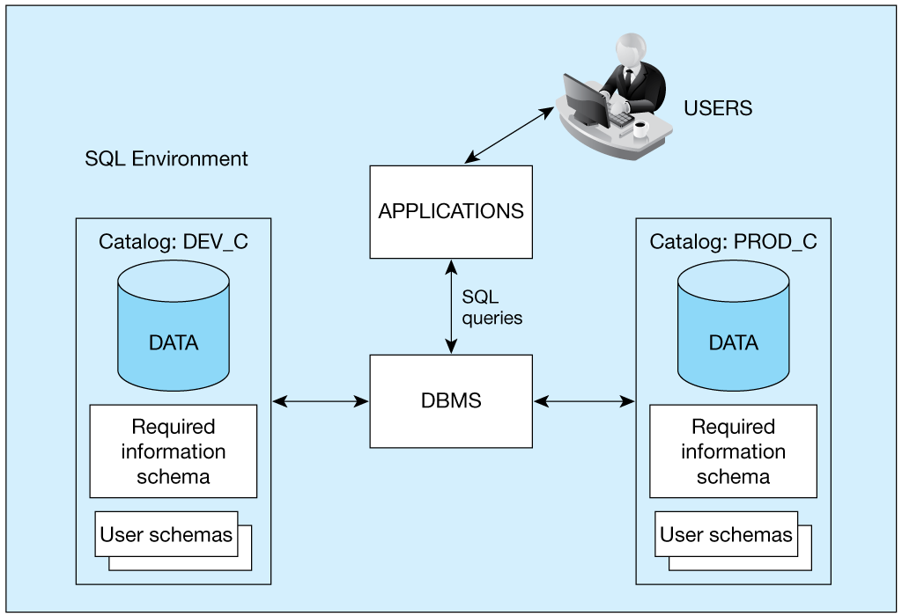
Figure 5-1 A Simplified Schematic of a Typical S Q L Environment, as Described by the S Q L:2016 Standard
Notes:
This diagram shows how SQL environments are organized in practice. Notice we have two catalogs: DEV_C and PROD_C. This reflects real-world database management where you never make changes directly to production systems.
Development Environment (DEV_C): This is your sandbox where you can experiment, test new features, and make mistakes without affecting real business operations. The data here might be anonymized or synthetic.
Production Environment (PROD_C): This contains live business data and must be extremely reliable. Changes here go through rigorous testing and approval processes.
Both environments contain user schemas and a required information schema. Users and applications interact with both, but through different access patterns - developers work heavily in DEV_C, while end-users primarily query PROD_C.
The DBMS manages both environments and handles SQL queries from applications. This separation is a fundamental best practice in database management - you always test in development before deploying to production.
Notice how applications can connect to either environment, but typically production applications only connect to PROD_C for security and stability reasons.

Slide 9
S Q L Data Types
Strings
  CHARACTER (n), CHARACTER VARYING (n)
Binary
  BINARY LARGE OBJECT (B L O B)
Number
  NUMERIC (precision, scale), DECIMAL (p, s), INTEGER
Temporal
  TIMESTAMP, TIMESTAMP WITH LOCAL TIME ZONE
Boolean
  BOOLEAN
Notes:
Choosing the right data type is crucial for both storage efficiency and data integrity. Let's explore the major categories:
Strings: CHARACTER(n) allocates exactly n characters, while CHARACTER VARYING(n) uses only what's needed up to n characters. For a customer name that might be 5-25 characters, VARCHAR saves space.
Binary: BLOB (Binary Large Object) handles images, documents, multimedia files - anything that isn't text. Think of storing employee photos or product manuals.
Number: NUMERIC and DECIMAL give you precise decimal arithmetic - essential for financial calculations where rounding errors could cost money. INTEGER is faster for whole numbers.
Temporal: TIMESTAMP records specific moments in time, while TIMESTAMP WITH LOCAL TIME ZONE handles global applications where users are in different time zones.
Boolean: Simple TRUE/FALSE values, perfect for flags like "Is this customer active?" or "Has this order been shipped?"
Here's a practical example: for a customer's phone number, you might think "it's all digits, so use INTEGER." But phone numbers can have formatting characters, international prefixes, and extensions. Plus, you never do math on phone numbers. So use VARCHAR instead.
The key principle: choose the data type that best represents your data's actual characteristics and usage patterns.

Slide 10
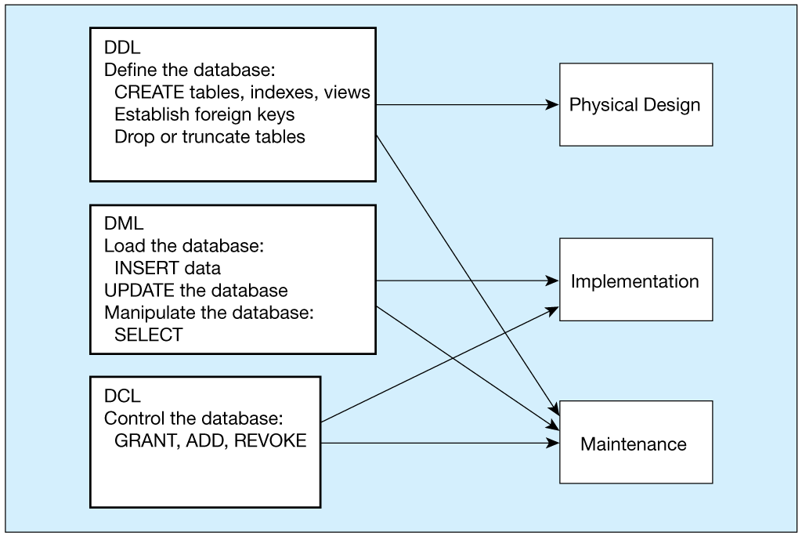
Figure 5-4 D D L, D M L, D C L, and the Database Development Process
Notes:
This flowchart shows how different SQL command types fit into the database development lifecycle:
Physical Design Phase: Uses DDL commands to CREATE tables, indexes, and views. You're establishing the fundamental structure - like building the foundation and frame of a house.
Implementation Phase: Uses DML to INSERT initial data and create procedures for ongoing data manipulation. This is like moving furniture into your house and setting up daily routines.
Maintenance Phase: Uses all three command types - DDL for structural changes, DML for data updates, and DCL for security management. This is ongoing operations - remodeling rooms, updating security systems, and daily housekeeping.
Notice how DDL touches all phases - you might need to ALTER tables or CREATE new indexes throughout the system's lifetime. This flexibility is why SQL remains valuable even as requirements change.
The arrows show that development isn't strictly linear - you often cycle back to earlier phases as you learn more about requirements or performance needs.

Slide 11
S Q L Database Definition
Major CREATE statements:
  CREATE SCHEMA—defines a portion of the database owned by a particular user
  CREATE TABLE—defines a new table and its columns
  CREATE VIEW—defines a logical table from one or more tables or views
  CREATE INDEX—creates a separate data structure
  Other CREATE statements: CHARACTER SET, COLLATION, TRANSLATION, ASSERTION, DOMAIN
Notes:
These CREATE statements are your database construction toolkit:
CREATE SCHEMA: Establishes a namespace for a user's database objects. Like creating a department's section in a corporate file system.
CREATE TABLE: Defines the structure where your data will live. This includes column names, data types, and constraints.
CREATE VIEW: Creates a logical table based on other tables. Views can simplify complex queries, provide security by hiding sensitive columns, or present data in user-friendly formats.
CREATE INDEX: Builds separate data structures to speed up queries. Like creating an index in a book - it doesn't change the content, but makes finding information much faster.
The additional CREATE statements handle specialized needs like character sets for international applications, collations for sorting rules in different languages, and domains for reusable data type definitions.
Each CREATE has a corresponding DROP command for removal, and ALTER for modification. This gives you complete control over your database structure throughout its lifetime.

Slide 12
Steps in Table Creation
Identify data types for attributes
Identify columns that can and cannot be null
Identify columns that must be unique (candidate keys)
Identify primary key–foreign key mates
Determine default values
Identify constraints on columns (domain specifications)
Create the table and associated indexes
Notes:
Creating tables requires systematic planning. Let's walk through each step:
1. Identify data types: Consider both storage efficiency and functionality. A product price needs DECIMAL for accuracy, while a product description needs VARCHAR for flexibility.
2. Identify null/not null columns: Critical business data like customer names and order dates should be NOT NULL. Optional data like middle names or special instructions can allow nulls.
3. Identify unique columns: These become candidate keys. Social Security numbers, email addresses, and product codes often need to be unique.
4. Identify primary-foreign key relationships: This enforces referential integrity. Every order must reference a valid customer, every order line must reference valid orders and products.
5. Determine default values: Set reasonable defaults like SYSDATE for order dates or 'Active' for customer status. This reduces data entry errors and ensures consistency.
6. Identify domain constraints: Use CHECK constraints to enforce business rules. Product categories might be limited to specific values, prices must be positive, etc.
7. Create tables and indexes: Execute your DDL statements in the right order - parent tables before child tables to satisfy foreign key constraints.
Following this systematic approach prevents many common database design problems and ensures your tables support your business requirements effectively.

Slide 13
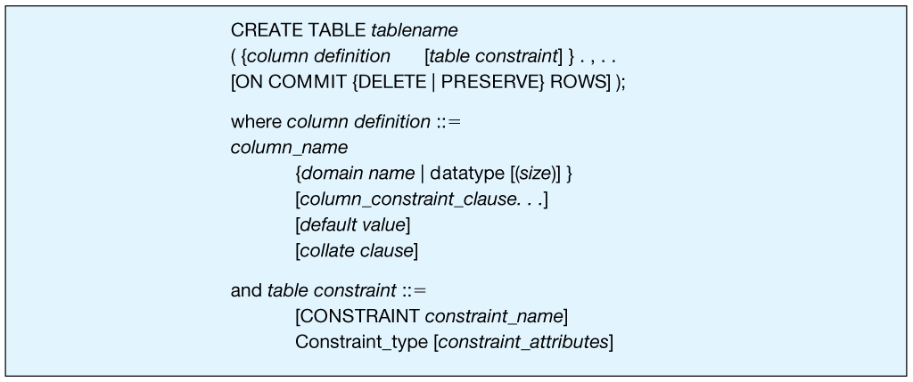
Figure 5-5 General Syntax of the CREATE TABLE Statement Used in Data Definition Language
Notes:
This syntax diagram shows the complete CREATE TABLE statement structure. Let me break down the key components:
The basic pattern is CREATE TABLE followed by the table name, then column definitions in parentheses. Each column definition includes the column name, data type, and optional constraints.
Column constraints include NOT NULL, DEFAULT values, and CHECK conditions. Table constraints like PRIMARY KEY and FOREIGN KEY can reference multiple columns and are defined separately from individual column definitions.
The optional ON COMMIT clause handles how the table behaves in transaction environments - this is advanced functionality you'll encounter in complex applications.
Notice how the syntax uses square brackets for optional elements and ellipses (...) to indicate repeatable components. This formal notation helps ensure you understand exactly what's required versus optional.

Slide 14
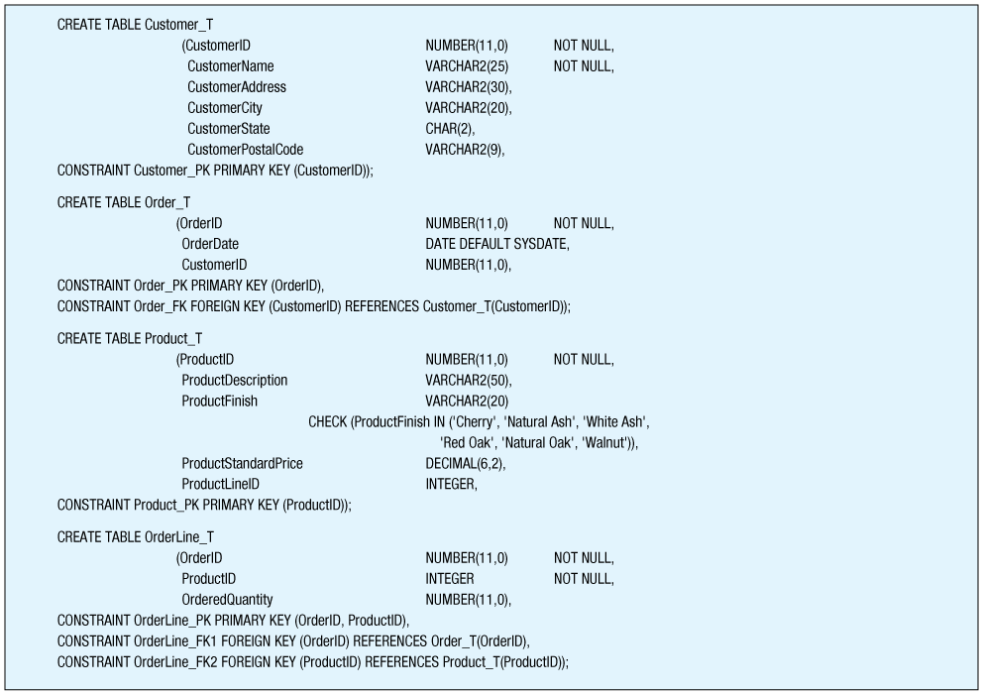
Figure 5-6 S Q L Database Definition Commands for Pine Valley Furniture Company (Oracle 19c)
Notes:
This real Oracle code shows how our theoretical Pine Valley Furniture database translates into actual SQL. Let's examine each table:
Customer_T: Notice CustomerID is NUMBER(11,0) - that's 11 digits with no decimal places. CustomerName is NOT NULL because every customer must have a name. The CONSTRAINT Customer_PK gives the primary key a meaningful name.
Order_T: OrderDate defaults to SYSDATE (Oracle's current date function). The foreign key constraint Order_FK references Customer_T, ensuring every order belongs to a valid customer.
Product_T: The CHECK constraint on ProductFinish limits values to specific wood types. This prevents data entry errors like 'Oak' when the valid value is 'Red Oak'.
OrderLine_T: Has a composite primary key (OrderID, ProductID) and two foreign keys. This creates a proper many-to-many relationship between orders and products.
Notice the naming convention: table names end with _T, constraints have descriptive names like Customer_PK and Order_FK. This makes the database self-documenting and easier to maintain.
The data types chosen reflect real business needs: precise numbers for IDs, variable-length strings for names and descriptions, dates for temporal data.

Slide 15
Creating Data Integrity Controls
Referential integrity—means that a value in the matching column on the many side must correspond to a value in the primary key or be NULL
The S Q L REFERENCES clause prevents a foreign key value from being added if it is not already a valid value in the referenced primary key column
Notes:
Referential integrity is one of SQL's most powerful features. It automatically maintains consistency between related tables:
Basic concept: A foreign key value must either match a primary key in the referenced table or be NULL. You cannot create an "orphan" record that references a non-existent parent.
REFERENCES clause: This establishes the foreign key constraint. When you try to INSERT an order with CustomerID = 999, but customer 999 doesn't exist, SQL rejects the operation.
Real-world example: Imagine you're running an e-commerce site. Without referential integrity, you could accidentally delete a customer while their orders remain in the system. Those orders would become orphaned - they'd reference a customer that no longer exists, creating data inconsistency and potential application errors.
With referential integrity, SQL prevents this mistake. If you try to delete a customer who has orders, the system will reject the deletion unless you first handle the related orders appropriately.
This automatic enforcement means your database maintains consistency even when multiple applications or users are making changes simultaneously.

Slide 16
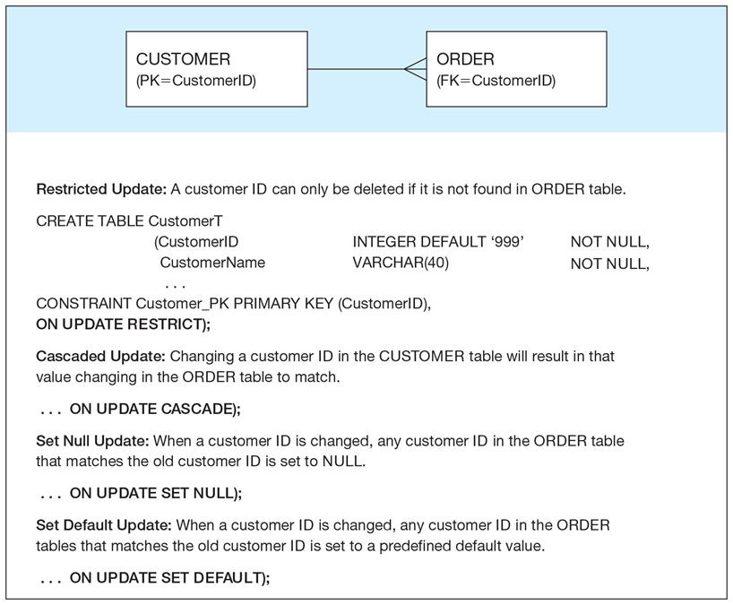
Figure 5-7 Ensuring Data Integrity Through Updates
Relational integrity is enforced via the primary-key to foreign-key match
Notes:
This diagram illustrates the options for handling primary key changes or deletions:
Restricted Update: Prevents changes to primary keys if foreign keys reference them. This is the safest option - it forces you to think through the implications of changes.
Cascaded Update: Automatically propagates primary key changes to all referencing foreign keys. If customer ID 123 changes to 456, all orders for that customer automatically update to reference 456.
Set Null Update: Changes referencing foreign keys to NULL when the primary key changes. This breaks the relationship but preserves the child records.
Set Default Update: Changes referencing foreign keys to a predefined default value when the primary key changes.
The same options apply to deletions. For our customer-order example, CASCADE delete would remove all orders when you delete a customer - usually not what you want! RESTRICT delete is safer - it prevents customer deletion until you handle their orders appropriately.
Choose your referential integrity options based on business rules, not just technical convenience.

Slide 17
Changing Table Definitions
ALTER TABLE statement allows you to change column specifications:
  ALTER TABLE table_name alter_table_action;
Table Actions:
  ADD [COLUMN] column_definition
  ALTER [COLUMN] column_name SET DEFAULT default-value
Example (adding a new column with a default value):
  ALTER TABLE CUSTOMER_T ADD CustomerType VARCHAR2 (10) DEFAULT ‘Commercial’;
Notes:
Databases evolve, and ALTER TABLE gives you flexibility to adapt:
ALTER TABLE syntax: The general pattern is ALTER TABLE table_name followed by the specific action.
Common actions: ADD COLUMN for new attributes, ALTER COLUMN to change defaults or data types, DROP COLUMN to remove attributes, ADD CONSTRAINT for new business rules.
Example: Adding CustomerType with a default value of 'Commercial' means existing customers automatically get classified appropriately. This prevents NULL values in the new column.
Best practices: Always test ALTER statements in development first. Some changes might fail if existing data violates new constraints. For example, you can't add a NOT NULL column without a default unless the table is empty.
Bulk loading strategy: Sometimes you'll DROP constraints before large data imports, then re-enable them afterward. This prevents constraint checking during the import while ensuring integrity is restored.
ALTER TABLE is essential for database evolution - business requirements change, and your database structure needs to adapt while preserving existing data and applications.

Slide 18
Removing Tables
DROP TABLE statement allows you to remove tables from your schema:
  DROP TABLE Customer_T
Notes:
DROP TABLE permanently removes tables and all their data:
Syntax: Simply DROP TABLE table_name. This is irreversible - once dropped, the table and its data are gone.
Prerequisites: You must own the table or have DROP privileges. The database prevents accidental deletions by requiring explicit permissions.
Cascade effects: Dropping a table also removes its indexes, triggers, and grants. Foreign key constraints referencing the dropped table will cause errors.
RESTRICT vs CASCADE options: RESTRICT (the default) prevents dropping if other objects depend on the table. CASCADE drops the table and all dependent objects.
Alternative: TRUNCATE TABLE removes all data but preserves the table structure. Use this when you want to clear data but keep the table definition.
Real-world advice: In production environments, never DROP tables directly. Instead, rename them (adding a date suffix) and drop them later after confirming no applications or reports break. This provides a safety net for mistakes.

Slide 19
INSERT Statement
Inserting into a table:
  INSERT INTO Customer_T VALUES
  (001, ‘Contemporary Casuals’, ‘1355 S. Himes Blvd.’, ‘Gainesville’, ‘F L’, ‘32601’);
Inserting a record that has some null attributes requires identifying the fields that actually get data:
  INSERT INTO Product_T (Product I D,
  Product Description, Product Finish, Product Standard Price)
  VALUES (1, ‘End Table’, ‘Cherry’, 175, 8);
Inserting from another table:
  INSERT INTO C a Customer_T
  SELECT * FROM Customer_T
  WHERE Customer State = ‘C A’;
Notes:
The INSERT statement populates your tables with data. Let's explore the variations:
Complete row insertion: When providing values for every column, you can omit the column list. Values must match the table's column order exactly. This is concise but fragile - if someone adds columns, your INSERT statements might break.
Partial row insertion: Specify which columns receive values. Unspecified columns get either their default values or NULL. This is more robust because column order doesn't matter.
Copying from another table: The INSERT ... SELECT pattern is incredibly powerful. You can populate entire tables, create backups, or copy subsets of data based on complex criteria.
Real-world example: When setting up a new regional office, you might use INSERT ... SELECT to copy all products and customers for specific geographic regions from the main database to the regional database.
Error handling: If an INSERT violates constraints (duplicate primary key, invalid foreign key, check constraint), the entire statement fails and no data is inserted.
The key is choosing the right INSERT variant for your situation and always being mindful of data integrity constraints.

Slide 20
DELETE Statement
Delete certain rows
  DELETE FROM Customer_T WHERE CustomerState = ‘H I’;
Delete all rows
  DELETE FROM Customer_T;
Notes:
DELETE removes rows from tables based on specified criteria:
Conditional deletion: The WHERE clause specifies which rows to remove. Without WHERE, you delete ALL rows - be very careful!
Example: DELETE FROM Customer_T WHERE CustomerState = 'HI' removes all Hawaiian customers, perhaps because you've stopped serving that market.
Complete table deletion: DELETE FROM Customer_T removes every row but preserves the table structure. This is different from DROP TABLE, which removes the table entirely.
Safety practices: Always test your WHERE clause first with a SELECT statement. If SELECT * FROM Customer_T WHERE CustomerState = 'HI' returns the right rows, then DELETE FROM Customer_T WHERE CustomerState = 'HI' will delete the right rows.
Referential integrity: You cannot delete parent records if child records reference them. To delete a customer, you must first delete or reassign their orders.
Performance: Deleting many rows can be slow and may lock tables. For large deletions, consider doing them in batches during low-usage periods.

Slide 21
UPDATE Statement
Modifies data in existing rows
  UPDATE Product_T
  SET Product Standard Price = 775
  WHERE Product I D = 7;
Notes:
UPDATE modifies existing data in tables:
Basic syntax: UPDATE table_name SET column = new_value WHERE condition. The WHERE clause is crucial - without it, you update EVERY row.
Example: UPDATE Product_T SET ProductStandardPrice = 775 WHERE ProductID = 7 changes one product's price. This might correct a data entry error or implement a price change.
Multiple columns: You can update several columns at once: UPDATE Product_T SET ProductStandardPrice = 800, ProductFinish = 'Natural Oak' WHERE ProductID = 7.
Calculated updates: SET clauses can include expressions: UPDATE Product_T SET ProductStandardPrice = ProductStandardPrice * 1.1 increases all prices by 10%.
Subqueries: Advanced UPDATE statements can use subqueries to determine new values based on data from other tables.
Safety: Like DELETE, always test your WHERE clause with SELECT first. UPDATE mistakes can be difficult to reverse if you don't have backups.
The UPDATE statement is essential for data maintenance - correcting errors, implementing business changes, and keeping information current.

Slide 22
MERGE Statement
Makes it easier to update a table by allowing the combination of Insert and Update in one statement
Useful for updating master tables with new data
  MERGE INTO Product_T AS PROD
  USING
  (SELECT Product I D, Product Description, Product Finish, …
  .
  .
  .
Notes:
MERGE, introduced in SQL:2008, combines INSERT and UPDATE operations:
Purpose: MERGE is perfect for data synchronization scenarios. Imagine you receive weekly updates from suppliers - some products are new (need INSERT), others have price changes (need UPDATE).
Basic concept: MERGE compares two data sets and performs different actions based on whether records match. It's like saying "If this product exists, update its price; if it doesn't exist, add it."
Efficiency: Instead of writing separate INSERT and UPDATE statements with complex logic to avoid errors, MERGE handles everything in one operation.
Real-world example: Data warehouses often use MERGE to load daily updates. New customers get inserted, existing customers with changed information get updated, all in one efficient operation.
Syntax complexity: MERGE statements can look intimidating, but they're just combining the logic you already know from INSERT and UPDATE.
Benefits: Reduces code complexity, improves performance, and eliminates race conditions that can occur when separate INSERT and UPDATE statements run concurrently.
MERGE is particularly valuable in data integration and ETL (Extract, Transform, Load) processes.

Slide 23
Internal Schema Definition in R D B M Ss
Control processing/storage efficiency:
  Choice of indexes
  File organizations for base tables
  File organizations for indexes
  Data clustering
  Statistics maintenance
Creating indexes
  Speed up random/sequential access to base table data
  Example
    CREATE INDEX Name_I D X ON Customer_T(Customer Name);
    This makes an index for the CUSTOMER NAME field of the CUSTOMER_T table
Notes:
Internal schema optimization focuses on performance tuning:
Choice of indexes: Create indexes on frequently queried columns to speed up SELECT operations. But remember - indexes slow down INSERT/UPDATE/DELETE operations because the indexes must be maintained.
File organizations: Different storage structures optimize for different access patterns. Sequential files are great for reporting, hash files for fast lookups, B-tree files for range queries.
Data clustering: Store related data physically close together. For example, store all orders for a customer near each other on disk to speed up customer history queries.
Statistics maintenance: The database optimizer needs current statistics about data distribution to choose efficient query plans. Outdated statistics lead to poor performance.
CREATE INDEX example: CREATE INDEX Name_IDX ON Customer_T(CustomerName) creates an alphabetical index on customer names. This makes "find customer by name" queries much faster.
Balance considerations: Every optimization has trade-offs. More indexes mean faster queries but slower updates. More complex file organizations use more storage but provide better performance.
The goal is matching your database's internal structure to your application's usage patterns.

Slide 24
SELECT Statement
Used for queries on single or multiple tables
Clauses of the SELECT statement:
  SELECT: List the columns (and expressions) to be returned from the query
  FROM: Indicate the table(s) or view(s) from which data will be obtained
  WHERE: Indicate the conditions under which a row will be included in the result
Notes:
Now we reach the heart of SQL - the SELECT statement for querying data:
Purpose: SELECT retrieves data from one or more tables based on specified criteria. It's your primary tool for asking questions of your database.
Three essential clauses:
SELECT: Specifies which columns to return
FROM: Identifies the source tables
WHERE: Filters rows based on conditions
Basic example: SELECT ProductDescription, ProductStandardPrice FROM Product_T WHERE ProductStandardPrice < 275 finds all products under $275.
Flexibility: SELECT can return raw data, calculated values, summaries, or complex analytical results. It's both simple enough for beginners and powerful enough for advanced analytics.
Set-based nature: Unlike procedural languages that process one record at a time, SQL processes entire sets of data at once. This makes it incredibly efficient for data analysis.
Understanding SELECT is crucial because it's the foundation for all data retrieval, reporting, and analysis tasks.

Slide 25
SELECT Example
For example, find products with standard price less than $275
  SELECT Product Description, Product Standard Price
  FROM Product_T
  WHERE Product Standard Price < 275;
Notes:
Let's examine this concrete example: finding products with standard price less than $275.
Query breakdown:
SELECT ProductDescription, ProductStandardPrice: Return these two columns
FROM Product_T: From the Product table
WHERE ProductStandardPrice < 275: Only for products under $275
Results interpretation: This query returns exactly what you'd expect - the End Table at $175 and Computer Desk at $250. Both meet the price criteria.
Column ordering: Notice the results show columns in the same order as specified in the SELECT clause, not necessarily the order they appear in the table definition.
Why this matters: This type of query might help a sales manager identify products for a discount promotion, or help customers filter products by their budget.
Scalability: Whether your Product table has 8 rows or 8 million rows, this query works the same way. SQL's set-based approach handles scale automatically.
This simple example demonstrates SQL's power - complex business questions become straightforward queries.

Slide 26
SELECT Example Using Alias
Alias is an alternative column or table name
SELECT CUST.Customer Name AS Name, CUST.Customer Address
FROM Customer_T AS Cust WHERE Name =
Home Furnishings’;
Notes:
Aliases make your queries more readable and flexible:
Column alias: AS Name creates a more user-friendly column header than the actual column name CUSTOMERNAME.
Table alias: AS Cust provides a shorthand for referencing the Customer_T table. This becomes essential in complex queries with multiple tables.
Benefits of aliases:
Shorter, more readable queries
Better column headers in reports
Essential for self-joins and complex multi-table queries
Allows referencing calculated columns
Limitation note: In Oracle SQL*Plus, you cannot use column aliases in WHERE clauses (except in ORDER BY). Other SQL implementations may allow this.
Real-world usage: Production queries almost always use aliases. When your SELECT statement joins five tables and calculates multiple derived values, aliases transform unreadable code into maintainable queries.
Best practice: Use meaningful aliases that reflect the data's business purpose, not just shorter technical names.

Slide 27
Using Expressions
Expressions are mathematical manipulations of the data in the table
  Stored functions to manipulate the rows of data
  Mathematical manipulations constructed by using mathematical operations
Notes:
Expressions let you perform calculations and transformations within SQL:
Mathematical operations: Use +, -, *, / for arithmetic. Calculate extended prices, percentage increases, age from birth dates, etc.
Stored functions: Built-in functions like SUM, AVG, ROUND handle common operations. These are optimized by the database engine.
Row-level calculations: Expressions are evaluated for each row. ProductStandardPrice * 1.1 calculates a 10% increase for every product.
Business applications:
Calculate tax amounts: Price * TaxRate
Determine discounts: Price * (1 - DiscountPercent)
Age calculations: Current_Date - Birth_Date
String concatenation: FirstName + ' ' + LastName
Performance: Database engines optimize expression evaluation. It's usually faster to calculate values in SQL than to retrieve raw data and calculate in application code.
Alias usage: Always alias calculated columns with meaningful names like Plus10Percent rather than letting the system generate names like "ProductStandardPrice*1.1".

Slide 28
Using Functions
Type | Examples
Mathematical | MIN, MAX, COUNT, SUM, ROUND (to round up a number to a specific number of decimal places), T R U N C (to truncate insignificant digits), and M O D (for modular arithmetic)
String | LOWER (to change to all lowercase), UPPER (to change to all capital letters), INIT CAP (to change to only an initial capital letter), CONCAT (to concatenate), SUBSTR (to isolate certain character positions), and COALESCE (finding the first not NULL values in a list of columns)
Date | NEXT_DAY (to compute the next date in sequence), ADD_MONTHS (to compute a date a given number of months before or after a given date), and MONTHS_BETWEEN (to compute the number of months between specified dates)
Analytical | TOP (find the top n values in a set, e.g., the top 5 customers by total annual sales)
Notes:
SQL provides rich function libraries for different data types:
Mathematical functions: MIN, MAX, SUM for aggregations; ROUND, TRUNC for number formatting; MOD for remainder operations.
String functions: UPPER, LOWER for case conversion; CONCAT for joining strings; SUBSTR for extracting parts; COALESCE for handling nulls.
Date functions: ADD_MONTHS for date arithmetic; MONTHS_BETWEEN for calculating intervals; NEXT_DAY for scheduling applications.
Analytical functions: TOP for rankings; window functions for complex analytics.
Real-world examples:
UPPER(CustomerName) standardizes name formatting
ROUND(Price, 2) ensures currency displays with two decimal places
ADD_MONTHS(OrderDate, 3) calculates payment due dates
COALESCE(MiddleName, '') handles optional middle names
Vendor variations: While SQL standards define many functions, each database vendor adds proprietary functions. Oracle has different date functions than SQL Server or MySQL.
Best practice: Learn your database's function library - it's much more efficient than writing complex application code for data transformations.

Slide 29
SELECT Examples Using a Function
How many different items were ordered on order number 1004?
  SELECT COUNT (*)
  FROM Order Line_T
  WHERE Order I D = 1004;
Which orders have been placed since 10/24/2024?
  SELECT Order I D, Order Date
  FROM Order_T
  WHERE Order Date >’24-OCT-2024’;
Display all customers that do not have a postal code.
  SELECT * FROM Customer_T
  WHERE Customer Postal Code IS NULL
Notes:
These practical examples show functions in action:
COUNT example: COUNT(*) FROM OrderLine_T WHERE OrderID = 1004 returns 2, telling us order 1004 contains 2 different line items.
Date comparison: OrderDate > '24-OCT-2024' finds recent orders. Notice the date format - this varies by database system, so always check your system's requirements.
NULL handling: CustomerPostalCode IS NULL finds customers missing postal codes. This is crucial for data quality analysis and mailing campaigns.
Key insights:
COUNT(*) counts all rows regardless of NULL values
Date literals need proper formatting and quotes
IS NULL is the only way to test for missing values (= NULL doesn't work)
Business applications:
Order counting helps measure customer activity
Date filtering supports time-based analysis
NULL detection identifies incomplete data
Performance tip: Functions in WHERE clauses can prevent index usage. Sometimes it's more efficient to restructure queries to use indexes effectively.

Slide 30
Using Boolean Operators
Operator | Result
AND | Joins two or more conditions and returns results only when all conditions are true.
OR | Joins two or more conditions and returns results when any conditions are true.
NOT | Negates an expression.
Notes:
Boolean operators let you combine multiple conditions:
AND: Both conditions must be true. Use for restrictive filtering.
OR: Either condition can be true. Use for inclusive filtering.
NOT: Reverses the condition. Use for exclusion filtering.
Practical examples:
Customer lives in California AND has placed an order this year
Product is a desk OR product is a table
NOT (Customer is inactive)
Truth table logic: Understanding how these operators work together is crucial for complex queries. AND is restrictive (narrows results), OR is expansive (widens results).
Precedence rules: AND is processed before OR, just like multiplication before addition in math. Use parentheses to control evaluation order.
Common mistake: Writing WHERE State = 'CA' OR 'TX' doesn't work. You need WHERE State = 'CA' OR State = 'TX'.
Mastering Boolean operators enables sophisticated data filtering that matches complex business requirements.

Slide 31
SELECT Example—Boolean Operators
AND, OR, and NOT Operators for customizing conditions in WHERE clause
SELECT Product Description, Product Finish,
Product Standard Price
FROM Product_T
WHERE Product Description LIKE ‘%Desk’
OR Product Description LIKE ‘%Table’
AND Product Standard Price > 300;
Notes:
This example demonstrates operator precedence problems:
Without parentheses: The query finds all desks (regardless of price) PLUS expensive tables (over $300). This happens because AND is processed before OR.
Processing order:
First: ProductDescription LIKE '%Table' AND ProductStandardPrice > 300
Then: (result from step 1) OR ProductDescription LIKE '%Desk'
Results: All desks appear, but only expensive tables. The $175 End Table is excluded, but the $250 Computer Desk is included.
Why this matters: Without understanding precedence, you might write queries that return unexpected results. In business applications, this could mean incorrect reports, wrong inventory counts, or missed sales opportunities.
Debugging tip: When Boolean queries return unexpected results, break them into smaller parts and test each condition separately.
This example illustrates why careful query construction is essential for accurate business intelligence.

Slide 32
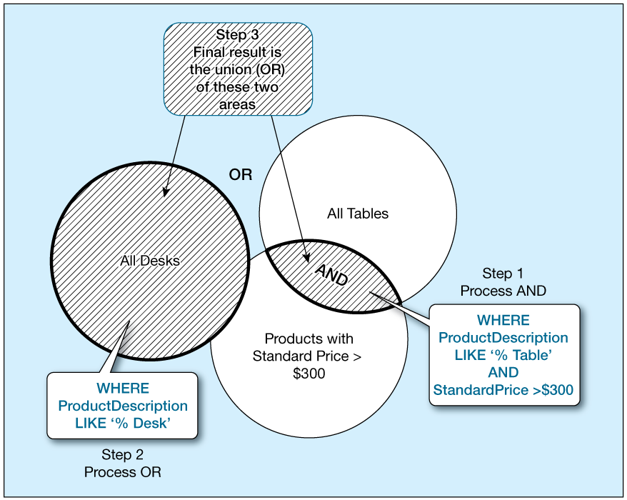
Figure 5-8 Boolean Query A Without the Use of Parentheses
Notes:
This Venn diagram visualizes how Boolean operators work:
Step 1: Process OR first (due to parentheses) - finds all desks and tables (large combined area)
Step 2: Process AND - intersects the result with products over $300 (smaller shaded area)
Result: Only expensive desks and tables (intersection area with diagonal lines)
Key difference: The parentheses ensure we first identify all relevant product types, then apply the price filter. Without parentheses, we got all desks plus only expensive tables.
Real-world analogy: This is like saying "From all furniture (desks or tables), show me only the expensive pieces" versus "Show me all desks plus expensive tables."
Query design principle: Use parentheses to group logical concepts together. This makes queries more readable and ensures they match your business requirements.

Slide 33
SELECT Example–Boolean Operators
SELECT Product Description, Product Finish,
Product Standard Price
FROM Product_T
WHERE (Product Description LIKE ‘%Desk’
OR Product Description LIKE ‘%Table’)
AND Product Standard Price > 300;
Notes:
Adding parentheses changes everything:
With parentheses: (ProductDescription LIKE '%Desk' OR ProductDescription LIKE '%Table') AND ProductStandardPrice > 300
Processing order:
First: Find all desks and tables (parentheses processed first)
Then: From that set, keep only items over $300
Results: Only expensive desks and tables appear. The cheap Computer Desk is now excluded because it doesn't meet the price requirement.
Business impact: This query better serves a business need like "find premium furniture for our high-end showroom." The parentheses ensure both product type and price requirements are met.
Lesson: Parentheses give you precise control over query logic. When in doubt, use parentheses to make your intent explicit.

Slide 34
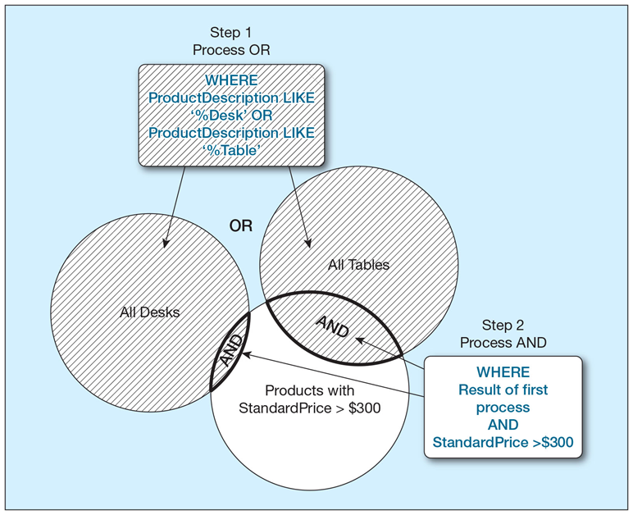
Figure 5-9 Boolean Query B with Use of Parentheses
Notes:
This diagram shows the corrected logic:
Step 1: Process OR first (due to parentheses) - finds all desks and tables (large combined area)
Step 2: Process AND - intersects the result with products over $300 (smaller shaded area)
Result: Only expensive desks and tables (intersection area with diagonal lines)
Key difference: The parentheses ensure we first identify all relevant product types, then apply the price filter. Without parentheses, we got all desks plus only expensive tables.
Real-world analogy: This is like saying "From all furniture (desks or tables), show me only the expensive pieces" versus "Show me all desks plus expensive tables."
Query design principle: Use parentheses to group logical concepts together. This makes queries more readable and ensures they match your business requirements.
Visual comparison: Compare this diagram to Figure 5-8. Notice how the final shaded area is much smaller and more focused. The parentheses created a logical intersection rather than a union of different criteria.
Business impact: This corrected query is more useful for real business scenarios. A furniture store manager looking for premium items to feature in a high-end catalog needs exactly this type of focused filtering.
Teaching moment: This comparison perfectly illustrates why understanding operator precedence is crucial in SQL. The difference between these two queries could mean the difference between a successful marketing campaign and wasted resources promoting the wrong products.

Slide 35
Using Ranges for Qualification
SELECT Product Description, Product Standard Price
FROM Product_T
WHERE Product Standard Price > = 200 AND
Product Standard Price < = 300;
SELECT Product Description, Product Standard Price
FROM Product_T
WHERE Product Standard Price BETWEEN 20
AND 300;
Notes:
Range queries are common in business applications:
Comparison operators: ProductStandardPrice >= 200 AND ProductStandardPrice <= 300 uses explicit comparisons.
BETWEEN operator: ProductStandardPrice BETWEEN 200 AND 300 is more concise and readable.
Inclusive ranges: BETWEEN includes both endpoints. BETWEEN 200 AND 300 matches products priced at exactly $200 or $300.
Practical applications:
Find customers aged 25-65 for targeted marketing
Identify orders placed in the last quarter
Select products in a specific price range for promotions
Filter employees by years of service
Performance advantage: Database optimizers can efficiently process BETWEEN clauses using indexes, often faster than separate comparison operations.
NOT BETWEEN: Excludes the specified range. NOT BETWEEN 200 AND 300 finds products under $200 or over $300.
Data type flexibility: BETWEEN works with numbers, dates, and even strings (alphabetical ranges).

Slide 36
Using Distinct Values
What are the unique combinations of order number and order quantity included in the Order Line table?
  SELECT DISTINCT Order I D, Ordered Quantity
  FROM Order Line_T;
Notes:
DISTINCT eliminates duplicate values from query results:
Purpose: When your query might return duplicate rows, DISTINCT ensures each unique combination appears only once.
Example business case: "What are the unique combinations of order number and order quantity?" This helps identify ordering patterns without duplicate entries skewing analysis.
How it works: SQL compares entire rows (all selected columns) for uniqueness. Only rows that are identical in ALL selected columns are considered duplicates.
Performance impact: DISTINCT requires sorting or hashing operations, which can slow queries on large datasets. Use only when necessary.
Alternative approaches: Sometimes GROUP BY can achieve similar results more efficiently, especially when you need aggregate calculations.
Common mistake: Using DISTINCT to "fix" queries that return unexpected duplicates. Usually, the better solution is to understand why duplicates occur and address the root cause.
Real-world usage: Distinct value queries are essential for data analysis, report generation, and understanding data patterns in your database.

Slide 37
Using IN and NOT IN with Lists
List all customers who live in warmer states
  SELECT Customer Name, Customer City,
  Customer State
  FROM Customer_T
  WHERE Customer State IN (‘F L’, ‘T X’, ‘C A’, ‘H I’);
Notes:
The IN operator simplifies multiple value comparisons:
Basic usage: CustomerState IN ('FL', 'TX', 'CA', 'HI') is much cleaner than four separate OR conditions.
Business application: This query finds customers in "warmer states" for seasonal product marketing. You might use this to promote outdoor furniture or swimwear.
Dynamic lists: The values in parentheses can come from subqueries: CustomerState IN (SELECT State FROM WarmClimateStates). This makes queries more maintainable.
NOT IN: Excludes listed values. CustomerState NOT IN ('AK', 'ME', 'VT') finds customers outside cold weather states.
Performance benefits: Database optimizers can efficiently process IN lists, often using indexes more effectively than multiple OR conditions.
Maintenance advantage: When your list of values changes, you only update one place in the query rather than multiple OR conditions.
NULL considerations: Be careful with NOT IN when the list might contain NULL values - this can produce unexpected results.
The IN operator makes queries more readable and maintainable when filtering on multiple discrete values.

Slide 38
Additional Clauses
Clause | Result
ORDER BY | Sorts the final results rows in ascending or descending order.
GROUP BY | Groups rows in an intermediate results table where the values in those rows are the same for one or more columns.
HAVING | Can only be used following a GROUP BY and acts as a secondary WHERE clause, returning only those groups that meet a specified condition.
Notes:
These three clauses extend SELECT's power significantly:
ORDER BY: Controls result presentation order. Essential for reports and user interfaces where data sequence matters.
GROUP BY: Organizes rows into groups for aggregate calculations. This transforms detail data into summary information.
HAVING: Filters groups after GROUP BY processing. It's like WHERE, but operates on groups rather than individual rows.
Relationship between clauses: These work together systematically - GROUP BY creates groups, HAVING filters groups, ORDER BY sorts the final results.
Business applications:
ORDER BY: Customer lists, product catalogs, sales reports
GROUP BY: Sales by region, inventory by category, orders by month
HAVING: Regions with sales > $10,000, categories with > 100 items
Processing sequence: SQL processes these clauses in a specific order (shown in Figure 5-10), not necessarily the order you write them.
Understanding these clauses is crucial for creating meaningful business reports and analytical queries.

Slide 39
Sorting Results: The ORDER BY Clause
Sort the results first by STATE, and within a state by the CUSTOMER NAME
  SELECT Customer Name, Customer City,
  Customer State
FROM Customer_T
WHERE Customer State IN (‘F L’, ‘T X’, ‘C A’, ‘H I’)
ORDER BY Customer State, Customer Name;
Notes:
ORDER BY transforms chaotic data into organized information:
Multiple column sorting: ORDER BY CustomerState, CustomerName sorts first by state, then by name within each state. This creates logical groupings in your results.
Business value: The sorted results are much more usable - customers in California are grouped together and alphabetized, making the data easier to scan and use.
Sort direction: Default is ascending (A-Z, 1-100). Use DESC for descending order: ORDER BY CustomerState DESC, CustomerName.
Column position shortcuts: ORDER BY 3, 1 references columns by their position in the SELECT list. This is convenient but less maintainable than using column names.
Performance considerations: Sorting large result sets can be expensive. Sometimes it's more efficient to sort in the application layer, especially for interactive applications where users might change sort orders frequently.
NULL handling: Different databases sort NULL values differently - some put them first, others last. Check your system's behavior.
Proper sorting makes your query results immediately useful for business purposes rather than requiring additional processing.

Slide 40
Categorizing Results Using GROUP BY Clause (1 of 2)
For use with aggregate functions
  Scalar aggregate: single value returned from S Q L query with aggregate function
  Vector aggregate: multiple values returned from S Q L query with aggregate function (via GROUP BY)
Notes:
GROUP BY enables powerful data summarization:
Scalar vs Vector aggregates:
Scalar: One value for entire table (AVG of all product prices)
Vector: Multiple values, one per group (AVG price per product category)
GROUP BY purpose: Divides table rows into groups based on common column values, then applies aggregate functions to each group separately.
Business transformation: GROUP BY converts detail transaction data into management summary information. Instead of seeing 1000 individual sales, you see sales totals by region, month, or product line.
Memory analogy: Think of GROUP BY like sorting mail into different boxes based on zip codes, then counting how many pieces go in each box.
Foundation for analytics: Most business intelligence and reporting relies on GROUP BY operations. Sales dashboards, inventory reports, and performance metrics all use grouped data.
Understanding GROUP BY is essential for transitioning from basic data retrieval to meaningful business analysis.

Slide 41
Categorizing Results Using GROUP BY Clause (2 of 2)
Count the number of customers with addresses in each state to which we ship
  SELECT Customer State, COUNT (Customer State)
      FROM Customer_T
      GROUP BY Customer State
      ORDER BY Customer State
Notes:
This practical example shows GROUP BY in action:
Query breakdown: SELECT CustomerState, COUNT(CustomerState) FROM Customer_T GROUP BY CustomerState counts customers per state.
Business insight: The results tell you where your customers are located geographically. This information drives decisions about shipping costs, regional marketing, warehouse locations, and expansion opportunities.
GROUP BY rule: Every column in SELECT must either appear in GROUP BY or be an aggregate function. This ensures each group produces exactly one result row.
ORDER BY integration: Adding ORDER BY CustomerState sorts states alphabetically, making the results easier to read and present.
Scalability: This same query pattern works whether you have 10 customers or 10 million. SQL's set-based approach handles the complexity automatically.
Extension possibilities: You could easily modify this to GROUP BY CustomerState, CustomerCity for more detailed geographic analysis.
This type of query forms the foundation of business reporting and data analysis across all industries.

Slide 42
Qualifying Results by Categories Using the HAVING Clause
Find only states with more than one customer
  SELECT Customer State, COUNT (Customer State)
  FROM Customer_T
  GROUP BY Customer State
  HAVING COUNT (Customer State) > 1;
Notes:
HAVING filters groups created by GROUP BY:
WHERE vs HAVING: WHERE filters individual rows before grouping; HAVING filters groups after aggregation. They serve different purposes in the query processing pipeline.
Example logic: "Show me only states with more than one customer" requires HAVING because the condition involves a count of grouped rows.
Business applications:
Markets with sales > $100,000 (significant markets only)
Product categories with > 50 items (major categories)
Customers with > 10 orders (frequent buyers)
Performance insight: HAVING executes after GROUP BY, so it can't improve query performance the way WHERE can. Use WHERE whenever possible to reduce the data set early.
Complex conditions: HAVING can use AND, OR, NOT just like WHERE: HAVING COUNT(*) > 1 AND AVG(OrderAmount) > 500.
Required aggregates: HAVING conditions typically involve aggregate functions because they're testing properties of groups, not individual rows.
HAVING enables sophisticated analysis by letting you focus on significant patterns in your grouped data.

Slide 43
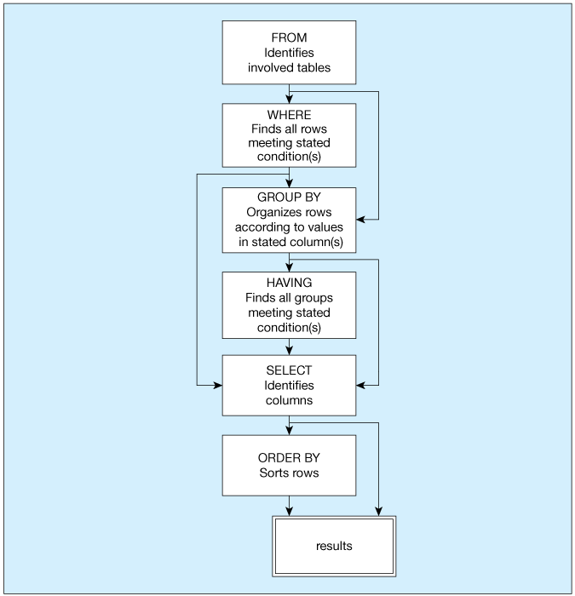
Figure 5-10 S Q L Statement Processing Order
SELECT [ALL/DISTINCT] column_list
FROM table list
[WHERE conditional expression]
[GROUP BY group_by_column_list]
[HAVING conditional expression]
[ORDER BY order_by_column_list]
(based on van der Lans, 2006, p. 100)
Notes:
This diagram reveals SQL's internal execution sequence:
Processing order (different from syntax order):
FROM: Identify and load source tables
WHERE: Filter individual rows
GROUP BY: Organize remaining rows into groups
HAVING: Filter groups based on aggregate conditions
SELECT: Choose columns and apply functions
ORDER BY: Sort final results
Why this matters: Understanding processing order helps you:
Write more efficient queries
Debug problems systematically
Understand why certain constructs work or don't work
Debugging strategy: When a complex query doesn't work, build it step by step following this processing order. Test each clause individually before combining them.
Performance implications: Each step creates an intermediate result set. Efficient queries minimize the size of intermediate results by filtering early (WHERE) rather than late (HAVING).
Optimization insight: Database optimizers may reorder operations for efficiency, but the logical sequence remains constant.
This processing model is fundamental to understanding how SQL transforms your query into results.

Slide 44

Copyright
This work is protected by United States copyright laws and is provided solely for the use of instructors in teaching their courses and assessing student learning. Dissemination or sale of any part of this work (including on the World Wide Web) will destroy the integrity of the work and is not permitted. The work and materials from it should never be made available to students except by instructors using the accompanying text in their classes. All recipients of this work are expected to abide by these restrictions and to honor the intended pedagogical purposes and the needs of other instructors who rely on these materials.

