Slide 1


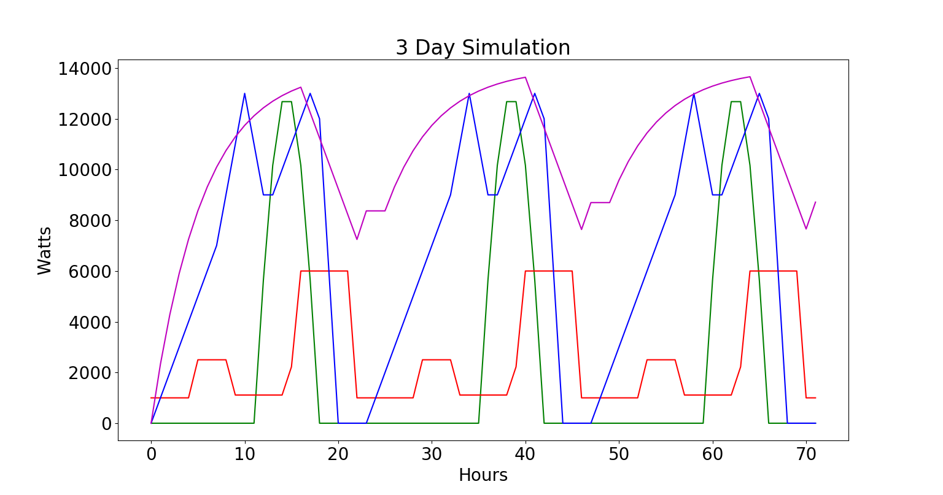
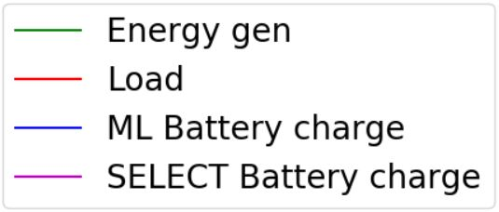



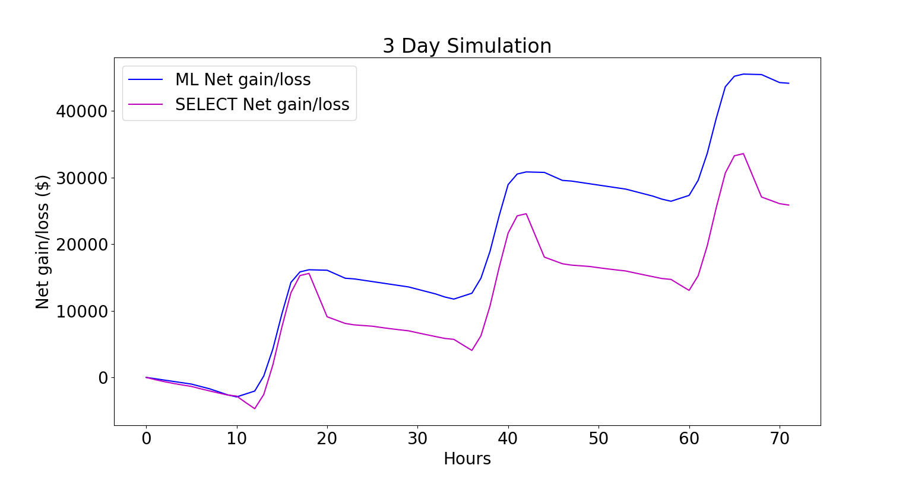
Micro-Grid Optimization
Trenton Griffiths and Jeff Wasden
CS 5890 ------ Machine Intelligence in Clean Energy ----- Fall 2018
Abstract
Results
Summary
The rapid deployment and optimal operation of micro-grids is an essential step in increasing the adoption of solar power, improving grid resilience and expanding electrical power availability in developing countries. Micro-grids integrate local energy generation
and storage, local loads, and run in isolation or with a grid connection. Given time-of-day grid energy pricing, predictions of solar energy production and knowledge of upcoming loads, it is possible to determine the optimal operating policy. This poster presents a system that combines historical weather and usage data with reinforcement learning methods to determine this policy. The results of this study show that given a cost of electricity, weather data for a region, and a specific battery size the net gain of a micro-grid can be significantly improved.
XXXXXXXXXXXXXXXXXXXXXXXXXXXXXXXXXXXXXXXXXXXXXXXXXXXXXXXXXXXXXXXXXXXXXXXXXXXXXXXXXXXXXXXXXXXXXXXXXXXXXXXXXXXXXXXXXXXXXXXXXXXXXXXXXXXXXXXXXXXXXXXXXXXXXXXXXXXXXXXXXXXXXXXXXXXXXXXXXXXXXXXXXXXXXXXXXXX.
XXXXXXXXXXXXXXXXXXXXXXXXXXXXXXXXXXXXXXXXXXXXXXXXXXXXXXXXXXXXXXXXXXXXXXXXXXXXXXXXXXXXXXXXXXXXXXXXXXXXXXXXXXXXXXXXXXXXXXXXXXXXXXXXXXXXXXXXXXXXXXXXXXXXXXXXXXXXXXXXXXXXXXXXXXXXXXXXXXXXXXXXXXXXXXXXXXX.
Graphical representation
or the results
Graphical representation for the results
Conclusion
XXXXXXXXXXXXXXXXXXXXXXXXXXXXXXXXXXXXXXXXXXXXXXXXXXXXXXXXXXXXXXXXXXXXXXXXXXXXXXXXXXXXXXXXXXXXXXXXXXXXXXXXXXXXXXXXXXXXXXXXXXXXXXXXXXXXXXXXXXXXXXXXXXXXXXXXXXXXXXXXXXXXXXXXXXXXXXXXXXXXXXXXXXXXXXXXXXX.
Problem Description
Computational Study
Within micro-grids, the problem of when to discharge the battery, as well as by how much, causes significant inefficiency in the system. The problem addressed in this project was that of optimization of a micro-grid. Using a reinforcement learning algorithm, value iteration, to calculate the best times and intervals to discharge and charge, the battery increased the net gain of the system.
XXXXXXXXXXXXXXXXXXXXXXXXXXXXXXXXXXXXXXXXXXXXXXXXXXXXXXXXXXXXXXXXXXXXXXXXXXXXXXXXXXXXXXXXXXXXXXXXXXXXXXXXXXXXXXXXXXXXXXXXXXXXXXXX
Graphical representation
Of study
Method
Graphical representation for the results
Graphical representation for the results
The approach used to optimize energy management in the battery was the reinforcement learning algorithm of value iteration. The state examined during the derivation of the optimal policy consisted of the charge in the battery and the time of day. The intermittent reward occurs at the end of every day and is the dollar equivalent of the energy stored in the battery.
Figure captions xxxxxxx
Xxxxxxxxxxxxxxxxxxxxx
xxxxxxxxxxxxxxxxx
Figure captions xxxxxxx
Xxxxxxxxxxxxxxxxxxxxx
xxxxxxxxxxxxxxxxx
References
XXXXXXXXXXXXXXXXXXXXXXXXXXXXXXXXXXXXXXXXXXXXXXXXXXXXXXXXXXXXXXXXXXXXXXXXXXXXXXXXXXXXXXXXXXXXXXXXXXXXXXXXXXXXXXXXXXXXXXXXXXXXXXXXXXXXXXXXXXXXXXXXXXXXXXXXXXXXXXXXXXXXXXXXXXXXXXXXXXXXXXXXXXXXXXXXXXX.

