Slide 1


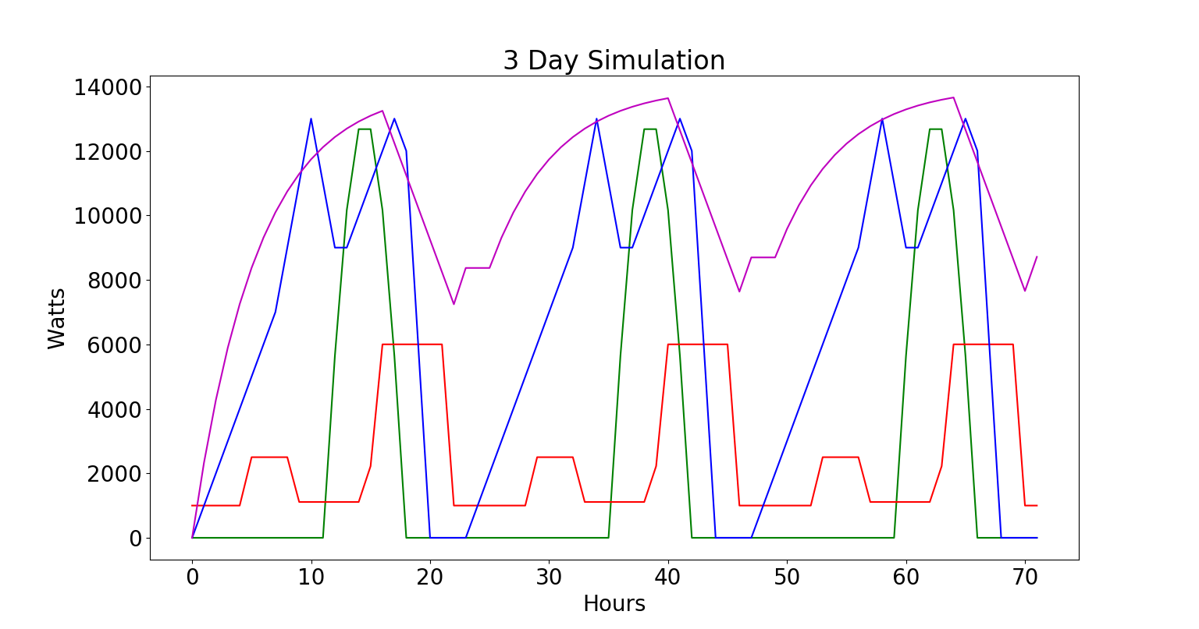
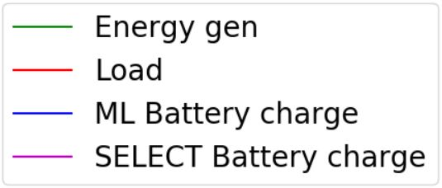
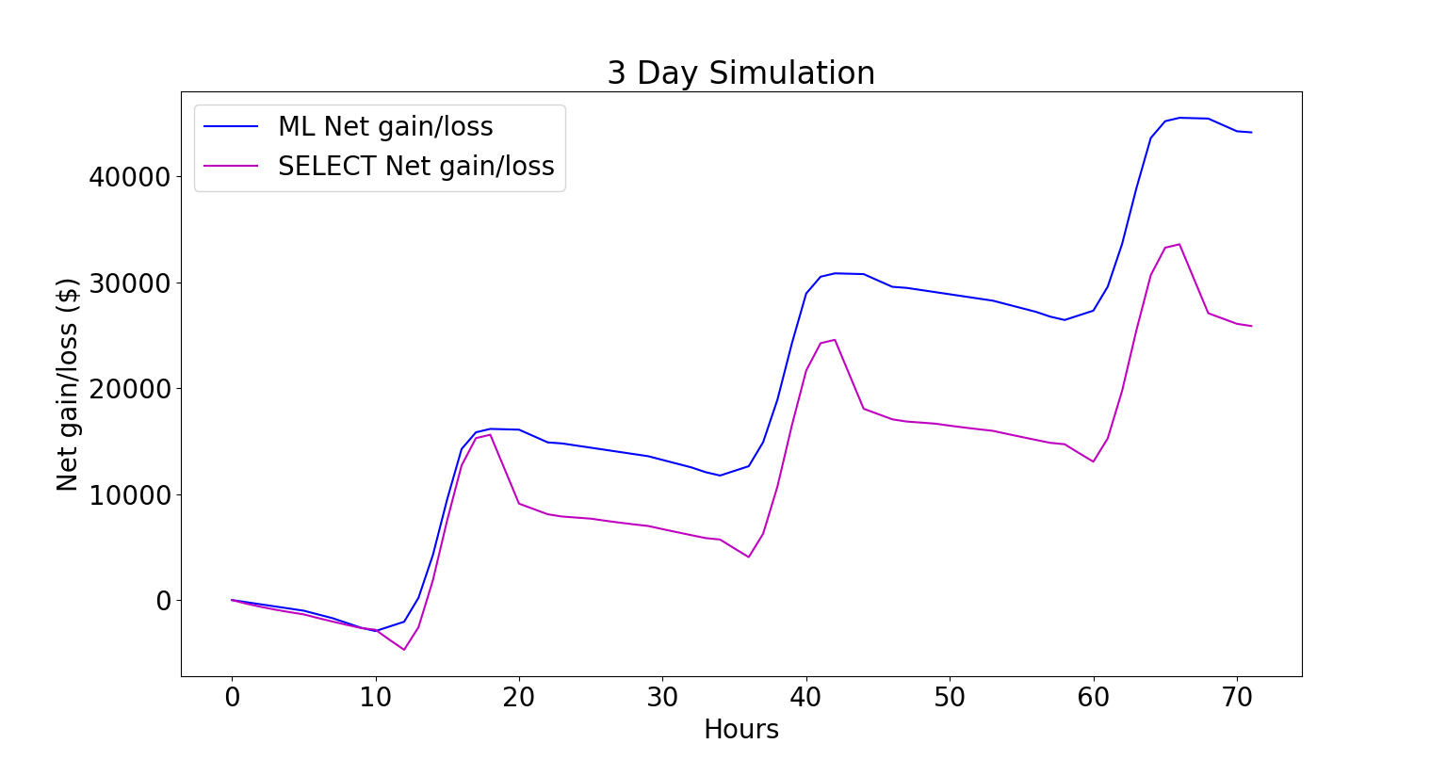
Micro-Grid Optimization
Trenton Griffiths and Jeff Wasden
CS 5890 ------ Machine Intelligence in Clean Energy ----- Fall 2018
Abstract
Results
Summary
The rapid deployment and optimal operation of Micro-grids is an essential step in increasing the adoption of solar power, improving grid resilience and expanding electrical power availability in developing countries. Micro grids integrate local energy generation
and storage, local loads and run in isolation or with a grid connection. Given time-of-day grid energy pricing, predictions of solar energy production and knowledge of upcoming loads, it is possible to determine the optimal operating policy. This paper presents a system that combines historical weather and usage data with neural-network prediction and reinforcement learning methods to determine this policy. The results of this study show that given a cost of electricity, weather data for a region, and a specific battery size the net gain of a Micro-grid can completely offset the cost of operation.
XXXXXXXXXXXXXXXXXXXXXXXXXXXXXXXXXXXXXXXXXXXXXXXXXXXXXXXXXXXXXXXXXXXXXXXXXXXXXXXXXXXXXXXXXXXXXXXXXXXXXXXXXXXXXXXXXXXXXXXXXXXXXXXXXXXXXXXXXXXXXXXXXXXXXXXXXXXXXXXXXXXXXXXXXXXXXXXXXXXXXXXXXXXXXXXXXXX.
XXXXXXXXXXXXXXXXXXXXXXXXXXXXXXXXXXXXXXXXXXXXXXXXXXXXXXXXXXXXXXXXXXXXXXXXXXXXXXXXXXXXXXXXXXXXXXXXXXXXXXXXXXXXXXXXXXXXXXXXXXXXXXXXXXXXXXXXXXXXXXXXXXXXXXXXXXXXXXXXXXXXXXXXXXXXXXXXXXXXXXXXXXXXXXXXXXX.
Graphical representation
or the results
Graphical representation for the results
Conclusion
XXXXXXXXXXXXXXXXXXXXXXXXXXXXXXXXXXXXXXXXXXXXXXXXXXXXXXXXXXXXXXXXXXXXXXXXXXXXXXXXXXXXXXXXXXXXXXXXXXXXXXXXXXXXXXXXXXXXXXXXXXXXXXXXXXXXXXXXXXXXXXXXXXXXXXXXXXXXXXXXXXXXXXXXXXXXXXXXXXXXXXXXXXXXXXXXXXX.
Problem Description
Computational Study
With in micro-grids the problem of when to discharge the battery, as well as by how much, causes significant inefficiency in the system. The problem addressed in this project was that of optimization of a micro-grid. Using a V-Learning algorithm to calculate the best times and intervals to discharge and charge the battery increased the net gain of the system. (SOMETHING LIKE THIS?)
XXXXXXXXXXXXXXXXXXXXXXXXXXXXXXXXXXXXXXXXXXXXXXXXXXXXXXXXXXXXXXXXXXXXXXXXXXXXXXXXXXXXXXXXXXXXXXXXXXXXXXXXXXXXXXXXXXXXXXXXXXXXXXXX
Graphical representation
Of study
Graphical representation Problem
Method
Graphical representation for the results
Graphical representation for the results
If we implement the NN we will have to change the model and reward function from deterministic to probabilistic. Won’t this require a lot of our code to change??? If not what is a good way to make it not need to change a lot.
Graphical representation for the method: Picture/
Algorithm
Flowchart/
Equations
Figure captions xxxxxxx
Xxxxxxxxxxxxxxxxxxxxx
xxxxxxxxxxxxxxxxx
Figure captions xxxxxxx
Xxxxxxxxxxxxxxxxxxxxx
xxxxxxxxxxxxxxxxx
References
XXXXXXXXXXXXXXXXXXXXXXXXXXXXXXXXXXXXXXXXXXXXXXXXXXXXXXXXXXXXXXXXXXXXXXXXXXXXXXXXXXXXXXXXXXXXXXXXXXXXXXXXXXXXXXXXXXXXXXXXXXXXXXXXXXXXXXXXXXXXXXXXXXXXXXXXXXXXXXXXXXXXXXXXXXXXXXXXXXXXXXXXXXXXXXXXXXX.

