Slide 1


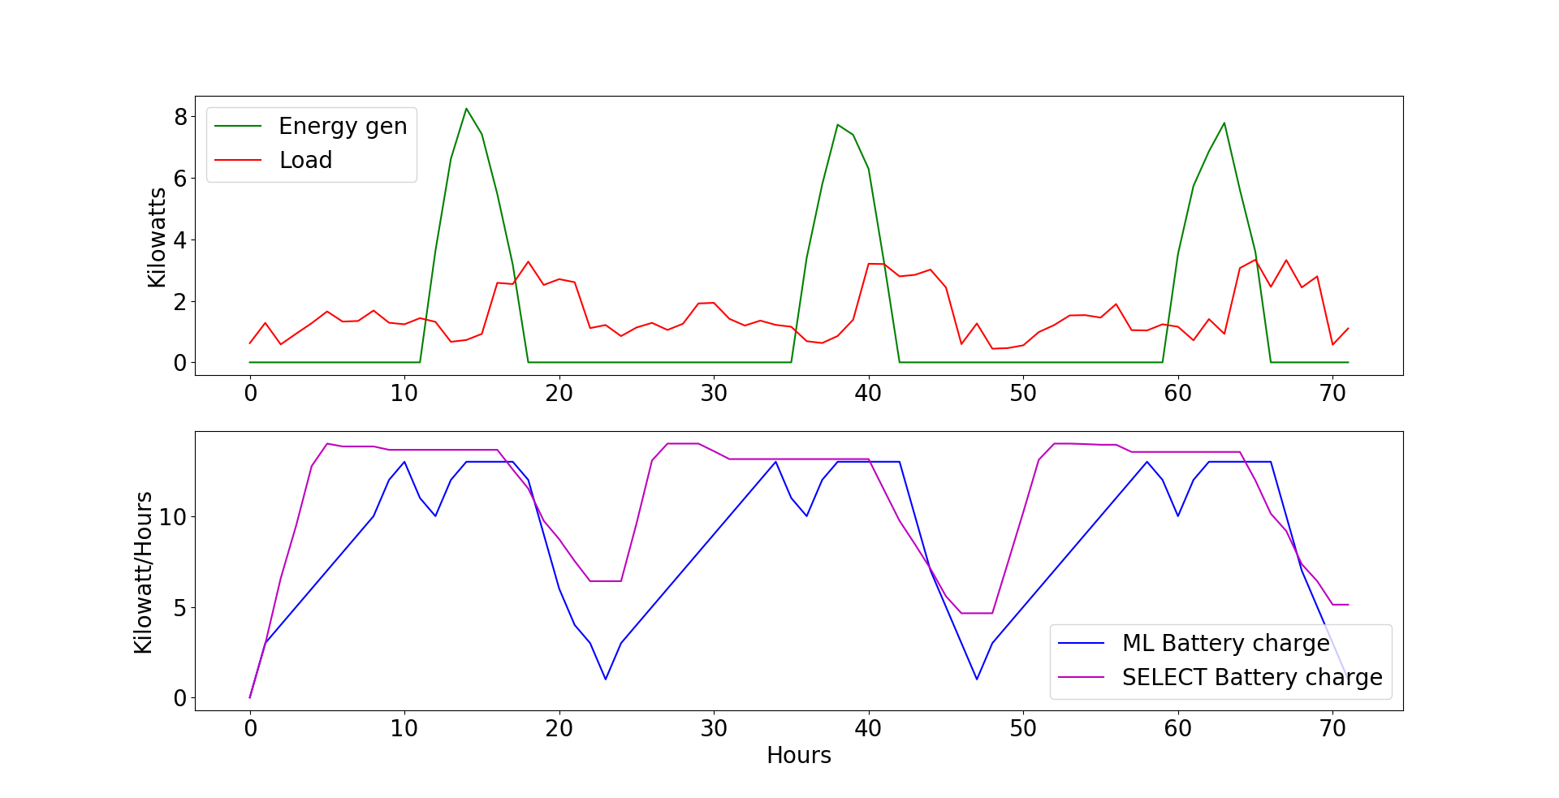
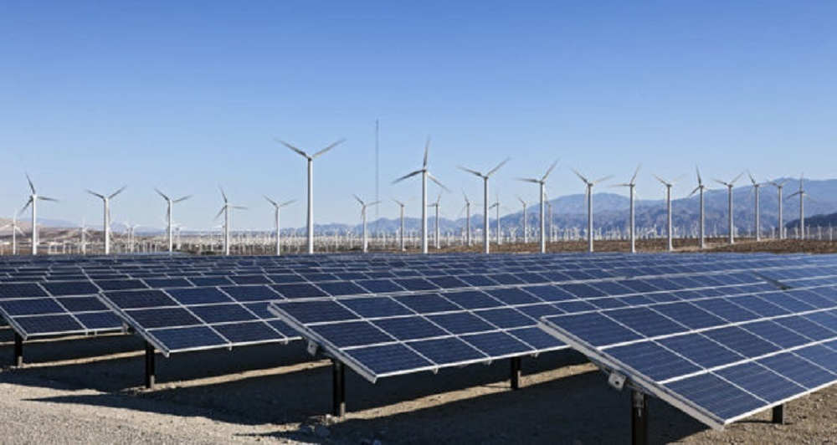


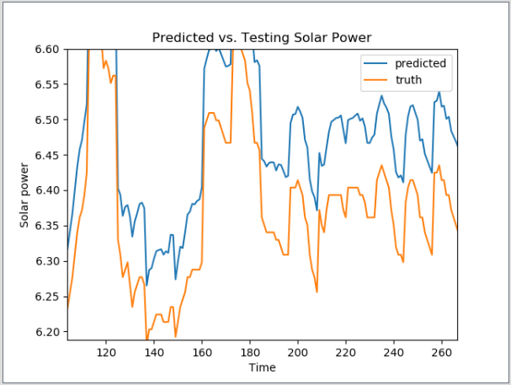
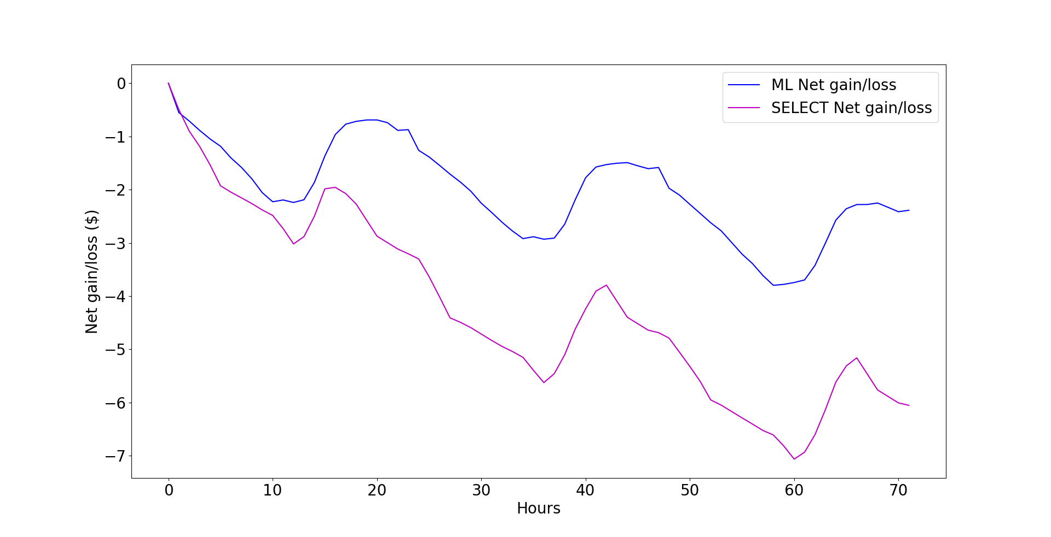
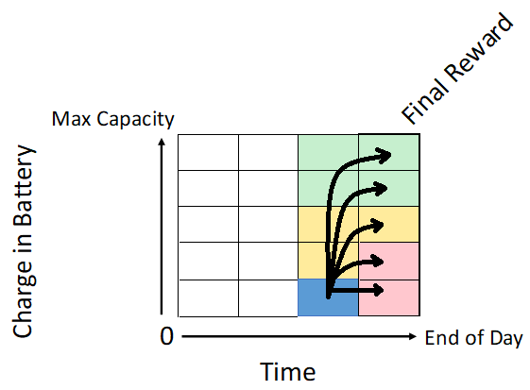
Micro-grid Optimization
Trenton Griffiths and Jeff Wasden
CS 5890 ------ Machine Intelligence in Clean Energy ----- Fall 2018
Abstract
Results
Summary
The rapid deployment and optimal operation of Micro-grids is an essential step in increasing the adoption of solar power, improving grid resilience, and expanding electrical power availability in developing countries. Micro-grids integrate local energy generation
and storage, local loads, and run in isolation or with a grid connection. Given time-of-day grid energy pricing, predictions of solar energy production, and knowledge of upcoming loads, it is possible to determine the optimal operating policy. This poster presents a system that combines historical weather and usage data with reinforcement learning methods to determine this policy. The learned policy is compared to a fixed policy that seeks to charge the battery every night. Results show the learned policy significantly reduces operating costs.
Using a simulated load and simulated solar generation the reinforcement learning algorithm was able to lower the total cost of a three-day simulation by a factor of three in the example case shown below. While the exact factor varied with each iteration, the reinforcement learning algorithm out preformed the SELECT algorithm each time.. By charging and discharging the battery at more optimal times the reinforcement learning algorithm can outperform the basic policy deployed at the SELECT micro-grid. The graph below shows the state of the Micro-grid over a three-day period.
A reinforcement learning algorithm was created using the current time, the charge in the system battery, and the load and solar energy generated by a facility. By implementing a reinforcement learning algorithm, the net gain of the Micro-grid was able to surpass the net gain of the SELECT algorithm.
Future Work
Future work on this project could include a Neural Network (NN) to predict the solar energy generation and anticipated loads of the Micro-grid. By using an NN to predict loads and solar generation the Micro-grid can become more accurate and efficient. The model could use the weather data supplied from a local weather station to predict the energy generated then using the actual energy to improve accuracy. Similarly for loads.
The current machine learning algorithm uses a value iteration model that is deterministic, but if the NN was to be implemented the model would need to include a discount factor and become probabilistic to account for the prediction and correction of the energy generation. Shown in the graphic below is a representation of a prediction NN developed.
3 Day Simulation
Problem Description
Within Micro-grids, the problem of determining when to discharge the battery, as well as by how much, causes significant inefficiency in the system. The problem addressed in this project was optimization of a Micro-grid. Using a reinforcement learning algorithm, value iteration, to calculate the best times and intervals to discharge and charge, the battery increased the net gain of the system.
The graphs above display SELECT’s current algorithm of charging the battery at night and then using it during the times when the load is greater than maximum specified load; this load is determined by calculating the average load based on historical data. It also demonstrates the reinforcement learning algorithm using its optimal policy that was generated to make decisions. The following graph shows that the Micro-grid system out preforms the SELECT system over the same three days.
Method
Model-based reinforcement learning was applied to derive the optimal policy using the value iteration algorithm. The state is represented by the current charge in the battery and the time of day, along with predicted loads and solar energy production.
The power of these methods is that the desired behavior is expressed as reward functions that combine:
The cost and value of electricity as a function of time-of-day
The cost on battery performance as a function of charge/discharge actions
3 Day Simulation
Computational Study
For the deterministic model, the data used was an hourly load of a facility, the solar generation of the facility, and the price of the electricity for a given time. Using this data, the reinforcement learning model’s net gain and the SELECT model’s net gain was calculated for a three day period and compared to one another.
The figure to the right is an example of a value iteration table used in the reinforcement learning model. By filling the table with intermediate rewards based on the back propagation of the final rewards, the dollar value of the energy stored.
References
Reinforcement learning for microgrid energy management
https://www.sciencedirect.com/science/article/pii/S036054421300481
Reinforcement Learning-based Energy Trading for
Microgrids
https://arxiv.org/pdf/1801.06285.pdf
github.com/ksanman/Clean-Energy

