Slide 1


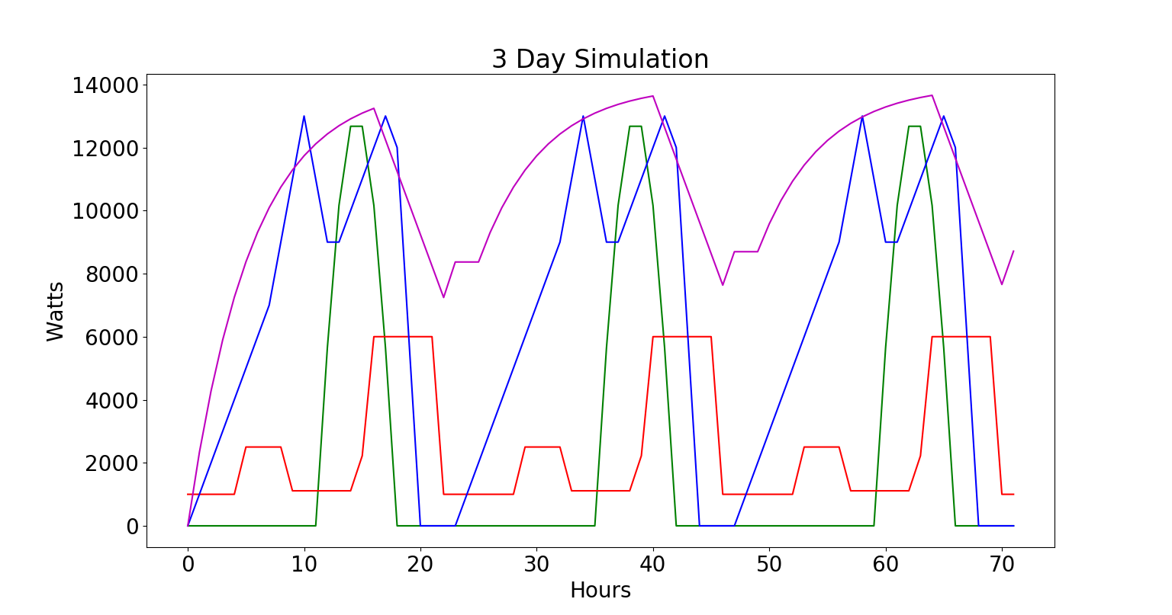
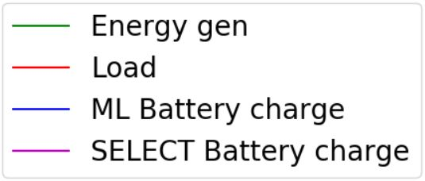
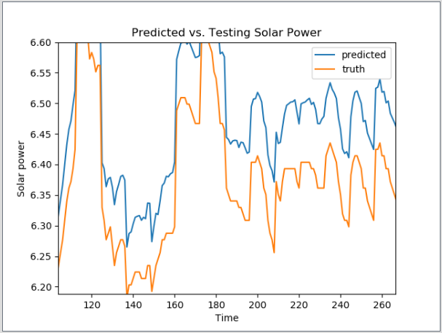
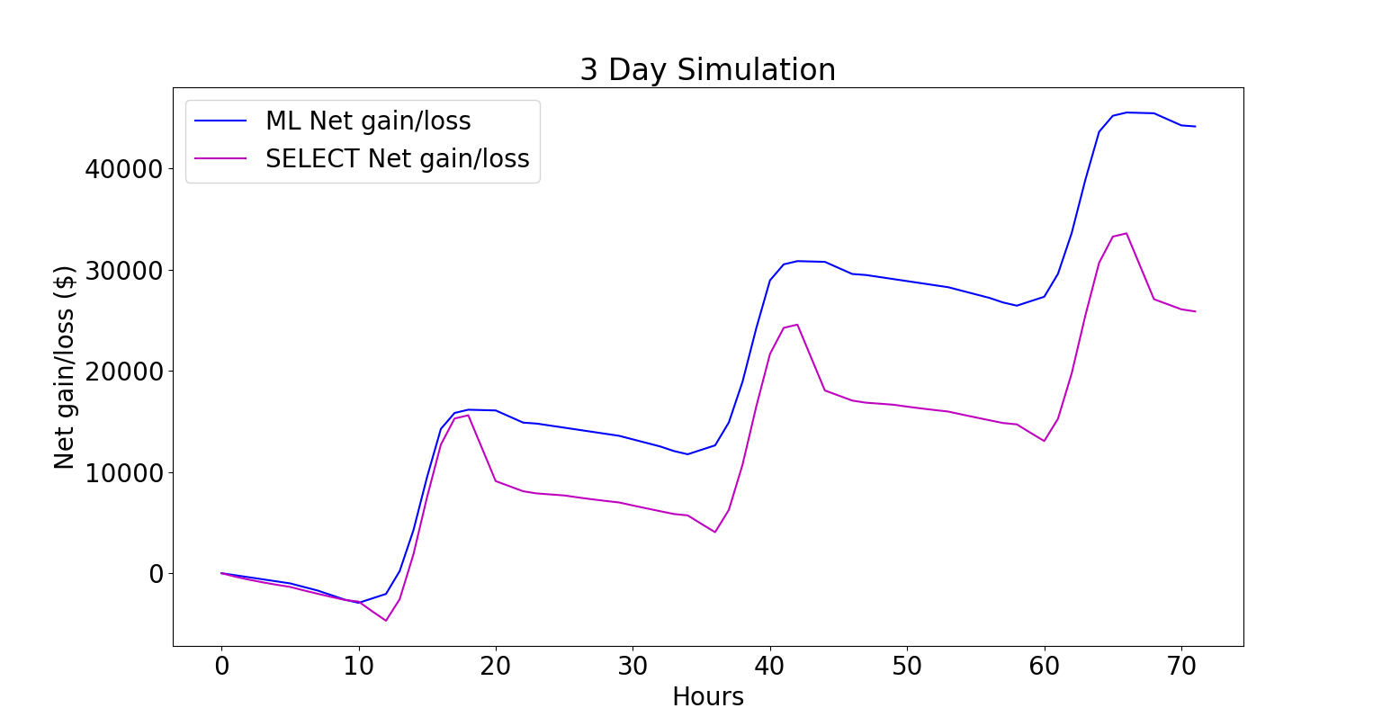
Micro-Grid Optimization
Trenton Griffiths and Jeff Wasden
CS 5890 ------ Machine Intelligence in Clean Energy ----- Fall 2018
Abstract
Results
Summary
The rapid deployment and optimal operation of Micro-grids is an essential step in increasing the adoption of solar power, improving grid resilience and expanding electrical power availability in developing countries. Micro grids integrate local energy generation
and storage, local loads and run in isolation or with a grid connection. Given time-of-day grid energy pricing, predictions of solar energy production and knowledge of upcoming loads, it is possible to determine the optimal operating policy. This paper presents a system that combines historical weather and usage data with neural-network prediction and reinforcement learning methods to determine this policy. The results of this study show that given a cost of electricity, weather data for a region, and a specific battery size the net gain of a Micro-grid can completely offset the cost of operation.
Using a dummy load
A reinforcement learning algorithm was created using the current time, the charge in the system battery, and the load and solar energy generated by a facility. By implementing a reinforcement learning algorithm the net gain of the Micro-grid was able to surpass the net gain of the SELECT algorithm.
Graphical representation
or the results
Graphical representation for the results
Future Work
Future work on this project could include a Neural Network (NN) to predict the solar energy generation of the Micro-grid. By using a NN to predict the generated solar energy the machine learning model can become more accurate and efficient. By doing this the model could use the weather data supplied from a local weather station to predict the energy generated andt hen compare the predicted energy to the actual energy. The current machine learning algorithm uses a value iteration model that is deterministic, but if the NN was to be implemented the model would need to include a discount factor and become probabilistic to account for the prediction and correction of the energy generation.
Problem Description
With in micro-grids the problem of when to discharge the battery, as well as by how much, causes significant inefficiency in the system. The problem addressed in this project was that of optimization of a micro-grid. Using a V-Learning algorithm to calculate the best times and intervals to discharge and charge the battery increased the net gain of the system. (SOMETHING LIKE THIS?)
XXXXXXXXXXXXXXXXXXXXXXXXXXXXXXXXXXXXXXXXXXXXXXXXXXXXXXXXXXXXXXXXXXXXXXXXXXXXXXXXXXXXXXXXXXXXXXXXXXXXXXXXXXXXXXXXXXXXXXXXXXXXXXXX
Graphical representation Problem
Method
Graphical representation for the results
Graphical representation for the results
Computational Study
If we implement the NN we will have to change the model and reward function from deterministic to probabilistic. Won’t this require a lot of our code to change??? If not what is a good way to make it not need to change a lot.
For the deterministic model the data that was used was an hourly load of a facility, the solar generation of the facility, and the price of the electricity for a given time. Using this data the machine learning model’s net gain and the SELECT model’s net gain was calculated for a three day period and compared to one another.
Graphical representation for the method: Picture/
Algorithm
Flowchart/
Equations
Figure captions xxxxxxx
Xxxxxxxxxxxxxxxxxxxxx
xxxxxxxxxxxxxxxxx
Figure captions xxxxxxx
Xxxxxxxxxxxxxxxxxxxxx
xxxxxxxxxxxxxxxxx
References
XXXXXXXXXXXXXXXXXXXXXXXXXXXXXXXXXXXXXXXXXXXXXXXXXXXXXXXXXXXXXXXXXXXXXXXXXXXXXXXXXXXXXXXXXXXXXXXXXXXXXXXXXXXXXXXXXXXXXXXXXXXXXXXXXXXXXXXXXXXXXXXXXXXXXXXXXXXXXXXXXXXXXXXXXXXXXXXXXXXXXXXXXXXXXXXXXXX.

