Slide 1
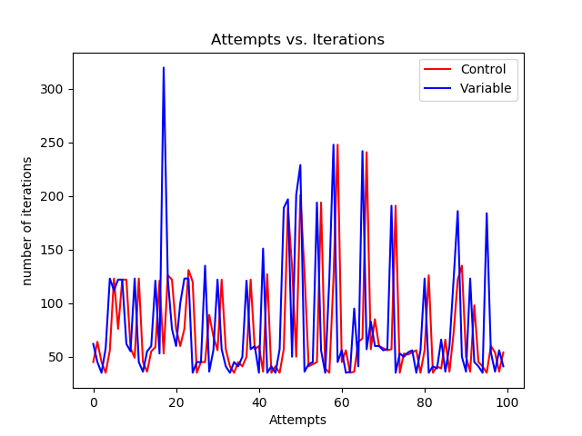
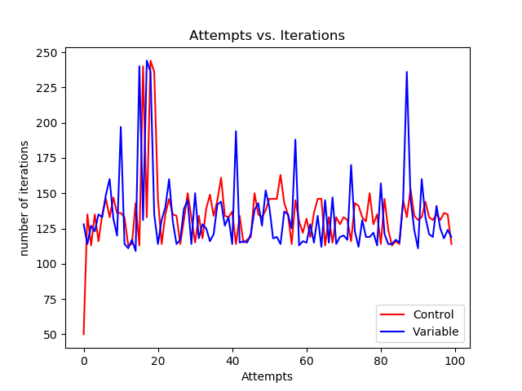
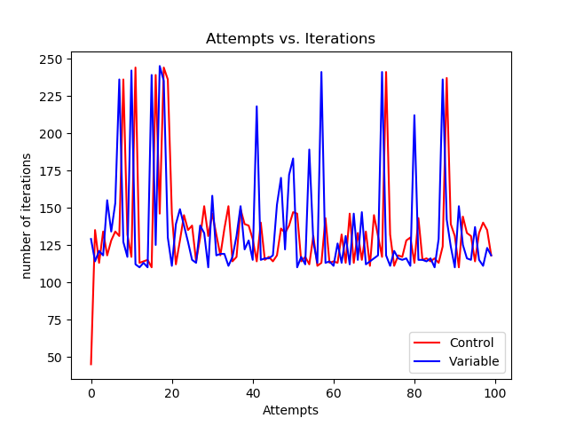
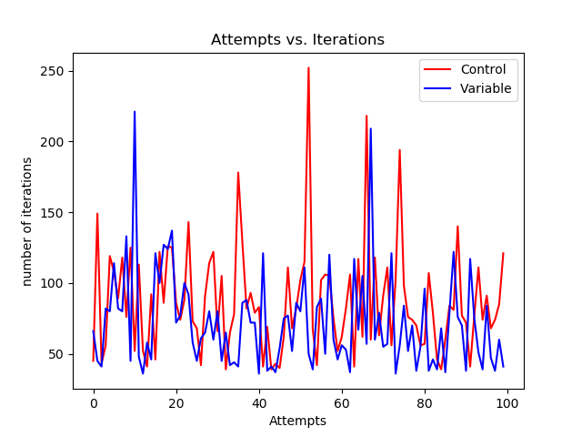
Reinforcement Learning Project
The control variables: Amount of Force, Gamma, and Alpha.
Change in Alpha
Change in All
Change in Force
Change in Gamma

Slide 2
What I Learned
The change in Force resulted in the most drastic change in the results.
Changing the Alpha resulted in a slight change, but the program was essentially the same.
Changing Gamma smoothed the progression, but lowered the total success.
Changing all three of the variables was the best result.

