Slide 1
Rubik cube solver
Trent Rand, Robert Dinaro

Slide 2
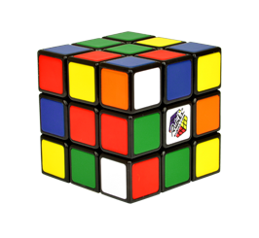
What is IT?
Invented in 1974 by Hungarian sculptor and professor Ernö Rubik
Originally called magic cube
Licensed in 1980 to Ideal Toy corp.
Cube has 6 sides, each with a specific color as the middle cube
Cube is solved when each side has only one color present
Achieved by rotating sides to manipulate placement of individual cubes

Slide 3
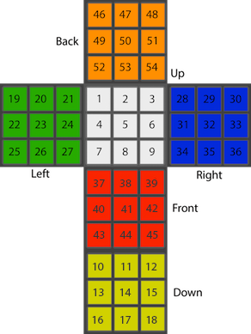
Representing Cube in Code
Cube is represented as a cube map
Each piece is entered in the order specified to the right
Pieces are represented with first letter in color: (w)hite, (y)ellow, (g)reen, (b)lue, (r)ed, (o)range
Example: cube(g,w,w,g,w,w,r,r,r,b,b,o,y,y,o,y,y,o,g,g,r,g,g,r,y,y,b,o,b,b,o,b,b,g,b,b,w,w,w,r,r,y,r,r,y,o,o,w,o,o,w,y,g,g)

Slide 4
Basic Approach
Enter cube into solver using the cube map format specified
White side on top, Red side in front, Blue side on right
Cube map is translated using operations of spinning different sides by 90°
All permutations are computed until a solution is found
Example of permutations: [up], [down], …, [up, up], [up, down], …, [up, up, down], …
Solution is found when unsolved cube map matches the solved cube map
| ?- solve(Solution, cube(g,w,w,g,w,w,r,r,r,b,b,o,y,y,o,y,y,o,g,g,r,g,g,r,y,y,b,o,b,b,o,b,b,g,b,b,w,w,w,r,r,y,r,r,y,o,o,w,o,o,w,y,g,g), C), solved(C). Solution = [up, up, up, right, right, right, front, front, front]

Slide 5
Proposal
Can be used for beginners to get used to the cube and its mechanics, since the solver only shows clockwise rotations
The more the user practices the better and faster they get
Can be used to help assist with solving the cube
Just for fun…

Slide 6
Improvements
Integrate counterclockwise rotations
Need to make sure the solver doesn’t waste computations of rotating the same face clockwise then counterclockwise
Maximize efficiency using minimax to pick the solution with least amount of moves
Implement a non-brute force solutions that will have a lower cost for solving

