Slide 1

Notes:
BRITTANY

Slide 2
WE ARE BACK
Notes:
BRITTANY
Welcome back to the 4th Annual Hackathon CLT. Who was here last year? Hackababy is here, OMG.
This event is made possible by our sponsors--Data Chambers, Harris Teeter, P&G, MillerCoors, Tresata, Kforce, University City Partners, Enlighted, Oak Ridge Staffing-- we thank them for supporting Charlotte’s tech community.
Thanks to DJ Smitty for dropping beats. Thank you to UNC Cfor providing space not just for this event and a big shoutout to Jim Currie specifically who manages the PORTAL building- he is the coolest. Thank you also to those of you from the media who are here to cover the event.
Events like this are made possible by the support of the community and by people like you.

Slide 3
on the line
wifiSSID: NinerWiFi Guest
Password: no password (like really there is no password)
Notes:
BRITTANY

Slide 4
#HACKATHONCLT
@charlottehacks
Notes:
BRITTANY
If you’re on Twitter you can follow this event’s conversation at #hackathonCLT and @charlottehacks.

Slide 5
agenda
friday, march 18
5p
5:30- 7:30p
7:30p
8:30p
12a
Registration Table Opens
Kickoff & Party
Hack Problem Presentation
Go Hack
Midnight Snacks
saturday, march 19
7a-8a
10a
12:00p
1:30p
Breakfast
Hacking Ends | Judging Round 1 Begins
Lunch
Presentations & Awards Ceremony
Notes:
BRITTANY Here’s how the next 20 or so hours will go…

Slide 6
the basics
what is a hackathon?
why charlotte?
what’s the motive?
big data AGAIN?
Notes:
BRITTANY
A hackathon is, simply put, a hacking marathon. How many of you are here for your first hackathon ever?
This is an opportunity to network, showcase your skills, challenge your skills, play in a creative outlet outside work, and most importantly connect with the tech community at large.
We’re in Charlotte first and foremost because we live and work here (obviously) but also because we believe Charlotte is still making a name for itself as a tech capital and a lot of the talent here go unrecognized.
Our motivation in creating this event (along with all of our sponsors) is simply to help foster community and draw attention to the talent we have right here in Charlotte. And throw an awesome party.
4th year running
Co-founded by Tresata and Harris Teeter
Charlotte’s biggest developer party
Celebrates tech talent and community in our city
REAL (anonymized) data…REAL problems…REAL(ly big) prizes

Slide 7
what made it possible
community
community
community
Notes:
BRITTANY
Again, we can’t thank our community of supporters enough for making this happen.

Slide 8
who made it possible
who made it possible
Notes:
BRITTANY

Slide 9
rules of engagement
nothing illegal
respect copyright
keep it clean
terms & conditions
all work must be on site
organizers reserve the right…
Notes:
BRITTANY

Slide 10
THE PROBLEM
Notes:
INTRODUCE ABHI/CHASE

Slide 11
business problem
HOW CAN THE SECOND HARVEST FOOD BANK OF METROLINA GROW –RAISE MORE DONATIONS, BECOME EFFICIENT IN DISTRIBUTION AND DO SOMETHING NO OTHER NON-PROFIT MAY HAVE DONE….
…THEN EVERYBODY WINS (LITERALLY)
Notes:
CHASE

Slide 12
key statistics
DOUBLING FOOTPRINT
SPACE - 23,000 sq. ft. - 61,000 sq. ft. of space
46MM lbs. of food - 75MM lbs. of food
35MM meals distributed
1 in 7 struggles with hunger
Counties served – Anson NC, Burke NC, Cabarrus NC, Catawba NC, Cleveland NC, Gaston NC, Iredell NC, Lincoln NC, Mecklenburg NC, Montgomery NC, Rowan NC, Rutherford NC, Stanly NC, Union NC, Cherokee SC, Lancaster SC, Spartanburg SC, Union SC, York SC

Slide 13
what are you looking for
understanding of the data (it is big)
scale trumps complexity in algo
Ability to tease out sophisticated insights
Merge data we haven’t given you
Bottlenecks (in collection, distribution)
PATTERNS (ANY pattern – checks, herringbone, tie’dye)
Simple yet powerful algorithms
Notes:
ASK CHASE TO ADD HERE

Slide 14
THE DATA
Notes:
MATT

Slide 15
what you get
real-world donation data + retail data
1.6 billion+ records
scrubbed & de-identified
field names & explanations in Data Dictionary on github
Notes:
MATT

Slide 16
donations data
Posting_Date | Date items were received
Location_Code|Location of distribution center
Lot_No | Internal set identifier
Pallet_No | Internal sub-set identifier
Document_No | Similar to receipt number
Ext_Gross_Weight | Weight of items in lbs
Unit | Unit to measure quantity
Quantity | Number of items or cases
Cost_Amount | Value of items if receipt provided
Entry_No | Number of entry
Category_Code | Item category identifier
Category_Description | Type of product
Donor_Category | High level description of the donor
Donor_City | City
Donor_State | State
Donor_Zip | Zip
Donor_ID | Unique identifier for donor
Notes:
MATT

Slide 17
monetary donations data
ID | Donation identifier
City | Donor city
State | Donor state
Zip | Donor zip
Donation_Date | Date donation was made
Donation_Amount | Monetary donation amount
Donation_Type | Code representing method of payment
Donation_Number | Entry number for donation
Donation_Batch_Number | Identifier for group donation
Donation_When_Added | Date donation was accepted
Donation_When_Acknowledged | Date donor was acknowledged
Notes:
MATT

Slide 18
distributon center data
Posting_Date | Date items were received
Location_Code | Location of distribution center
Lot_No | Internal set identifier
Pallet_No | Internal sub-set identifier
Document_No | Unique to each Donor's donation, bring together types of donations
Ext_Gross_Weight | Weight of items
Unit | Unit to measure quantity
Quantity | Number of items
Cost_Amount | Value of items if receipt provided
Entry_No | Number of entry
Category_Code | Item category identifier
Category_Description | Type of product
Agency_FBC_County_Code | County
Agency_UNC_Activity_Status | Flag indicating agency is still active
Agency_City | City
Agency_State | State
Agency_Zip | Zip
Agency_FBC_Size_Code | Estimate of person count
Agency_FBC_Category_Code | Internal program that is receiving items
Agency_ID | Unique identifier for agency
Notes:
MATT

Slide 19
ht transactions
field | definition
customer | unique id per customer household
receipt | unique id per checkout
date time |date and time of checkout in yyyy-mm-dd hh:mm:ss
zip | 5 digit postal code where the transaction took place
Ean | industry standard item id number
Plu | item id number for weighted items like produce and meat
Mupc | id number for small groups of items (different flavors of a particular brand and size of yogurt will have different eans but may have the same mupc)
Subcat | item subcategory number
Cat | item category number
Dept | item department number
Ean description | item description at the ean level
Subcat description| item description at the subcat level
Cat description| item description at the cat level
Dept description | item description at the dept level
Promo id |id identifying the promotion (if there is one) that applies to the transaction
Price | gross $ sales for this ean from this receipt
Discount | total $ discounts for this ean from this receipt
Quantity | total number of units of the ean purchased on this receipt
Notes:
MATT

Slide 20
how will you share results
format – your call
time – 5 minute presentations for shortlisted teams
Creativity (yours), predictability (machines), scalability (your code) are all important
judges will be revealed in 2 seconds… they are tough, but they are awesome
Notes:
MATT

Slide 21
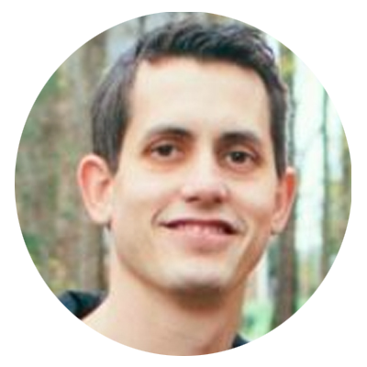
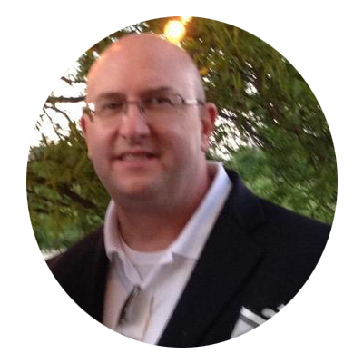
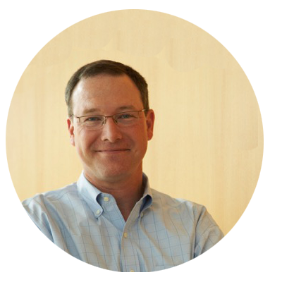
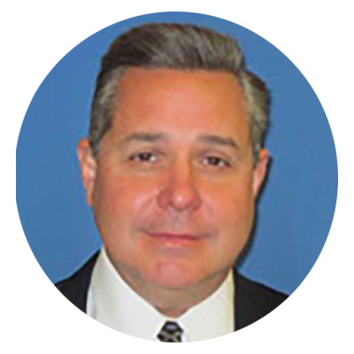
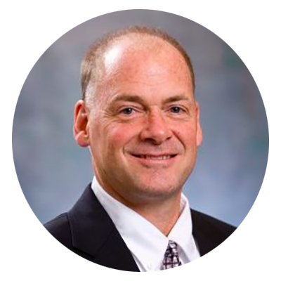
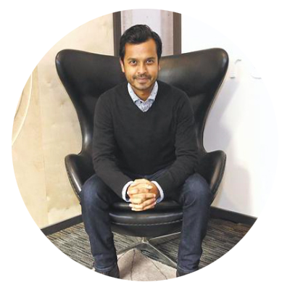
Shortlist Judges
Chase Cabanillas
Mike Keating
Pete Murphy
Tim Reagan
Kevin Ledford
Abhishek Mehta
Notes:
BRITTANY Starting at 10:30am tomorrow morning.

Slide 22
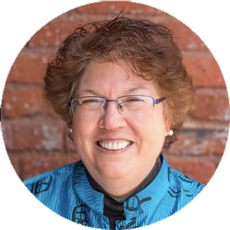
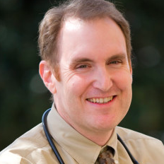
Finals Judges
Abhishek Mehta, tresata
Jean Wright, CHS
Dr. Michael Dulin, UNCC
Notes:
BRITTANY Starting at 1:30PM tomorrow afternoon.

Slide 23
TECH
Notes:
JAININ

Slide 24
hardware stack
At scale hadoop 5 node cluster (hat tip DataChambers)
Node specifications:
32 cores
128GB RAM
14TB storage
Notes:
JAININ

Slide 25
dataset stored
stored in HDFS
For data dictionary location, visit here: http://www.github.com/tresata/hackathonclt2016
DO NOT PULL DOWN THE ENTIRE SET
DO NOT LEAVE WITH ANY DATA
YES WE WILL SPOT CHECK
Notes:
JAININ

Slide 26
languages
anything that can compile to a .jar (like java, scala, etc.)
JDBC connection available through Hive
Python, via pyspark and Anaconda
Apache Spark
Notes:
JAININ

Slide 27
tresata ORION
You asked…we listened…
We’ve given you access to our real-time network graph engine + a summary explaining how to use it
Not required
To access location, visit here: http://www.github.com/tresata/hackathonclt2016
Notes:
CAITLIN

Slide 28
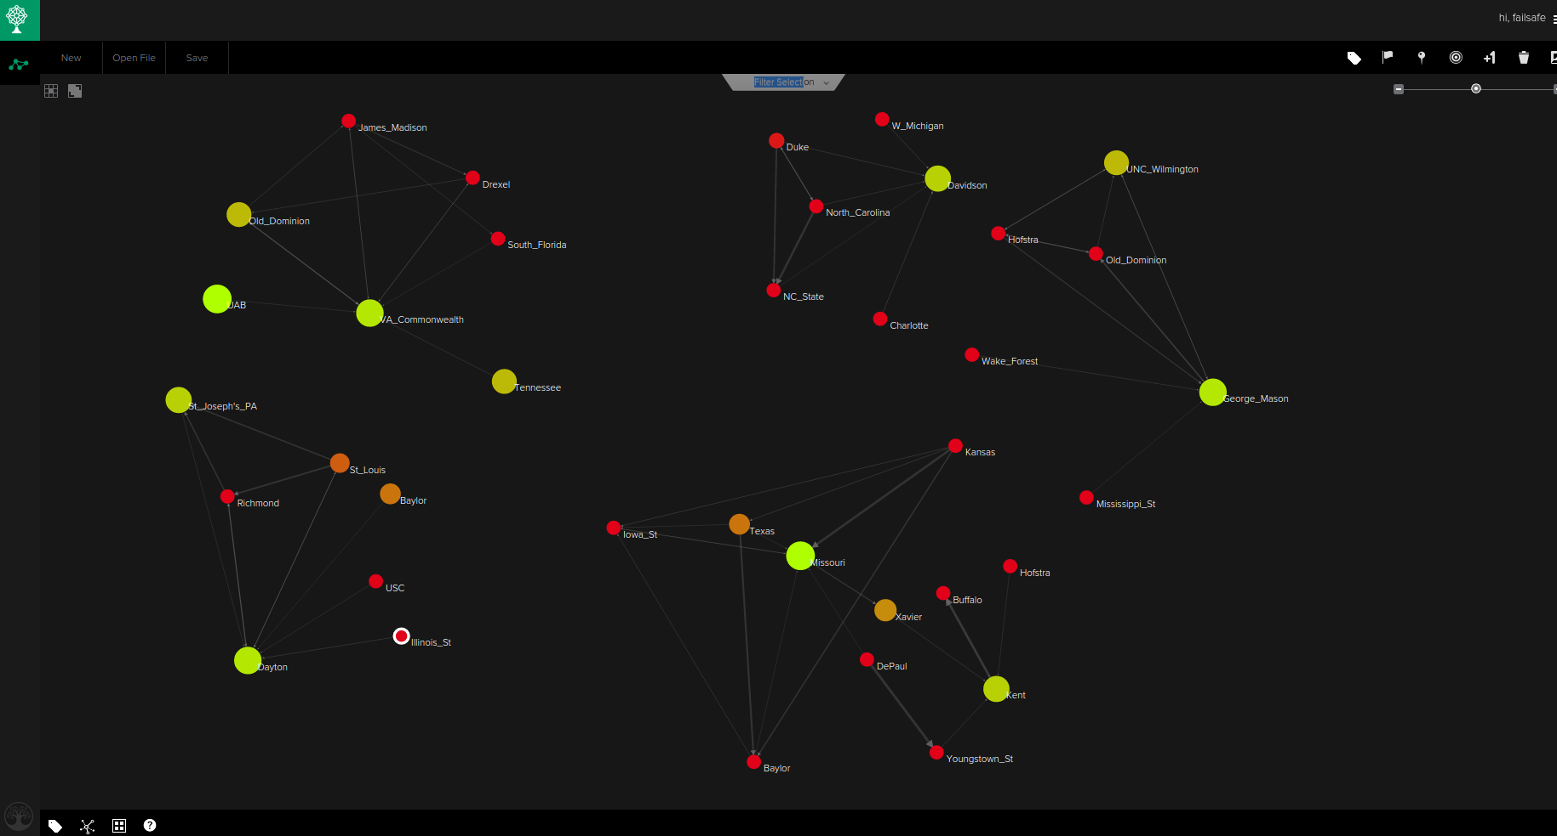
ORION
Notes:
CAITLIN

Slide 29
THE PRIZES
Notes:
BRITTANY

Slide 30
in it to win it
$5,000 HACK PRIZE
$2,000 CODE PRIZE
$1,000 freeSTYLE PRIZE
Notes:
BRITTANY

Slide 31
not just about the cheddar
RAFFLE PRIZE
4 DAY, 3 NIGHT
SKI TRIP FOR 2
Notes:
BRITTANY …OR IS IT
COURTESY OF CABOT CHEDDAR, AIRFARE, MEALS, ACCOMODATIONS INCLUDED FOR A TRIP TO SMUGGLER’S NOTCH. TERMS LISTED ON THE SITE, BUT NEEDED TO REGISTER BY MARCH 10TH, PARTICIPATE AND PROMOTE THE EVENT VIA THE HASHTAG #HACKATHONCLT. IF YOU HAVEN’T PROMOTED YET, WHICH MANY OF YOU HAVE NOT, PLEASE DO SO BEFORE TOMORROW SO WE CAN KEEP YOU IN THE RUNNING

Slide 32
LOGISTICS
Notes:
BRITTANY

Slide 33
the basics
restrooms – located on 5th and 4th floors
building access – DO NOT LEAVE
be reasonable – alcohol, noise, trash, etc.
lounges – vote for your favorite tomorrow
support – look for grey hoodie shirts (or all black onesies), help desks, and slack
Notes:
BRITTANY

Slide 34
slack
General guidelines for use:
Ask questions in relevant channel
Keep it clean (not joking)
Remember, this is public to everyone at the event
Notes:
BRITTANY

Slide 35
help desks
DATA
ORION
TECH
BUSINESS PROBLEM
GENERAL
Notes:
BRITTANY
ALL LOCATED ON MAIN LEVEL…FOR THOSE FACE TO FACE QUESTIONS
Also blue bands = data, green bands = tech, white = orion

Slide 36
if you haven’t registered yet…
COME FIND ME RIGHT AFTER THIS
Also, for those of you who have not declared teams…no access until I have all your details !!

Slide 37
questions?
www.hackathonclt.slack.com
Brittany Box– Event
Jainin Shah – Tech/Infrastructure
Caitlin Lohrenz – ORION
Matthew Dix – Data
Chase & Abhi – Business Problem
Notes:
BRITTANY

Slide 38
LET’S HACK
@charlottehacks | #HACKATHONCLT
http://www.github.com/tresata/hackathon2016
Notes:
BRITTANY

