Slide 1

The Haynes-Shockley Experiment
Resul Teymuroglu
17/4/23

Slide 2

Computational Physicist
What I do:
Visualise the equations we work with
Produce simulations
Provide an understanding of what we should expect

Slide 3
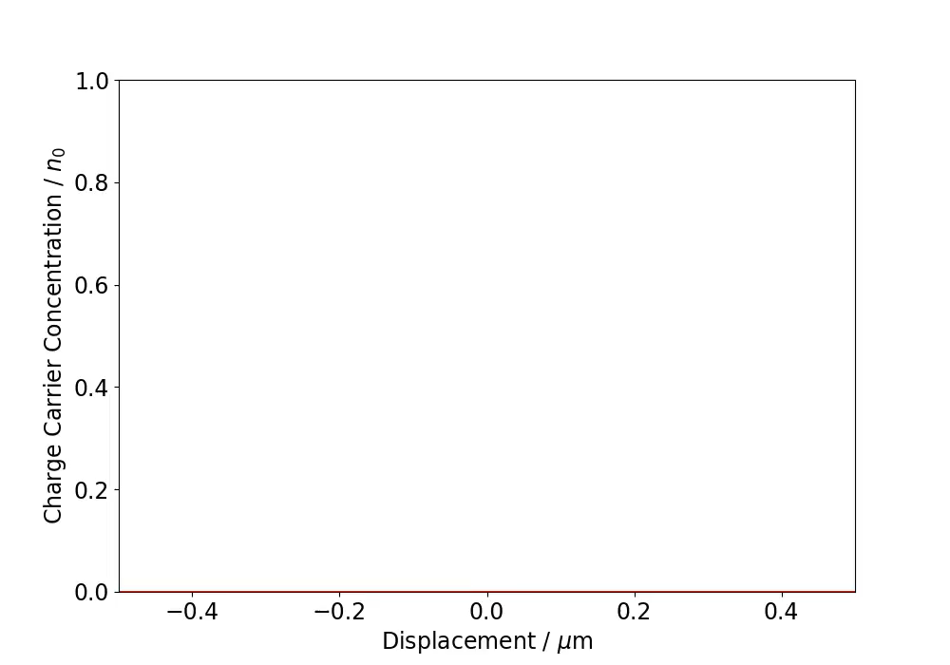


Background
Injection of minority charge carriers (MCCs) into semiconductor
How can we model their motion?
Very large in quantity
Move either in positive or negative $x$-direction
Random motion
$P\left(x,t\right)=A\left(t\right)e^{−\frac{x^{2}}{4Dt}}$
$A\left(t\right)= \frac{1}{\sqrt{4πDt}}, D= \frac{μk_{B}T}{q}$

Slide 4

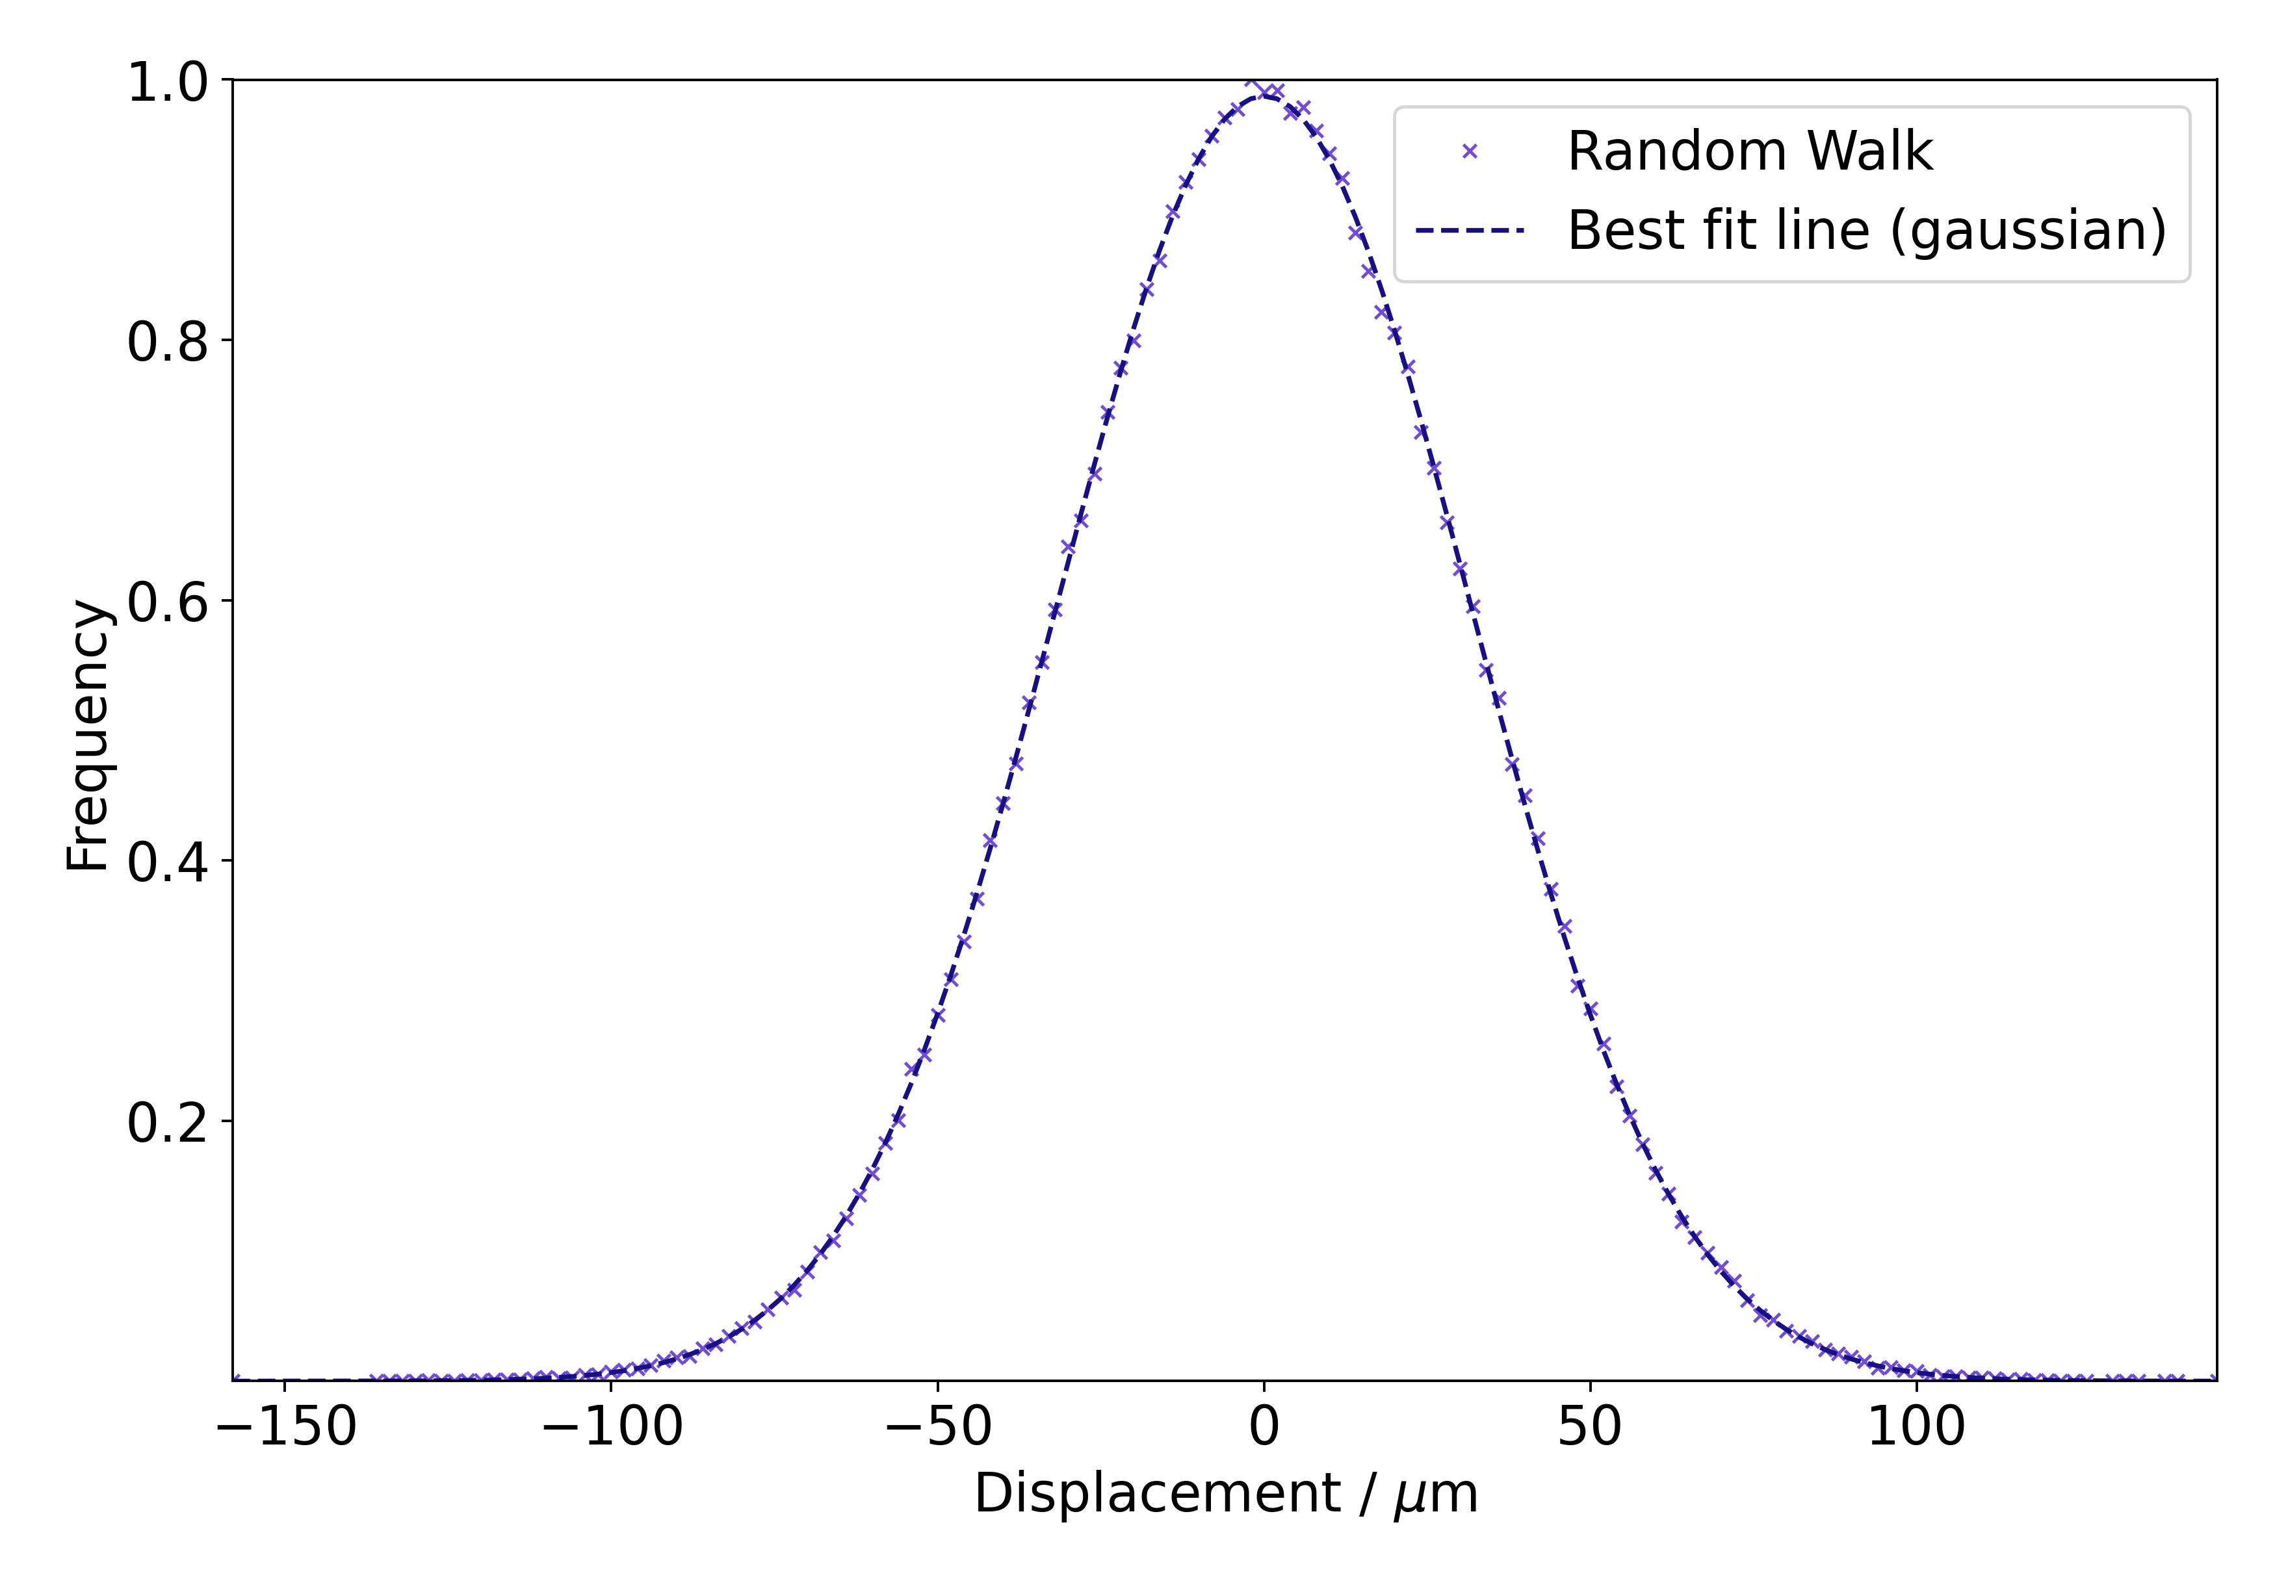
The Random-Walk Algorithm
Particle in 1-D number line, initially at origin
Reaches a final displacement after 1,000 coin tosses
Repeat for 500,000 particles
Collect two pieces of data:
Final positions of each particle
The frequency of each final position reached
…but there are two problems

Slide 5

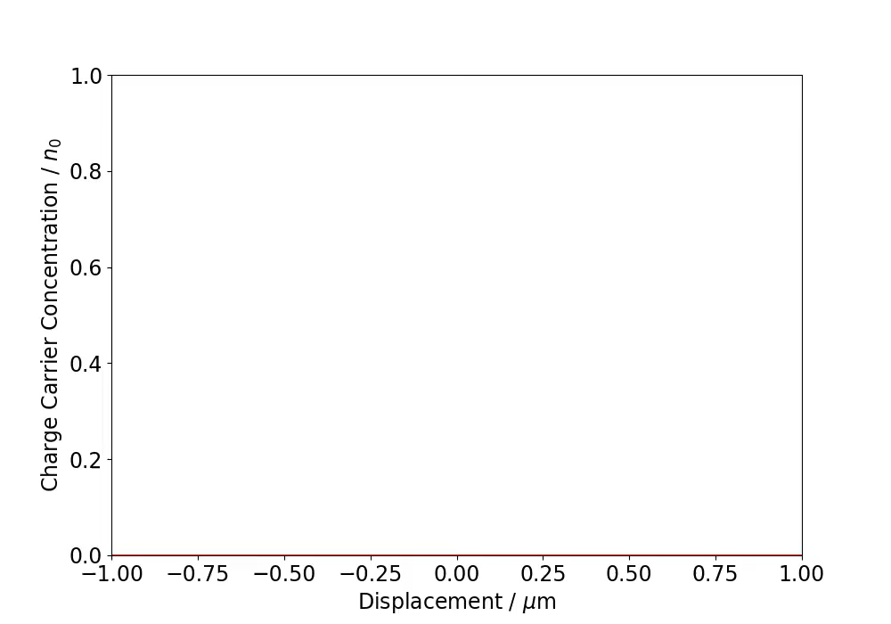

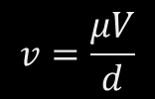

Drift
MCCs will experience a drift velocity,
$$v=\frac{μV}{d}$$
$P(x,t)$ becomes
$$P\left(x, t\right)=A\left(t\right)e^{−\frac{{(x−vt)}^{2}}{4Dt}}$$

Slide 6
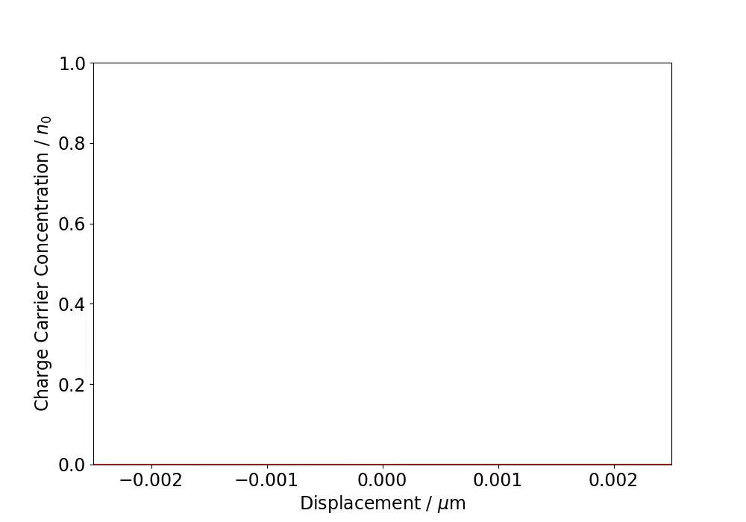


Decay
MCCs will recombine with opposite charge in semiconductor, removing them from system.
$P\left(x,t\right)$ becomes
$$P\left(x,t\right)=A(t)e^{−\frac{{(x−vt)}^{2}}{4Dt}}e^{−\frac{t}{τ_{F}}}$$

Slide 7
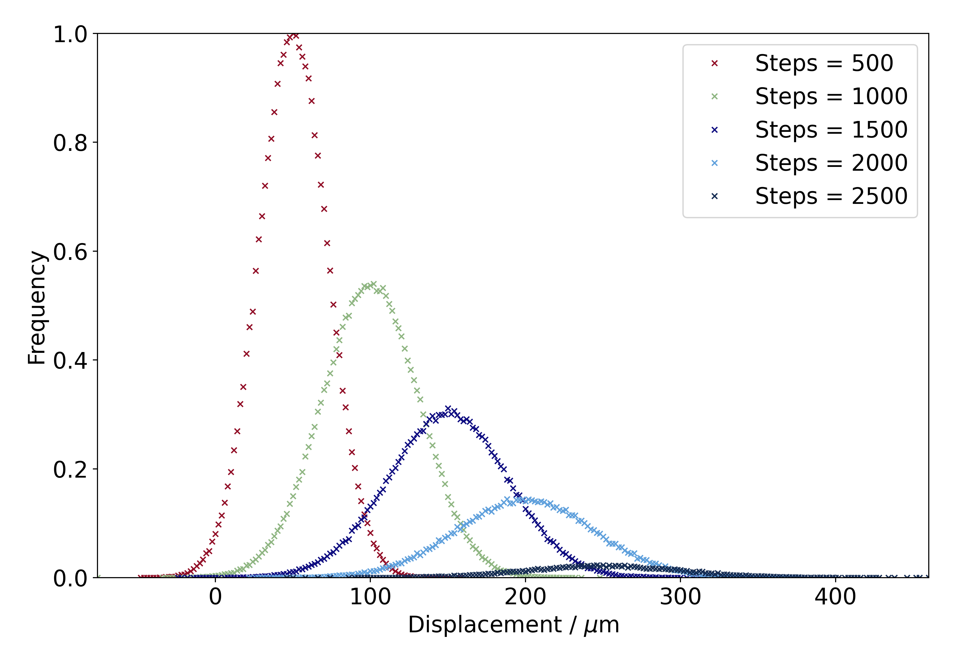
A Refined Simulation
No Gaussian plot on simulations due to decay
Higher drift probability = faster drift velocity
Higher decay probability = shorter carrier lifetime
Larger number of steps = longer progression of time

Slide 8

Thank you
GitHub https://github.com/tresul03/The-Haynes-Shockley-Experiment-
Email

Slide 9
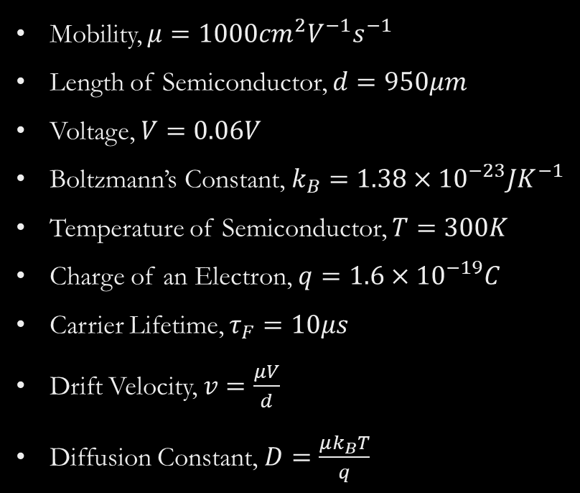
Values used in Diffusion Equation
Mobility, $μ=1000cm^{2}V^{−1}s^{−1}$
Length of Semiconductor, $d=950μm$
Voltage, $V=0.06V$
Boltzmann’s Constant, $k_{B}=1.38×{10}^{−23}JK^{−1}$
Temperature of Semiconductor, $T=300K$
Charge of an Electron, $q=1.6×{10}^{−19}C$
Carrier Lifetime, $τ_{F}=10μs$
Drift Velocity, $v=\frac{μV}{d}$
Diffusion Constant, $D=\frac{μk_{B}T}{q}$

