Slide 1


Capstone Project
Analysis of Prosper Loan Dataset with Dashboard Visualizations on Tableau.
Presented by: Treta Pawaskar
5/7/2021

Slide 2

The peer-to-peer lending industry in the United States San-Francisco California started in February 2006.
The practice of lending money to individuals (or small businesses) via online services.
The Lenders can typically earn higher returns. There is also risk involved that the borrower defaults on his or her loan.
The Company includes various borrower Profiles known as Prosper Ratings A ,AA,B,C ,D,E,HR suggests range from lowest risk to high risk based on credit scores obtained from independent source.

Slide 3
The Raw Dataset consists of data Between years 2009 to 2014 and has 113937 observations and 81 variables which lists :
Interest rate,
Loan amount,
Monthly installment amount,
Loan status (e.g., fully paid, default, charged-off), and
Several additional attributes related to the borrowers such as Occupation, type of house ownership, annual income, Credit score , debt-to-income ratio amongst the important ones.
Questions to be answered:
Are these data valuable when selecting loans to invest in?
How could an investor use these data to make better investment decisions?
(Data Source :Kaggle)

Slide 4
Cleaning the Dataset
Dropped irrelevant columns
Filtered unwanted and null entries
Checked and corrected datatypes

Slide 5
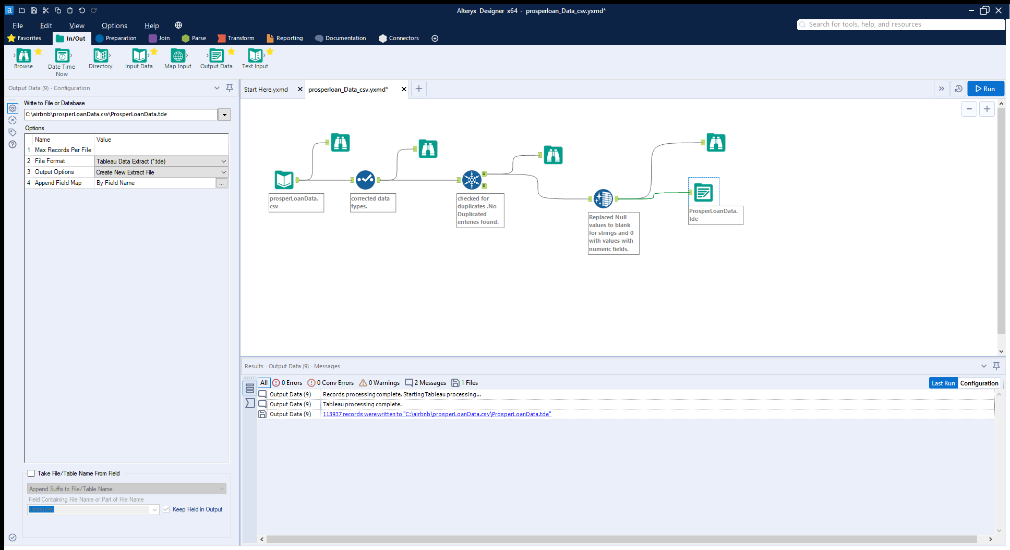
Alteryx Workflow for Data cleaning

Slide 6
Thank you!

