Slide 1



Capstone Project
TractorTek Management User Interface APP Demo and Sales Dashboard Analysis Report
Presented by: Treta Pawaskar
4/14/2021

Slide 2
Brief Introduction To The User Interface APP
How to use:
The main features include:
Built with Python Flask.
The App is built to enter real time entries of sales data into the MySql Database.
Also has a Bulk File upload option incase of Bulk orders entries of the Products.
User Interface Demo.. Continue…

Slide 5
Value to the customer
Total Sales by Products and Employees:
The Product Gator xuv590M has the highest sales both in the years 2019 and 2020 respectively. Whereas 2930M z track was the least sold product in the years 2019 and 2020.
The sales of Products by Region shows highest sales in NW region 62% compared to sales in SW region of 32%.
Gina Evans and Beverly Clement are top 2 employees for total sales of products whereas Allen Maude has the least sales.
There was approx 5 % drop in sales in 2020 in all products compared to year 2019.
SUGGESTIONS:
The above findings suggest that the sales team should focus on acquiring more of the Gator xuv products for sales as it makes the maximum of profit in sales.
Sales Team should focus on deficit in sales in SW region.Survey on products in demand will help business gains in SW region.

Slide 6
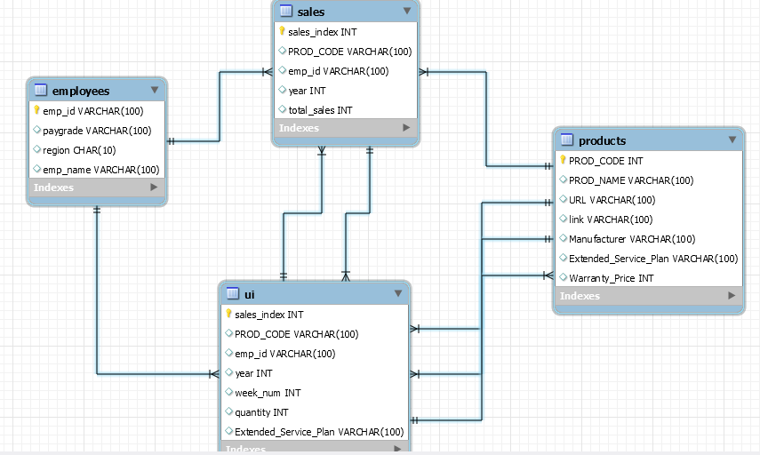
The Database Design
The Database is based on Relational Database Model.
Having Star Schema.
Has one fact table containing normalized data and 3 denormalized tables .
The fact table has multiple foreign keys.
Each table is connected to fact table with foreign keys.
This is
a chart

Slide 7
Thank you!

