Slide 1







Predicting Safety Incidents
Evan Trevathan
L48 Data Analytics Team

Slide 2

Problem
Can we predict the number of incidents that will occur over the next 14 days?

Slide 3
Data Wrangling
Safety+3.0 excluding Material Releases
14,497 original data points
(Beginning of Data-set) – June 18, 2018
Excluded Central Support due to lack of data points
Excluded rows with no BU defined
Added WeekDay column
Counted number of events by: type, day, BU
Replaced NaN with 0
1,006 data points post transformations

Slide 4
Data Wrangling for final Model Preparation
Added rolling sum columns to count past incidents and observations on [3,7,14,30,45] intervals by BU
Added rolling sum column to count future incidents on a 14 day interval by BU
Threw out dates prior to 1/1/2018
Threw out dates that do not have a 14 day rolling sum forward

Slide 5
Model Choice
Models Considered
Linear Regression
Ridge Regression
Random Forest Regression
Method of Choice
Used Cross-validation to choose model and combinations of predictors
Random Forest Regression was model of choice
Yielded highest and most consistent r² score across all BUs
event_Observation_Rolling45 had the highest feature importance
WeekDay had the lowest feature importance

Slide 6
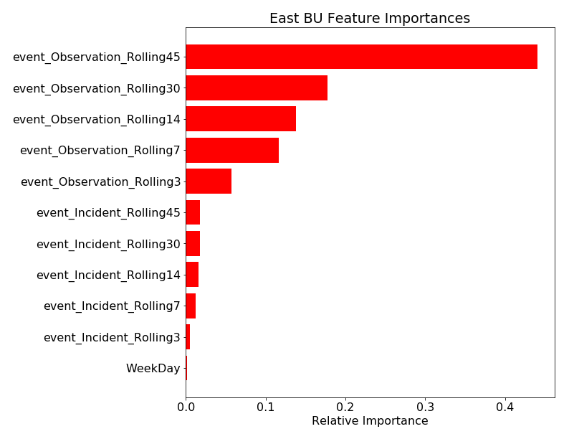
East BU Feature Importances

Slide 7
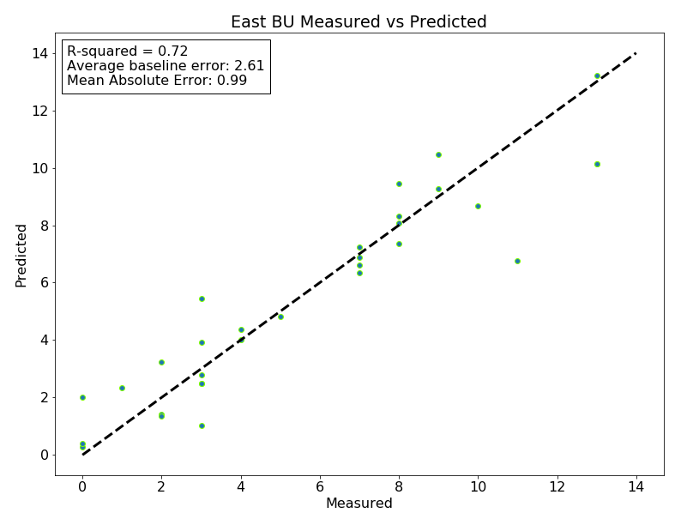
East BU Measured vs Predicted

Slide 8
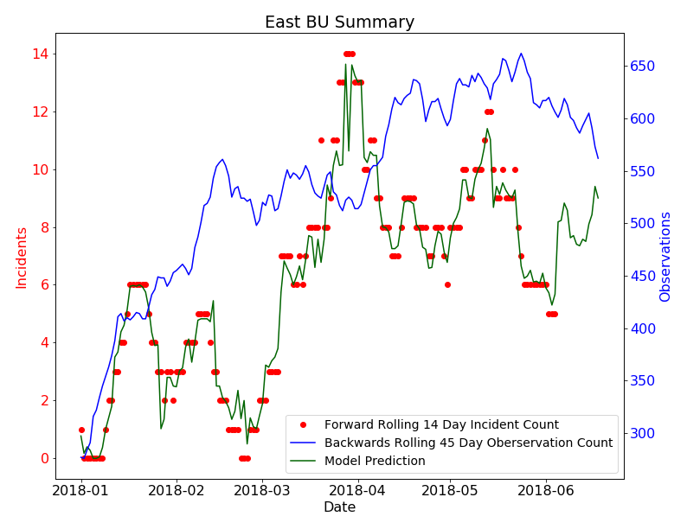
East BU Summary

Slide 9
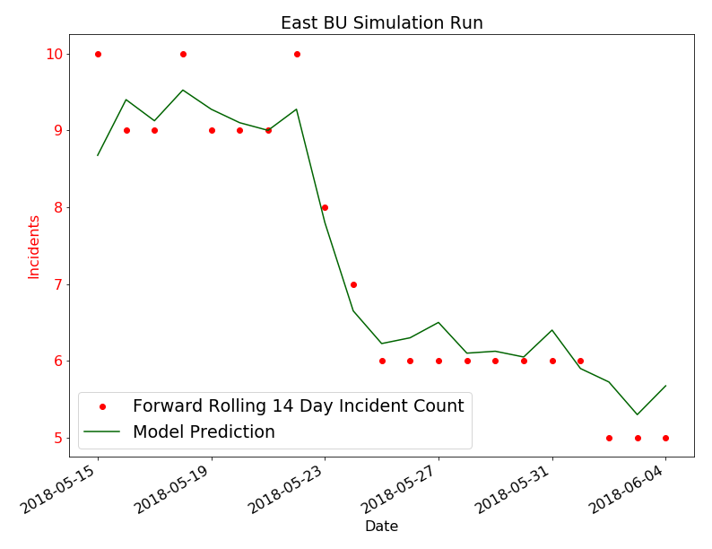
East BU Simulation Run

Slide 10
Next Steps
Have we shown enough value with this data to increase data collection without setting data collection quotas?
Consider running this data-set through a Poisson Regression model due to nature of project.
Future project: Capture safety stand down dates and town hall dates by Business Unit and fit a model to these events as a predictor of incident counts.

Slide 11
Appendix

Slide 12
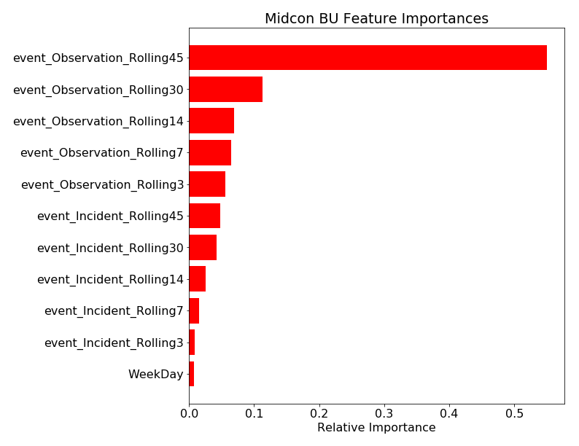
Visualizations

Slide 13
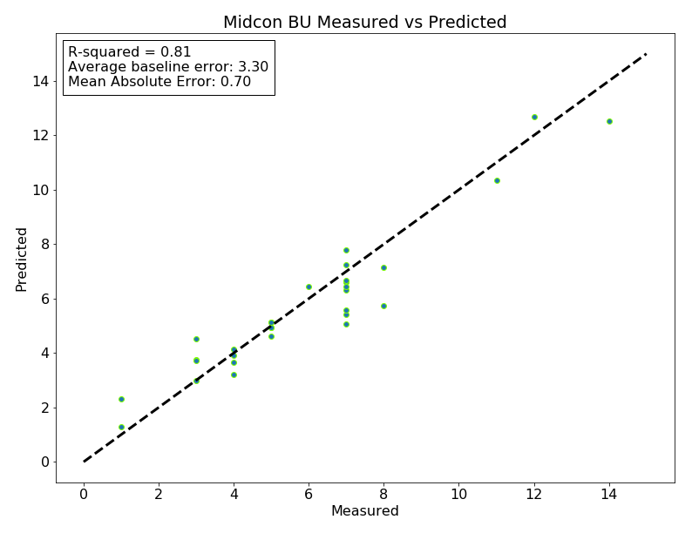
Visualizations

Slide 14
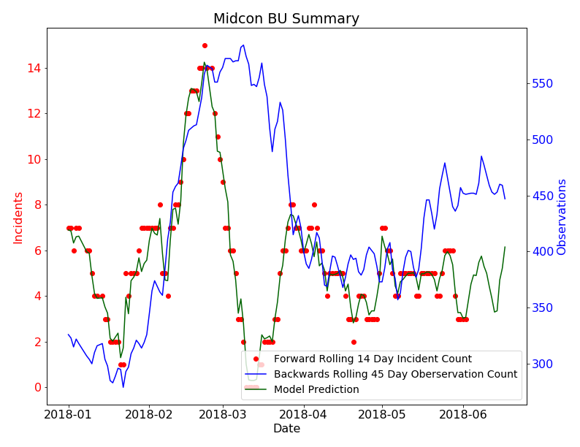
Visualizations

Slide 15
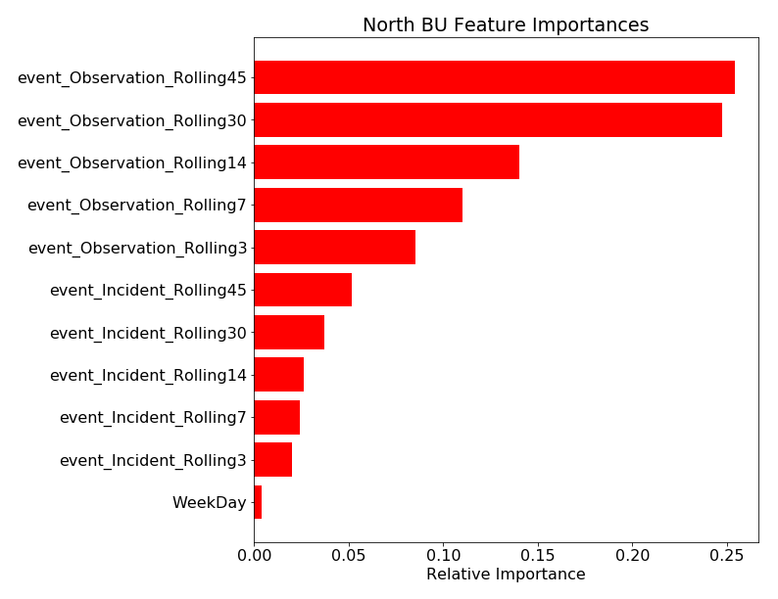
Visualizations

Slide 16
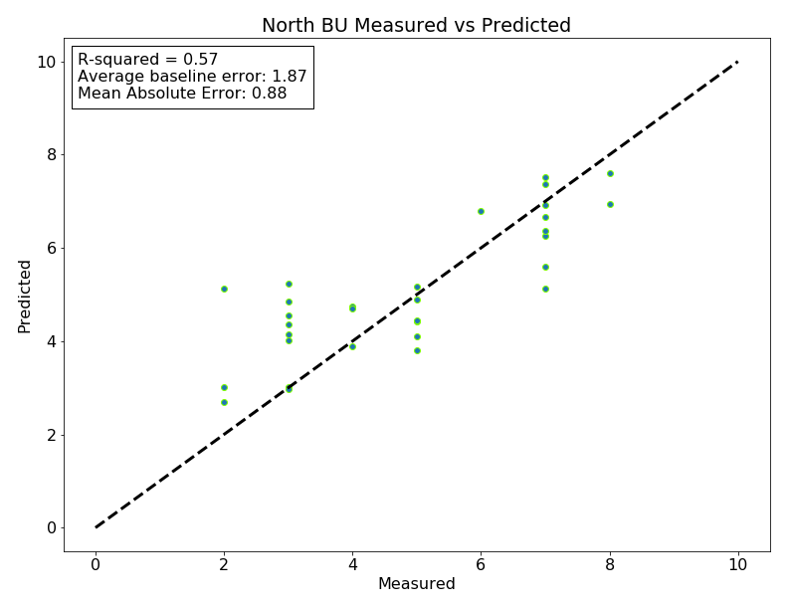
Visualizations

Slide 17
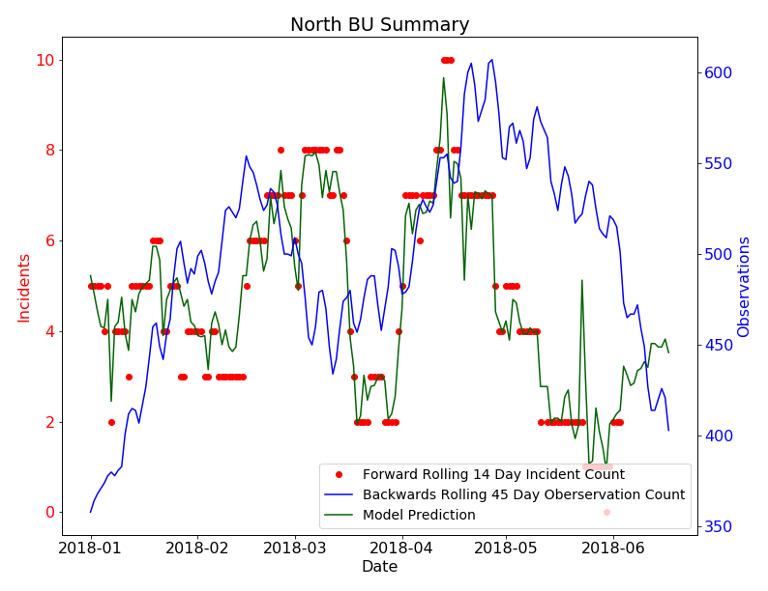
Visualizations

Slide 18
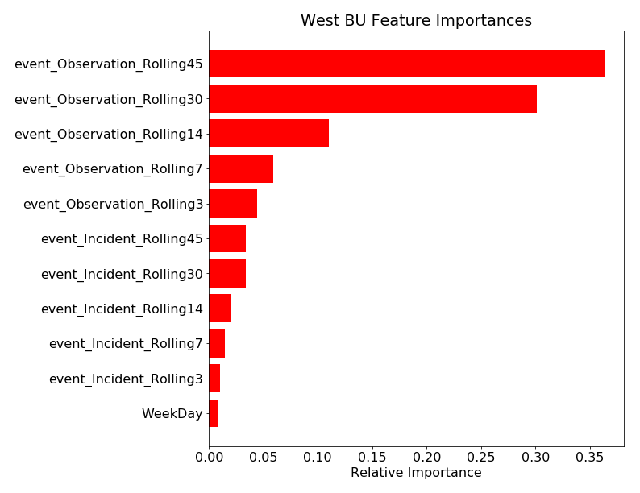
Visualizations

Slide 19
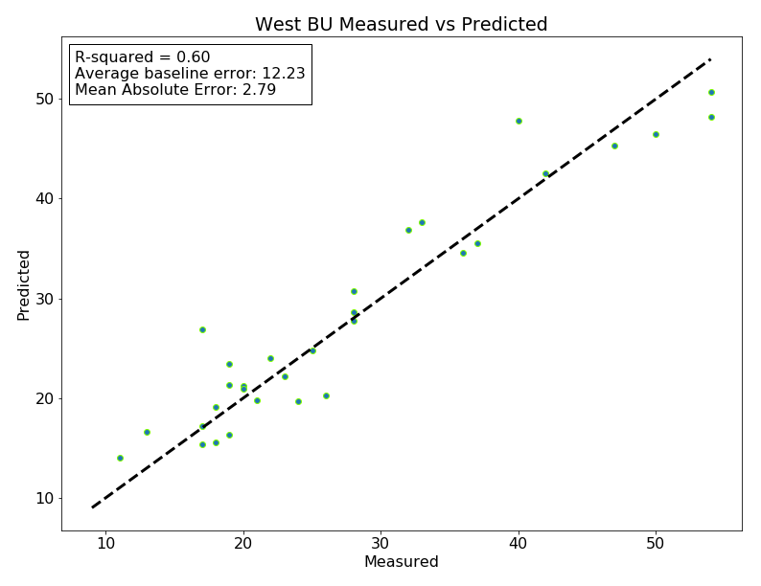
Visualizations

Slide 20
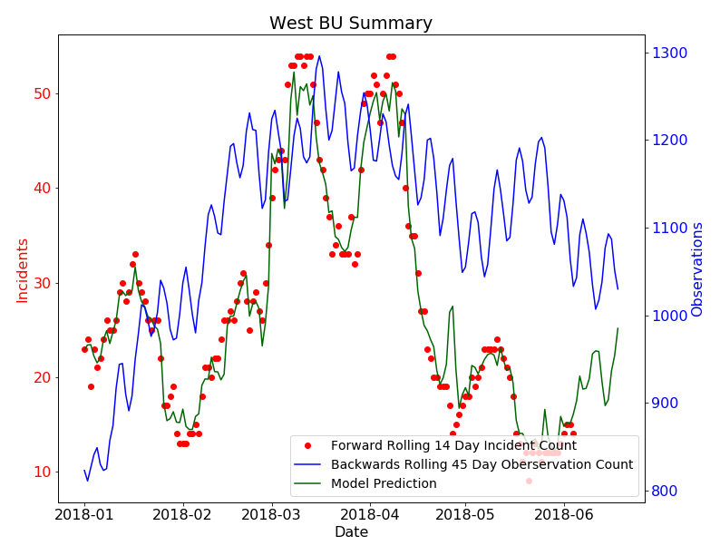
Visualizations

