Slide 1







Predicting Safety Incidents
Evan Trevathan
L48 Data Analytics Team

Slide 2

Problem
Can we predict the number of incidents that will occur over the next 14 days?

Slide 3
Data Wrangling
Safety+3.0 excluding Material Releases
14,497 original data points
(Beginning of Data-set) – June 18, 2018
Excluded Central Support due to lack of data points
Excluded rows with no BusinessUnit defined
Added WeekDay column
Counted number of events by type by day by BusinessUnit
Replaced NaN with 0
1,006 data points post transformations

Slide 4
Data Wrangling for final Model Preparation
Added rolling sum columns to count past incidents and observations on [3,7,14,30,45] intervals by BusinessUnit
Added rolling sum column to count future incidents on a 14 day interval by BusinessUnit
Threw out dates prior to 1/1/2018
Threw out dates that didn’t yet have a rolling sum counting future incidents 14 days forward

Slide 5
Model Choice
Models Considered
  Linear Regression
  Ridge Regression
  Random Forest Regression
Method of Choice
  Brute force loop through each model by BusinessUnit
  Secondary loop running the models with every combination of predictors
Random Forest Regression was model of choice
  Yielded highest and most consistent r² score across all BusinessUnits
  event_Observation_Rolling45 had the highest feature importance
  WeekDay had the lowest feature importance
Notes:
We used cross-validation on our training set from our train-test split to take multiple random collections of our data so we could better generalize the model to accommodate new data points.
These are the sets we use to train our various models for comparison of goodness of fit (R-squared).
Once we selected what is believed to be the best possible model we run that model against the original and previously unseen test data set to produce the following results.

Slide 6
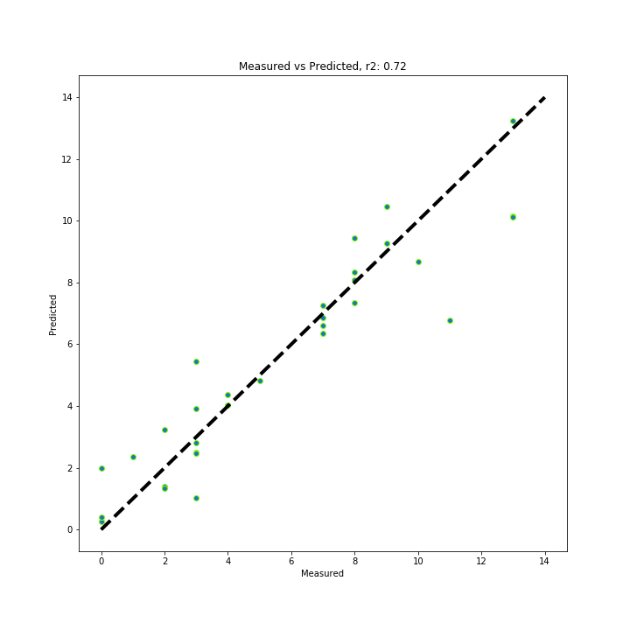
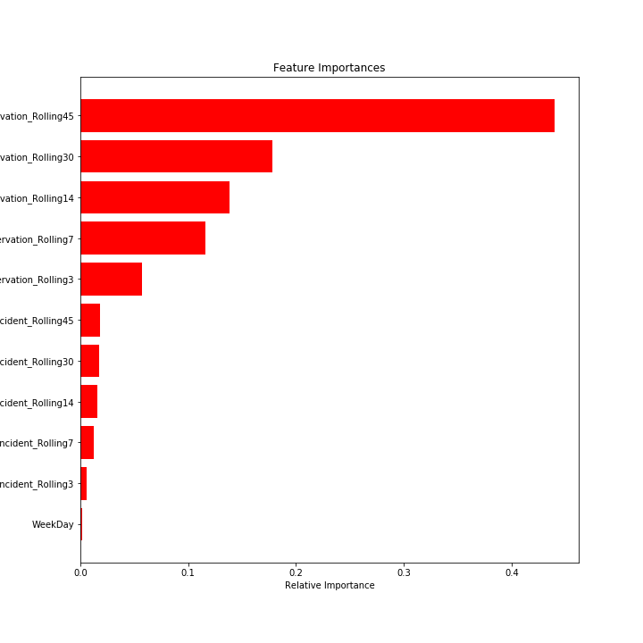
Visualizations East Business Unit
Average baseline error: 2.61
Mean Absolute Error: 0.99
Notes:
Average baseline error is the error that would be present if we merely used the mean values to fit our model.
Mean absolute error is the error represented from our model of choice and gives us an idea of how much better our model is versus just taking the mean.
R-squared is a statistical measure of how close the data are to the fitted regression line.

Slide 7
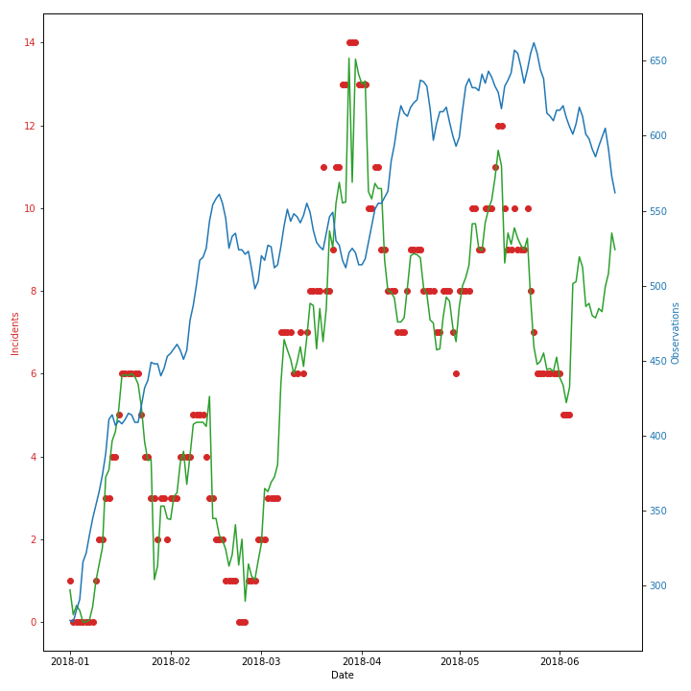
Visualizations East Business Unit
Notes:
We can see from this graph how well our model fits the actual observed data points.
You can also see the representation of the 45 day rolling sum of observations (our most significant feature) that often we see an inverse relationship between these observation counts and our 14 day rolling future sums.

Slide 8
Next Steps
Have we shown enough value with this data to increase data collection without setting data collection quotas?
Consider running this data-set through a Poison Regression model due to nature of project.
Future project: Capture safety stand down dates and town hall dates by Business Unit and fit a model to these events as a predictor of incident counts.
Notes:
We saw from the previous graphs that sometimes there is a relationship between Observation count and Incident count.
We already know not discussing safety doesn’t improve safety awareness.
My recommendation is to hold more safety stand-downs and enter more verifications as we see these incident estimates begin to climb?

Slide 9
Appendix

Slide 10
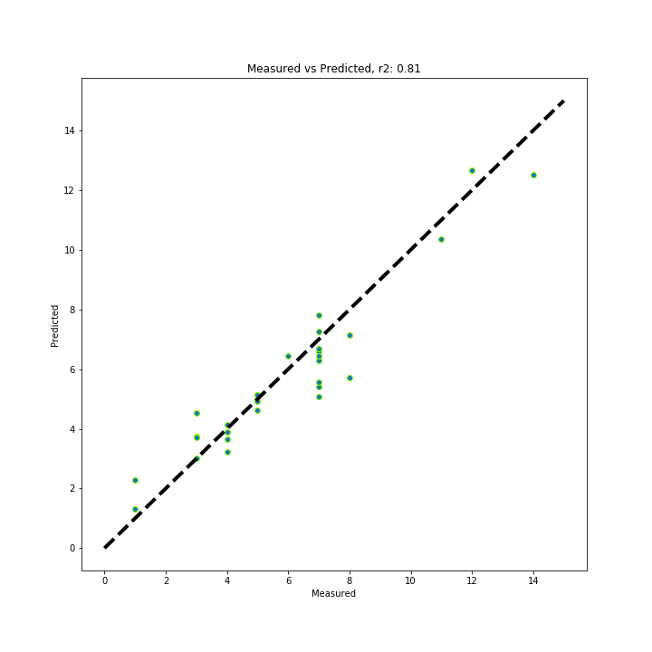
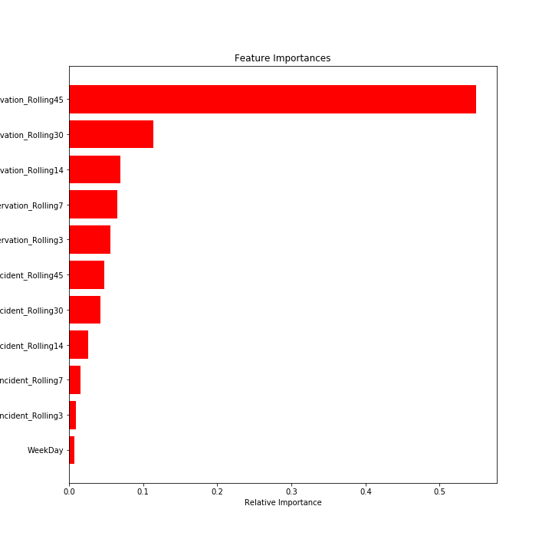
Visualizations MidCon Business Unit
Average baseline error: 3.3
Mean Absolute Error: 0.7
Notes:
Average baseline error is the error that would be present if we merely used the mean values to fit our model.
Mean absolute error is the error represented from our model of choice and gives us an idea of how much better our model is versus just taking the mean.
R-squared is a statistical measure of how close the data are to the fitted regression line.

Slide 11
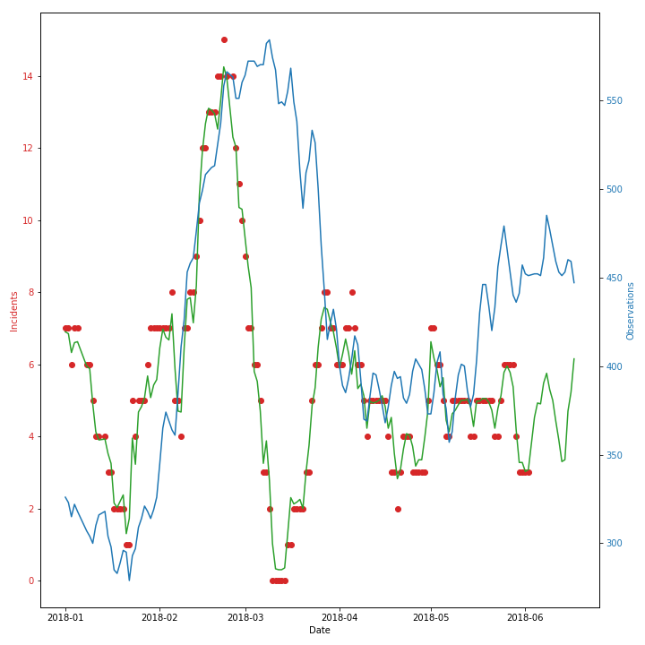
Visualizations MidCon Business Unit

Slide 12
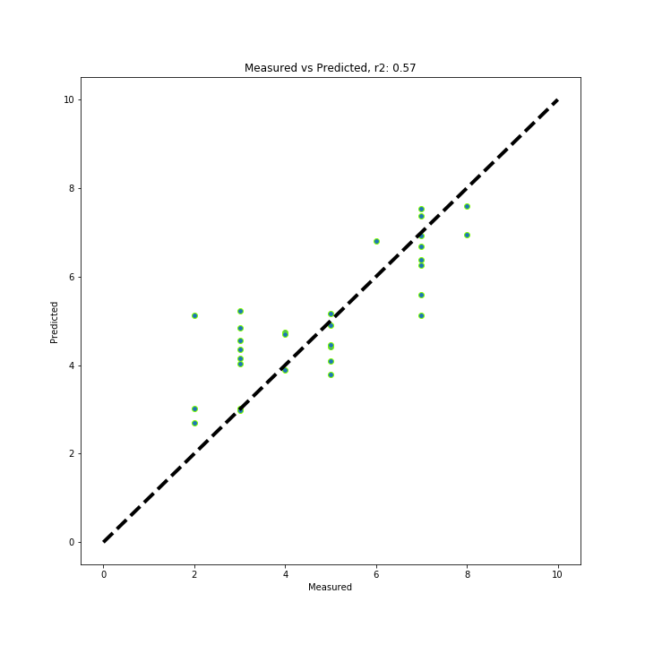
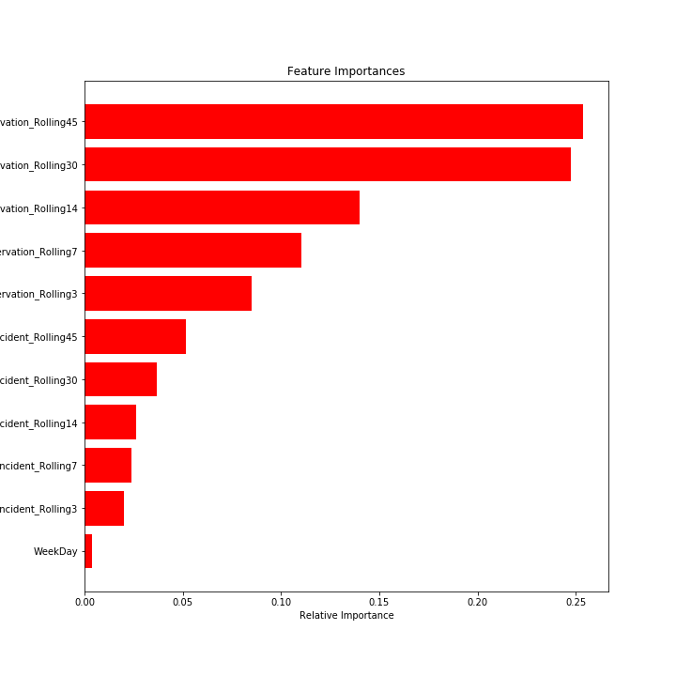
Visualizations North Business Unit
Average baseline error: 1.87
Mean Absolute Error: 0.88
Notes:
Average baseline error is the error that would be present if we merely used the mean values to fit our model.
Mean absolute error is the error represented from our model of choice and gives us an idea of how much better our model is versus just taking the mean.
R-squared is a statistical measure of how close the data are to the fitted regression line.

Slide 13
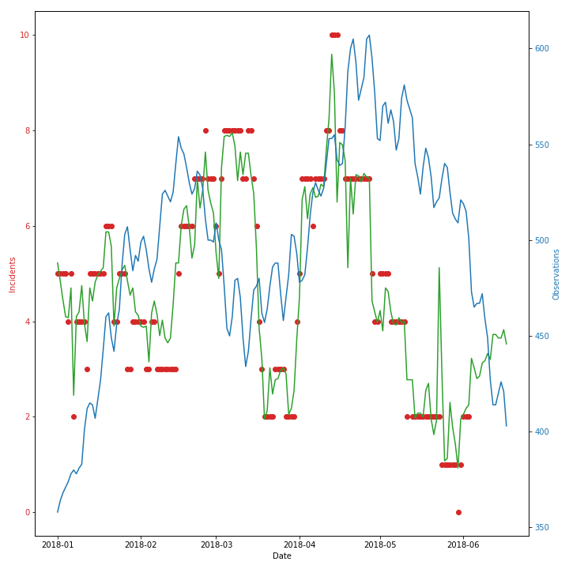
Visualizations North Business Unit

Slide 14
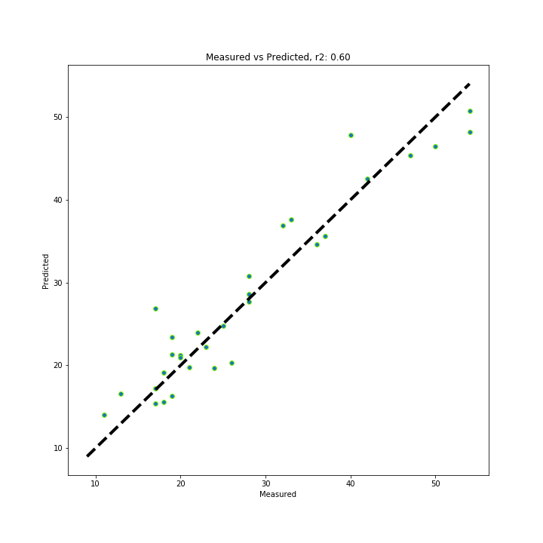
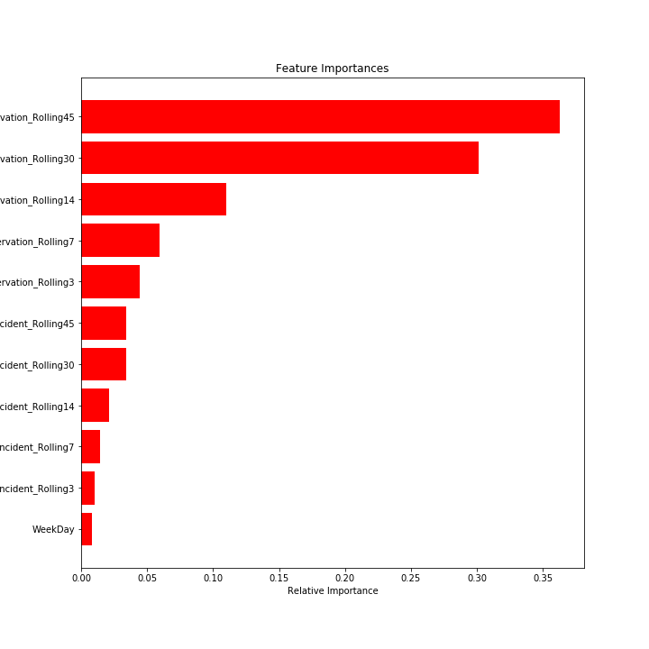
Visualizations West Business Unit
Average baseline error: 12.23
Mean Absolute Error: 2.79
Notes:
Average baseline error is the error that would be present if we merely used the mean values to fit our model.
Mean absolute error is the error represented from our model of choice and gives us an idea of how much better our model is versus just taking the mean.
R-squared is a statistical measure of how close the data are to the fitted regression line.

Slide 15
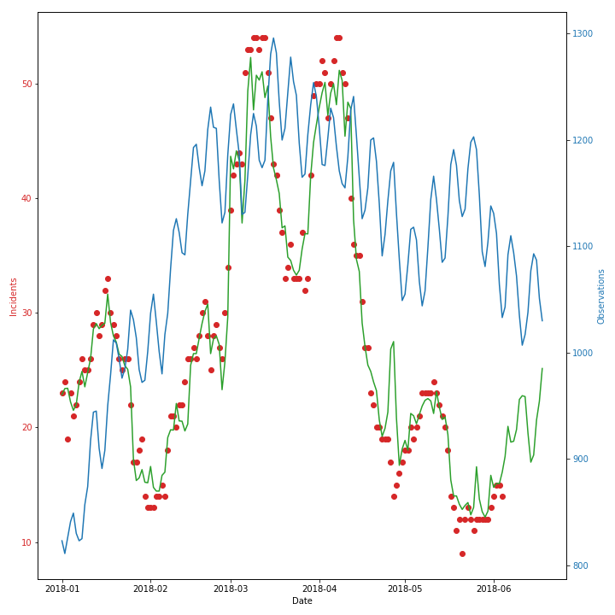
Visualizations West Business Unit

