Slide 1
OSE Enterprise Tools Integration Schedule
ISD/ECB
C/ISD: Douglas11
DC/ISD: Kelley05
Branch Chief: Cham18
Project Manager: Treva31
March 16, 2022

Slide 2



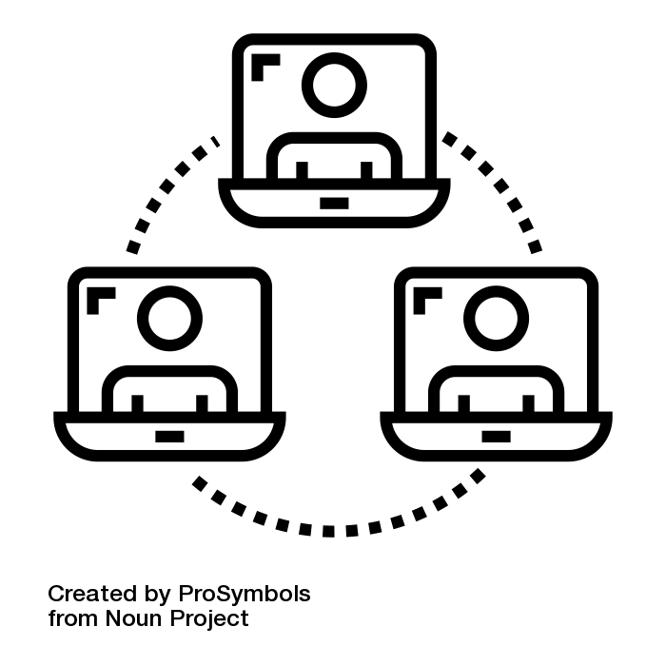




ISD Enterprise Capabilities Branch - Enterprise Tools
SecDevOps Tool Suite
Service
Management
Development
DIYOS
OpenShift
ServiceNow
Bitwarden
Collaboration
Management
CI
CD
Confluence/Wiki
Jira
Quality & Security Management
SonarQube
Version Control
GitHub
Environment Configuration
Automated Build
Jenkins
AutoProv
Chef
Nexus

Slide 3
OSE SecDevOps Tools – Schedule
The following roadmaps provide estimated timelines for routine O&M, user engaging, and enhancing the OSE SecDevOps Tools
Roadmaps
Slide 5 – O&M
Slide 6 – Upgrades
Slide 7 – Accreditation
Slide 9 – Enhancements
Slide 11 – Engagements

Slide 4
Roadmap - O&M Objectives
VSR = Vendor Supported Release
LR = Latest Release
All Tools operate at the latest vendor release version
Quarterly Software Analysis identifying upgrade requirements to latest version and deployment (Gray Timelines)
Provide Security Scans as required by Security
Every 120-days archive Security Scans in Roadrunner (Blue Timelines)
Maintain User Licenses
Conduct Quarterly analysis to release inactive user accounts from Jira and GitHub to guarantee Dev on-boarding and reduce cost (Violet Timelines)
Obtain Security Accreditation
ATD completion indicated with Red timelines
ATO indicated with Yellow timelines

Slide 5
Roadmap - O&M
Upgrade = Upgrade Analysis
ULM = User License Maintenance
TODAY
Q1 2022
Q2 2022
Q3 2022
Q4 2022
Q1 2023
Oct
Nov
Dec
Jan
Feb
Mar
Apr
May
Jun
Jul
Aug
Sep
Oct
Nov
Dec
AutoProv
Patch
Patch
Patch
Upgrade
Scans
Scans
Scans
Bitwarden
Scans
Scans
Scans
Upgrade
Scans
Chef
Renew License
Upgrade
Scans
Scans
Scans
Scans
Confluence
Security Update
DB
Renew License
Scans
Scans
Scans
Scans
DIYOS
Scans
Transfer 2 ESB
GitHub
ULM
License
ULM
Renew License
ULM
ULM
ULM
Upgrade
Scans
Scans
Scans
Scans
Jenkins
Scans
Scans
Upgrade
Scans
Scans
Renew License
JIRA
ULM
ULM
ULM
ULM
Scans
Upgrade
Scans
Scans
Nexus
Scans
Upgrade
Scans
Scans
Renew License
Scans
OpenShift
Scans
Scans
Scans
ServiceNow
Scans
Scans
Scans
SonarQube
Log4j Patch
Log4j Patch
Upgrade
Scans
Scans
Scans
Scans

Slide 6
End of Life (version as of Nov 2021)
Complete
Roadmap - Upgrades
Major Upgrade
TODAY
Minor Upgrade
Q4 2021
Q1 2022
Q2 2022
Q3 2022
Q4 2022
Q1 2023
Jul
Aug
Sep
Oct
Nov
Dec
Jan
Feb
Mar
Apr
May
Jun
Jul
Aug
Sep
Oct
Nov
Dec
ServiceNow
Bitwarden (Serv)
Bitwarden (Web)
Rome
1.43
2.23
Confluence
Jira
7.13
PostgreSQL 11.13
PostgreSQL 11.13
8.13
AutoProv
GitHub
Jenkins
Nexus
SonarQube
Chef Infra.
Chef Auto.
Chef Manage
Chef Super.
2021..
8.7
20211213b1
20211216b1
2.2.1
3.0.7
3.0.7
3.2.x
2.322
3.31.1
3.37.x
8.9
8.9.6
14.4.4
migrate
Once complete, the full SecDevOps ATO can proceed (everything here, except ServiceNow and OpenShift)
2.5
DIYOS
OpenShift
2.11.7
4.7
3.11.420

Slide 7
Roadmap – Accreditation
TODAY
Q4 2021
Q1 2022
Q2 2022
Q3 2022
Q4 2022
Jul
Aug
Sep
Oct
Nov
Dec
Jan
Feb
Mar
Apr
May
Jun
Jul
Aug
Sep
SecDevOps
ATD
ATO
OpenShift
ATO 18-month term
ServiceNow
ATO 3yr term

Slide 8
Roadmap – Enhancements Objectives
Provide easy access to the Code Management and Development Tools
Assigning users to AD Groups that grant access to specific tools to
auto-create of folders/teams/projects
auto-assignment of project/organizations
Control access
Integration of Code Management and Development Tools
Leveraging Tools to meet stakeholder requirements

Slide 9









Roadmap – Enhancements
Q4 2022
Q1 2023
Q2 2023
Q3 2023
Q4 2023
Jul
Aug
Sep
Oct
Nov
Dec
Jan
Feb
Mar
Apr
May
Jun
Jul
Aug
Sep
System Integration
Integration
Integration
Integration
Integration
Integration
Auto-Create Team/Project specific:
Folders/views
Organizations
Groups
Auto-Assign User to Organization or Group
Dev Team Features
Associate AD Groups
Control User access
Notes:
Automation around configuration/management of tools
- auto-creation of
Jenkins folders/views for that project
Team-specific GitHub organization
Team/project-specific Chef organization
Team/project-specific SonarQube group
- auto-assign users to
Chef organizations
SonarQube groups
Eliminate Chef/SonarQube Team Admin granting access
use LDAP groups to assign users
AutoProv Auto-deployment in (a Cloud team suggestion)
AWS
Azure
Google Cloud
Dev Team Features
Associate AD Groups
Confirm users are associated to a common AD Groups supporting permissions to tools
Nexus Controls
Configure to restrict access to other users’ work

Slide 10
Roadmap – Engagement Objectives
Inform OSE developer of the 12 Enterprise Tools capable to assist with their Mission application development efforts
Formalize the 12 Enterprise Tools as a centralized SecDevOps tool suite supporting CI/CD framework
Collect insight to implement tools that effectively support the features and capabilities desired in development

Slide 11
Roadmap - Engagement
TODAY
Q4 2021
Q1 2022
Q2 2022
Q3 2022
Q4 2022
Jul
Aug
Sep
Oct
Nov
Dec
Jan
Feb
Mar
Apr
May
Jun
Jul
Aug
Sep
Software Tracking System
Icon design & deployment
Edit 200+ Wiki pages
Tool surveys/evaluations
Map survey results to solutions
Brown Bag
Brown Bag

Slide 12
OSE SecDevOps – Backlog
ECB Backlog / Initiatives (Priorities in order)
Bugs – Nexus, Chef, Jira
Upgrades – Jira, Chef, ServiceNow, others
Accreditation
Remediate Security Recommendations
Linux SSH Implementation
Bitwarden decommission
Improvements
Pipelines & CloudFormations
Automate backups, snapshots & configuration scaling
Tool enhancements
Software Analysis
Nexus Firewall
Alternatives to Jira, GitHub, Jenkins, etc
Accessibility Testing Tools

Slide 13
OSE SecDevOps Suite – Future
Engage SecDevOps Suite as a centralized CI/CD solution for OSE
Develop enhancements and/or deploy new capabilities to meet OSE Dev Community demands

