Slide 1
Support Requests Workflow
OSE Enterprise Tools
BOSD
C/BOSD: Alma22
Program Lead: Cham18
Project Manager: Treva31

Slide 2
BOSD Enterprise Tools Team Tasks
monitor the health and status of the Enterprise Tools
provide Operations and Maintenance (O&M) (upgrades, license and certificate renewals, managing service accounts, supporting user requests, etc)
prioritize high demand initiatives (e.g., splunk infrastructure) over planned tool upgrades
respond to user support requests via:
ServiceNow
Phone
Teams chat
Teams channels (e.g. GitHub, Jira, etc.)

Slide 3
BOSD Enterprise Tools Support Request Workflow
Receive Request
Enter Request
Process Request
Development
Phone
Tier 1 resolve basic request to closure
within 1 hour
Teams Chat
Create
ServiceNow
Support Ticket
Tier 2 resolve technical request to closure within 3 workdays
JIRA Epic/Story
Teams Channels
Tier 3 & 4 request not resolved requires development > 3 workdays
Email

Slide 4
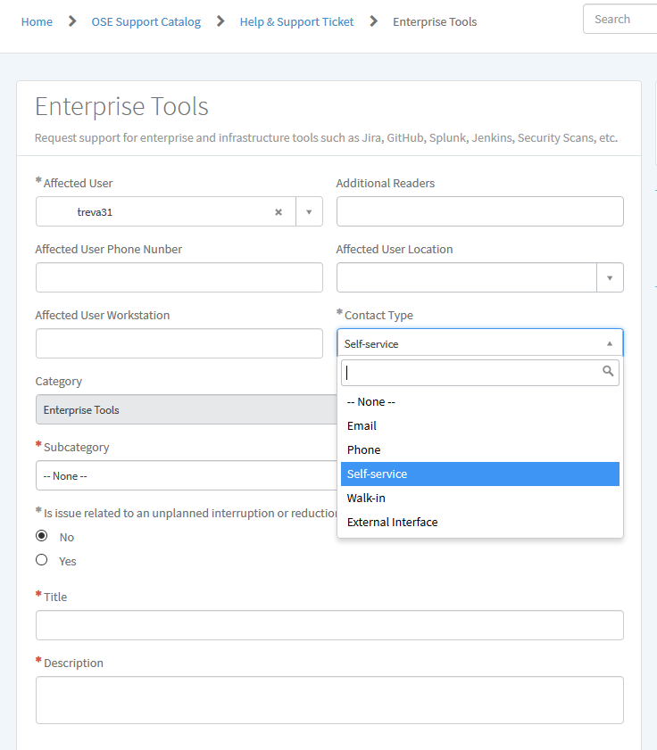
BOSD Enterprise Tools Support Request Workflow – Enter
Enter Request
Receive request
When entering the request into ServiceNow, specify how it was received using the Contact Type field
Addition to Contact Type field is required:
Teams

Slide 5
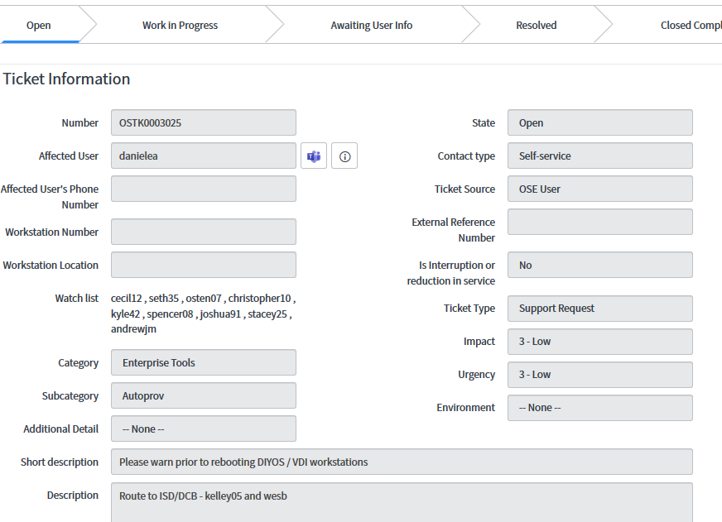
BOSD Enterprise Tools Support Request Workflow – Process
Process Request
Once the request is a ServiceNow ticket, specify the level of support conducted using the Urgency field
Support Level
Tier 1 – Basic
Tier 2 – Technical
Tier 3 – Development
Tier 4 – Vendor Support
Addition of the Support Level field is required with these options:
Tier 1 – Basic
Tier 2 – Technical
Tier 3 – Development
Tier 4 – Vendor Support

