Slide 1
Enterprise Capabilities Branch Project Status Report (PSR)
18-Oct-21 through 29-Oct-21
C/ISD: Douglas11
DC/ISD: Kelley05
Branch Chief: Cham18
Project Manager: Treva31
Nov 3, 2021

Slide 2
PSR Agenda
Reorganization
Contractual Transition
A&A status
Upgrades status – Critical, All
OpenShift
Enterprise Tools
ServiceNow
InfoSec
R&D
Backlog

Slide 3
MTG Reorganization
Structured within Infrastructure Services Division (ISD)
ISD leadership
Douglas11, Chief
Kelley05, Deputy Chief
ISD Branch - Enterprise Capabilities
Enterprise Tools
Identity Access Management
Information Security (InfoSec) Services
OpenShift
ServiceNow
Enterprise Capabilities leadership
Cham18, Branch Chief
Angela38, PM – Identity Access Mgmt & InfoSec Services
Treva31, PM – Enterprise Tools, OpenShift, ServiceNow

Slide 4
Contractual Transition
Black Panther Contract
Awarded - Aysmmetrik
Transition/Knowledge Transfer
Enterprise Tools Team
ServiceNow Team
Transition leadership
Treva31, Gov’t
Isaac91, Aesir
Karen45, Asymmetrik
Eric55, Asymmetrik

Slide 5


03-Nov-21
OSE Enterprise Tools - ATO Status
Updated |  | ATO Expired |  | ATO Expires in 3 months
 |  | A & A RMF Process
Project | Status | STEP 0 registration | STEP 1 categorize | STEP 2 select | STEP 3 implement | STEP 4 assess | STEP 5 authorization | STEP 6 monitoring | % Complete | Accreditation Expiration Date
SecDevOps includes 12 tools | ATD | X | X | X | X |  |  |  | 25% | 23Oct22
ServiceNow | ATO | X | X | X | X | X | X | X | 76% | 25Aug24
OpenShift | ATO | X | X | X | X | X | X | X | 71% | 17Feb23

Slide 6
OSE SecDevOps Tools Status - Critical Upgrades
03-Nov-21
Tools with current version at EOL or enforced by JetBrains decommission
n = Prioritization change
Step | Description | Nexus | DIYOS | AutoProv | SonarQube | GitHub | Confluence & PostgreSQL | Jira & PostgreSQL | SNow | Jenkins & Java 11 | Bit Server & Web
1 | Review release notes / security relevant changes | X | X | X | X | N/A | current | current | X | N/A | N/A
2 | Plan for upgrade identifying versions & dependencies | X | X | X | X | N/A |  |  | X | X | current
3* | Obtain approval from ISSM/ISSE confirming security changes are N/A | X | X | X | X | X |  |  | X | X
4^ | Submit P&SC ticket for software authorization | X | N/A | N/A | X | X |  |  | X | X
5^ | Submit ServiceNow ticket to obtain the software | X | N/A | N/A | X | X |  |  | X | X
6 | Obtain the software from either DCB, or alternate | X | N/A | N/A | X | X |  |  | current | current
7 | Perform the Upgrade in DEV/TEST/Stage | DEV & TEST | N/A | DEV & TEST | DEV & TEST | DEV & TEST | DEV & TEST | TEST | Stage, DEV & TEST | DEV & TEST | TEST
8 | Submit ServiceNow ORB Change Request for PROD | X | X | X | X | X
9 | Submit a Maintenance and/or Tech Note | X | X | X | X | X
10 | Perform the Upgrade to PROD | X | X | X | X | X
11 | Request Security Scans of DEV/TEST/PROD | X | X | X | X
12 | Provide ISSM/ISSE with POA&Ms | Current | current | current | current
* Step 3 is not applicable for minor version updates. ^ Step 4 & 5 are not applicable if software version is registered in P&SC.

Slide 7
OSE SecDevOps Tools Status – All Upgrades
03-Nov-21
n = Prioritization change
Priority | Tools | Current Version (CV) | CV Supported by Vendor | Upgrade version | Upgrade Driver | ISSM Approval date | Upgrade Process per Slide 6 | Upgrade Completed
2 | Nexus | 3.21.2 | No | 3.31.1 | ATO | 6July21 | Step 11 | 22July21
3 | DIYOS | 2.6.1 | Yes | 2.11.7 | JetBrains | 22July21 | Step 12 | 30Jul21
4 | Linux AutoProv | 20201125b1 | Yes | 20210903b0 | JetBrains | n/a | Step 12 | 14Sep21
5 | SonarQube | 8 | No | 8.9 | ATO | n/a | Step 11 | 23Sep21
6 | GitHub | 2.22.17 | Yes | 3.0.7 | EOL* | 22Sep21 | Step 11 | 02Nov21
7 | Confluence | 6.15.6 | No | 7.13 | ATO |  | Step 2
8 | JIRA | 8.7.1* | Yes | 8.13 LTS | EOL* | n/a | Step 1
8 | ServiceNow | Orlando | Yes | Rome | EOL |  | Step 6
9 | Jenkins | 2.249.1 | No | 2.303.1 | ATO | n/a | Step 7
9 | OpenShift | 3.11.420* | Yes | 4.7 | EOL* |  | Step 1
10 | Bitwarden Server | 1.31.1 | No | 1.43.0 | ATO | n/a | Step 2
10 | Bitwarden Web | 2.11.0 | No | 2.23.0 | ATO | n/a | Step 2
12 | Chef Infra Server | 13.0.17 | Yes | 14.4.4 | outdated
12 | Chef Automate | 20210420090302 | Yes | 20210713164523 | outdated
12 | Chef Manage | 2.5.16 | Yes | Migrate to Chef Automate | EOL*
12 | Chef Supermarket | 3.3.1 | Yes | 3.4.13 | Outdated
*reaches EOL: GitHub 2.22 on 23-Sep-21; Jira 8.7 on 03-Feb-22; OpenShift 3.11 on 22-Jun-22; Chef Manage on 31-Dec-22

Slide 8
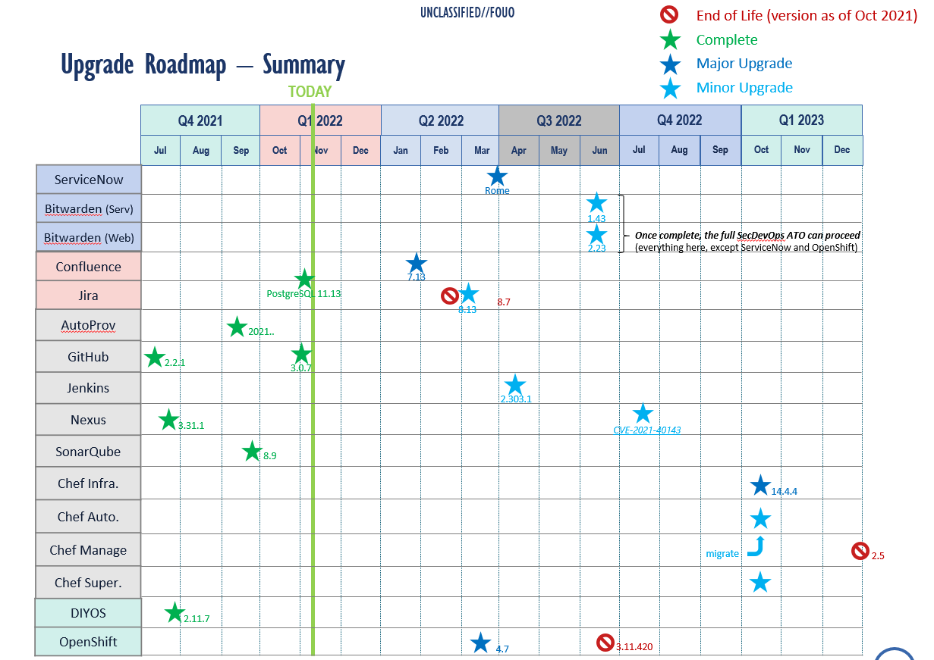
OSE Enterprise Tools O&M
03-Nov-21
Chart edited in the Enterprise Tools roadmap PPT, located in this folder: https://opensourcegov.sharepoint.com/:f:/s/toolsandservices/EgGoTX9DzkhHjsgbtyjQ-rsB0he1uGHuCdyJQq9hli6PdA?e=WAb0BC

Slide 9


OpenShift for OSE
03-Nov-21
Overall Status
Overview
OpenShift is a container hosting platform providing an easy way for missions to host, scale, and secure workloads. Our goal is to reduce time-to-mission by removing the operational overhead and friction for common tasks like configuring application environments, building fault tolerance, and scaling workloads.
MTG Lead: Treva31
Team: Ashley95, Kevin76, and Dirk33
Users: 40+
User Engagement Method: Teams, Email, Phone, ServiceNow
Partner(s): MTG, OSE
Accomplishments
(Upgrade) Installed kube2iam in Test VPC and verified functionality.
(Upgrade) Completed initial install of OCP4 in Development VPC.
Planned Activities
(Upgrade) Perform kube2iam install in Production.
(Upgrade) Create custom Red Hat CoreOS AMI for OCP4.
(O&M) November patching will be completed by COB 11/17/21.
Schedule
Milestones | Planned Start Date | Actual Start Date | End Date | Status
(Upgrade) Initial briefing for security and technical stakeholders | Jan-Mar ’21
(Upgrade) Deploy OpenShift v4 to FWD Lab | Apr-Jun ’21 | Sep ‘21 | Sep ’21
(Upgrade) Deploy prototype to customer environments | Sep-Dec ’21 | Sep ‘21 | TBD
(Upgrade) Coordinate with security to execute scans and update docs | Jan-Feb ’22 | -- | --
(Upgrade) Conduct user acceptance testing | Mar-Apr ’22 | -- | --
(Upgrade) Transition users and workloads | May ’22 | -- | --
Constraints
Assumptions:
N/A
Dependencies:
N/A
Risks:
(Upgrade) DeveloperFull IAM role does not appear to have all needed permissions for OCP4 install; opened ticket (OSTK0034812) with cloud team to investigate.
Major Concern |  | Minor Concern |  | On Target |  | Completed

Slide 10
OSE Enterprise Tools O&M
03-Nov-21
Overall Status
Overview Continuous operations and maintenance (O&M) support for the 12 Enterprise Tools that assist with developing, managing, and delivering OSINT solutions.
MTG Lead: Treva31
Team: Isaac91, Spencer08, Wesley74, Victoria63
Users: 600+
User Engagement Method: Phone, Email, Teams, ServiceNow
Partner(s): MTG, ISSM, DVV, OMA
Accomplishments
Deployed: 26-Oct Confluence Security Patch
Completed: 29-Oct Migration of Chef Supermarket to a new instance (due 31 Oct)
Deployed: 02-Nov GitHub upgrade from v2.22.17 to v3.0.7
Deployed: 02-Nov PostgreSQL (for Jira & Confluence) upgrade from v9.6.22 to v11.13
Recevied: ATD for the new SecDevOps single A&A Project
Completed weekly audit review of TNS Splunk logs
Updated Roadmap to account for Transition Impacts (1 month)
O&M Roadmap
Planned Activities
Complete weekly audit review of TNS Splunk logs
Confluence v7.13 Upgrade Efforts
Participate in Knowledge Transfer / TEMs with Black Panther team
GitHub License: Receive temporary key if long term is not ready yet, as the current license expires 8 Nov (working with Brett H on this)
Schedule
Milestones | Planned Start Date | Actual Start Date | Projected End Date | Status
A&A ATO | 03Nov20 | 03Nov20 | TBD
RR PROD Security Scans | 16Apr21 | 16Apr21 | 30Sep21
Update SonarQube | 09Aug21 | 10Aug21 | 23Sep21
PostgreSQL Update | 15Oct21 | 15Oct21 | 10Nov21
Security Update Confluence | 15Aug21 | 15Aug21 | 26Oct21
Upgrade GitHub | 22Sep21 | 15Oct21 | 30Nov21
Upgrade Confluence | 06Dec21 | 1Nov21 | 31Jan22
Update Jira | 01June21 | TBD | 01Mar22
License: GitHub | 29June21 | 29June21 | 08Nov21
Constraints
Assumptions:
ATO can not proceed until all tools are at least on vendor-supported versions (6 remaining to upgrade)
Dependencies:
Temporary (and long term) GitHub License via procurement
Risks:
GitHub will provide temp license, but we are getting close
Major Concern |  | Minor Concern |  | On Target |  | Completed

Slide 11
OSE ServiceNow
03-Nov-21
Overall Status
Overview
Enterprise IT Service Management (ITSM) platform that automates IT Business Management activities for OSE, replacing the legacy Supportworks.
MTG Lead: Treva31
Team: Isaac91, Max87, Ernest96, Zechary11, Wesley74, Victoria63
Users: 400+
User Engagement Method: ServiceNow User Group, Sprint Planning
Partner(s): MTG
Accomplishments
Hosted Sprint 29 Demo/Review/Planning sessions with stakeholders, and coordinated user acceptance testing (UAT)
Deployed Sprint 28 to PROD on 26 October
Knowledge Article, update to My Requests list, update to DNS Form, update to ORB pre-approved list, updates to Emergency ORB email notifications
Patched PROD servers with latest AMI
Prep for deployment: Dashboards (Iteration 1), DXD/COSO group for ATOM tix
Planned Activities
Prep changes in system for BOSD shift to ISD/ECB
Participate in Transition/TEMs with Black Panther as necessary
Deploy AERB once MTG TD has hosted demo to team and stakeholders
Coordinate with ISD/PSB to update and test Cloud API integration
Remove ServiceNow Form/Workflow for Enhancements
Focus on the PROD clone (to TEST) per ISSM approval
Finalize updated CM Plan approval
Continue Dashboards and Reporting (i.e., performance analytics)
Continue prep for Upgrade to Rome
Deploy Sprint 29 to PROD on 9Nov
Provide demo to ISD new folks on 10 Nov
Roadmap
Schedule
Milestones | Planning Date | Start Date | End Date | Status
A&A ATO | 19Apr21 | 24May21 | 31Aug21
Requirement Intake | 18Aug21 | 18Aug21 | 12Oct21
AERB request | 12Aug21 | 16Aug21 | 23Nov21
Upgrade to Quebec | 22Jun21 | 29Jun21 | Mar‘22
Automated Testing | 29Jul21 | 29Jul21 | TBD
Casper Account requests | 01Jul21 | 05Jul21 | TBD
Automate Cloud | 29Jul21 | 02Aug21 | TBD
Performance Analytics | 12Aug21 | 30Aug21 | 9Nov21
Constraints
Assumptions:
Dependencies:
ISD/PSB for Cloud API modifications and testing
Risks:
Major Concern |  | Minor Concern |  | On Target |  | Completed

Slide 12
OSE InfoSec
03-Nov-21
Overall Status
Overview
MTG Lead: Angela33
Team:
Users:
User Engagement Method:
Partner(s): MTG
Accomplishments
Planned Activities
Schedule
Milestones | Planning Date | Start Date | End Date | Status
A&A ATO | 19Apr21 | 24May21 | 31Aug21
Requirement Intake | 18Aug21 | 18Aug21 | 12Oct21
AERB request | 12Aug21 | 16Aug21 | 9Nov21
Upgrade to Quebec | 22Jun21 | 29Jun21 | Feb ‘22
Automated Testing | 29Jul21 | 29Jul21 | TBD
Casper Account requests | 01Jul21 | 05Jul21 | TBD
Automate Cloud | 29Jul21 | 02Aug21 | TBD
Performance Analytics | 12Aug21 | 30Aug21 | 9Nov21
Constraints
Assumptions:
Dependencies:
Risks:
Major Concern |  | Minor Concern |  | On Target |  | Completed

Slide 13
OSE R&D
03-Nov-21
Overall Status
Overview
TBD.
MTG Lead: TBD
Team:
Users:
User Engagement Method:
Partner(s): MTG
Accomplishments
Planned Activities
Schedule
Milestones | Planning Date | Start Date | End Date | Status
A&A ATO | 19Apr21 | 24May21 | 31Aug21
Requirement Intake | 18Aug21 | 18Aug21 | 12Oct21
AERB request | 12Aug21 | 16Aug21 | 9Nov21
Upgrade to Quebec | 22Jun21 | 29Jun21 | Feb ‘22
Automated Testing | 29Jul21 | 29Jul21 | TBD
Casper Account requests | 01Jul21 | 05Jul21 | TBD
Automate Cloud | 29Jul21 | 02Aug21 | TBD
Performance Analytics | 12Aug21 | 30Aug21 | 9Nov21
Constraints
Assumptions:
Dependencies:
Risks:
Major Concern |  | Minor Concern |  | On Target |  | Completed

Slide 14
SDO Project Backlog
06-Oct-21
Overview
Support and Advance Software Delivery and Operation (SDO) Strategy, Objectives, and Roadmaps
MTG Lead: Cham18
Team: treva31 and Isaac91
Projects | Description | Mission Impact | Status
SDO Strategy & Roadmap | Engage with developers' community and provide SDO and Enterprise Tools to our developers to achieve their delivery for the OSE missions. | TBD | In Progress
SDO & Enterprise Tools’ Research and Development (R&D) | This effort is to preform market research for of all commercial companies that have the capability of advancing SDO & Enterprise Tools and empower our developers to achieve more with OSE objectives and deliveries | Ensure OSE is getting best value product to meet current needs. Researching companies with SDO and Enterprise Tools capability | Due to no resource, on hold
CHiPs | Provide updates to MTG Leadership regarding BOSD’s assigned cyber implementation steps. Work in coordination with ISD and ISSM teams to close identified gaps. | Improve the overall security of the OSE Network. | Working with MTG Technical Director to provide updates as needed (Closed as of Sept 25)
Survey / Communication Forum | Engage with Developers and provide better solutions to their requirements
Metrics Efforts
ServiceNow Integration | TBD | TBD | Explored with JIRA and SN capabilities using within AWS Services
Tool Evaluation | Analyze the functionality of the current pipeline and the extent of use (capture the as-is state) and conduct an assessment of available tools including recommendations for future use (potential to-be state) |  | Under evaluation

