Slide 1

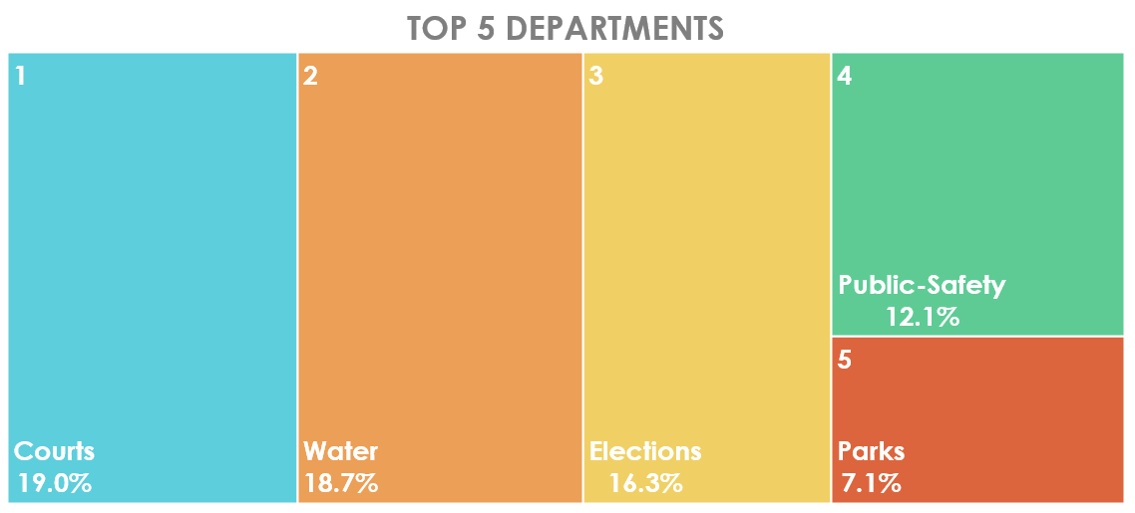
Cobb Elections Website Sitewide Performance August 2020
~ 20 Departments
Elections Site
#3
increase from July decrease from June
Notes:
Key Site Performance Statistical Results:
In August 2020 (Runoff Election), ranked #3 sitewide generating 16.3% of CobbCounty.org visitor traffic;
TERMINOLOGY:
Landing Session(LS): Visitor directly arriving on a webpage
Unique Page View (UV): Visitor viewing a webpage for the first time
Page View: Visitor viewing a webpage once or multiple times
Session: Visitor browsing the site, viewing one or more webpages over a period of time
Section: Website's navigational categories (e.g. Voting, Voter Registration, Election Reference, Candidates, About, Employment, Homepage, News, Events)

Slide 2

Cobb Elections Website Monthly Performance August 2020
78,120
landing sessions
155% increase*
125,400
Unique Pageviews
136% increase*
152,500
Pageviews
134% increase*
the sum of visitors directly landing on one of the Elections webpages
the sum of Elections webpages counted as first displayed
the sum of Elections webpages viewed once or multiple times
*prior month comparison
Notes:
Key Site Performance Statistical Results:
CobbElections.org generated 125,400 unique pageviews &152,500 pageviews;
Prior month comparisons
125,400 Unique Pageviews
136% increase from July 2020 (53,140)
28% decrease from June 2020/Election (173,500)
152,500 Pageviews
134% increase from July 2020 (65,250)
28% decrease from June 2020/Election (210,900)
78,120 Landing Session/Visitors
155% increase from July 2020 (30,680)
25% decrease from June 2020/Election (104,500)
80,767 Total Visitors
146% increase from July 2020 (32,865)
27% decrease from June 2020/Election (110,465)
TERMINOLOGY:
Landing Session(LS): Visitor directly arriving on a webpage
Unique Page View (UV): Visitor viewing a webpage for the first time
Page View: Visitor viewing a webpage once or multiple times
Session: Visitor browsing the site, viewing one or more webpages over a period of time
Section: Website's navigational categories (e.g. Voting, Voter Registration, Election Reference, Candidates, About, Employment, Homepage, News, Events)

Slide 3
Cobb Elections Website Visitors Breakdown August 2020
80,767 Total Visitor Sessions
Notes:
Key Site Performance Statistical Results:
78,120 landing visitor sessions
2,647 sitewide visitors
80,767 total visitors;
97% (78,120) directly landing on an Elections page
3% (2,647) arrived from other Cobb County department pages
TERMINOLOGY:
Landing Session(LS): Visitor directly arriving on a webpage
Unique Page View (UV): Visitor viewing a webpage for the first time
Page View: Visitor viewing a webpage once or multiple times
Session: Visitor browsing the site, viewing one or more webpages over a period of time
Section: Website's navigational categories (e.g. Voting, Voter Registration, Election Reference, Candidates, About, Employment, Homepage, News, Events)

Slide 4
Cobb Elections Website Top 5 Sections August 2020
1
2
3
4
5
46,760
landing visitor sessions
2,350
landing visitor sessions
4,100
Landing visitor sessions
2,360
landing visitor sessions
3,420
landing visitor sessions
69,450
unique pageviews
8,630
unique pageviews
7,340
unique pageviews
7,150
unique pagviews
4,630
unique pageviews
84,530
total pageviews
11,880
total pageviews
8,290
total pageviews
8,270
total pageviews
5,710
total pageviews
VOTER REGISTRATION
VOTING
CANDIDATES
NEWS
EMPLOYMENT
Notes:
Key Site Performance Statistical Results:
Voting: 46,720 LS, 69,450 UV, 84,530 PV
Candidates: 2,350 LS, 8,6330 UV, 11,880 PV
Voter Registration: 4,100 LS, 7,340 UV, 8,290 PV
News: 2,360 LS, 7,150 UV, 8,270 PV
Employment: 3,420 LS, 4,630 UV, 5,710 PV
TERMINOLOGY:
Landing Session(LS): Visitor directly arriving on a webpage
Unique Page View (UV): Visitor viewing a webpage for the first time
Page View (PV): Visitor viewing a webpage once or multiple times
Session: Visitor browsing the site, viewing one or more webpages over a period of time
Section: Website's navigational categories (e.g. Voting, Voter Registration, Election Reference, Candidates, About, Employment, Homepage, News, Events)

Slide 5
Cobb Elections Website Top 5 Sections August 2020
1
2
3
4
5
Absentee Voting
Home
Election Day
Advance Voting
Voting
32,020
unique views
18,210
unique views
14,230
unique views
11,900
unique views
6,370
unique views
38,350
total views
21,840
total views
17,150
total views
15,230
total views
7,870
total views
Notes:
Key Site Performance Statistical Results:
Absentee Voting 32,020 UV, 38,530 PV
Main/Home 18,210 UV, 21,840 PV
Election Day 14,230 UV, 17,150 PV
Advance Voting 11,900 UV, 15,230 PV
Voting 6,370 UV, 7,870 PV
TERMINOLOGY:
Landing Session(LS): Visitor directly arriving on a webpage
Unique Page View (UV): Visitor viewing a webpage for the first time
Page View: Visitor viewing a webpage once or multiple times
Session: Visitor browsing the site, viewing one or more webpages over a period of time
Section: Website's navigational categories (e.g. Voting, Voter Registration, Election Reference, Candidates, About, Employment, Homepage, News, Events)

Slide 6

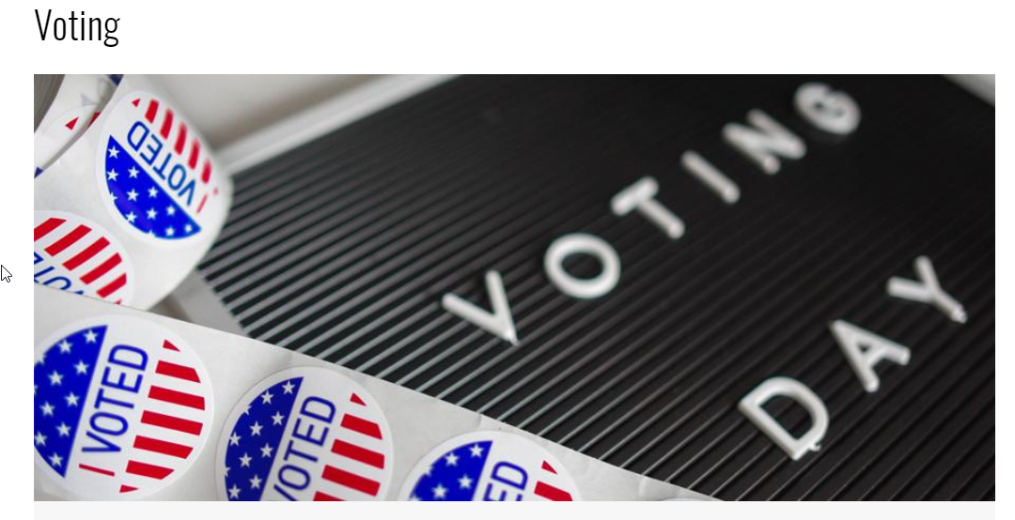
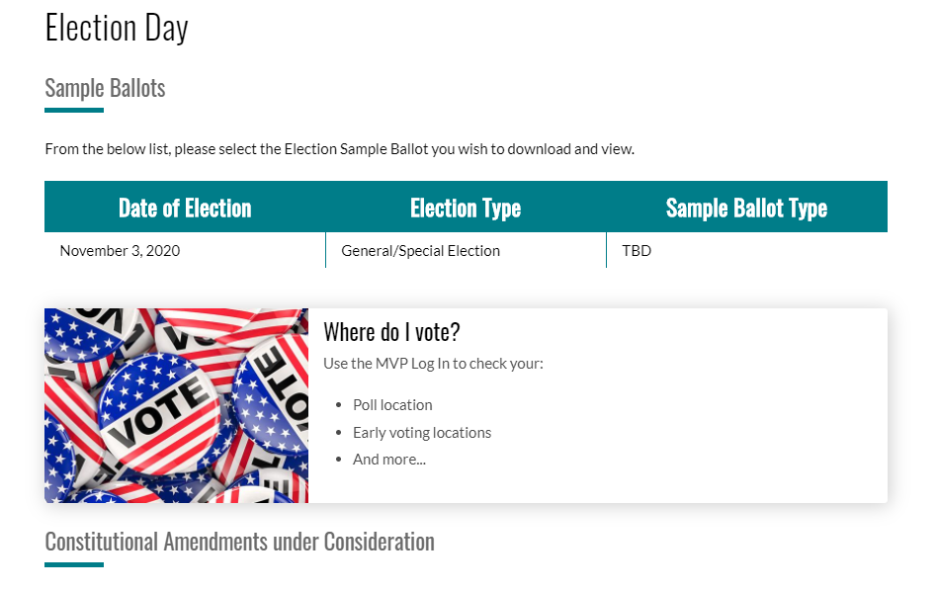
Cobb Elections Website Most Visited August 11, 2020
DAY
SECTION
PAGE
This Photo by Unknown Author is licensed under CC BY-NC
TUESDAY August 11th Election Day
16,920 LS
26,830 UV
32,530 Views
VOTING
10,110 LS
14,350 UV
17,300 Views
ELECTION DAY
7,620 UV
9,160 Views
Notes:
Key Site Performance Statistical Results:
Most Visited
DAY: Tuesday, Aug 11th (Election Day) with 16,920 Sessions, 26,830 UV; 32,530 Views;
SECTION: Voting 10,110 Sessions; 14,350 UV; 17,300 Views
PAGE: Election Day 7,620 UV; 9,160 Views
TERMINOLOGY:
Landing Session(LS): Visitor directly arriving on a webpage
Unique Page View (UV): Visitor viewing a webpage for the first time
Page View: Visitor viewing a webpage once or multiple times
Session: Visitor browsing the site, viewing one or more webpages over a period of time
Section: Website's navigational categories (e.g. Voting, Voter Registration, Election Reference, Candidates, About, Employment, Homepage, News, Events)

Slide 7
Cobb Elections Website Monthly Visitor (LS) Comparison
Notes:
Key Site Performance Statistical Results:
August 2020/Runoff Election (78,120 LS)
155% increase to July 2020 (30,6810 LS)
25% decrease to June 2020/Election (104,500 LS)
TERMINOLOGY:
Landing Session(LS): Visitor directly arriving on a webpage
Unique Page View (UV): Visitor viewing a webpage for the first time
Page View: Visitor viewing a webpage once or multiple times
Session: Visitor browsing the site, viewing one or more webpages over a period of time
Section: Website's navigational categories (e.g. Voting, Voter Registration, Election Reference, Candidates, About, Employment, Homepage, News, Events)

Slide 8
Cobb Elections Website Online Forms Performance
August 2020
Poll Worker
Training
Acknowledgement
Poll Worker
Application
Seasonal Worker
Application
Cobb Employee
Poll Worker
Signup
1,505 submissions
140% increase*
25 submissions
2400% increase*
18 submissions
47% decrease*
355 submissions
492 Bitly clicks
1,204 Bitly clicks
111% increase*
73 Bitly clicks
711% increase*
65 Bitly clicks
7% decrease*
870 video views
100% conversion rate
34% conversion rate
28% conversion rate
41% viewed video & STA
*prior month comparison
STA = Submitted Training Acknowledgement
September 2, 2020
8
Notes:
Key Performance Indicators:
Poll Worker Application: 1,505 submissions, 140% increase from July; 1,204 clicks, 111% increase from July; 100% conversion rate
Seasonal Worker Application: 25 submission, 2400% increase from July ; 73 clicks, 711% increase from July; 34% conversion
Cobb Employee Poll Worker Signup: 18 submissions, 47% decrease from July; 65 clicks, 7% decrease from July; 28% conversion rate
Poll Worker Training Acknowledgement: 355 submissions; 492 clicks; 870 video views; 41% viewed video & submitted training acknowledgement
TERMINOLOGY:
Landing Session(LS): Visitor directly arriving on a webpage
Unique Page View (UV): Visitor viewing a webpage for the first time
Page View: Visitor viewing a webpage once or multiple times
Session: Visitor browsing the site, viewing one or more webpages over a period of time
Section: Website's navigational categories (e.g. Voting, Voter Registration, Election Reference, Candidates, About, Employment, Homepage, News, Events)

Slide 9
Cobb Elections Website
Bitly Links Performance
August 2020
CobbABRequest
GAABRequest
MyGAVoterPage
AVMap110820
link to the Cobb Absentee Ballot Application
link to the GA Absentee Ballot Request Portal
link to the GA My Voter Page
link to the Advance Vote Wait Time Map
20,318 clicks
197% increase*
289 clicks
Started Aug 31st
7,317 clicks
1,323 clicks 23% increase*
11Aug20ElecResults
BoardMeeting
PollWorkerPortal
PollTrainingCompleted
link to the Election Results page
link to the E&R Board WebEx Meeting Registration
link to the Poll Worker page
link to the PW Training Acknowledgement Form
1,400 clicks
74 clicks
0% change*
145 clicks
59% decrease*
495 clicks
*prior month comparison
PollWorkerPortal, PollTrainingCompleted, and BoardMeeting links are publicly shared
CobbABRequest, GAABRequest, MyGAVoterPage, 11Aug20ElecResults, and AVMap110820 links are implemented to track external tools performance
September 2, 2020
9
Notes:
% increase or decrease is based on prior month comparison
PollWorkerPortal, PollTrainingCompleted, and BoardMeeting links are publicly shared
CobbABRequest, GAABRequest, MyGAVoterPage, 11Aug20ElecResults, and AVMap110820 links are implemented to track external tools performance

