Slide 1
Funda
Fundamentally choosing stocks for your investment
Spencer Brown & Treveon Williams

Slide 2
CONTENTS
Overview
Questions and Data
Data Cleanup & Exploration
Data Analysis
Demo
What’s Next?

Slide 3
INTRODUCTIon
The concept of the stock selector is to show the trader/investor the relationship between certain fundamental metrics (i.e. P/E ratio, price/book, price/sales)
The motivation for the Stock Selector creation stemmed from our interest in Algorithmic Trading, you could say this was a prelude.
Scenario:
A random guy whose name is Trencer wants to trade equities on S&P Financials, however, he doesn’t know where to begin his investment journey. What he does know is that he needs to be able to pick quality companies with strong fundamentals that will decrease his risk in the markets.

Slide 4
Overview
Creating Funda, we had to ask ourselves, what metrics should be implemented in the analysis?
Should we use the P/E ratio? Or the EBITDA?
How can we visually represent those metrics in the program?
We created Funda to answer the above questions. First, we had to obtain good data to minimize any unforeseeable issues. Next was cleaning the data ensuring the program could run efficiently. Then we want to project the data in an easy-to-understand format, without the complexities that would frustrate the investor.

Slide 5
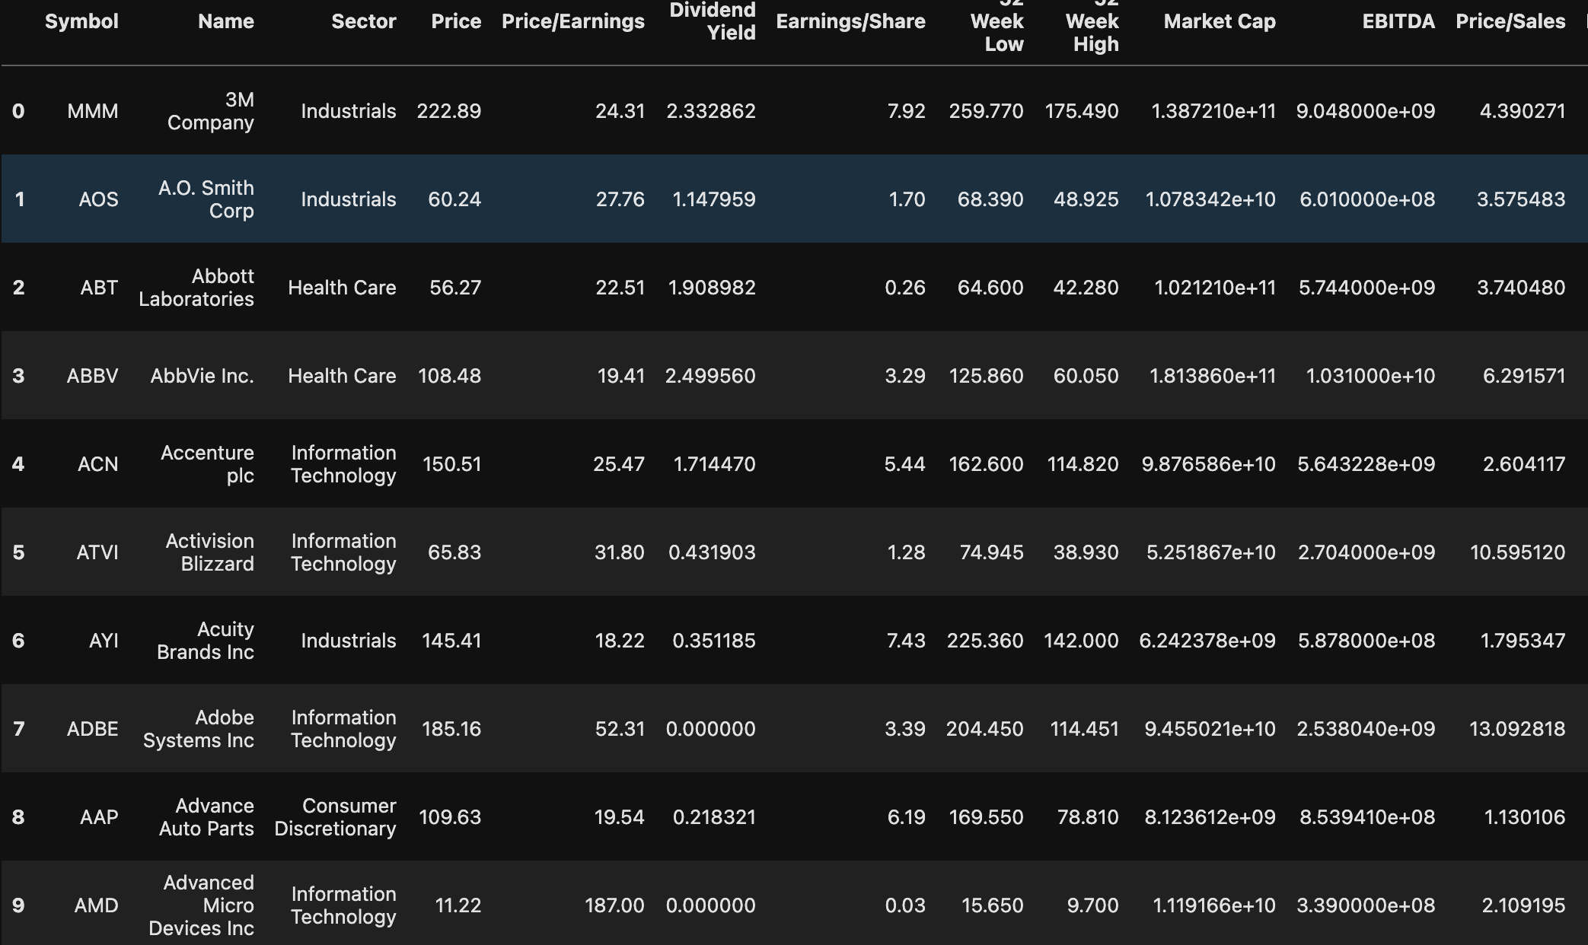
Data cleanup & Exploration
To obtain the data, we used Alpaca API to pull fundamental stock data of companies listed on the S&P 500 for investing. We decided to use Alpaca API because of the up-to-date and accurate data that it provides as well as the minimal cleaning required for proper usage with HV plot. While cleaning the date we noticed, we decided reduce it to the most important companies we want to invest in. We want to take a laser-focused approach so we can select a quality business for investment.

Slide 6
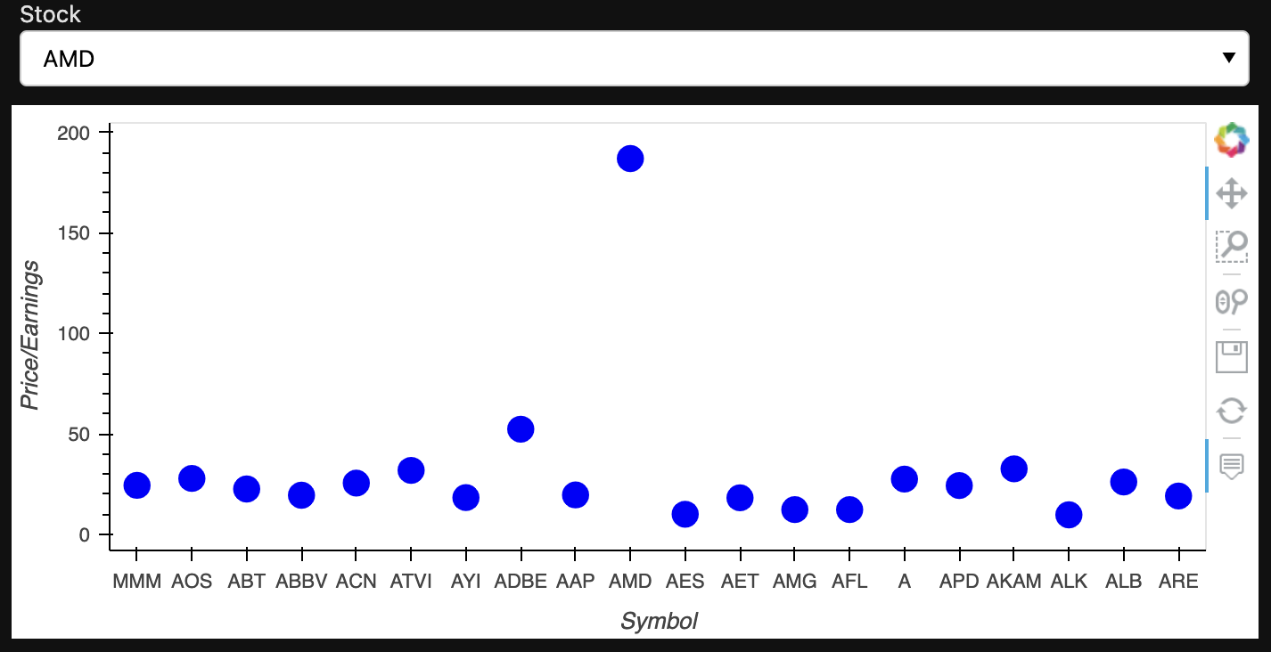
Price/earnings
 | $USD | £EUR | ¥JPY | ₿BTC
Q1 | 4.5 | 2.3 | 1.7 | 5.0
Q2 | 3.2 | 5.1 | 4.4 | 3.0
Q3 | 2.1 | 1.7 | 2.5 | 2.8
Q4 | 4.5 | 2.2 | 1.7 | 7.0

Slide 7
DATA ANALYSIS
Approach
Challenges
For this program to be created we had to use well-known python libraries such as numpy, pandas, and hvplot. As well as python libraries, we weren’t knowledgeable with Panel.
​
The main challenge we faced was attempting to use the Alpaca Trade Api with hvplot to create the graphs. Specifically making it interactive with the alpaca trade API.
Creating a dropdown box to choose a stock from the data frame.
Researching a new library to be imported that would work efficiently was more difficult than we anticipated.

Slide 8
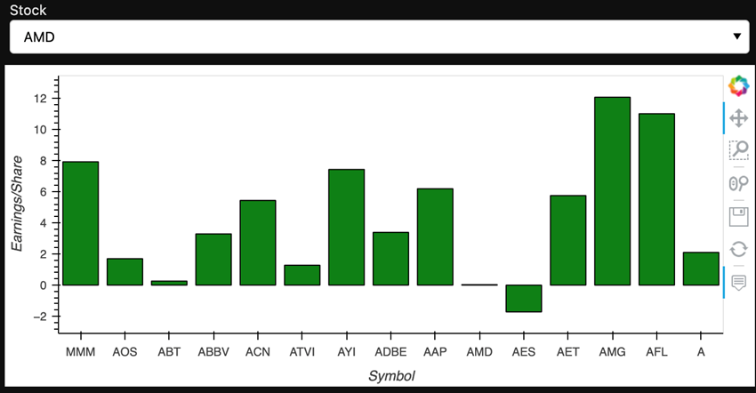
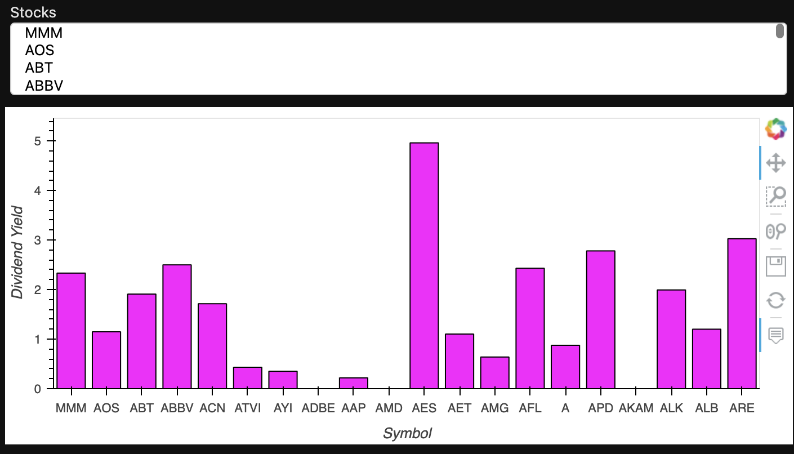
DEMO

Slide 9
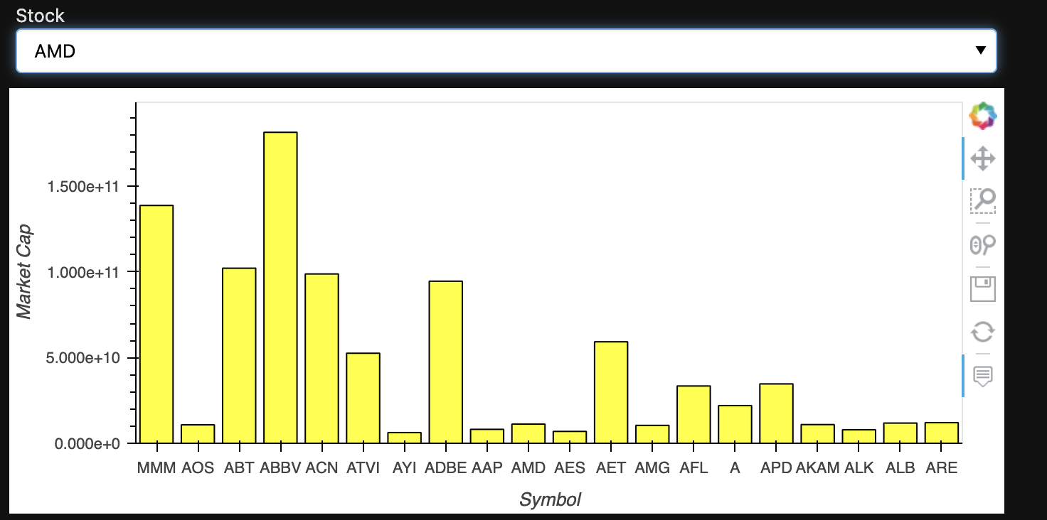
What’s next?
During the project, we found that a company that has a really high P/E ratio alone does not constitute a good investment. In this case AMD [Advanced Micro Devices, Inc.]
We expected to find similarities between the companies listed on the S&P 500 based on the metrics that would entice a novice investor.
The next step is Funda’s IPO!!!!!!!
The difficulty in this program lies in how data flows and how the data is visualized. To combat this we took the trial and error approach.
Additional questions that would require more time would be how to make the analysis in real-time.

Slide 10
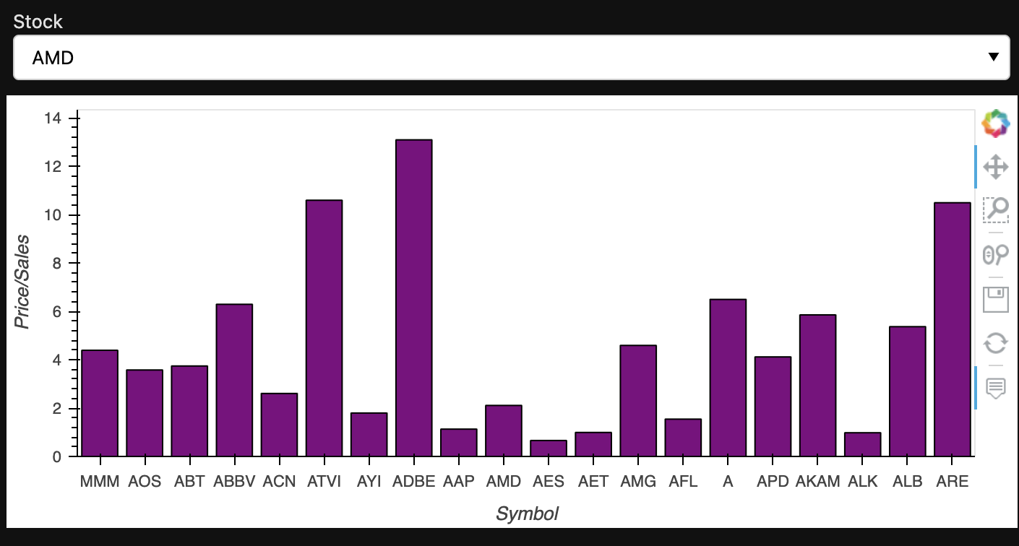

Slide 11
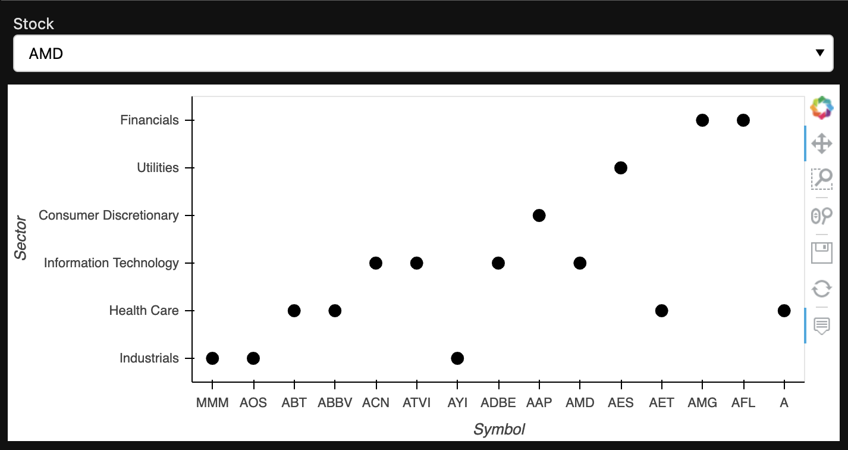

Slide 12
THANK YOU
Funda
Treveon Williams
Spencer Brown
And our first customer Trencer

