Slide 1
“Ticketing Dashboard”
Project-2
Fernando Trevino

Slide 2
Agenda
Background
Project Goals
Demonstration

Slide 3
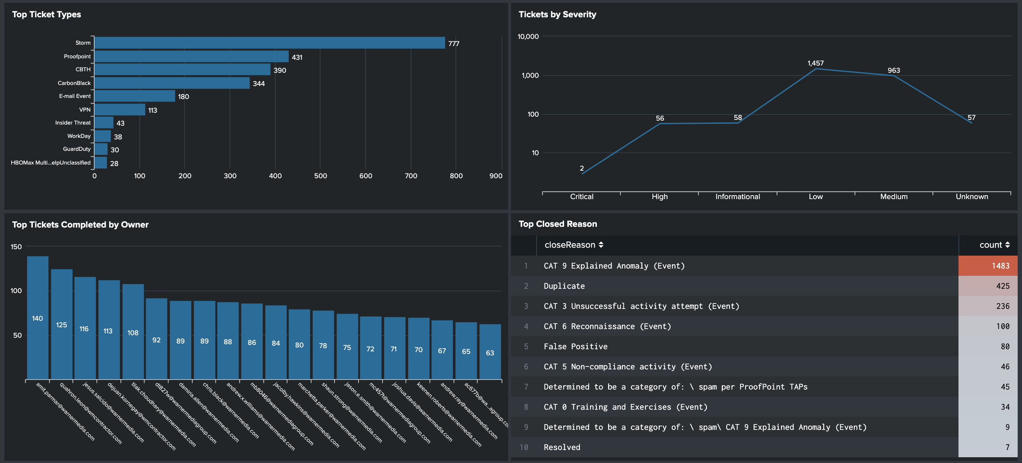
Background
Who am I, and why am I taking this class?
I work in IT and for years I have complained that out of the box metric graphics were clunky and limited.
I took this course so I could stop complaining and learn how to create my own dashboards that look cleaner and can tell a better story.
Current out of the box graphics provided by Splunk:

Slide 4

Project-2 Goals
For Project-2 I wanted to created a dashboard page to monitor my teams log events.
The dashboard will identify:
Ticket Type and Severity?
How long the ticket was open?
Which analyst did the most tickets?
How many tickets were automatically closed?
For the data source I used an old Splunk .csv file with 30 days of data containing over a 1,000 rows, then add the file to a SQL DB.
My script utilized python flask and includes, D3, Ploty, HTML/CSS and one JS library.

Slide 5
Code Flow
Using the Flask framework a user initiates a request from app.py
The Flask app references instructions in app.py and returns an HTML page
The HTML page references JS (app.js) code instructions.
JS then makes a request back to Flask
Flask then requests data from the SQL DB
Data from the DB is shaped by PD and returned as JSON
Data is then rendered in HTML format referencing CSS for style
Any drop down request on the HTML page repeat steps 4 - 7
Flask App (app.py)
HTML Page
JS
(app.js)
SQL DB
(postgres)
CSS
(style.css)

Slide 6
Demonstration

Slide 7
What did I learn?
API feed will need to be added for better dynamic refresh and lookup.
Need to research permissions to secure site, key, 2FA?
Work to integrate better d3 objects?

