Slide 1
Measuring CyberSecurity
Fernando Trevino
Project 2

Slide 2
Agenda
Background
Project Goals
Code design
Demonstration

Slide 3
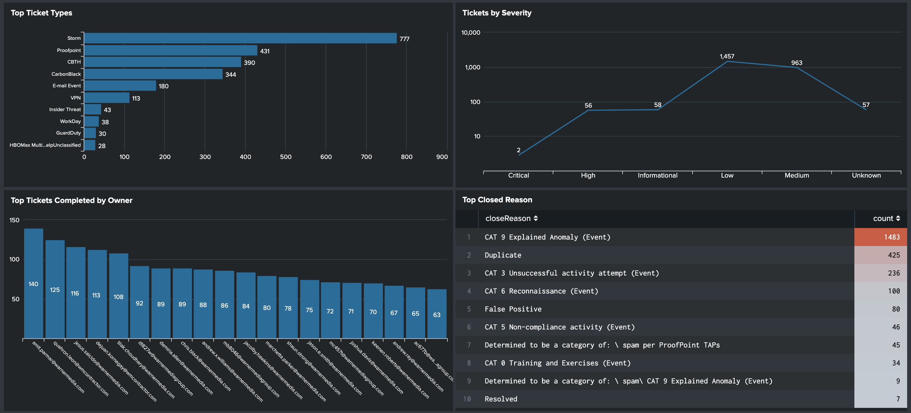
Background
Who am I, and why am I taking this class?
I work in IT and for years I have complained that out of the box metric graphics were clunky and limited.
I took this course so I could stop complaining and learn how to create my own dashboards that look cleaner and can tell a better story.
Current out of the box graphics provided by Splunk:

Slide 4

Project-2 Goals
For Project-2 I wanted to create a dashboard page for ticket monitoring.
The dashboard will need to identify:
Ticket Type and Severity?
How long the ticket was open?
Which analyst did the most tickets?
Which tickets were automatically closed?
For the data source I used an old Splunk .csv file that I added to a SQL DB created in PGAdmin.
My script utilized python flask and includes, D3, HTML/CSS and one JS library.

Slide 5
Code Design

Slide 6
Demonstration

Slide 7
Questions

