Slide 1
“Ticketing Dashboard”
Project-2
Fernando Trevino

Slide 2
Agenda
Background
Project Goals
Demonstration

Slide 3
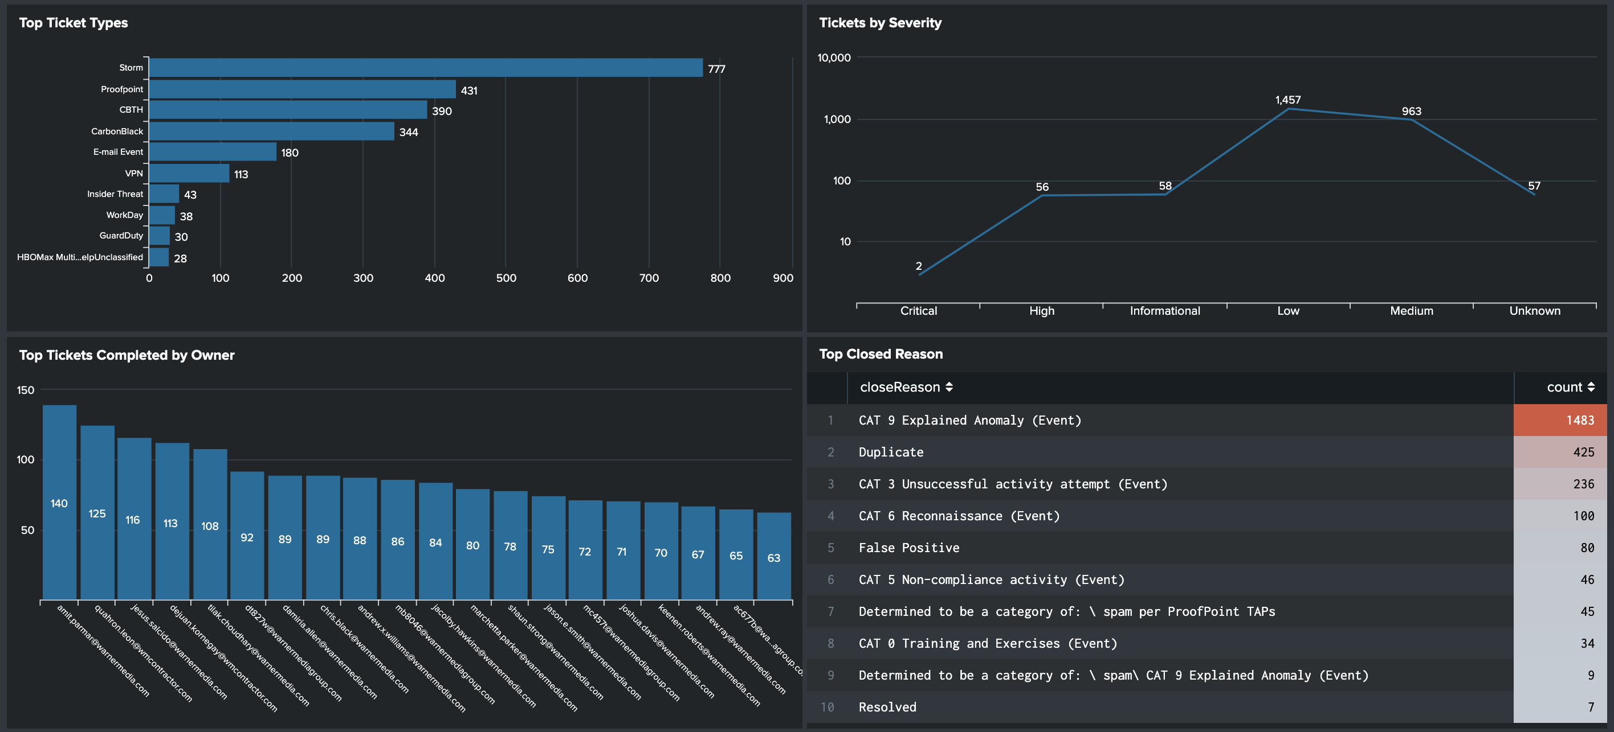
Background
Who am I, and why am I taking this class?
I work in IT and for years I have complained that out of the box metric graphics were clunky and limited.
I took this course so I could stop complaining and learn how to create my own dashboards that look cleaner and can tell a better story.
Current out of the box graphics provided by Splunk:

Slide 4

Project-2 Goals
For Project-2 I wanted to created a dashboard page to monitor my teams log events.
The dashboard will identify:
Ticket Type and Severity?
How long the ticket was open?
Which analyst did the most tickets?
How many tickets were automatically closed?
For the data source I used an old Splunk .csv file with 30 days of data containing over a 1,000 rows, then add the file to a SQL DB.
My script utilized python flask and includes, D3, Ploty, HTML/CSS and one JS library.

Slide 5
Demonstration

Slide 6
What did I learn?
API feed will need to be added for better dynamic refresh and lookup.
Need to research permissions to secure site, key, 2FA?
Work to integrate better d3 objects?

