Slide 1
“Ticketing Dashboard”
Project-2
Fernando Trevino

Slide 2
Agenda
Background
Project Goals
Demonstration

Slide 3
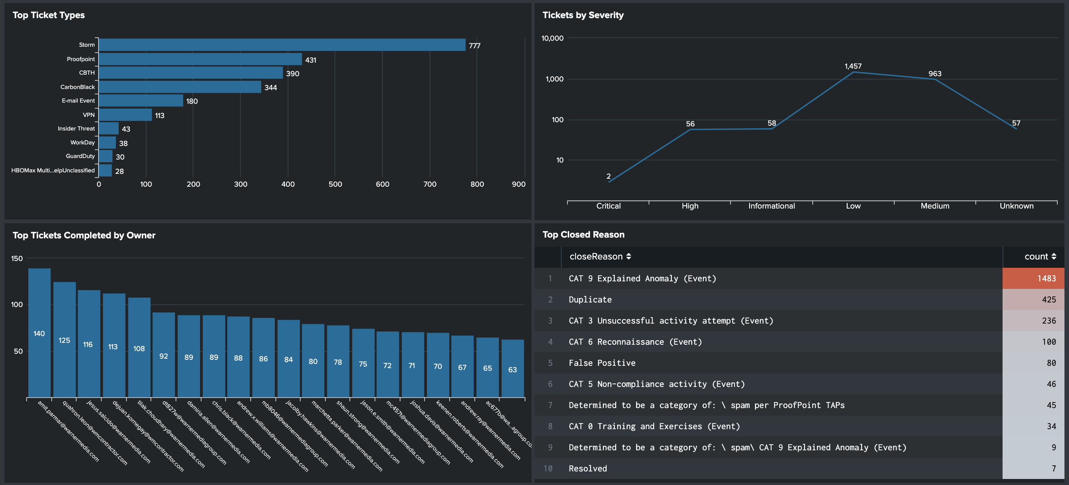
Background
Who am I, and why am I taking this class?
I work in IT and for years I have complained that out of the box metric graphics were clunky and limited.
I took this course so I could stop complaining and learn how to create my own dashboards that look cleaner and can tell a better story.
Current out of the box graphics provided by Splunk:

Slide 4

Project-2 Goals
For Project-2 I wanted to created a dashboard page for my teams ticket monitoring.
The dashboard identify:
Ticket Type and Severity?
How long the ticket was open?
Which analyst did the most tickets?
How many tickets were automatically closed?
For the data source use an old Splunk .csv file with 30 days of data containing over a 1,000 rows, then add the file to a SQL DB.
My script utilized python flask and includes, D3, HTML/CSS and one JS library.

Slide 5
Demonstration

Slide 6
What did I learn?
API feed will need to be added for better dynamic refresh and lookup.
Need to research permissions to secure site, key, 2FA?
Work to integrate better d3 objects?

