Slide 1
Homework 2 Group 1
Ali Abbas
Ahsan Sanaullah
Fernando Trevino Ramirez
Notes:
Fernando

Slide 2
Goal
Explore how different representations on a Genetic Algorithm (GA) can affect its performance.
The Problem
Traveling Salesman: An NP-Hard Problem [2].
Description: Given a number of cities, find the shortest path that goes through all the cities exactly one time and ends in the first city you chose.
Notes:
Fernando

Slide 3
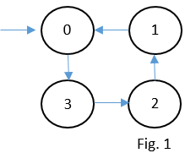
Representations
List Representation
Simply list the path from start to finish. For Fig.1 would be [0, 3, 2, 1].
Ordinal Representation [3]
Is best to explain with an example of how to go from list -> ordinal:
“A” is the list representation we want to translate and “B” are the indexes of the array in order. Remove first city from A on both arrays after each step and write in the answer the index location of the element removed from B. A: [0, 3, 2, 1] -> [3, 2, 1] -> [2, 1] -> [1] -> [] 0 2 1 0 B: [0, 1, 2, 3] -> [1, 2, 3] -> [1, 2] -> [1] -> []
Answer: [0, 2, 1, 0]
Notes:
Ahsan

Slide 4
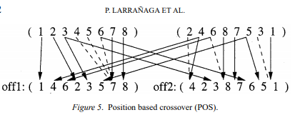
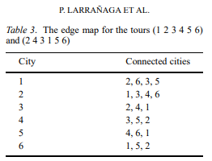
Crossover
List/Path Representation
Order Crossover: the order of a subset of cities of 1 parent is imposed on the other parent [3]
[3]
Genetic Edge Recombination:
“tries to preserve the edges of parents” [3].
Ordinal Representation
One point
Notes:
Ali

Slide 5
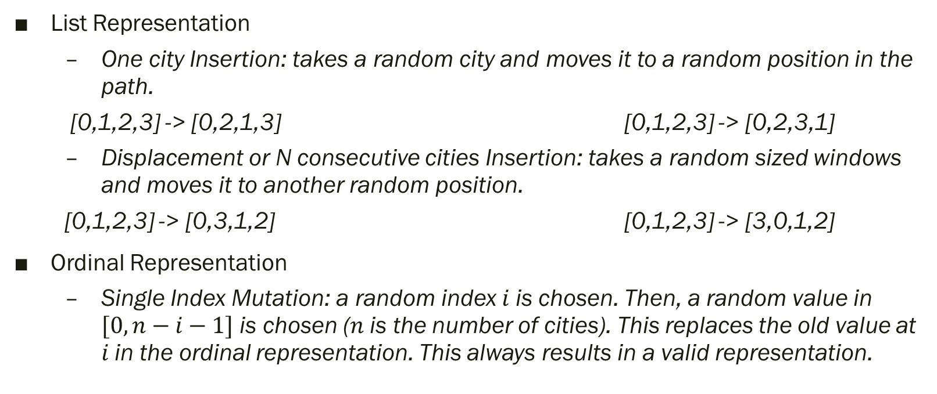
Mutation
List Representation
One city Insertion: takes a random city and moves it to a random position in the path.
[0,1,2,3] -> [0,2,1,3] [0,1,2,3] -> [0,2,3,1]
Displacement or N consecutive cities Insertion: takes a random sized windows and moves it to another random position.
[0,1,2,3] -> [0,3,1,2] [0,1,2,3] -> [3,0,1,2]
Ordinal Representation
Single Index Mutation: a random index $i$ is chosen. Then, a random value in $[0,n−i−1]$ is chosen ($n$ is the number of cities). This replaces the old value at $i$ in the ordinal representation. This always results in a valid representation.
Notes:
Ahsan

Slide 6
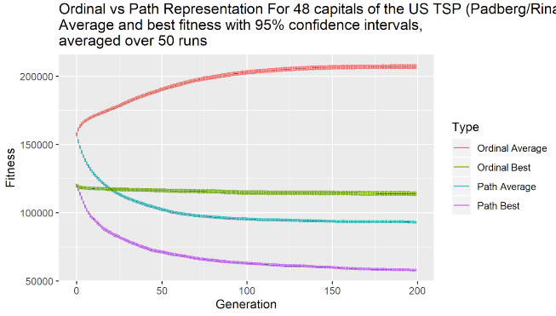
Experiment
The best parameter we found included:
For Berlin 52 we used a population size of 2000 with 200 generations over 50 runs.
And for rl1323 we had to reduce the population size to 500, but increased to 500 generations, and did 50 runs.
Notes:
Ali

Slide 7
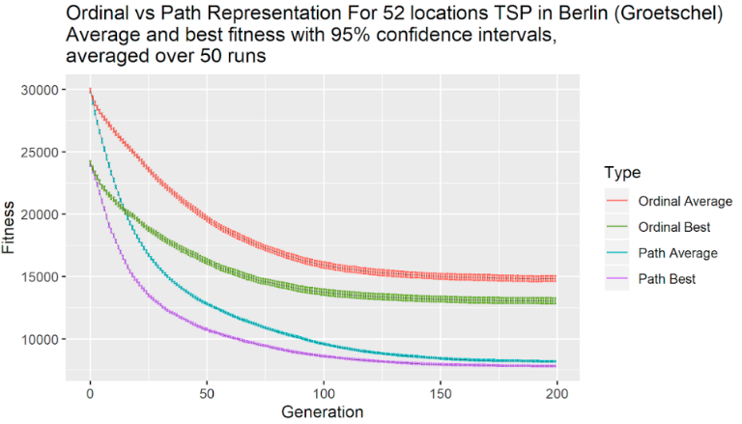
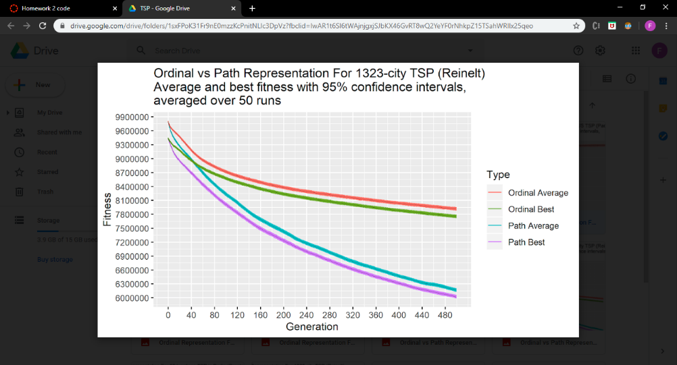
Results
Performance is highly dependent on the specific cities.
Notes:
Ahsan

Slide 8
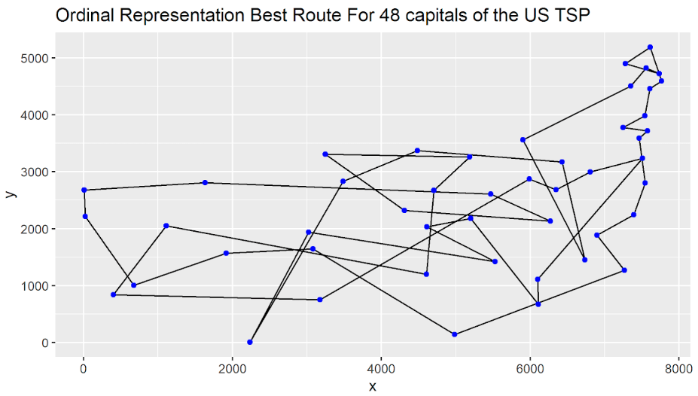
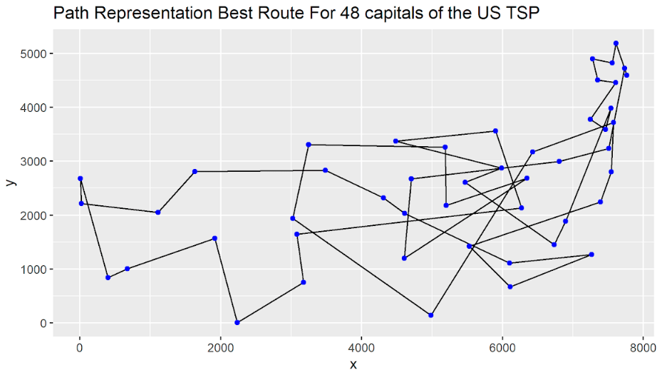
Best Solution Graphs For 48 Capitals
Ordinal vs Path
Notes:
Fernando

Slide 9
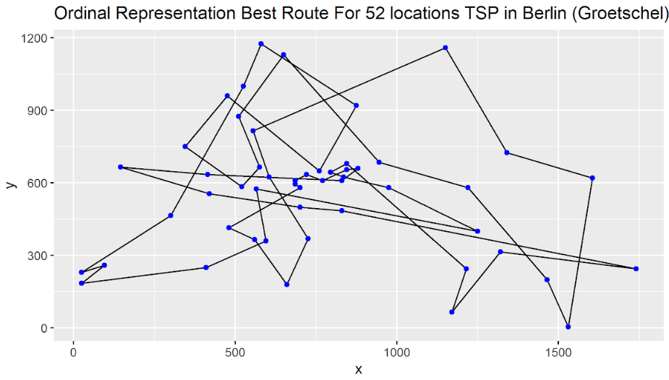
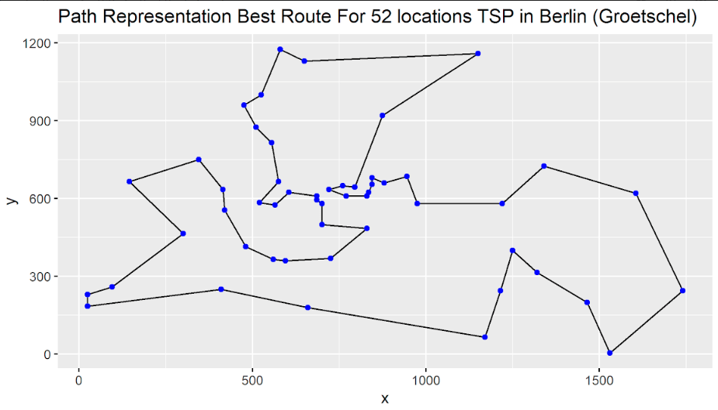
Best Solution Graphs For Berlin 52
Ordinal vs Path
Notes:
Fernando

Slide 10
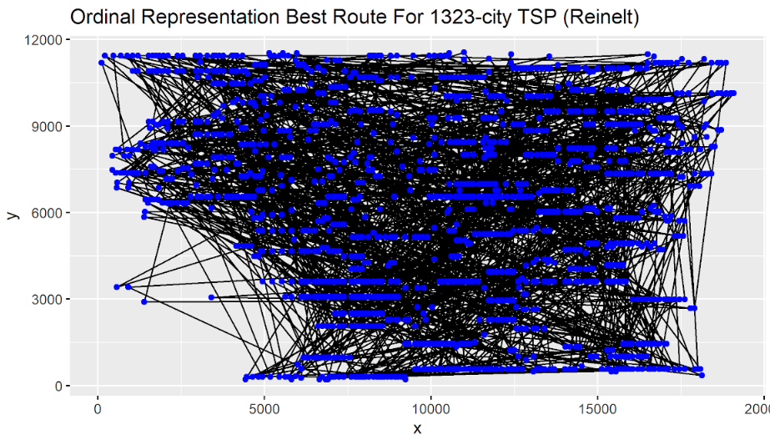
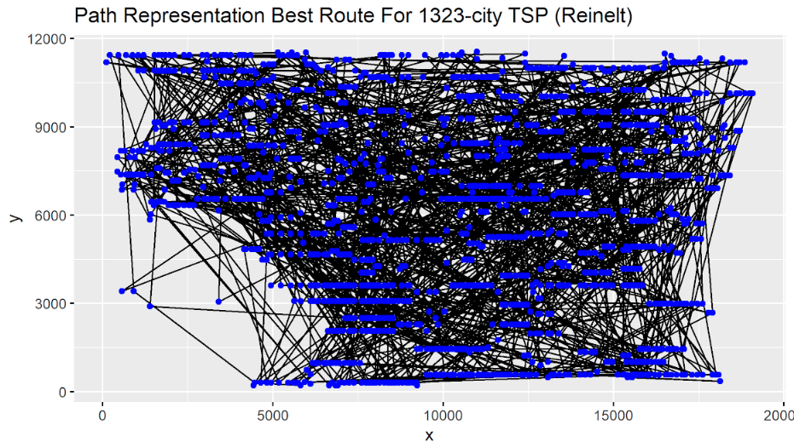
Best Solution Graphs For Reinelt 1323
Ordinal vs Path
Notes:
Fernando

Slide 11
References
[1] Hal Stringer & Annie Wu (2004). “A Teaching GA” [Computer software]. Florida, Orlando: UCF.
[2] Applegate, D. L.; Bixby, R. M.; Chvatal, V.; Cook, W. J. (2006), “The Traveling Salesman Problem”, ISBN 978-0-691-12993-8.
[3] Larranaga, P. (1999). “Genetic Algorithms for the Travelling Salesman Problem: A Review of Representations and Operators”. Retrieved February 19, 2020, from https://link.springer.com/article/10.1023/A:1006529012972
Notes:
Fernnado

