Slide 1
Homework 2 Group 1
Ali Abbas
Ahsan Sanaullah
Fernando Trevino Ramirez

Slide 2
Goal
Explore how different representations on a Genetic Algorithm (GA) can affect its performance.
The Problem
Traveling Salesman: An NP-Hard Problem [2].
Description: Given a number of cities, find the shortest path that goes through all the cities exactly one time and ends in the first city you chose.

Slide 3
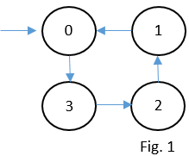
Representations
List Representation
Simply list the path from start to finish. For Fig.1 would be [0, 3, 2, 1].
Ordinal Representation [3]
Is best to explain with an example of how to go from list -> ordinal:
“A” is the list representation we want to translate and “B” are the indexes of the array in order. Remove first city from A on both arrays after each step and write in the answer the index location of the element removed from B. A: [0, 3, 2, 1] -> [3, 2, 1] -> [2, 1] -> [1] -> [] 0 2 1 0 B: [0, 1, 2, 3] -> [1, 2, 3] -> [1, 2] -> [1] -> []
Answer: [0, 2, 1, 0]

Slide 4
Crossover
List Representation
Order Crossover: the order of a subset of cities of 1 parent is imposed on the other parent
Genetic Edge Recombination: “tries to preserve the edges of parents” [3].
Ordinal Representation
One Point

Slide 5
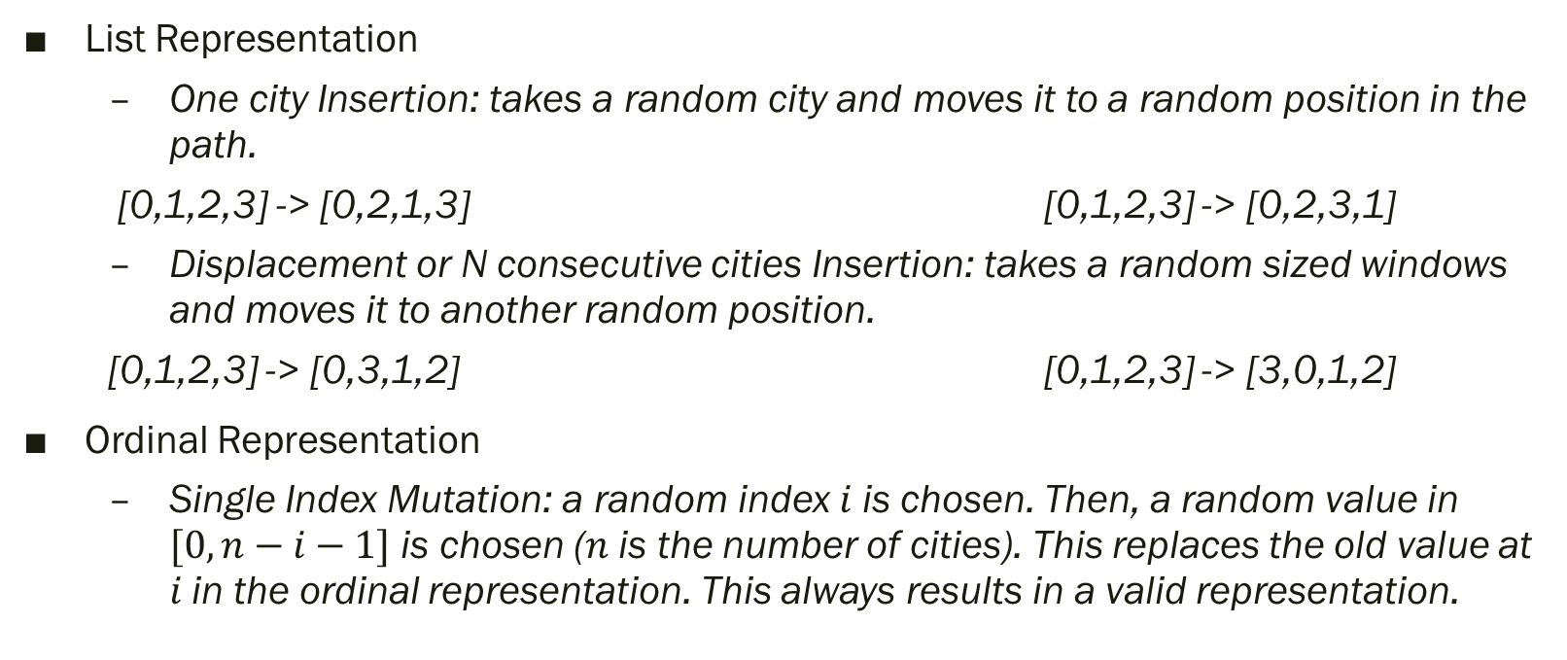
Mutation
List Representation
One city Insertion: takes a random city and moves it to a random position in the path.
[0,1,2,3] -> [0,2,1,3] [0,1,2,3] -> [0,2,3,1]
Displacement or N consecutive cities Insertion: takes a random sized windows and moves it to another random position.
[0,1,2,3] -> [0,3,1,2] [0,1,2,3] -> [3,0,1,2]
Ordinal Representation
Single Index Mutation: a random index $i$ is chosen. Then, a random value in $[0,n−i−1]$ is chosen ($n$ is the number of cities). This replaces the old value at $i$ in the ordinal representation. This always results in a valid representation.

Slide 6
Experiment

Slide 7
Results

Slide 8
References
[1] Hal Stringer & Annie Wu (2004). “A Teaching GA” [Computer software]. Florida, Orlando: UCF.
[2] Applegate, D. L.; Bixby, R. M.; Chvatal, V.; Cook, W. J. (2006), “The Traveling Salesman Problem”, ISBN 978-0-691-12993-8.
[3] Larranaga, P. (1999). “Genetic Algorithms for the Travelling Salesman Problem: A Review of Representations and Operators”. Retrieved February 19, 2020, from https://link.springer.com/article/10.1023/A:1006529012972

